Slide 1
Introduction
  Definition of B-trees
  Properties
  Specialization
  Examples
  2-3 trees
  Insertion of B-tree
  Remove items from B-tree

Slide 2
B-Trees
Definition
A balanced search tree in which every node has between m/2 and m children, where m>1 is a fixed integer. M is the order. The root may have as few as 2 children. This is a good structure if much of the tree is in slow memory (disk), since the height, and hence the number of accesses, can be kept small, say one or two, by picking a large m.
M is the height of a tree, the maximum number of children of nodes in a B-tree.

Slide 3
A B-tree of order M with the following properties
The data items are stored at leaves
The nonleaf nodes store up to M-1 keys to guide the searching; key I represents the smallest key in subtree I +1.
The root is either a leaf or has between two and M children.
All nonleaf nodes (except the root) have between [M/2] and M children
All leaves are at the same depth and have between [L/2] and L children, for some L (the determination of L is described shortly).

Slide 4
Specialization
2-3-4 tree
A B-tree of order 4, that is, internal nodes have two, three, or four children.
B-tree with m=4.
2-3 tree
A B-tree of order 3, that is, internal nodes have two or three children.
B*-tree
A B-tree in which nodes are kept 2/3 full by redistributing keys to fill two child nodes, then splitting them

Slide 5
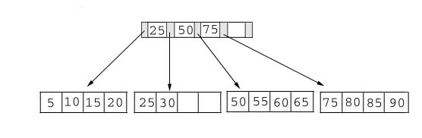
Example of B-Trees
This table shows a B+ tree. As the example illustrates this tree does not have a full index page. (We have room for one more key and pointer in the root page.) In addition, one of the data pages contains empty slots
B+ Tree with four keys

Slide 6
Illustrations of the insert algorithm
The key value determines a record's placement in a B+ tree. The leaf pages are maintained in sequential order AND a doubly linked list (not shown) connects each leaf page with its sibling page(s). This doubly linked list speeds data movement as the pages grow and contract.

Slide 7
The following examples illustrate each of the insert scenarios. We begin with the simplest scenario: inserting a record into a leaf page that is not full. Since only the leaf node containing 25 and 30 contains expansion room, we're going to insert a record with a key value of 28 into the B+ tree. The following figures shows the result of this addition.

Slide 8
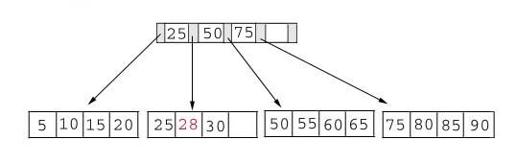
Add to a non-full tree
Add Record with Key 28

Slide 9
Adding a record when the leaf page is full but the index page is not
we're going to insert a record with a key value of 70 into our B+ tree. This record should go in the leaf page containing 50, 55, 60, and 65. Unfortunately this page is full. This means that we must split the page as follows
Left Leaf Page Right Leaf Page
50 55 60 65 70

Slide 10
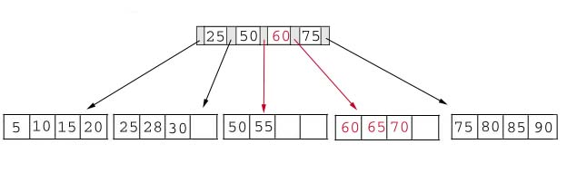
Add Record with Key 70
The middle key of 60 is placed in the index page between 50 and 75. The following table shows the B+ tree after the addition of 70.

Slide 11
Adding a record when both the leaf page and the index page are full
As our last example, we're going to add a record containing a key value of 95 to our B+ tree. This record belongs in the page containing 75, 80, 85, and 90. Since this page is full we split it into two pages:
Left Leaf Page Right Leaf Page
75 80 85 90 95

Slide 12
The middle key, 85, rises to the index page. Unfortunately, the index page is also full, so we split the index page:
Left Index Page Right Index Page New Index Page
25 50 75 85 60

Slide 13
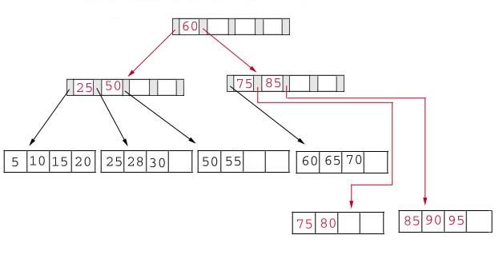
The following table illustrates the addition of the record containing 95 to the B+ tree.

Slide 14
Deleting Keys from a B+ tree
As our example, we consider the B+ tree after we added 95 as a key. As a refresher this tree is printed in the following table.

Slide 15
Delete 70 from the B+ Tree
We begin by deleting the record with key 70 from the B+ tree. This record is in a leaf page containing 60, 65 and 70. This page will contain 2 records after the deletion. Since our fill factor is 50% or (2 records) we simply delete 70 from the leaf node. The following table shows the B+ tree after the deletion.

Slide 16
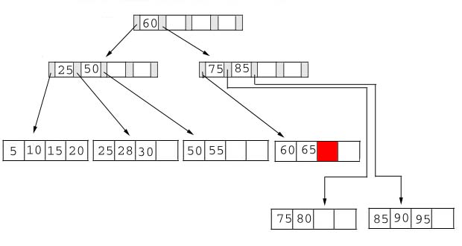
Delete Record with Key 70

Slide 17
Delete 25 from the B+ tree
Next, we delete the record containing 25 from the B+ tree. This record is found in the leaf node containing 25, 28, and 30. The fill factor will be 50% after the deletion; however, 25 appears in the index page. Thus, when we delete 25 we must replace it with 28 in the index page.

Slide 18
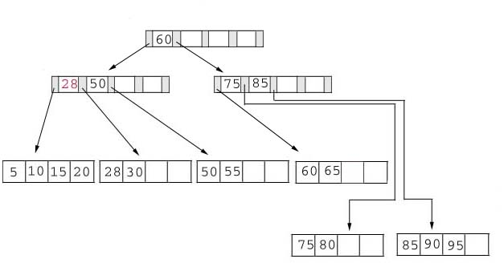
Delete 25 from the B+ tree

Slide 19
Delete 60 from the B+ tree
As our last example, we're going to delete 60 from the B+ tree. This deletion is interesting for several reasons:
The leaf page containing 60 (60 65) will be below the fill factor after the deletion. Thus, we must combine leaf pages.
With recombined pages, the index page will be reduced by one key. Hence, it will also fall below the fill factor. Thus, we must combine index pages.
Sixty appears as the only key in the root index page. Obviously, it will be removed with the deletion.

Slide 20
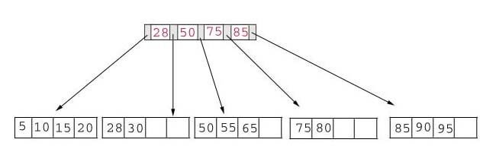
The following table shows the B+ tree after the deletion of 60. Notice that the tree contains a single index page.
Delete Record with Key 60

Slide 21
2-3 tree
contain 1 or 2 keys
a node a specialization of 2-3 tree
all leaf nodes are at the same depth
all non-leaf nodes(except the root) have either a key or two subtresss, or 2 keys and three subtree.
it is not a binary tree

