Slide 1
Project Title: The Battle of Neighborhoods, segmenting and clustering
Nilu Isakova

Slide 2
introduction
In this project we aim to create an analysis of features for a people migrating to Toronto
To search a best neighborhood as a comparative analysis between neighborhoods.
The features include better school according to ratings and etc.

Slide 3
Data Description
We used Toronto dataset which we scrapped from wikipedia.
Dataset consisting of latitude and longitude, zip codes.
https://en.wikipedia.org/wiki/List_of_postal_codes_of_Canada:_M
The dataset consist of three columns: PostalCode, Borough, and Neighborhood
To get the latitude and the longitude coordinates of each neighborhood, to getthe geographical coordinates of each postal code, we used the link below
http://cocl.us/Geospatial_data
To get the schools rating we used the following link
https://www.greatschools.org
We used the Foursquare API to explore neighborhoods.

Slide 4
Data cleaning and packages
numpy library to handle data in a vectorized manner
pandas library for data analsysis
json library to handle JSON files
geopy.geocoders, Nominatim convert an address into latitude and longitude values
requests ibrary to handle requests
pandas.io.json, json_normalize tranform JSON file into a pandas dataframe
Matplotlib and associated plotting modules
matplotlib.pyplot
k-means from clustering stage
sklearn.cluster, KMeans
folium map rendering library
wordcloud, WordCloud, STOPWORDS for wordcloud plots
BeautifulSoup parse html data, and create a dataframe.

Slide 5
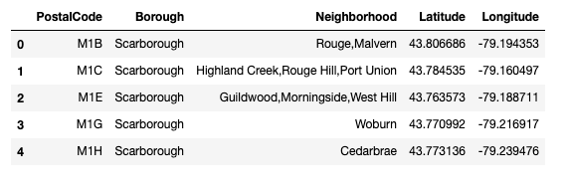
Structured format of the dataset

Slide 6
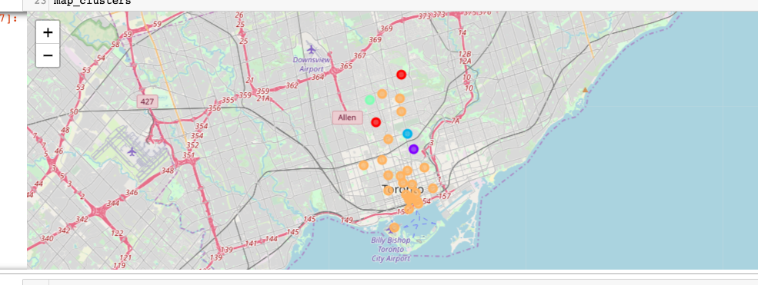
methodology
Clustering Approach: To find similar neighborhoods we explore and cluster neighborhoods, segment them, and group them into 5 clusters, and we used k-means clustering algorithm. The below picture shows the five clusters on map.

Slide 7
results
As a result, York is one of the most diverse and multicultural areas in the Greater Toronto Area.
We used Foursquare API to get neighborhoods, values.
As a result we found out that 1) Park 2) West 3) North South were the most prefered neighborhoods.
The best rating schools were in in the following neighborhoods:
Glencairn Lawrence Park Dorset Park,Scarborough Town Centre Cliffcrest,Cliffside,Scarborough Village West
For the latitude and longtitude information we used the York Toronto address.

Slide 8
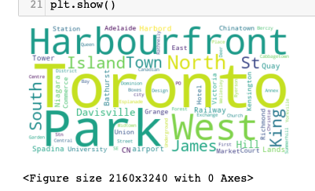
Discussion
Sorted list of best neighborhoods and most of them belong to cluster4

Slide 9
Conclusion
In this project, using k-means cluster algorithm we separated the neighborhood into five different clusters and for 103 different lattitude and logitude from dataset, and analyzed neighborhoods in Toronto, York city.

