Slide 1

Project TURA
Model Driven Architecture
Arseniy Isakov

Slide 2
Summary
1. Introduction
2. MDA Overview
3. Developing in MDA
4. MDA in the Practice
5. References

Slide 3
What is the MDA?
An approach to IT system specification that separates the specification of system functionality from the specification of the implementation of that functionality on a particular technology platform
“Design once, build it on any platform”
Notes:
Java’s mantra: “write once, run anywhere”

Slide 4
Basic concepts of MDA
A model is a formal specification of the function, structure and/or behaviour of a system
  Examples:
    Source code is a model
    An UML-based specification is a model
Models of different systems are structured explicitly into:
  Platform Independent Models (PIM)
  Platform Specific Models (PSM)
Notes:
Spiegare meglio

Slide 5
Platform Independent Model (PIM)
A “formal” specification of the structure and function of a system that abstracts away technical detail
Domain specific language ( DSL )
Expressed using UML
Notes:
Realizzazione di un modello concettuale del sistema completamente indipendente dalla piattaforma

Slide 6
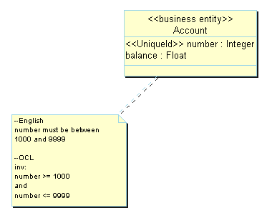
PIM: an example

Slide 7
Platform Specific Model (PSM)
Specifies how the functionality specified in a PIM is realized on a particular platform
Expressed using DSL / UML

Slide 8
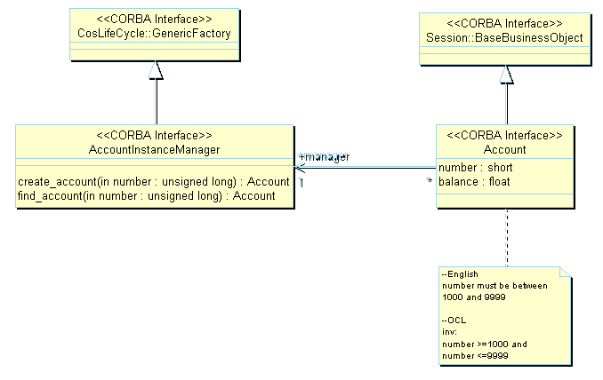
PSM: an example

Slide 9
MDA metamodel
Infrastructure
PIM Mapping techniques
<<based on>>
Mapping from PIM to PIM
UML
1..n
<<expressed with>>
1..n
PIM
Metamodel
<<described with>>
MOF
<<independant of>>
1..n
<<expressed with>>
1..n
1..n
Mapping from PIM to PSM
Refactoring from PSM to PIM
<<expressed with>>
Other languages
<<based on>>
<<described with>>
1..n
PSM
<<depends on>>
PSM Mapping techniques
1..n
Mapping from PSM to PSM

Slide 10
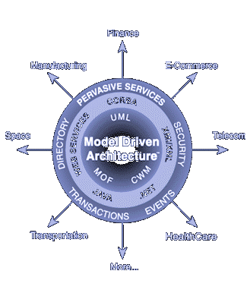
MDA in a Snapshot
Vertical Domains
Core Technologies
Pervasive Services
Core Target Platforms
Notes:
Snapshot or Overview?
Ci dà un’idea di come i vari standard si inseriscono insieme

Slide 11
3. Developing in MDA

Slide 12
System Development Lifecycle and the MDA approach
PIM to PIM mappings
PSM to PSM mappings
DSL
Time
PIM to PSM mappings (projection on a specific platform)
Notes:
1 - UML MOF CWM used to describe PIMs
2 - PIM can be refined n-times with PIM to PIM mappings
3 -

Slide 13
Developing in MDA
All MDA development projects start with the creation of a PIM
PIM at this level represents business functionality and behaviour, undistorted by technology details
Notes:
PIM is built by business and modeling experts working together

Slide 14
Developing in MDA
Mapping from
PIM to PSM
PSM
PIM

Slide 15
Program languages generation
4GL language
DSL
3GL language
C / C ++ / JAVA
First and second generation
of program languages

Slide 16
Mapping DSL TO PSI
4GL language
3GL language

Slide 17
Mapping DSL TO PSI
4GL language
Engine
(Domain framework)
3GL language

Slide 18
Building DSL editor
DSL language required specific editor
Editor has to be created fast and easily customizable

Slide 19
Building DSL editor
EMF
GMF
GMF toolkit
Notes:
Still a lot of manual workj

Slide 20
Building DSL editor
Epsilon
Generated
DSL editor
EMF
GMF
GMF toolkit
Notes:
Still a lot of manual workj

Slide 21
Developing in MDA
Mapping from
PIM to PSM
PSM
PIM

Slide 22
Developing in MDA
Recipe
Types mapping
PSM
PIM
Artifacts
Templates

Slide 23
4. MDA in the Practice

Slide 24
Conclusions (1/2)
Abstracting out the structure and behaviour of a system in the PIM makes easier:
  To validate the correctness of the model
  To produce implementations on different platforms
  The application of tool supported solutions

Slide 25
Conclusions (2/2)
The major drawback is that MDA does not provide a standard for the specification of mappings
  Different implementation of mappings can generate very different code or models
  This can create dependencies between the software and the mapping solution used

Slide 26
The End

Slide 27
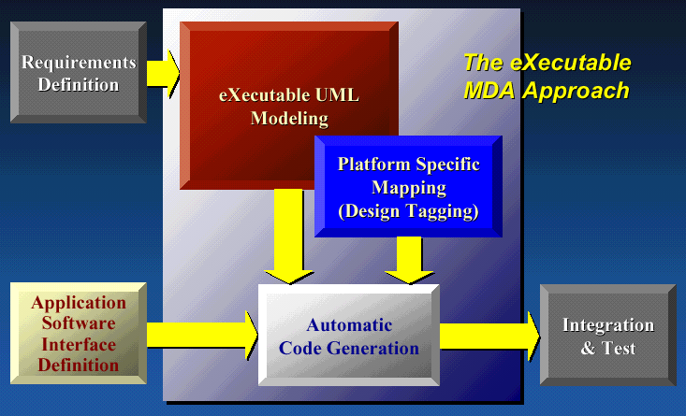
The KC’s xMDA approach
xMDA: eXecutable UML + MDA

