Slide 1
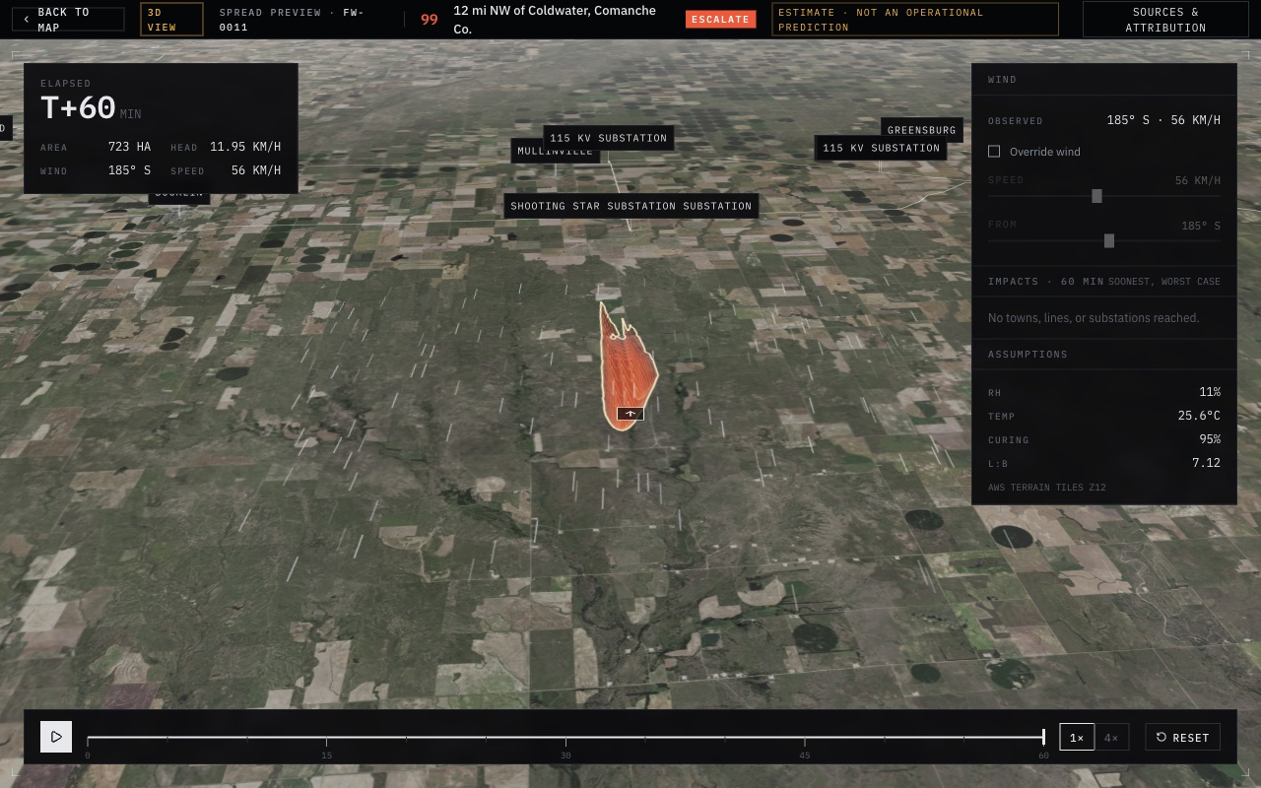

FIREWATCH 2026 · WSU INNOVATION WORKS × LOCKHEED MARTIN SKUNK WORKS
Firewatch
Detect → Confirm → Respond
Early wildfire warning for rural Kansas volunteer fire districts, built to work on one bar of cell.
COTTONWOOD CREEK · 450 SQ MI · 18 VOLUNTEERS
Notes:
(15 s) We're Firewatch. We built an early-warning system for rural volunteer fire districts like Cottonwood Creek: 450 square miles, 18 volunteers, and often one bar of cell. Behind me is our forecast of the packet's fire, 60 minutes after the line came down.

Slide 2
THE PROBLEM
A fire nobody sees for 31 minutes
2:17
A rancher sees smoke
2:34
Trucks roll
NOBODY KNOWS
1:50
Line drops into dry grass
2:21
911 is called
2:52
First truck: fire 2–3 mi long
31 min
+8 min
2–3 mi
from ignition to the first 911 call
satellites see Kansas wildfires a median 8 minutes after someone reports them (2016–2025)
of fire front when the first truck arrives at 2:52
And a system that cries wolf over March pasture burns gets switched off by April.
FIREWATCH
2 / 12
Notes:
(35 s) Here's the packet's scenario. At 1:50 a line comes down into dry grass. For 27 minutes nobody sees it; 911 is called at 2:21, and the first truck arrives at 2:52 to a fire two to three miles long. Satellites don't save us: across ten years of Kansas wildfires they saw the fire a median eight minutes after a person reported it. And any system that alarms on every spring pasture burn gets ignored. Those first 31 minutes are where this fire is won or lost.

Slide 3



HOW IT WORKS
Detect → Confirm → Respond
Detect
Confirm
Respond
One event per fire
No drive-out needed
Before the first engine
Co-op line faults on fire-weather days
Satellite hotspots: VIIRS, MODIS, GOES, NGFS
Texted reports and tower smoke sensors
ML score tells wildfires from burns and flares
Two independent signals to escalate (a line fault on a red-flag day counts alone)
Nearest neighbors texted: "See smoke? 1 yes, 2 no, 3 my burn"
Duty officer replies PAGE by text
Downwind ranchers get direction and arrival time
Mutual aid drafted when crews are short
Humans decide every page. Every signal, text and decision is logged on the event.
FIREWATCH
3 / 12
Notes:
(35 s) Firewatch works in three steps. Detect: we combine cheap signals into one event per fire: a co-op line fault on a fire-weather day, satellite hotspots, a texted report, a tower smoke sensor. Confirm: a machine-learning score separates wildfires from prescribed burns and refinery flares, it takes two independent signals to escalate, unless the co-op reports a line fault on a red-flag day, and we text the nearest neighbors to ask if they see smoke. Respond: the duty officer gets one text and replies PAGE; downwind ranchers get a warning with an arrival time. A person decides every page.

Slide 4
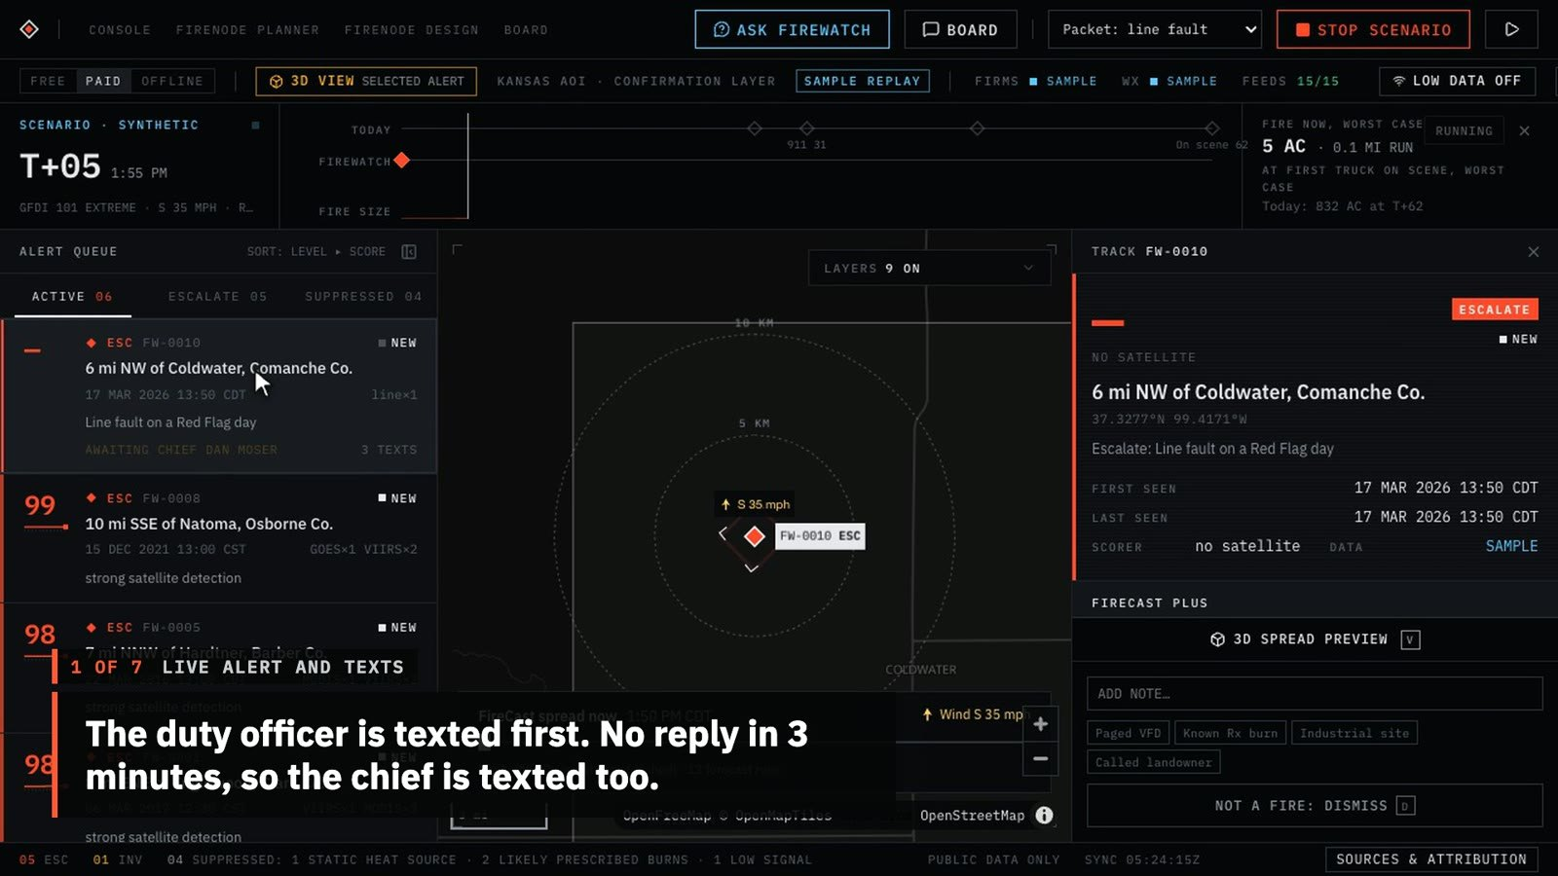
SEE IT WORK · 1:49, NO SOUND NEEDED
The packet's fire, replayed in Firewatch
FIREWATCH
4 / 12
Notes:
(1 min 49 s, play it) Here it is running. This is the packet's Tuesday replayed through the real decision code: the line fault, the texts to the duty officer and the chief, the page, the burn log, the 3D spread forecast, the neighbours' board, the sensor planner, the chief's phone and the result. The replies are simulated, and the video says so.

Slide 5
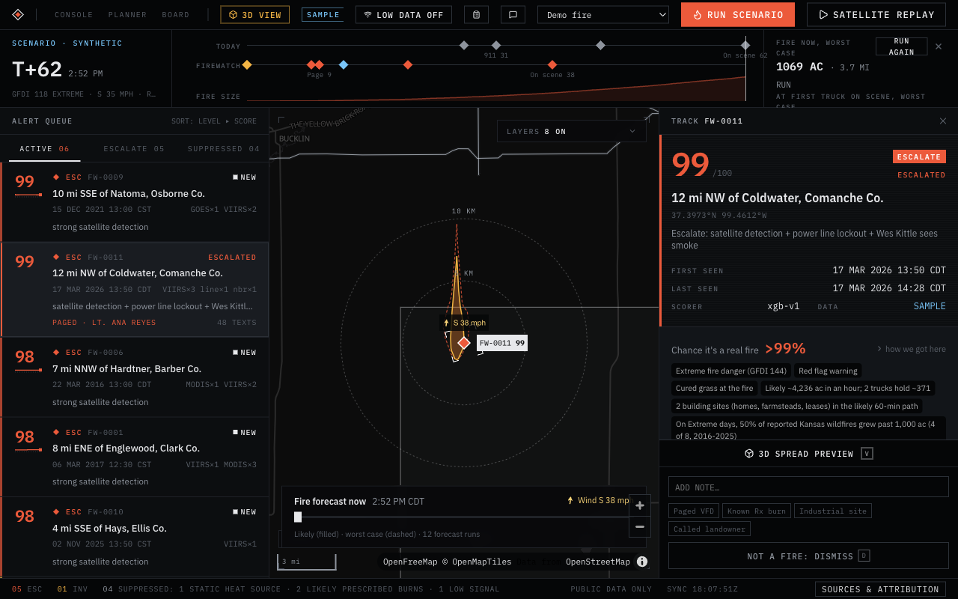
THE CONSOLE · COTTONWOOD CREEK REPLAY
Duty officer asked at once, district paged at T+7
T+0
Co-op line locks out on a red-flag day: Escalate, the duty officer is texted
T+3
No reply in 3 minutes: the chief is texted, with a link to the alert
T+7
Chief replies PAGE; county dispatch tones out the district
T+7
Crew paged; neighbors with a disc or water truck asked to help
T+7
Mutual aid drafted: up to 1,030 ac in an hour, more than 2 trucks can hold
FIREWATCH
5 / 12
Notes:
(40 s) This is the console during the replay. At T+0 the co-op's line lockout on a red-flag day is enough to escalate, and the duty officer gets one text: reply PAGE or NO. No answer in three minutes, so the chief gets the same text with a link to the alert. At T+7 the chief replies PAGE, county dispatch is told to tone out the district, the crew is paged, neighbors with a disc or a water truck are asked to help, and a mutual-aid request is drafted because the forecast is bigger than two trucks can hold. The satellite doesn't see this fire until T+38, after the trucks have rolled. Every text is in the drawer on the right.

Slide 6
SAME FIRE, SAME CREW
First truck on scene 26 minutes sooner
~830 ac
Today
Nobody knows
911 to roll
Driving
Firewatch
Paged
Turnout
Driving
~270 ac
1:50
2:00
2:10
2:20
2:30
2:40
2:50
T+7
T+36
~270 ac
district paged
first truck on scene
burned when it arrives
today: 911 call at T+31
today: T+62
today: ~830 acres
Fire sizes are our spread forecast's median for the packet's red-flag Tuesday, not field data. The forecast is back-tested on real Kansas fires (Anderson Creek 2016, Starbuck 2017).
FIREWATCH
6 / 12
Notes:
(35 s) Same fire, same crew, same roads. Today the district hears about it at T+31 and the first truck arrives at T+62 to about 830 acres. With Firewatch the district is paged at T+7, the truck is on scene at T+36, and our forecast puts the fire at about 270 acres: a third of the size. Those sizes are our forecast's median, which we back-tested against real Kansas fires, not field measurements.

Slide 7
NO CRYING WOLF
Quiet on burns, loud on wildfires
Refinery and plant heat kept quiet
99%
10 years
of Kansas satellite fires, matched to 224 reported wildfires and 490 burns
Unreported Flint Hills spring burns kept quiet
82%
A person pages
Two sources to escalate, or a line fault on a red-flag day. Then someone replies PAGE.
Real wildfires sent to the duty officer
76%
0 texts
for a burn the landowner registered, unless it escapes
Machine-learning scorer, tested on 2023–2025 fires it never saw
FIREWATCH
7 / 12
Notes:
(30 s) Trust is the whole game, so we measured false alarms. Our scorer is trained on ten years of Kansas satellite fires and tested on 2023 to 2025 fires it never saw. It keeps 99 percent of refinery and plant heat and 82 percent of unreported spring pasture burns quiet, while 76 percent of real wildfires reach the duty officer. On top of that, it takes two independent sources to escalate, or a co-op line fault on a red-flag day, and even then nobody is paged until a person replies PAGE. A registered burn texts nobody unless it escapes.

Slide 8
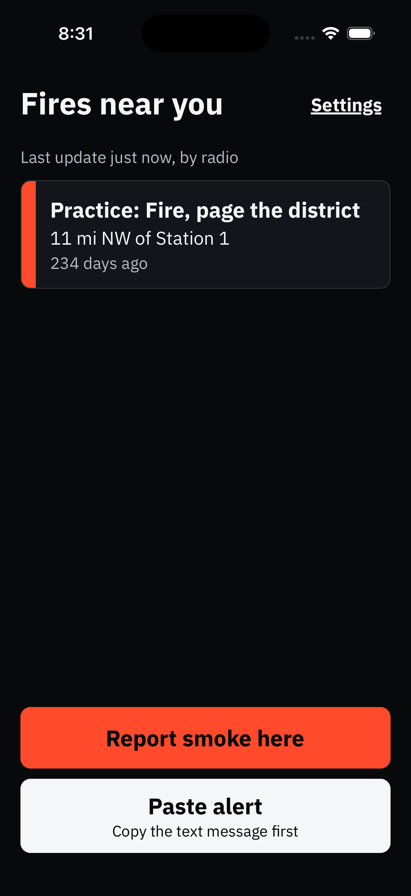
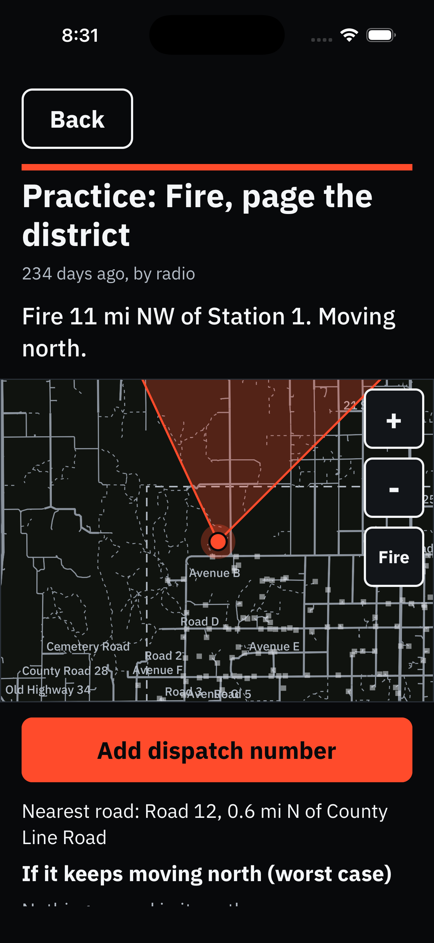
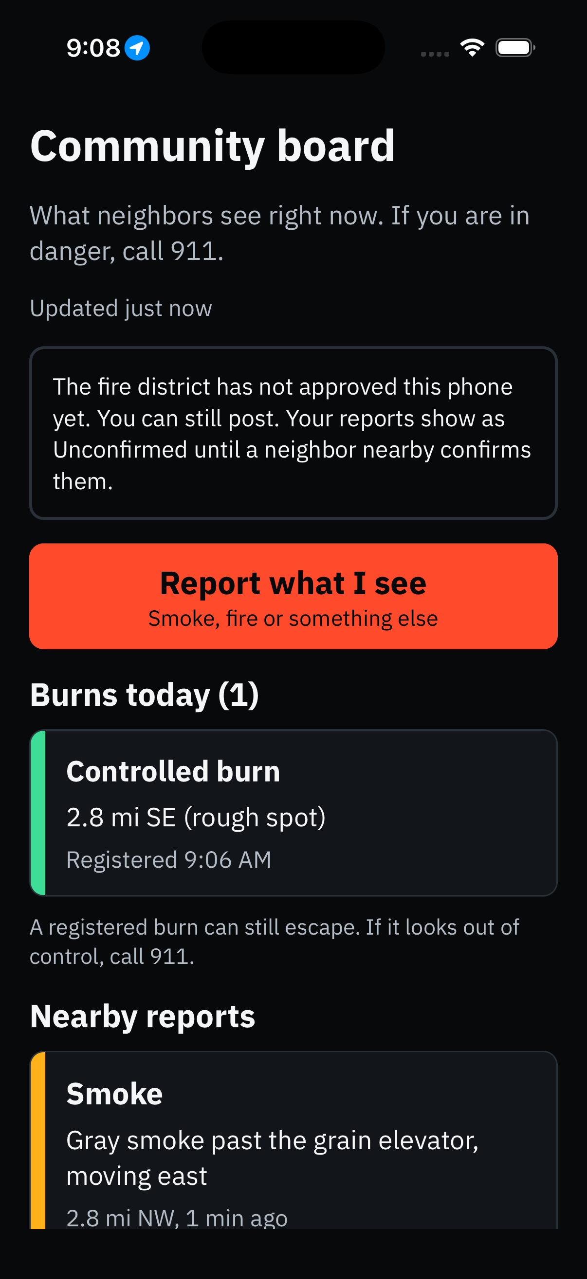



BUILT FOR ONE BAR OF CELL
Reaches people where cell doesn't
Plain text messages
Reply PAGE, 1, 2 or 3. Works on any phone, about 1 cent a text.
LoRa mesh radios
Meshtastic radios carry the same texts to trucks and ranches out of coverage. Tested with real radios.
Phone app
Alerts by text or radio, an offline map of where it's heading, and a board for neighbors' reports.
FIREWATCH
8 / 12
Notes:
(30 s) Rural Kansas often has one bar of cell, so everything is plain text: reply PAGE, or 1, 2, 3. Where there's no cell at all, the same texts go over Meshtastic LoRa mesh radios to trucks and ranches; we've run it on real radios this weekend. And the phone app gets alerts by text or by radio, shows where the fire is heading on an offline map, and lets neighbors report and confirm smoke.

Slide 9
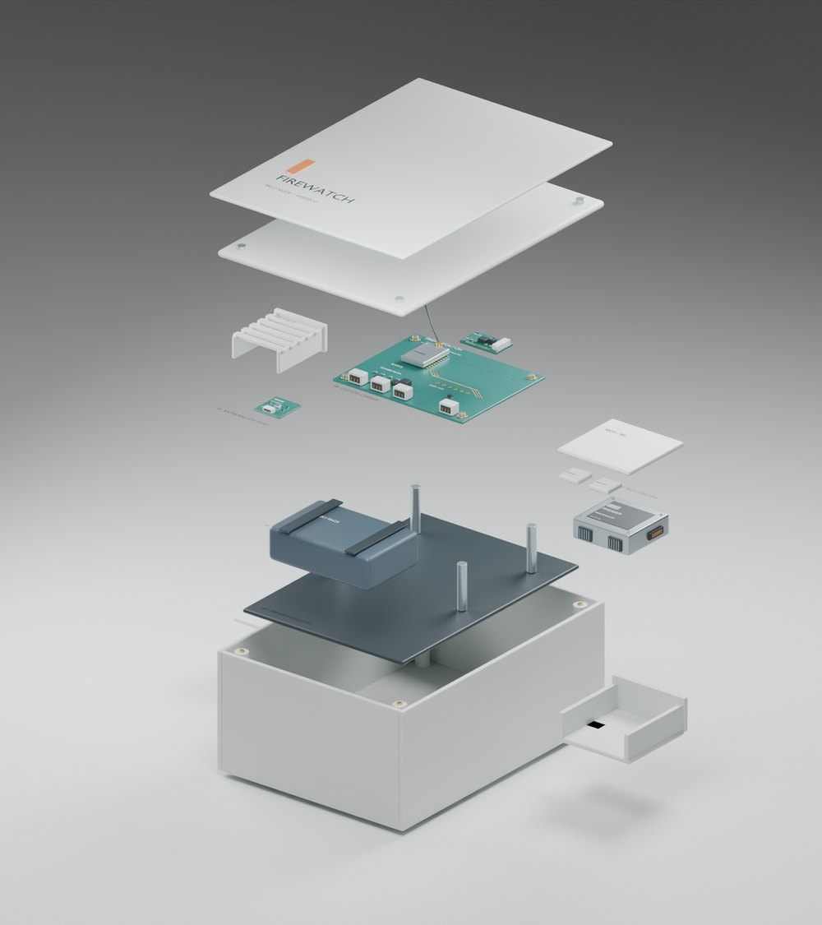
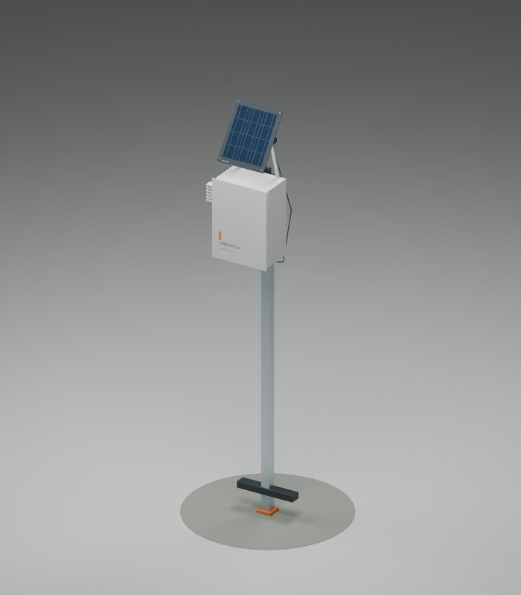
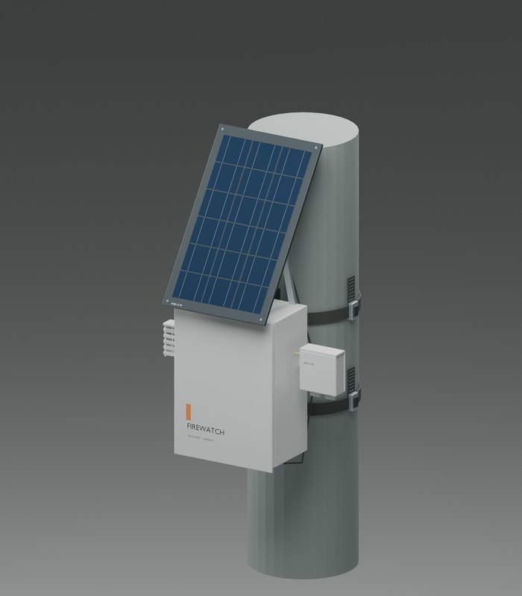
THE SENSOR NODE · CAD REVISION 2
One box, two tiers, on a stake or a pole
RICH NODE, EXPLODED
$136
bare node at ~100 units
$204
rich node, adds smoke sensing
Solar
no wiring, relays the mesh
Bare · ground stake
Rich · pole band
BARE
RICH
Gas, temperature, humidity, pressure (Bosch BME688). 2 W panel, 4,400 mAh.
Adds a particle sensor that sees smoke (Plantower PMSA003I). 5 W panel, 6,600 mAh.
Blender design model, not a routed board. Detection distance, power budget and radio range are what the field burn trial measures.
FIREWATCH
9 / 12
Notes:
(20 s) This is our sensor node. One weatherproof box in two tiers: the bare node measures gas, temperature, humidity and pressure; the rich node adds a particle sensor that sees smoke. Both run on solar, talk over the same Meshtastic mesh and relay each other's messages, and mount on a ground stake or band onto a pole. At about a hundred units it's 136 dollars bare and 204 rich. It's a design model today; the field burn trial measures how far away it can smell a fire.

Slide 10
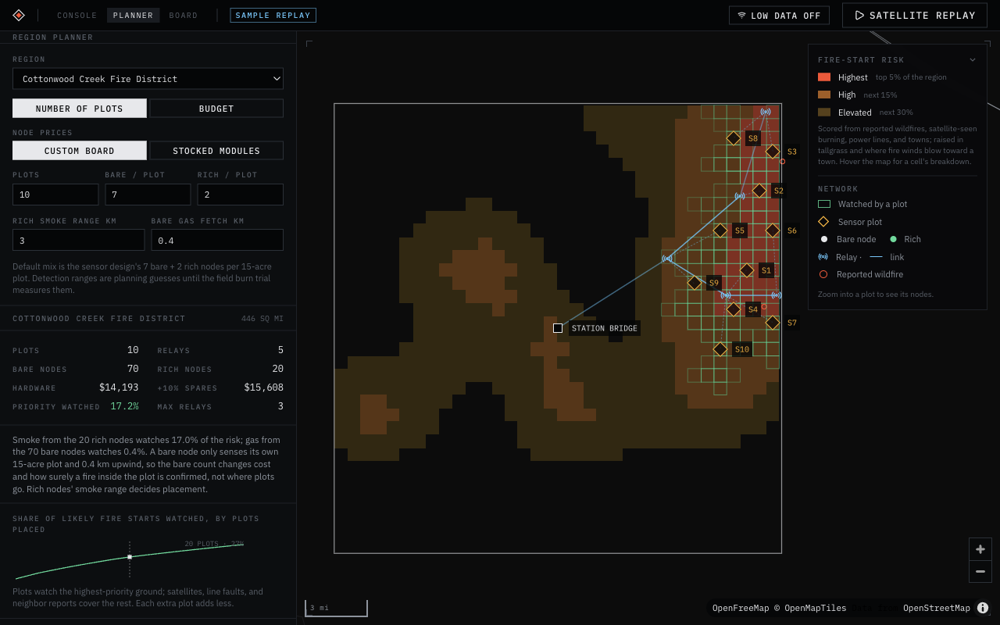
REGION PLANNER
Plan sensors for any Kansas county
Places 15-acre sensor plots where fires start and where the wind carries their smoke, from ten years of fires, power lines, tallgrass, terrain and hourly winds. Each plot says why it was chosen.
$15.6k
Cottonwood Creek: 10 plots, 90 nodes, 5 relays, with spares
$136 / $204
custom-board bare and rich nodes
$0 / month
free public data, no subscriptions
FIREWATCH
10 / 12
Notes:
(25 s) For districts that want their own sensors, the planner lays out a network for any Kansas county. It puts sensor plots where fires start and where the wind carries smoke, routes relays with terrain line of sight, and prices it. For Cottonwood Creek, ten plots and five relays come to about fifteen and a half thousand dollars with spares, and every data source is free.

Slide 11


WHERE IT STANDS
Built this weekend, tested on real data
BUILT AND TESTED
NEXT
662 automated tests pass
Field burn trial to measure sensor range
Scorer trained on 10 years of Kansas fires
Live texting on real phones
Spread forecast back-tested on real fires
Pilot with one Kansas district before spring burn season
13 live public data feeds checked today
To run a district
Free public data, about 1 cent a text, optional sensors from $136 a node
Packet scenario runs end to end, every text logged
FIREWATCH
11 / 12
Notes:
(25 s) It's real code: 662 automated tests, a scorer trained on ten years of Kansas fires, a spread forecast back-tested on real fires, and thirteen live public data feeds we checked working today. Next: a field burn to measure sensor range, live texting on real phones, and a pilot with one Kansas district before spring burn season.

Slide 12
Win back the first 31 minutes.
Firewatch · Detect → Confirm → Respond
Paged at T+7 instead of T+31 · on scene at T+36 instead of T+62 · humans decide every page
github.com/isaksmith/Firewatch
Notes:
(10 s) Firewatch wins back those first 31 minutes, with people deciding every page. Thank you; we'd love your questions.

