Slide 1
BACKUP SLIDES · FOR QUESTIONS
When things break,
and what we'd add next
Sensor failures and fallbacks · why no drones yet, and which ones later · protecting the sensor mounts from fire
The rule behind all of it: if any part of Firewatch fails, the district is back to today, never worse. 911 stays the main path.
Notes:
Backup slides for the question period. The one rule to say out loud: if any part of Firewatch fails, the district is back to how it works today, never worse, and 911 stays the main path.

Slide 2
CONTINGENCY · FIRENODE SENSORS
A broken sensor goes quiet. It never pages.
Radio link
No check-in for 30 min: Watch. For 2 hours: "Radio link down, cause unknown".
Never pages
Sensors alone never page anyone. All sensors together count as one source.
Stuck sensor
Check-ins arrive but a reading repeats 3 times: "stale, may need replacement". Its readings can't raise smoke.
Battery
Under 80% of its capacity: Watch. Under 70%: Replace.
Others keep working
Satellites, co-op line faults and texted reports don't depend on the sensors.
Solar panel
Under 45% of the network's output: clean or re-aim. No output in daylight: Replace.
Smoke inlet
Reads zero while other nodes see smoke: blocked inlet or stopped fan.
Fix on the next visit
The console names the node and the part: battery, panel, inlet or radio.
Built: backend/app/sensor_health.py (DESIGN.md 5.12). The thresholds are placeholders until a first field season sets real ones. The sensors themselves are a design, not yet field-tested.
FIREWATCH · BACKUP
B2 / 7
Notes:
If a sensor breaks, it goes quiet; it never raises an alarm. Every node is checked from its own reports: radio, stuck readings, battery, solar and the smoke inlet, and the console tells the volunteer which part to fix on the next visit. Sensors alone can never page anyone, and the satellites, the co-op's line faults and texted reports don't depend on them. These thresholds are placeholders until a field season.

Slide 3
CONTINGENCY · EVERY LAYER
Every part has a fallback; the floor is 911
IF THIS FAILS
WHAT HAPPENS
STATUS
Duty officer doesn't answer
After 3 minutes the chief gets the text, then county dispatch
BUILT
Volunteers don't answer
A mutual-aid request is drafted; one reply sends it
BUILT
FireMesh radio is down
Texts carry on as normal; the console shows MESH down
BUILT
A data feed is late or down
The top bar says DOWN or NO DATA, never "no fire"
BUILT
A sensor node dies
It drops to offline; the other sources keep working
BUILT
The scorer is wrong
A person decides every page; overrides are logged
BUILT
Firewatch's server is down
An outside monitor texts the chief: "Firewatch offline, 911 is your only detection"
PLANNED
Failure table: docs/PLAN.md section 6. "Built" means it runs in the app today; "Planned" means designed but not built yet.
FIREWATCH · BACKUP
B3 / 7
Notes:
Every part has a fallback. If the duty officer doesn't answer, the chief gets it in three minutes, then dispatch. If crews don't answer, mutual aid is one reply away. Radio down, texts still go. A feed down says so, it never says no fire. The one we haven't built yet is the outside monitor that tells the chief when our server itself is down. And the floor under all of it is today: 911 still works.

Slide 4



FUTURE · DRONES
Why we didn't make drones the detector
The rules
The wind
The people
A pilot must see it
Red-flag days ground them
Someone has to fly it
FAA Part 107 needs the drone in the pilot's sight. Flying beyond that needs a waiver. The rule that would allow it routinely (Part 108) went to White House review in July 2026 and isn't final.
Red-flag days here run 30–40 mph. A DJI Matrice 4T is rated to 12 m/s (27 mph). A Trinity Pro fixed-wing: 11 m/s (25 mph) to take off and land, 14 m/s (31 mph) in flight.
A certified pilot has to launch it on site. Only 5 of the 18 volunteers can leave work on a weekday, and they're needed on the truck.
A drone is a good tool for the first volunteer on scene. It can't watch 450 square miles.
FAA 14 CFR 107.31; Part 108: UAV Coach, Airdata (Oct 2026). Wind: DJI dealer specs; Trinity Pro tech sheet (2024). Red-flag winds: RESEARCH.md. Volunteers: packet.
FIREWATCH · BACKUP
B4 / 7
Notes:
Why not drones as the detector? Three reasons. Rules: a drone has to stay in the pilot's sight; flying beyond that needs a waiver, and the FAA rule that would make it routine, Part 108, has been at the White House since July and isn't final. Wind: red-flag days here run 30 to 40 mph, and even good enterprise drones are rated to roughly 25 to 31. People: someone certified has to launch it, and only five of our eighteen volunteers can leave work on a weekday. So a drone helps the first volunteer on scene, but it can't watch 450 square miles.

Slide 5
FUTURE · DRONES
Which drones could help later, and what they cost
Quadcopter with thermal camera
Fixed-wing VTOL
Example
Skydio X10 (US-made, Blue UAS)
Quantum Systems Trinity Pro
Cost
Quote only; the Army paid about $20k each in a 2,500-unit order
Quote only; roughly $20–40k with a thermal camera (our estimate)
Wind
Gusts to about 28 mph
25 mph to take off and land, 31 mph in flight
Reach
Kept within the pilot's sight
5–7.5 km radio range, up to about 60 min a flight
Crew
1 pilot with a Part 107 card ($175 test)
A pilot plus an observer; past line of sight needs a waiver or Part 108
Best use
First on scene: size-up, night hot spots, mop-up
Shared by the county: scout long power lines, map the burn afterward
Buy US-made or Blue UAS: since December 2025 new foreign-made drones are on the FCC's Covered List, and federal grants can't buy them. Funding: Kansas Forest Service VFA grant or FEMA's Assistance to Firefighters.
Skydio X10 specs and Army order: Skydio, DroneXL (2026). Trinity Pro: Quantum Systems tech sheet (2024). FCC Covered List: Morgan Lewis, DroneXL (2026). Part 107 fee: PSI test, $175. Prices are quote-only; get dealer quotes before budgeting.
FIREWATCH · BACKUP
B5 / 7
Notes:
If the district wants a drone later, there are two kinds. A quadcopter with a thermal camera, like the US-made Skydio X10, for the first volunteer on scene: size-up, night hot spots and mop-up, flown by one certified pilot. And a fixed-wing VTOL like the Trinity Pro, better shared at county level to scout long power lines and map a burn afterward; it needs a pilot and an observer and still can't fly beyond sight without a waiver. Neither has a public price; the Army paid about twenty thousand each for Skydios. And buy US-made: since December, federal grants can't buy new foreign-made drones.

Slide 6
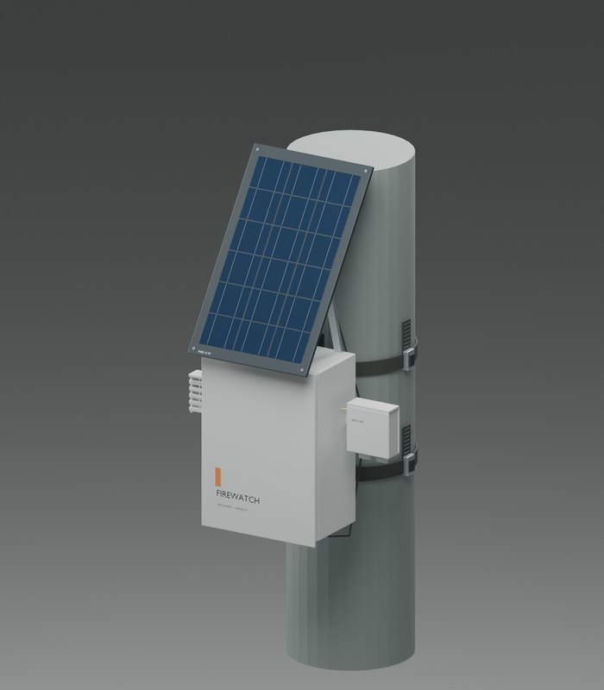
FUTURE · PROTECTING THE SENSOR MOUNTS
A self-activating extinguisher on the mount
HOW IT WORKS
HONEST LIMITS
A ball of dry chemical powder that bursts by itself when flame touches it.
Bursts 3–10 seconds after flame contact.
Covers about 5–10 m² around it.
No power, no wiring. One use, 5-year shelf life.
About $100–130 each in US stores.
It saves the node, not the pasture: a grass fire front passes in seconds and keeps going. One shot per ball. Untested on our mounts.
WHAT IT COSTS
One per node: 90 nodes × $100–130 = $9,000–11,700, close to the $14,200 of hardware for the whole network. Start with the 20 rich nodes on poles: $2,000–2,600 (our estimate).
Rich node on a pole band. A ball would mount just below it.
Cheaper first step: mow or gravel a 3 m circle under every node, so a passing fire has nothing to burn next to it (our estimate).
Specs and prices: AFO spec sheet (3–10 s, 8–10 m²), Elide Fire ELY6 listings at Tractor Supply and Ace ($99.99–129.99, about 60 sq ft, 5-year shelf life). Network size and $14,200: the FireNode planner for Cottonwood Creek, 10 plots (our estimate).
FIREWATCH · BACKUP
B6 / 7
Notes:
Could we protect the sensors themselves? There are self-activating extinguisher balls: dry powder that bursts on its own when flame touches it, within a few seconds, covering a few square meters, with no power or wiring, about a hundred to a hundred and thirty dollars each. To be honest about it: it saves the node, not the pasture, and it's one shot. One per node would cost nearly as much as the nodes, so we'd start with the twenty rich nodes on poles. And the cheaper first step is a mowed or gravel circle under every node so a fire has nothing to burn next to it.

Slide 7
FUTURE CONSIDERATIONS
What we'd add, in order
THIS BURN SEASON
NEXT YEAR
WHEN THE RULES ALLOW
Field burn trial: how far a node smells smoke
Mow or gravel a circle under each node
Build the outside server monitor
Pilot with one district and its co-op
Extinguisher balls on the 20 rich nodes on poles
A thermal drone for the first volunteer on scene (US-made, grant-funded)
Test a safer battery chemistry for nodes in full sun
Once Part 108 is final: a county-shared fixed-wing to scout lines on red-flag days
Cameras on grain elevators or water towers: about $1.5–4k per site (rough)
Camera cost: docs/PLAN.md phase 3 (rough, before vendor quotes). Battery: nodes use a protected single-cell Li-ion pack with a temperature probe (sensors/README.md); a safer chemistry is our suggestion, not tested.
FIREWATCH · BACKUP
B7 / 7
Notes:
What we'd add, in order. This burn season: the field burn trial, a cleared circle under each node, the outside server monitor, and a pilot with one district and its co-op. Next year: extinguisher balls on the riskiest pole nodes, a US-made thermal drone for the first volunteer on scene, and a safer battery for nodes in full sun. When the rules allow: a county-shared fixed-wing once Part 108 is final, and cameras on grain elevators or water towers.

