Slide 1
Adaptive Systems
Ezequiel Di Paolo
Informatics
Lecture 2: Cybernetic roots of AI

Slide 2
Approaches to history in science
Looking at the history of ideas
Looking for ideas themselves
It is often a mistake to assume conceptual progress in the history of science. The less firmly established the discipline, the bigger the mistake.

Slide 3

In the beginning…
Artificial Intelligence is often considered to have two founding events:
  Turing's 1950 paper “Computing Machinery and Intelligence”, Mind, 59(236), pp. 433-460
  The Dartmouth Conference of 1956.
  McCarthy, Minsky, Newell, Simon, Shannon, Samuel, Selfridge, were all at the latter. The rise of representational symbol manipulation GOFAI can be traced to this event (theorem provers, general problem solvers, chess playing)

Slide 4
Before the beginning…
But what was going on before this?
In the early/mid-1940s a group of scientists and engineers interested in an interdisciplinary study of intelligence and communication founded the field of Cybernetics. Norbert Wiener, Arturo Rosenblueth, Warren McCulloch, Walter Pitts, John von Neumann, Claude Shannon.

Slide 5
Cybernetics
A movement bringing together different currents of research in mathematics (Wiener,von Neumann), neuroscience (Rosenblueth, McCulloch), anthropology/social science (Bateson, Mead), engineering (Shannon), psychology (Frank, Lewin), etc.
Founding event: Macy's meeting on “The feedback mechanisms and circular causal systems in biology and the social sciences”, NY, March, 1946.
Ten such meetings were held until 1953

Slide 6
Cybernetics
Cybernetics (from Greek for `steerman‘, the title of Wiener’s 1948 book) is the study of the mathematics of machines, their control and communication.
It aims at offering unifying principles for general classes of phenomena. For this reason it works at abstract levels introducing concepts such as control, feedback, signal, information, and so on, in models that could be applied to brains, ecologies, economies, societies, etc. Black box models.
AI: a subset of the central aims of cybernetics.

Slide 7
Outside the American scene
Britain:
  Ratio Club (W. Grey Walter, W. Ross Ashby, A. Turing, D. Mackay). A dinner and discussion group on new ways of thinking about the brain and intelligence.
Austria/Germany:
  General system's theory (von Bertalanffy), social systems, biological cybernetics.

Slide 8
Well outside …
Soviet Union: Initially persecuted as contrary to Marxist views (Wiener's book was banned). Considered a “reactionary pseudo-science appeared in the USA after the World War II and becoming also wide spread in other capitalist countries; a kind of modern mechanicism”. S.A. Lebedev, A.A. Lyapunov, A.N. Kolmogorov (maths, computers) helped overturn the tide in the early 50s. N.A. Bernstein (neurophysiology, movement coordination) was not so successful against the Pavlovian heritage, but his work has been re-discovered in the 90s.

Slide 9
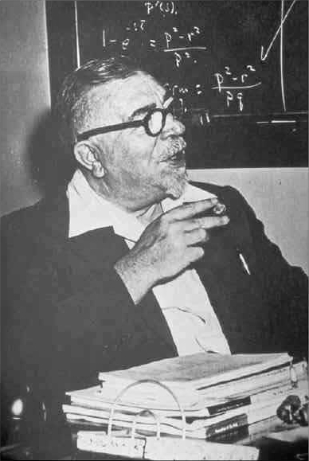
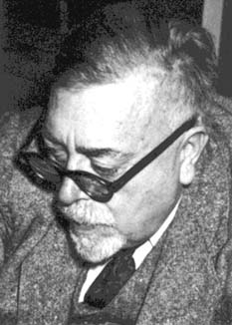
Norbert Wiener
1894 -1964
Mathematician
Published Cybernetics: or control and communication in the animal and machine (1948).

Slide 10
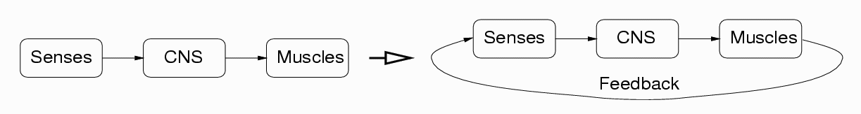
Norbert Wiener
Tried to reconcile purposeful behaviour and mechanistic views by introducing the idea of feedback. “Behavior, purpose and teleology”, Rosenblueth, A., Wiener, N., Bigelow, Philosophy of Science, 10, 18--24, 1943
Sensing and acting tightly coupled. Not the standard view at the time (not quite standard even now).

Slide 11
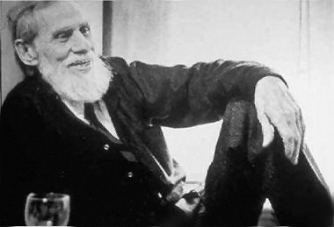
Warren McCulloch
1898 - 1972
Mathematician, neuroscientist, philosopher

Slide 12
Warren McCulloch
“A logical calculus of the ideas immanent in nervous activity”, McCulloch, W., Pitts, W., Bull. Math. Biophys., 1943, 5, 115. First neural network model. A formalization of brain activity viewed as a network of logical elements, including loops and delays. They proved that any finite-state Turing machine could be replaced by a network of logical elements. Precursor of connectionist movement in the mid-80s.

Slide 13
Warren McCulloch
“What the frog eye tells the frog brain”, Lettvin, J.Y., Maturana. H., McCulloch, W. and Pitts, W.H., Proc. IRE 47:1940-51, 1959. Showed topographical organisation of layers of neurons. “Processing” is not centralised but happens in the sensors themselves that extract action relevant features from the visual image. No general purpose mechanisms, Kantian synthetic a priori.

Slide 14
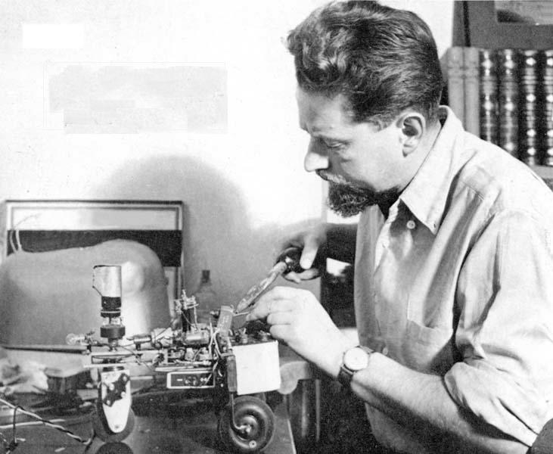
W. Grey Walter
1910 - 1977
Neurophysiologist and roboticist.
Invented a very sensitive Electroencephalograph.First to observe theta and delta rhythms in the brain.

Slide 15
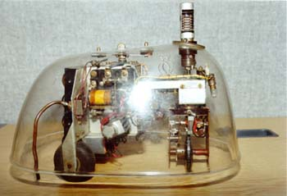
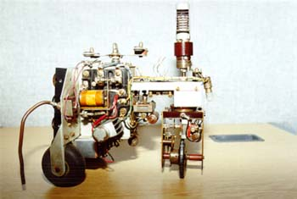
Grey Walter’s tortoises
Two `neurons', two sensors (light and contact) and two motors. Contrasting ideas with GOFAI: design a whole machine, exploit interactions with the environment (active perception), internal interaction of different `behaviours' (subsumption architecture). The value of these ideas was `re-discovered' in the late 80s with the work of R. Brooks.

Slide 16
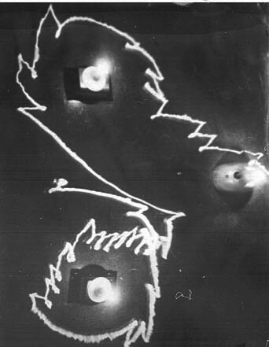
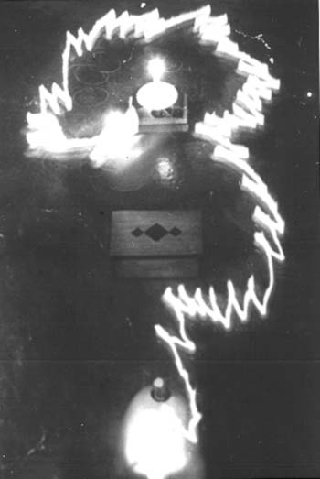
Phototaxis, obstacle-avoidance

Slide 17
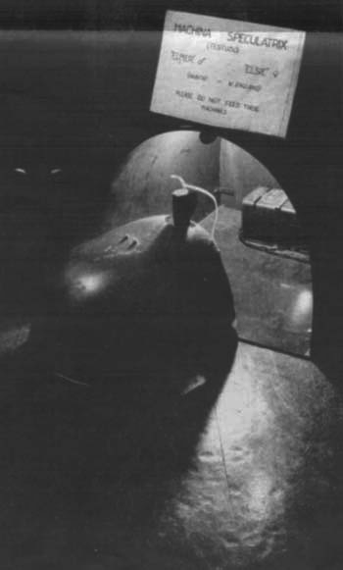
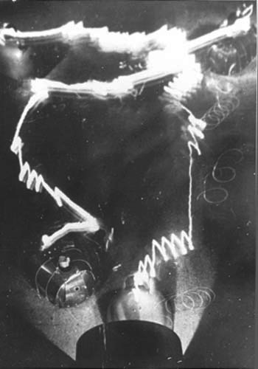
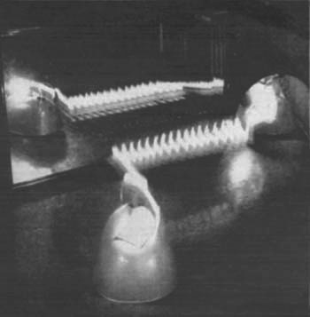
Recharging Interaction Narcissism

Slide 18
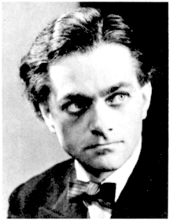
Gordon Pask
1928–1996, a polymath
Very complex, far reaching pieces of work on the nature of learning, adaptation, life, human communication, conversation theory, constructivist epistemology, among other things such as adaptive hanging mobiles, airport baggage handling systems, teaching machines.

Slide 19
Growing an ear
Pask developed a chemical adaptive system that learns to perform a task by growing threads of low conductivity in a ferrous solution (1958). The threads gradually disappear if they are not used, but lower the resistance to current if they are used frequently. He managed to grow an artificial “ear” in this way.
There’s a project currently underway to replicate this device here in Sussex.

Slide 20
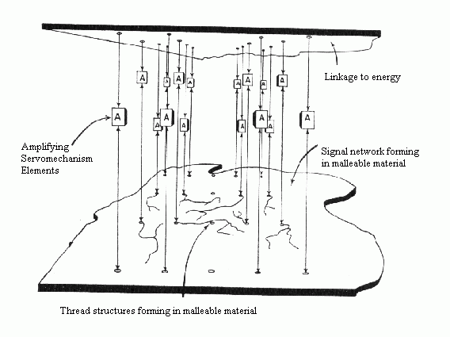
Growing an ear
The resulting apparatus would have grown a mesh of fine connections between its electric terminals and its wall as the source of vibrations. Functionality and structure change continuously in response to history.

Slide 21
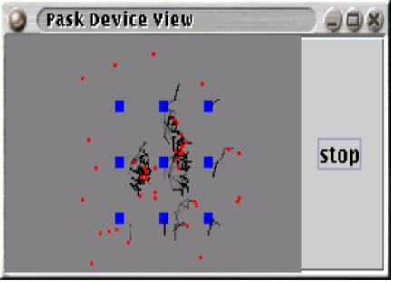
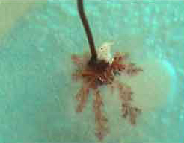
Current versions …
Simulation using active agents as currents, and L-systems for threads. Cristiano Solarino, Adaptive Systems project 2004
Jon Bird (Sussex) exploring electrolytic thread formation, 2002-present

Slide 22
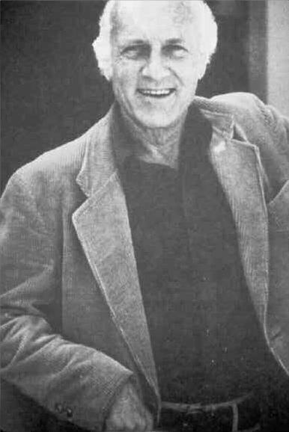
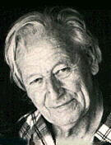
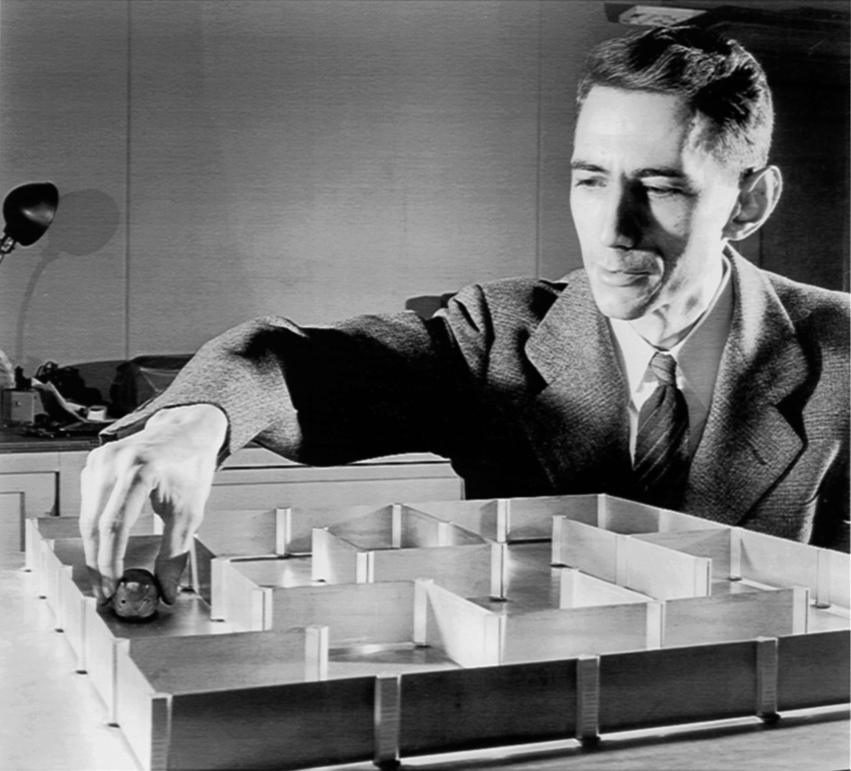
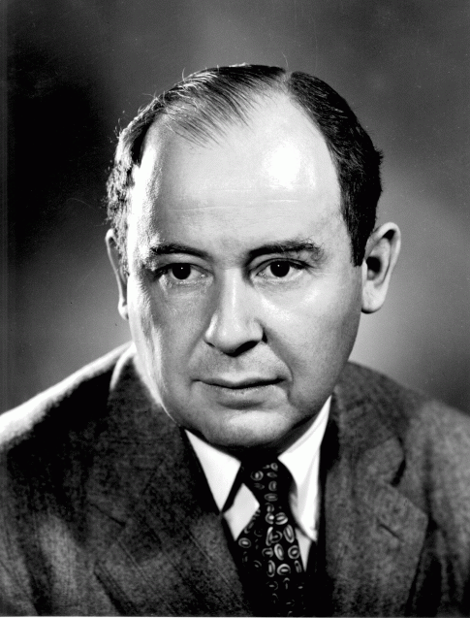
And others…

Slide 23
What came out of cybernetics?
AI/Robotics
Control Theory
Systems thinking
Complex systems
Information theory
CAs, NNs, GAs.
Self-organisation,
Ultrastability,
Requisite variety,
Order from noise,
Autopoiesis,
Double-bind.
It influenced the work of many people (Piaget, Arbib, Pattee, Rosen, Maturana, Varela, J.Z. Young, Braitenberg, Rosenblatt, Cariani, J.J. Gibson, etc.)

Slide 24
Why did Cybernetics die out?
Tensions due to breadth of the subject. Not quite a discipline in itself. Bits of it went to form separate and reputable disciplines such as Control Engineering.
Technological limitations constrained practical applicability.
Winds of funding blew in the direction of symbolic AI which promised a lot (heuristics, LISP, GPS, theorem provers, etc; McCarthy, Newell, Simon, Minsky).

Slide 25
Why did Cybernetics die out?
Too abstract at times. Details could not afford to be ignored in real-world systems.
Fell into disrepute (too philosophical for some people).
Did not quite move into digital age.
Went underground: small groups doing interesting work such as Heinz von Foerster's Biological Computation Lab at University of Illinois; Pask's System Research, etc.

Slide 26
Where are we today?
For a long time (esp. in the US) anything bearing the cybernetic tag was considered as old history, to be ignored safely. Lots of ideas were lost only to be painfully rediscovered (and some only partially). E.g., Neural networks, behaviour-based robotics. Today's new trends in cognitive science and AI owe many basic insights to ideas originating in the cybernetic era:
Whole agent in constant interaction with environment, Subsumption architecture, Situated Robotics,
Artificial Evolution, Self-organisation,
Dynamical systems theory applied to cognition

Slide 27
And we’re still rediscovering…
Ashby's framework for adaptive behaviour (next lecture),
Systems that grow their own sensors,
Systems that modify themselves,
Systems with many hierarchical levels.

Slide 28
Why bother with this?
Often the questions that motivated research in cybernetics have more value than the ways they tried to answer them. Sometimes these questions need to be rediscovered as well. Current situation in (mostly European) ALife, very much a continuation of the cybernetics movement.

Slide 29
Take-home message
Know your history;
If you have a brilliant novel idea, go and check the cybernetics literature first;
If you are looking for interesting questions nobody seems to be asking, go and check the cybernetics literature.

Slide 30
Literature
In library: QE 1 to QE 200 shelfmark
“Self-Organising Systems”, 1959, edited by M. C. Yovits and S. Cameron. QE 200 Yov.
“Principles of Self-Organization”, edited by H. Von Foerster and G. W. Zopf Pergamon P., 1962. QE 200 Uni.
“The cybernetics group”, S.J. Heims. MIT P.,1991, Q430 Hei
“The mechanization of mind”, J-P. Dupuy, 2000, Princeton UP

Slide 31
Next week…
Ashby’s framework for adaptive behaviour

