Slide 1
Adaptive Systems
Ezequiel Di Paolo
Informatics
A framework for adaptive behaviour

Slide 2
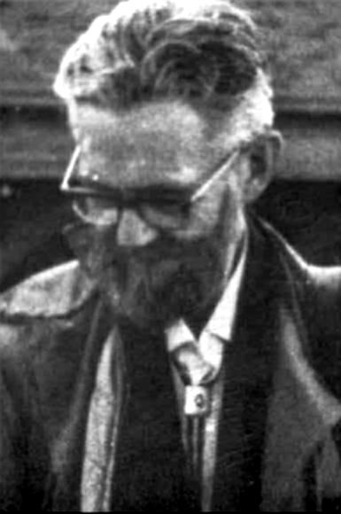
W. Ross Ashby
1903 – 1972
Cybernetician
“Design for a brain”, 1952, (2nd edition 1960)
“An introduction to cybernetics”, 1956

Slide 3
The problem and method
The Problem: what mechanisms underly the production of adaptive behaviour in living organisms? In particular, how does the brain produce adaptive behaviour?
The Method: An operational, dynamical-systems approach. The organism is viewed primarily as a purposeless machine instead of a purposeful, goal-seeking device.
Consequence: Purposeful behaviour, adaptivity, etc. must be explained rather than assumed.

Slide 4
The framework was intended to show that the brain, while mechanistic in nature, could still be the source of adaptive behaviour.
Fairly high-level (abstract) framework, but thoroughly relevant today.
Many details not filled in (in keeping with cybernetic style), so interesting in the context of today's larger amount of information about possible candidates for the lower-level mechanisms.

Slide 5

Ashby distinguishes between two kinds of nervous system activity (today we would probably speak of different degrees of plasticity) :
  hardwired, reflex
  learned behaviour
He concentrates on the 2nd, since he is more concerned with somatic (lifetime) adaptation.
The view is operational and objective (although it allows observer involvement in the definition of the system). Teleological explanations not used (Teleology: purposeful accounts of behaviour)

Slide 6
A machine or animal behaves in a certain way at a certain time because its physical and chemical nature at that moment allow it no other option.
The problem: to identify the nature of the changes which show as learning and to find why such changes should tend to cause better adaptation of the whole organism.
Same problem as that faced by the designer of an artificial nervous system.

Slide 7
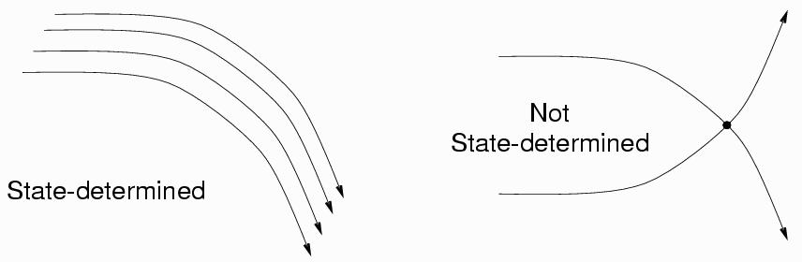
State-determined systems
A machine can be studied experimentally by observing transition between states. A system is defined as a set of variables chosen by the observer, but not totally arbitrary if we want a state-determined system.
A system is state-determined if each new state is uniquely determined by a previous state. Consequence: only one line in the phase-portrait can pass through a given point.

Slide 8
It's an approximation, but unavoidable if we want to study systems governed by well-defined laws.
Variables define the system, but in a description of the law governing the system other constraints are involved: parameters and the form of the law.
Parameters are not variables
In state-determined systems interactions with the environment occur through couplings between the variables of one system and the parameters of the other.

Slide 9
The organism
The organism defined as a set of variables.
The environment is defined as a system whose variables affect the organism through coupling and which are in turn affected by it.
Hence the environment is peculiar to the organism
Division somewhat arbitrary. (Where is the boundary?)

Slide 10
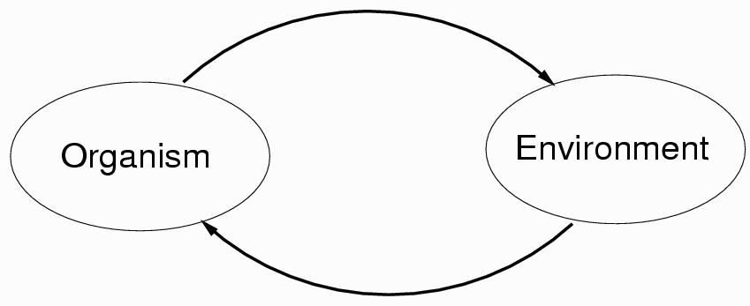
The organism
Organism and environment taken together form a state-determined system. They can also be treated as coupled systems (in which case the environment need not be state-determined, e.g., if we allow for fluctuations, uncertainty, etc., but the organism still does).

Slide 11
Essential variables
Essential variables of an organism are a closely related set of physiological variables strongly linked to survival (e.g., body temperature, sugar level, oxygen intake, etc.)

Slide 12
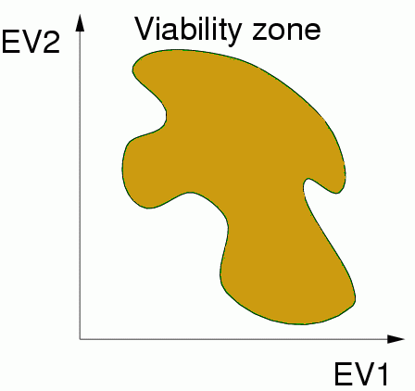
Essential variables
In order for an organism to survive, its essential variables must be kept within viable limits. Otherwise the organism faces the possibility of disintegration and/or loss of identity (dissolution, death).

Slide 13
Adaptation as stability
An organismic criterion
Definition: Behaviour is adaptive if it contributes to the maintenance of the essential variables within viable limits.
Homeostasis is a low-level example of self-correcting mechanism.

Slide 14
Adaptation as stability
An adaptive system is a stable system, the region of stability being that part of the state space where all essential variables are within physiological limits.
Depending on point of view, a stable system may be regarded as blindly obeying its nature and also as showing great skill in returning to equilibrium in spite of disturbances.

Slide 15
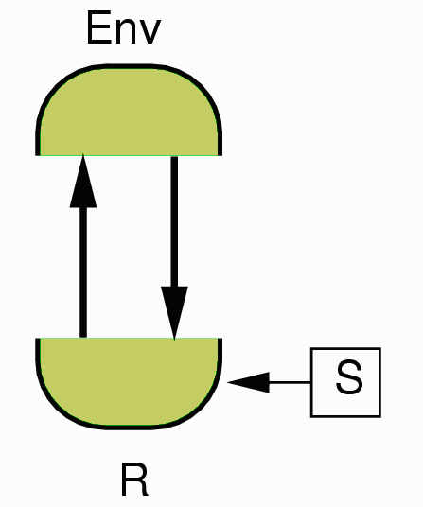
Ultrastability
Sensorimotor interaction
R represents a subsystem of the organism responsible for overt behaviour/ perception.
S represents those parameters affecting R. We assume that relevant features of behaviour do not change unless there is a change in S.

Slide 16
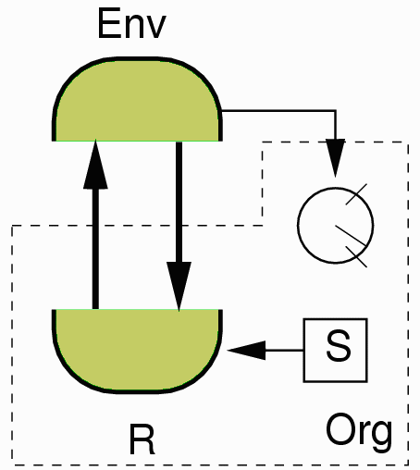
Ultrastability
Realistic case: Essential variables are affected solely by the environment.

Slide 17
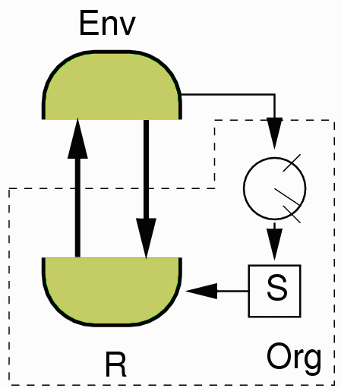
Ultrastability
When essentials variables go out of bounds (system ceases to be stable) they introduce changes in S.
IF the whole system finds a new equilibrium, it will have adapted.

Slide 18
Ultrastability
Double feedback:
  Sensorimotor coupling.
  Through essential variables acting on parameters.
How do essential variables affect parameters? Depends on the system. Ashby proposed step-functions as a possibility.

Slide 19
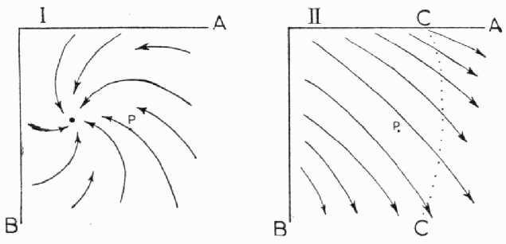
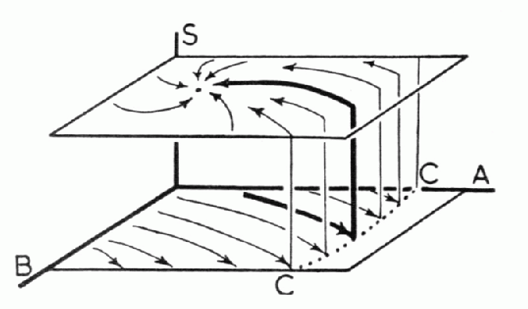
Ultrastability
In the unstable case, state trajectories will reach a critical condition (right). If parameters were different (left) the system could still be stable under the new environmental pressure.
Steps functions acting through secondary feedback could take the dynamics from one field to the other.

Slide 20
Ultrastability in organisms
Ashby claims that many organisms undergo two forms of disturbance:
  Frequent small impulses to main variables.
  Occasional step changes to its parameters.
If this is so, then this framework provides a good explanation for adaptation.
In real organisms the actual mechanisms remain to be specified.

Slide 21
Multistable systems
A system composed by ultrastable sub-systems
An ultrastable system may be regarded as one complex regulator that is stable against a bimodal set of disturbances. Alternatively, it may be thought of as a first-order regulator for type-1 disturbances that can re-organise itself to achieve stability in the face of type-2 disturbances. When regarded in this way we can say that the system has learned. (Notice that the ambiguity is given by different timescales which is rooted in the ambiguity between variables and parameters.)

Slide 22
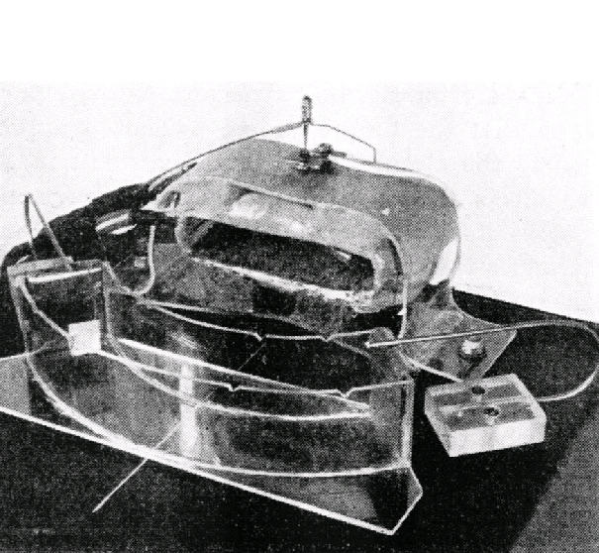
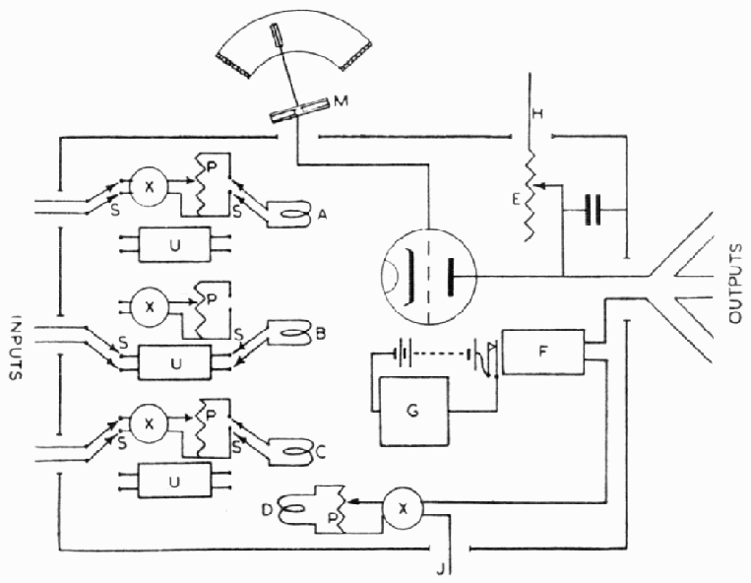
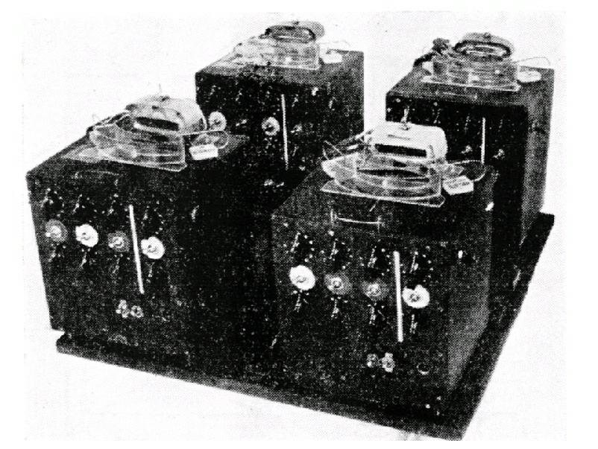
The Homeostat
Electromagnetic device consisting of 4 ultrastable units that could be coupled in different ways
Many experiments including habituation, reinforcement learning.

Slide 23
Adaptation to visual inversion
Adaptation to left/right visual inversion in a phototactic robot using the individual activity of neurons as the essential variables, (Di Paolo, 2000 following ideas by J. G. Taylor, 1964).
Neurons facilitate local plasticity when their activity is too high or too low.
Robots evolved to perform only normal phototaxis and to be internally stable (minimize internal change).
When sensors are inverted a robot becomes unstable and starts to change. Eventually phototaxis is regained.

Slide 24
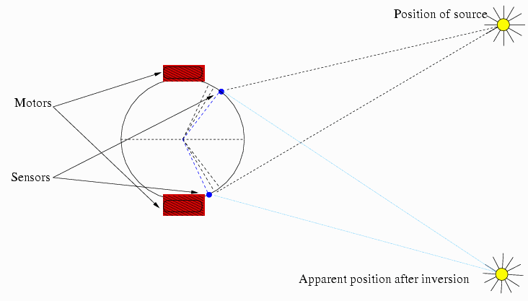
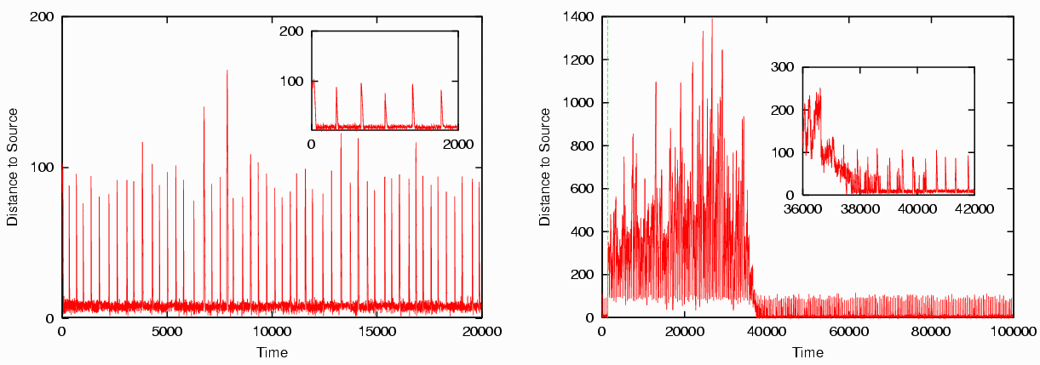
Adaptation to visual inversion

Slide 25
Significance of the framework
It remains the only well-thought out account of non-task-based adaptation in organisms and machines. It has been slightly recognized in the AI/robotics community, but its ideas have not been followed in practical terms to any major extent yet. (Not many ultrastable robots around).
Many of these ideas remain unexplored in areas where they should be quite relevant (animal behaviour, neuroscience). There's been a few applications in psychology (J. G. Taylor), but little follow-up work.

Slide 26
Limitations
There are some holes in the framework, mainly in the idea of an essential variable. What does “essential” mean? If it is essential, how can its value go out of bounds without causing death? And if it doesn't, in what sense is it essential? These problems originate in equating adaptation and viability. An extended framework would have to look at these issues, maybe going beyond the organismic point of view to an ecological perspective (see future lecture).
(Inadvertedly, Ashby does something like this in some examples, e.g., S 17/4.)

Slide 27
Seminar week 4
W.R. Ashby (1947) “The nervous system as a physical machine: with special reference to the origin of adaptive behaviour”, Mind, 56(221), pp. 44-59.
To be read in two manners:
  As a historical document
  In its contemporary relevance
  Write down 5 questions or comments and bring them to the seminar.

