Slide 1
Adaptive Systems
Ezequiel Di Paolo
Informatics
Evolution

Slide 2
Background to the Origin
Static view of species. Species as natural kinds. Independent creation.
Transformism: species do change (Lamarck, 1809) but lineages do not branch or go extinct. Inheritance of acquired characteristics.
Not very well received. Cuvier, leading French anatomist, was an orthodox believer in fixity of species
Malthus's Essay on Population (1798)
Charles Lyell's Principles of Geology (1830-33)
Voyage of Beagle (1837-38).

Slide 3
Darwin – Wallace, Origin (1859)
Evolution by common descent Species change, they are not independently created, but branch from common ancestors. Generally accepted in scientific circles (comparative anatomy, Gegenbauer, Haeckel).
They do so by a process of natural selection. In a non-uniform population of those variants that present characteristics resulting in a reproductive advantage will increase their representation in future generations, provided those characteristics are inheritable. Less well received.
Explains both evolution and complex adaptive design.

Slide 4
Inheritable how?
Darwin lacked a good theory of heredity.
Blending heredity: Offspring show characteristics somewhere “in between” its parents’. Problem: adaptive mutations would be blended away.
In the absence of selection variation is cut by half each generation if inheritance is blending.

Slide 5
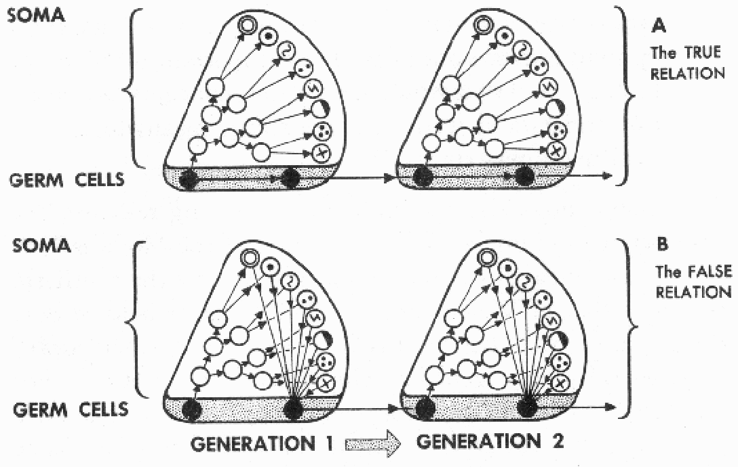
Inheritable how?
Are acquired characteristics inheritable? Darwin did not think so. Weissmann produced strong evidence that this is not so. (Weissmann's barrier, the intellectual product of cutting the tails of 1,592 mice).

Slide 6
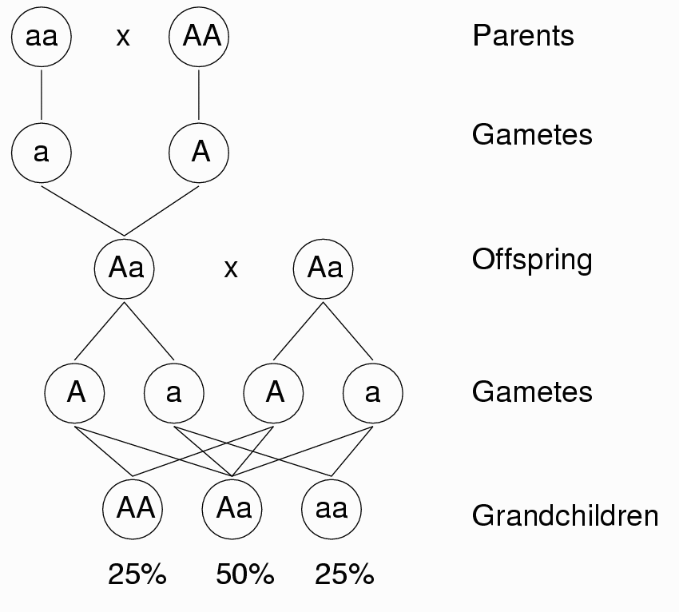
Particulate inheritance: Mendel
Experiments in Plant Hybridization (1865).
Differential traits that disappear in first generation can re-appear in the next.
In Mendelian inheritance characters are transmitted by discrete “factors”. Beneficial mutations are not blended away. With no selection variation is constant.

Slide 7
The modern synthesis
Gradualism: whilst gradual changes could be accounted by natural selection, it was difficult to imagine it explaining the origin of novel traits. Macromutations a possible solution, but problematic. Darwin also rejected these.
In the decades of the 1920-30s a series of theoretical works unified gradual natural selection and Mendelian genetics. The three main contributors to this synthesis were JBS Haldane, Sewall Wright and Ronald A. Fisher. This is the basis of the current view: Neo-Darwinism.

Slide 8
The adaptationist program
Evolution is a process of natural selection among randomly produced variations.
The unit of selection is the individual organism or its genes. Genotype determines fitness. Weissmann's barrier cannot be crossed.
Organism is clearly divisible into traits. These are adaptive because they are the solution to environmental problems.
Suboptimality in individual traits comes from tradeoffs.
Environments are fixed, or change independently
Non-selective effects play a minimum role.

Slide 9
Gould & Lewontin (1979)The Spandrels of San Marco and the Panglossian Paradigm. Complexity does not imply adaptation. If an adaptationist hypothesis fails, it is replaced by another; “Just So” stories.
Other factors play an important role in evolution: developmental and historical constraints, allometry, genetic drift.
Environments are not independent of organisms. They are co-defined, life changes the physical constitution of the environment.
Dividing integrated organisms into traits is controversial.

Slide 10
Maynard-Smith defends adaptationist thinking as the first alternative in the explanation of a biological trait. We find out what the optimum situation should be and the when it does not compare with Nature, we have reasons to suspect that other factors may have intervened.
The optimality assumption is not under test. But he recognises the poor science in rescuing failed adaptationist hypothesis with further ad hoc adaptationist hypotheses. (e.g Maynard-Smith, Optimisation theory in evolution, 1978)

Slide 11
Niche construction
Organisms choose and actively affect their environments, both during their lifetime and from one generation to the other. Selective “problems” are not independent of current “solutions”.
Birds and insects build nests, rabbits and rats dig burrows and tunnel systems, beavers create ponds and alter local water levels, leaves accumulate under high plants, etc. On longer timescales, oxygen in the atmosphere and the seas is constantly being renewed by life (algae, plankton, trees, etc.)

Slide 12
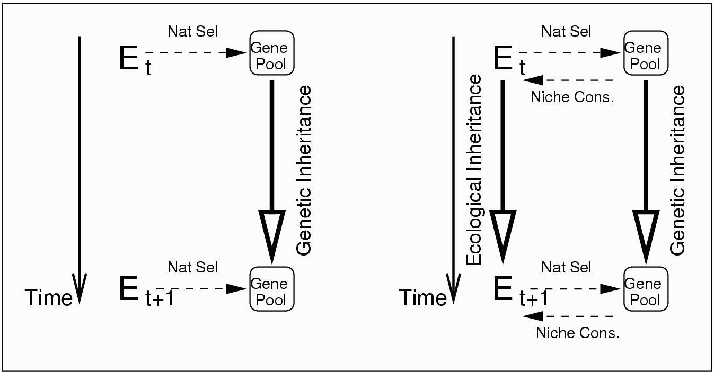
Niche construction contradicts the basic premises of the adaptationist program. E.g., Daisyworld: optimal temperature for daisy growth = env. temperature, but the latter and not the former has been modified.

Slide 13
Frequency-dependence
The fitness of a trait depends on the current pool of traits in the population.
Co-evolution: Two or more species influence each other's niches. (Predator/prey, host/parasite, +- symbiosis ++, resource competition --). Can lead to arms races: runaway evolution
Density dependence: Fitness depends on the number and distribution of individuals.
All social behaviour is, by definition, frequency dependent.

Slide 14
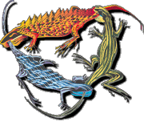
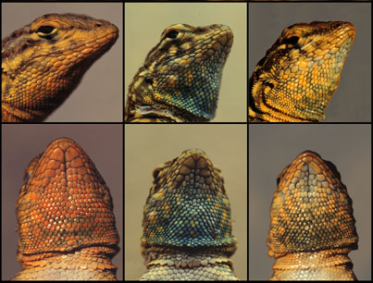
ESS
A game-theoretic approach (Maynard-Smith & Harper, 1973)
Evolutionarily Stable Strategy (ESS): one that cannot be invaded once it has been adopted by most of the population.
It may not exist. Cyclic solutions are possible. Strategy A may be the best if most of the population uses strategy B, but be beaten by C once it has invaded the whole population. Side-blotched lizards: Male phenotype has a period 3 cycle. (B. Sinervo)

Slide 15
Evolutionary “progress”
“There is no theoretical reason to expect evolutionary lineages to increase in complexity with time, and no empirical evidence that they do so”, (Szathmáry & Maynard-Smith, 1995)
S.J. Gould's argument: a random walk process bounded on one end would look as if it were directed towards the other, but it is not. So even the null-hypothesis of undirected change produces increased complexity over time. (Don’t take this as a model of complexity!)

Slide 16
Major transitions
However we can observe transitions in complexity that “redefine” the evolutionary process:
  Replicating molecules Molecules in compartments
  Independent replicators chromosomes
  RNA as gene and enzyme DNA and proteins
  Prokaryote Eukaryote
  Asexual clones Sexual populations
  Protists Animals, Plants, Fungi
  Solitary Individuals Colonies
  Primate Societies Human Societies, Language

Slide 17
Transitions to new entities
A common theme in many of these transitions is the passing from entities that reproduce independently to entities that reproduce by forming part of a larger whole. Difficult to explain from a gene-centred view but not impossible.
Kin selection: (Hamilton, 1964); individuals within a group tend to be more genetically related than individuals between groups. One must be careful, though to also count the added cost of local (within group) competition.

Slide 18
Transitions to new entities
Group selection: (e.g, D.S. Wilson) Competition between groups may overcome intragroup competition if pressures are sufficiently high, or because of other ecological factors. Bias sex-ratios can be good evidence of GS. Provoked bitter controversies in the 60s but it's become more acceptable in a modern form thanks to convincing modelling and evidence.
KS and GS can sometimes be shown to be formally equivalent (Wade)

Slide 19
Other “transitional” themes
Synergistic effects, non-linear dynamics and frequency dependent evolution may also lead to transitions.
Mechanisms of “heredity” also change during transitions. “Transmission” can occur via different routes: genetic, epigenetic effects, social learning, culture.
In general it is difficult for Neo-Darwinism to explain evolutionary novelty (transitions included) solely by natural selection.

Slide 20
Multilevel evolution
Selection acts at different levels in a hierarchy (gene, organism, group, colony, etc.) Particular traits can be explained as the tradeoff of selective pressures at different levels.
Michod (Darwinian Dynamics: Evolutionary Transitions in Fitness and Individuality, 1998) explores the mathematics of the formation of composite reproductive entities, and the different meanings of fitness.

Slide 21
Non-selective factors
Synergistic effects in niche-construction.
Density-dependent effects: Allee effect, random fixation due to genetic drift.
Developmental constraints: Goodwin, morphogenetic fields; Waddington; assimilation. Allometry. Pleiotropy.
Historical constraints: founder effect, exaptations, social inertia, maternal effects (e.g., imprinting).

Slide 22
Non-selective factors
Self-organisation: Kauffman: structural stability of genetic regulatory networks; order for free. Bak, Sneppen; self-organised criticality; ecologies poised at a critical state; power laws for extinction events, independent of selection.
Neutral evolution: (Kimura, Ohta). Controversial beyond molecular evolution. Neutral networks, speciation as percolation in “holey” landscapes (Gavrilets). Natural drift (Maturana, Varela), species are all equally adapted. Selection and niche creation drift unpredictably.

Slide 23
Plasticity, developmental effects
J. Baldwin (1896): plastic phenotypic change can smooth fitness landscapes by making different genotypes equally good in terms of fitness. It can speed up evolution and, if costly, may lead to genetic assimilation. Non-Lamarckian.
C.H. Waddington: Robustness of wildtype implies canalised, switch-like development. Switching can be the effect of the environment but then the switch could also be genetic. This can lead to assimilation of response to environment. Callosities in ostrich embryos.

Slide 24
Plasticity, developmental effects
Brian Goodwin: Organisms develop within morphogenetic fields with discrete attractors. There is a logic of form that cannot be changed so easily. Role of genes: to act as parameters in defining the field but not to specify a developmental trajectory. D'Arcy Thompson’s heritage.
Susan Oyama: Similar view as niche construction, but from a developmental point of view. Developmental systems theory.

Slide 25
Modelling tools
Population genetics: mathematical analysis of variation in gene pools. 1st order models: infinite population, random-mating, fixed environments, static gene-to-fitness mapping.
Ecological modelling: Species interaction, (can include selective dynamics and space in the form of patches): Lotka-Volterra equations, predator-prey systems. Network models.

Slide 26
Modelling tools
Game Theory: looks for ESSs in frequency-dependent conditions. Interactions between individuals modelled as games, fitness = payoff.
Individual-based models: Pitched at the level of individuals but observed at population level and evolutionary timescales. If carefully constructed they can extend the above tools, by exploring evolution in finite and variable populations, subject to stochasticity and spatial variation; by studying the effects of discreteness, and integrating environmental factors as variables.

Slide 27
Evolutionary adaptation
Adaptation as fit: harmony between parts, congruence between structures, behaviours and environment.
Adaptation as solution to a problem: adaptations have functions, all functions are adaptations arising via natural selection.

Slide 28
Evolutionary Adaptation
Adaptation as amelioration: when it makes sense to say A is better adapted than B. Usually works only within a same species, and not always (selection may operate without adaptation changing in any meaningful way, Lewontin, 1978).
Adaptation as conservation: maintenance of viable organism/ niche relation. Makes sense in macroevolutionary contexts. Adaptation of different species cannot be compared meaningfully. Non-adapted means extinct.

Slide 29

Final comment
Organisms are adapted, evolution is the adaptive process in this case. (Organisms also are adaptive, but incidentally so from this perspective, cf., artificial evolution).
Seminar reading:
  Lewontin, R. L. (1978), Adaptation. Scientific American

