Slide 1
Adaptive Systems
Ezequiel Di Paolo
Informatics
Sensorimotor substitution, perceptual plasticity

Slide 2
Aims
This lecture looks at how perceptual systems develop by an adaptive process that creates sensorimotor invariants.
Taking a look at the field of artificial sensorimotor interfacing.
Brief overview of state-of-art in sensory substitution.
Lessons on perceptual adaptation from experiments by Bach-y-Rita.
Held and Hein's experiments in sensorimotor development
Recent experiments revealing plasticity of the body image.

Slide 3
Substituting vision: projects
Using tactile stimuli: Bach-y-Rita pioneering work (from late 60s on). Some current devices commercially available. A camera sends data to an array of skin stimulators. Also Compiègne group, (Charles Lenay).
Using auditory stimuli: Use different frequency/ volume patterns to provide information about an image picked by a camera or distance sensors.
Echolocation: Ultrasonic devices. Anne De Volder (Louvain), Tom Bower (Edinburgh) 70s.
Direct stimulation: (Dobelle Institute) Plug camera output directly on visual cortex. Also work on retinal stimulation.

Slide 4
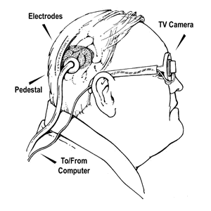
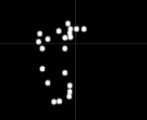
Direct stimulation
Dobelle Institute, Zürich, NY, Jan. 2000
Artificial vision system for the blind. Direct stimulation of the visual cortex. (working on this since the 70s)

Slide 5
Direct stimulation
Miniature camera + ultrasonic distance sensor. A wearable computer simplifies camera image (edge detection, noise reduction, etc.) Stimulation is applied on visual cortex via an implant of 68 platinum electrodes.
A 62-year-old male patient (blind since 36, electrode implanted in 1978) after adapting to the system is now able to “read” 2-inch tall letters at a distance of 5 feet. Subject able to move around NY City subway system. Replacing camera with special interface allows subject to watch TV, and use Internet.

Slide 6
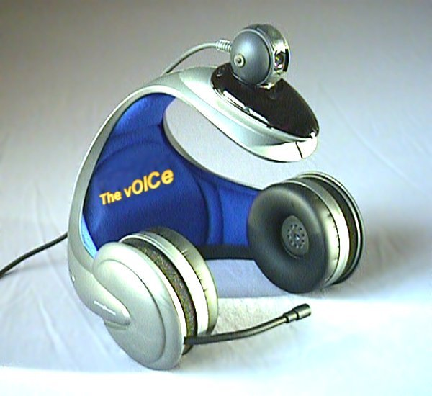
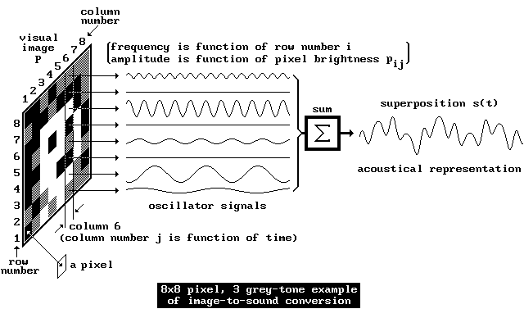
The vOICe system
P. Meijer (Eindhoven, 90s) Transforms camera image into 64x64 pixel image then converted into sound.

Slide 7


vOICe system

Slide 8
Echolocation
T. Bower (1974)
Using ultrasound. Pitch coding for distance, volume for size and distorted sound for texture. Plus stereo effect for spatial orientation.
4-month baby started to locate objects on first use. Two-handed reaches at 6 months, searches for a hidden object at 8.

Slide 9
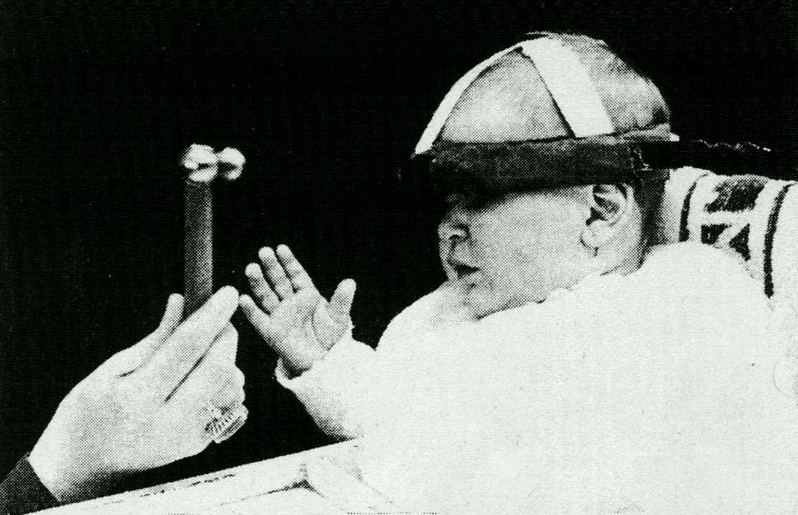
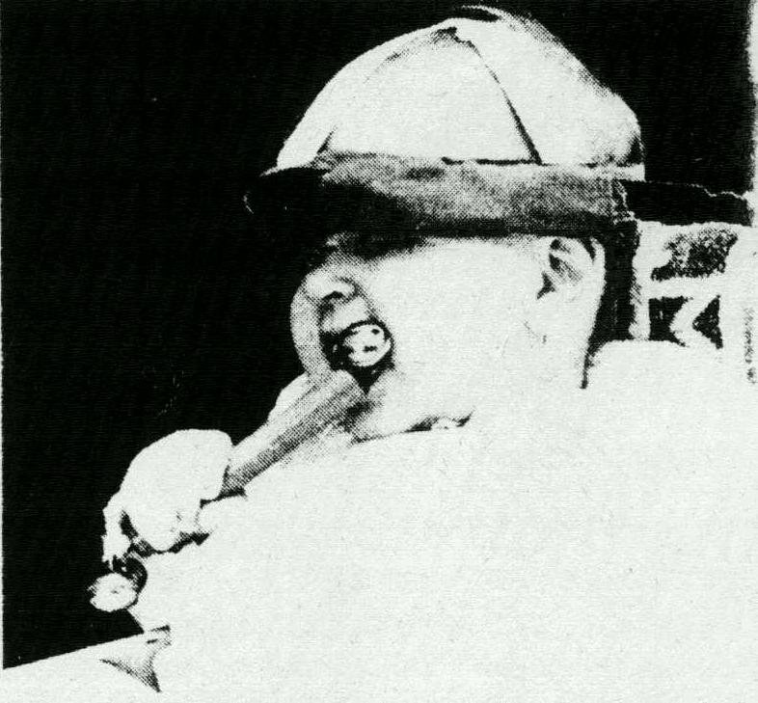
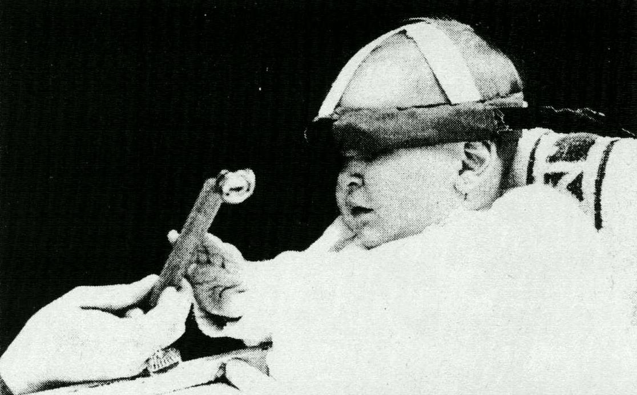
Echolocation

Slide 10
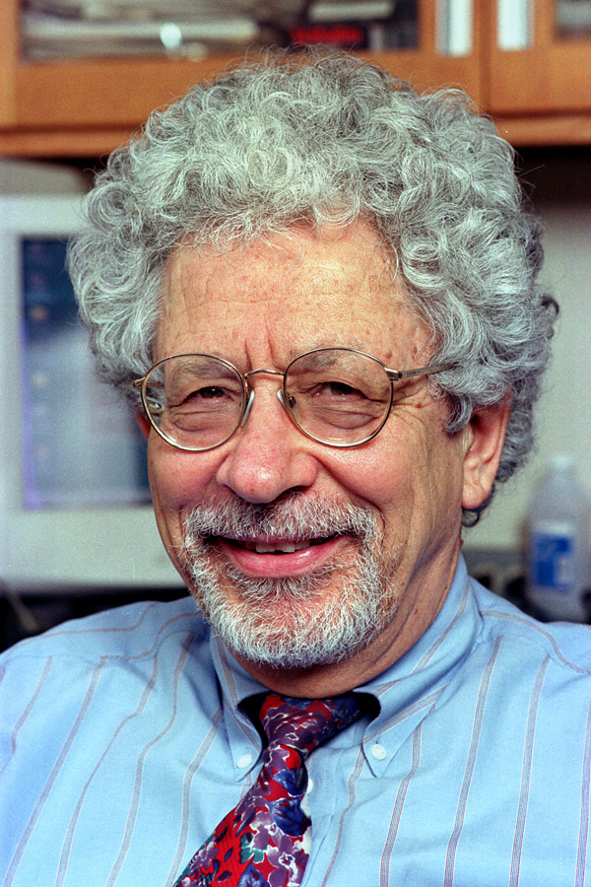
Bach-y-Rita
Paul Bach-y-Rita (Neuroscientist, University of Wisconsin). Has worked on neural rehabilitation, volume brain plasticity and haptic sensory substitution.
First project published in Nature, 1969, improved through the 70s. Tactile-vision sensory substitution (TVSS) system. Tried successfully on 100s of blind people (including congenitally blind).

Slide 11
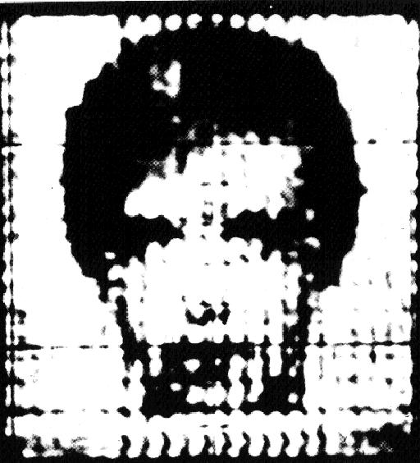
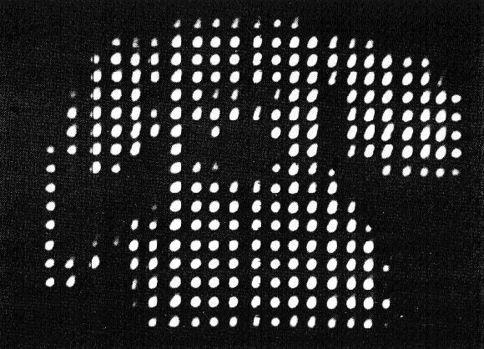
TVSS
An array (20x20) of vibrating elements (10-inch-square) is located on the subject thorax, abdomen or back. The pattern of vibration follows the input from a camera according to brightness (no colour discrimination). Camera can be mounted on spectacle frames or moved by hand.

Slide 12
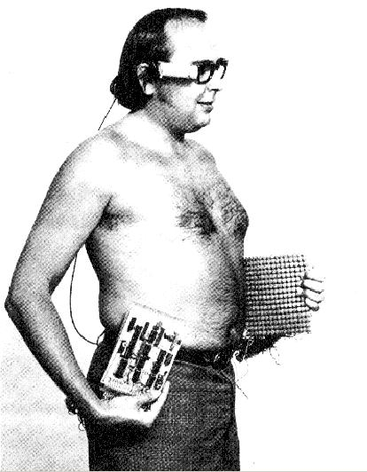
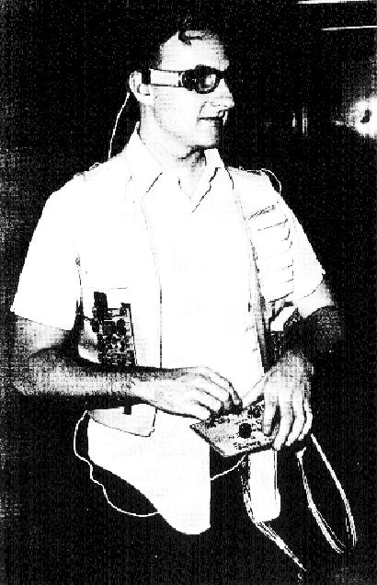
TVSS
Two blind subjects wearing the TVSS system (Bach-y-Rita 1972, Brain mechanisms of sensory substitution, Academic Press).

Slide 13
A personal account
G. Guarniero (1974), Experience in tactile vision, Perception, 3, 101-104. Congenitally blind subject relates his experience using the device.
No perception without voluntary camera movement
Skin sensation only felt on first use.
Soon “images” appeared located in a 2-D space outside the body.
Self-produced sensation due to camera movement quickly discriminated from moving objects.

Slide 14
A personal account
After 1-2 days object discrimination was possible.
Addition of zoom lens introduced complication, but soon was adapted to.
Distance discrimination from cues.
Adaptation to shifting 2-D image of 3-D objects.
Experiments with mirrors, candles, “hand-camera” coordination.

Slide 15
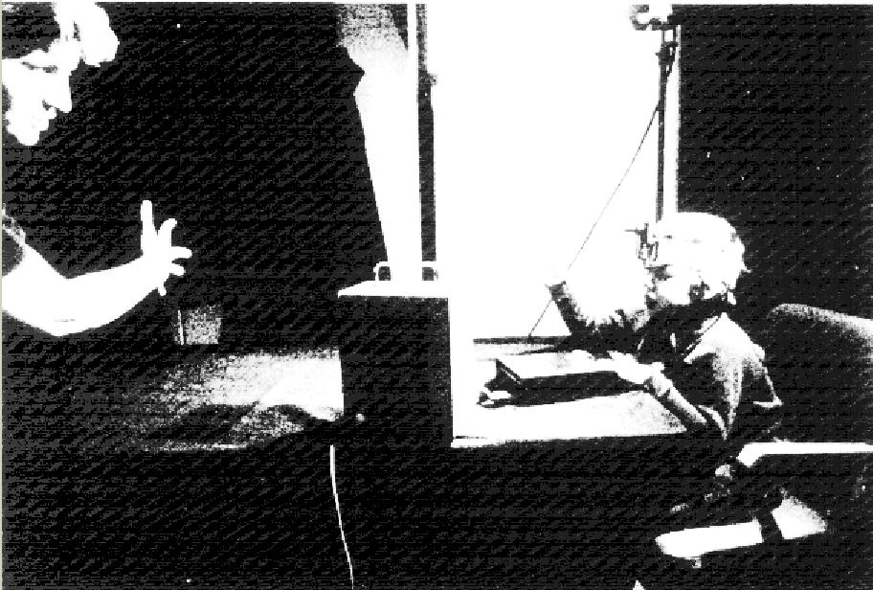
Array can be moved from one position to another (back to abdomen) and cameras may be hand-held or mounted on frames. Either change is adapted to very quickly. The array can even be divided in halves without perceptual impairment.
Congenitally blind child using TVSS system

Slide 16
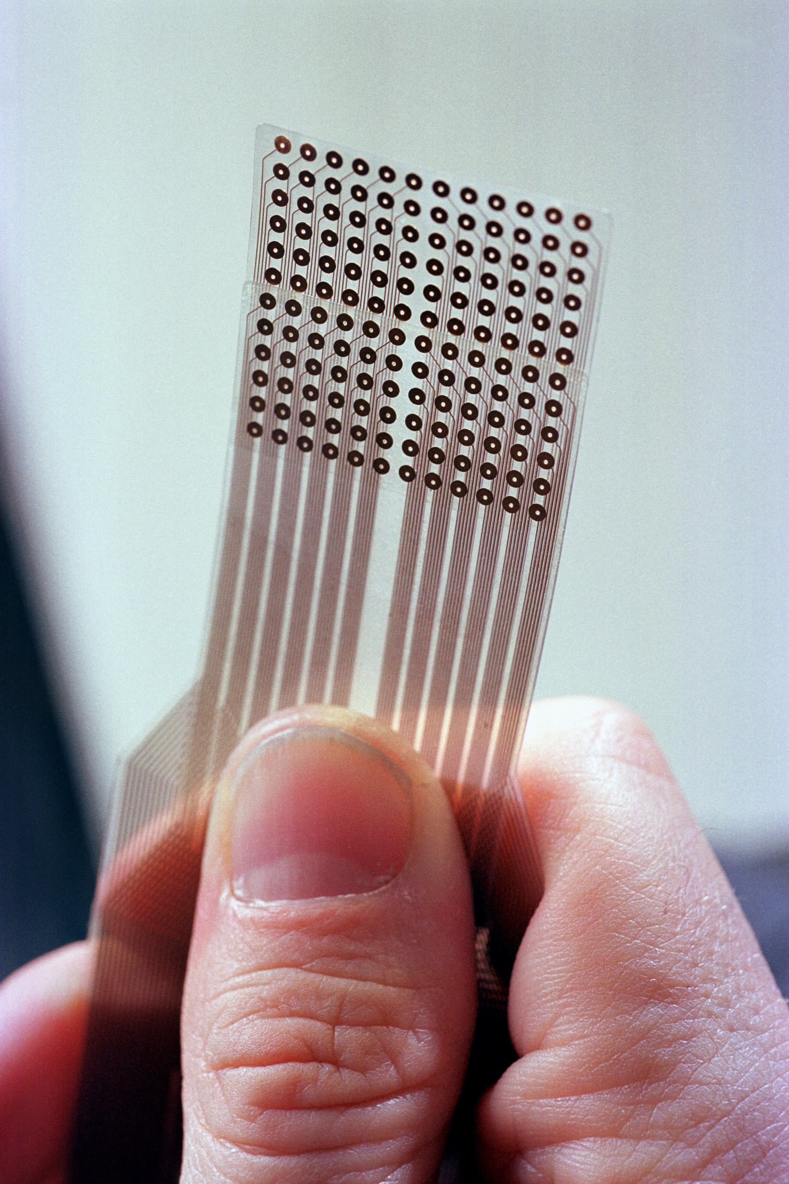
Current versions
The tongue is ideal in its density and quality of sensors.
Development hoping to reach miniaturization state (tooth size implant)
Also useful for divers for getting radar information.

Slide 17
Some implications
“Seeing” is not about having functional eyes. To perceive is to create sensorimotor invariants. No perception by just sitting still, or if someone else moves the camera. Same thing with normally sighted people. You cannot perceive visually if you do not move (head, eye movements, focus, etc.)

Slide 18
Some implications
Perceived objects not felt on the skin. (Same as with normally sighted people!) A trained subject whose camera zoom setting was changed without warning moved backwards to avoid an incoming object.
Adaptation is parallel to visual inversion experiments, revealing power of brain plastic re-organisation.

Slide 19
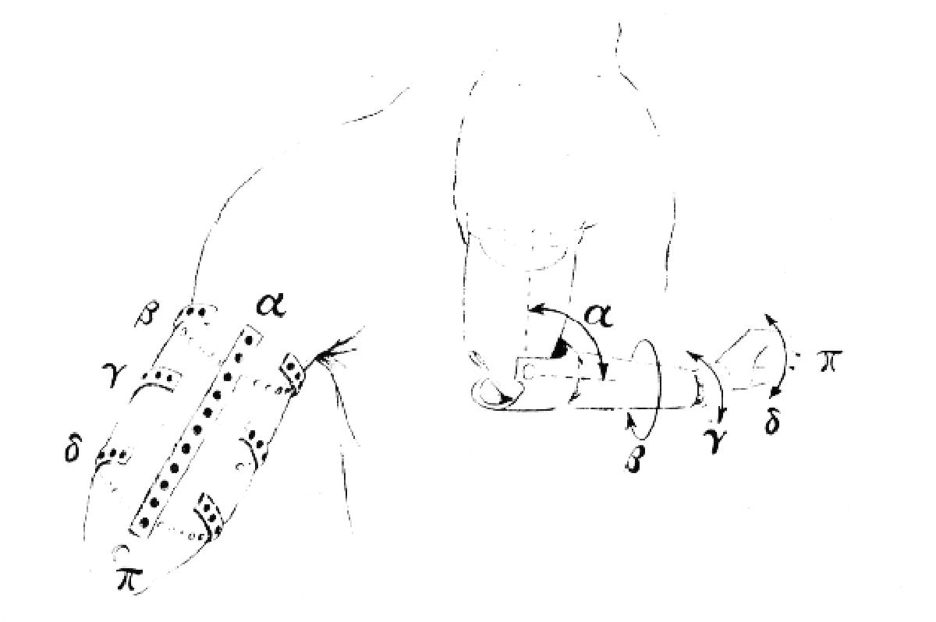
Possible extension: Sensory feedback from prosthesis.

Slide 20
Rubber hands that feel
Experiments by Botvinick and Cohen (1998), (extended by Ramachandran and colleagues).
Subject sits with left arm resting on table. A screen prevents direct visual contact with the arm. A rubber hand is placed in front of the subject.
Experimenter uses paintbrushes to simultaneously stimulate both the rubber hand and the subject's hand.

Slide 21
After a few minutes subjects feel that the rubber hand “belongs” to their body.
The “location” of the touched sensation appears to be on the rubber hand.
In extended versions the same experiment was performed with a shoe instead of a rubber hand. Same effect.
When experimenter brought a hammer and struck the shoe down, the subject reacted defensively. Measures of skin resistance showed startling reaction.

Slide 22
Extended noses
On a similar vein, Ramachandran and colleagues experimented with illusions of distorted body image.
A blindfolded subject seats on a chair. An accomplice seats in front of subject facing in the same direction.
The experimenter takes the subject's hand and uses its finger to repeatedly and randomly stroke the accomplice's nose. Synchronously the experimenter strokes the subject's own nose.
Subject experiments after a few seconds the illusion of having a dislocated or stretched nose.

Slide 23
Sensorimotor development
Experiment by Held and Hein (1963). Development of visually guided behaviour in kittens. Two kittens (previously reared in darkness) subject to roughly the same visual experience. One of them can move relatively freely but the other follows symmetric (non-voluntary) movements.
The experiments decouples proprioceptive and visual inputs, and it shows the importance of the first to distinguish self-generated movement

Slide 24
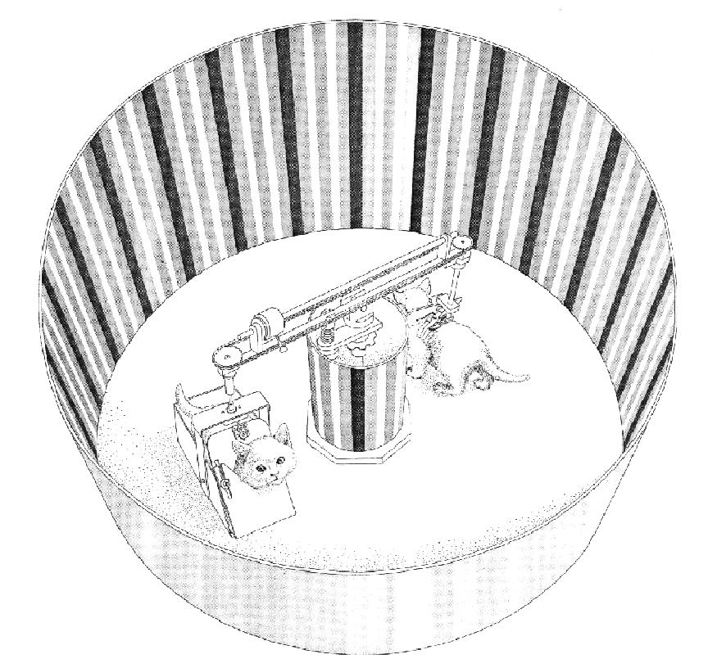
Active kitten developed normal sensorimotor coordination. Passive kitten failed to show blinking response to approaching hands, did not retreat from visual cliff, failed to anticipate contact with surface by placing its paws accordingly. (Normal behaviour recovered after freed for several days.)

Slide 25
Conclusions
Perception is about creating sensorimotor invariants.
Experiments that distort those invariants show the adaptive process behind their creation. Plasticity triggers changes in behaviour which modifies plastic mechanisms, and so on, until an invariant state is achieved.
Research on sensory substitution supports this conclusion.

Slide 26
Adaptation occurs only through the subject's own activity. So does development of perceptual capabilities.
The idea that perception has an associated spatial location is not obvious. Sensory apparatus and perceptual objects need not be physically correlated in terms of location. The lack of perception of the skin stimulation by the TVSS subjects and the experiments with rubber hands confirm this.

Slide 27
Implications for theories of embodiment and consciousness.
Not mentioned: after-effects, phantom limbs, colour invariants, etc.
Hypothesis: perceptual development and adaptation are a consequence of the same organismic processes.
If true, then perhaps an artificial system should develop in order to adapt with the same versatility as an living organism.

Slide 28
Seminar
Ivo Kohler, “Experiments with goggles”, Scientific American, May, 1962.
Richard Held, “Plasticity in sensory-motor systems”, Scientific American, November, 1965

