Slide 2
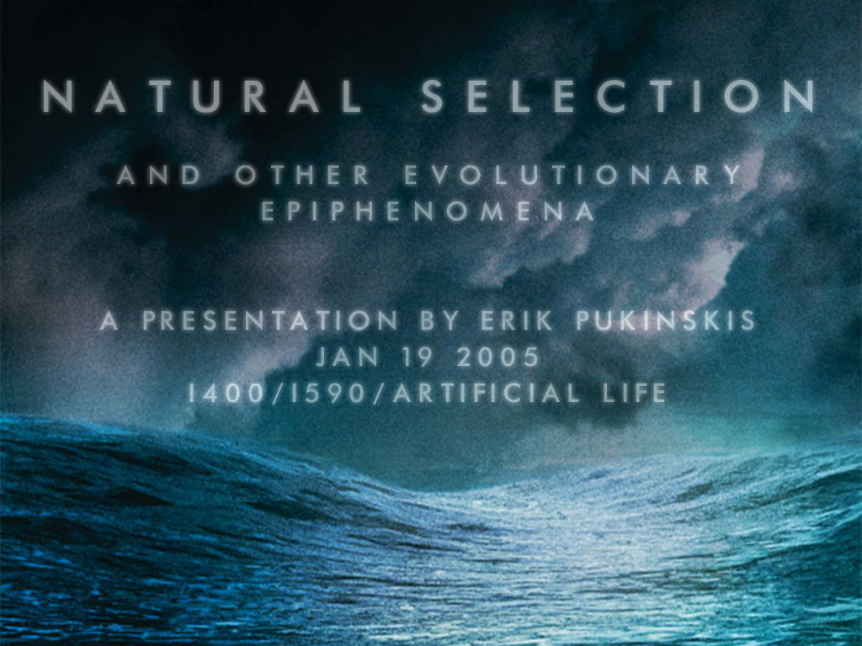

Slide 3

Farmer & Belin:
Life is a pattern which...
reproduces itself
stores a representation
of itself
metabolizes
responds to its
environment
is indivisible
is robust
can evolve

Slide 4
Farmer & Belin:
Life is a pattern which...
reproduces itself
stores a representation
of itself
metabolizes
responds to its
environment
is indivisible
is robust
can evolve
Langton
evolution requires organisms which are similar to their parents...
but not exactly like them
have behavior which is tied to their reproductive success

Slide 5
Farmer & Belin:
Life is a pattern which...
reproduces itself
stores a representation
of itself
metabolizes
responds to its
environment
is indivisible
is robust
can evolve
Langton
evolution requires organisms which are similar to their parents...
but not exactly like them
have behavior which is tied to their reproductive success

Slide 6
1) Evolution did not appear in a world of organisms, organisms evolved from non-organisms

Slide 7
2) Life does not simply increase its numbers, but also its complexity

Slide 8
3) The earth itself cannot participate in natural selection

Slide 9
Thermodynamic Reasons for Perception-Action Cycles
R. Swenson, M. T. Turvey

Slide 10
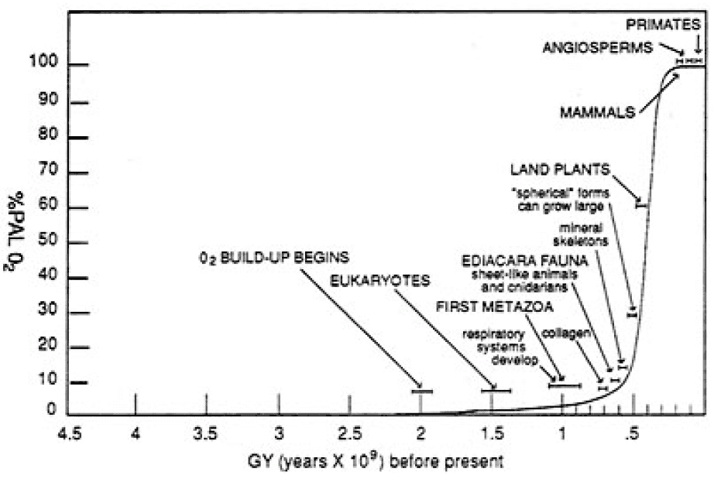
Figure 1: Increase in atmospheric O₂, in percent of current atmospheric level. From "Engineering Initial Conditions in a Self-Producing Environment" by R. Swenson

Slide 11
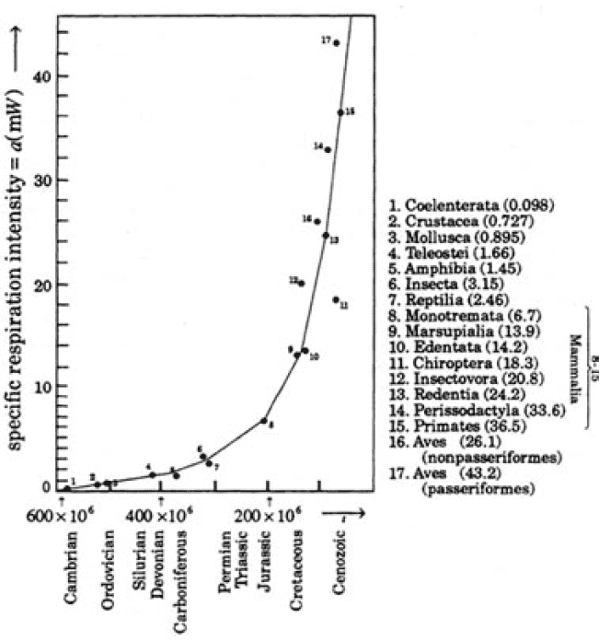
Increase in respiration intensity per unit mass of living things over time. From "Bioenergetic Trends of Evolutionary Progress of Organisms" by A. Zotin

Slide 12
forward

Slide 14
Life is a progressive increase in order of complexity of the earth toward the end of maximal entropy production.

Slide 15
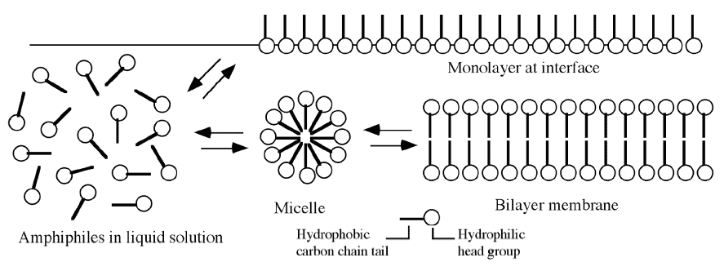

Slide 16
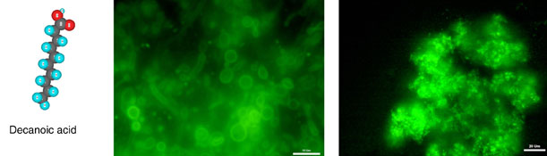

Slide 17
Farmer & Belin:
Life is a pattern which...
reproduces itself
stores a representation
of itself
metabolizes
responds to its
environment
is indivisible
is robust
can evolve
Langton
evolution requires organisms which are similar to their parents...
but not exactly like them
have behavior which is tied to their reproductive success
David Deamer:
a polymer that can participate in a template-directed polymerizaiton process
a catalytic activity tied to replication
containment
ability to grow
ability to reproduce (bifurcate)

Slide 18
Farmer & Belin:
Life is a pattern which...
reproduces itself
stores a representation
of itself
metabolizes
responds to its
environment
is indivisible
is robust
can evolve
Langton
evolution requires organisms which are similar to their parents...
but not exactly like them
have behavior which is tied to their reproductive success
David Deamer:
a polymer that can participate in a template-directed polymerizaiton process
a catalytic activity tied to replication
containment
ability to grow
ability to reproduce (bifurcate)

Slide 19
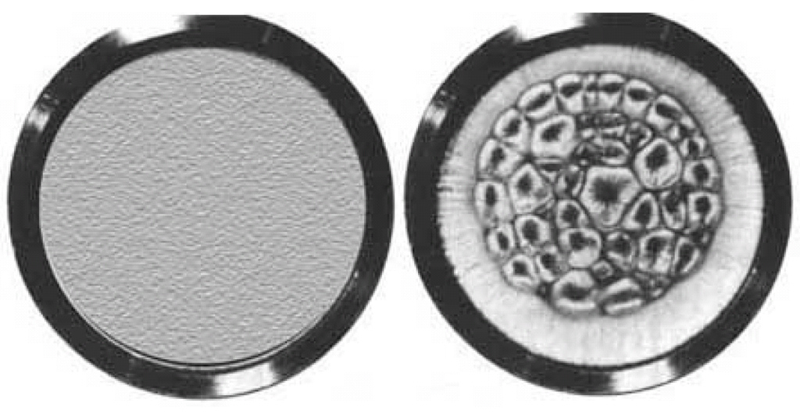
From "Emergent Attractors and the Law of Maximum Entropy Production: Foundations to a Theory of General Evolution" by R. Swenson,

Slide 20
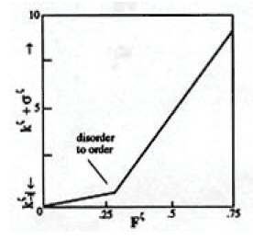
Heat transfer as a function of field force. From "Engineering Initial Conditions in Self-Producing Environment" by R. Swenson

Slide 21
Spontaneous fissioning is observed in...
the Benard experiment
in the multiplication of living cells
in the increase in population through the proliferation of villages during the Paleolithic period from approximately 1,500 villages at the beginning to about 75,000 villages at the end (Carneiro, Swenson).

Slide 22
Question
How did nature bootstrap natural selection?

Slide 23
Question
Is it really necessary to account for the earth’'’s evolution as a whole?
back

Slide 24
Question
If maximal entropy production is the driving force behind life on earth, and not natural selection, what are the implications on Artificial Life?

Slide 25
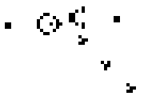

Slide 26
Thanks
You're the best.

