Slide 1
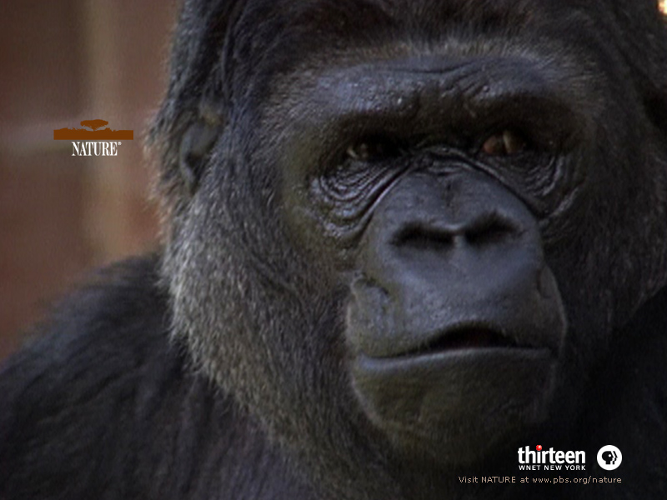
Koko the Gorilla
Matt Kane
Artificial Life
April 4, 2005

Slide 2

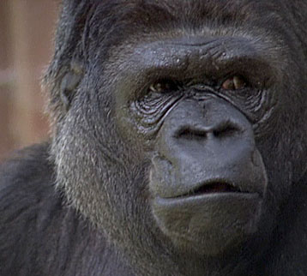
The “Fine Animal Gorilla”
Born Hanabi-Ko (“the fireworks child”) at the San Francisco zoo in 1972
Very poor health and malnourished
Size at four months equivalent to a newborn gorilla

Slide 3
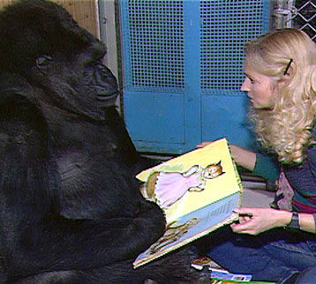
Penny to the Rescue
Penny Patterson grew up in the wilds of Minnesota, where as a child she interacted with almost every animal she could find
Doctoral candidate in Psychology at Stanford before meeting Koko
Stubborn zoo master made the project difficult to begin

Slide 4
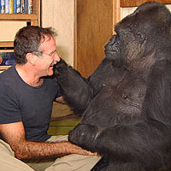
Patience, Patience, Patience
Initially, hours were spent every day molding Koko’s hands to model American Sign Language
Even her faculty advisor was highly skeptical
Very difficult to get Koko to even pay attention at all, regardless of hand movements
Window Games

Slide 5
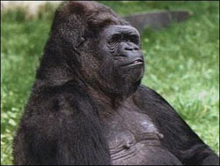
Finger Bracelet
After only about two weeks, Koko began to sign
Commonly will combine old words to create new expressions for novel experiences
Ice cream and yogurt

Slide 6
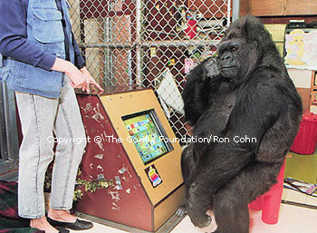
More than Communication
Koko can often be seen signing quietly to herself
Tends to eavesdrop on other conversations
Koko’s understanding of death: “Trouble old…comfortable hole bye…sleep.”
Frown, frown, frown…

Slide 7
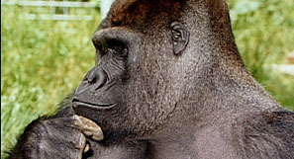
No Time to Think
Usually takes about eight hours to transcribe one hour of exchanges with Koko
This does not include any analysis or reflection
Tons of tapes and notes remain to be examined

Slide 8
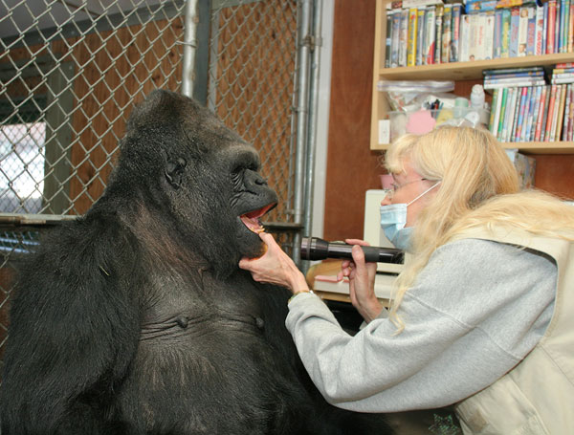
Just Another Family Member
Tells lies when it suits her
Has her favorite insults
Understands emotional significance of color
Developed a crush on a human guy

Slide 9
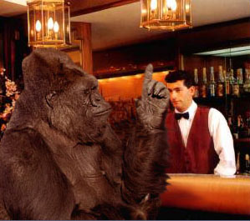
Another Beer, Please?
Typically initiates most of the conversations with her human companions

Slide 10
Faith and Meaning of Life
When asked about the meaning of life, responds “People be polite. People have goodness.”
When asked who God is, responds “Me.”
When asked who created the world, responds “Another woman.”
Penny describes interspecies communication as her experience of Communion.
Penny: “If there’s anything sacred in us, it’s in them too”

Slide 11
Yaeger at Work
While working for Apple Computer, Professor Yaeger designed an coded a software package, called Lingo, that allowed Koko to “have a voice.”
An array of on-screen buttons, each with an image hand-selected by Ron Cohn and Penny Patterson of the Gorilla Foundation, would play a sound sample of the corresponding word whenever Koko would press them.
Lingo kept track of all Koko's interactions with the system, and saved each utterance, date- and time-stamped, in an archive file, for subsequent inspection, review, and linguistic analysis.

Slide 12
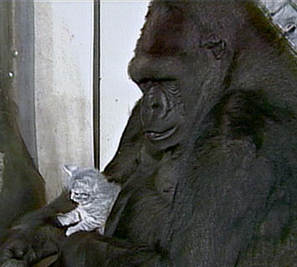
Intelligent Gorilla?
Today Koko can use over 1000 signs and can understand about 2000 total
Easily can decode pig latin
IQ has been tested at between 70 and 95
Statements combine up to eight words

Slide 13
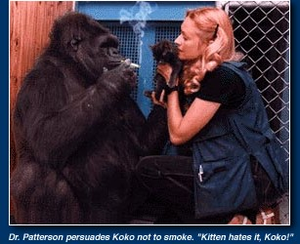
Smoking Gorilla???

Slide 14
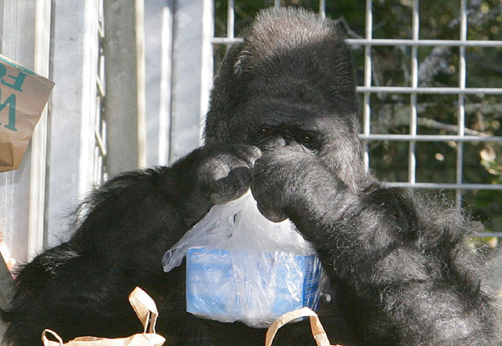
The End
Thank God he’s done…
Time to eat!

Slide 15
References
http://www.ontology.com/canton/weird/koko/koko-smokes.jpg
http://www.pbs.org/wnet/nature/koko/
http://home.comcast.net/~metrbb/fark/koko-signs-one-more.jpg
http://www.citizenlunchbox.com/monkey/famous/pix/koko.jpg
http://www.popgadget.net/images/koko.jpg
http://www.koko.org/friends/images/press/Robin_Koko_smile_200.jpg
http://www.beanblossom.in.us/larryy/KokoLingo.html
http://koko.org

