Slide 1
Evolutionary Robotics
Teresa Pegors

Slide 2
Importance of Embodiment
Embodied system includes:
  Body – morphology of system and movement capabilities
  Control Architecture – nervous system, normally adaptive and plastic.
  Environment – all things external to the system but can include system as well.
All 3 dynamically coupled to each other
Can we synthesize such a system in an evolutionary context?

Slide 3
Simulation vs. Real World
Problems with Simulation:
  Not all physical properties are simulated
  sensors return perfect values
  Same sensors are considered exactly same
Problems with Real World:
  Limited resources
  Time constraint
Makes doubly difficult to evolve both controllers and morphology

Slide 4
General Solutions
(Miglino, Lund, and Nolfi 1996) - evolving neurocontrollers
Look-up Table
  Sensor readings are taken from large combination of orientations and distances
  Allows for intrinsic differences in sensors
  Accounts for idiosyncrasies of environment
After transfer to real world, run a few more generations
  Allows system to regain lost fitness

Slide 5
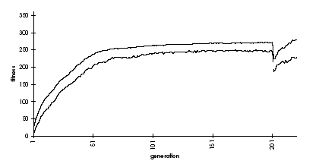
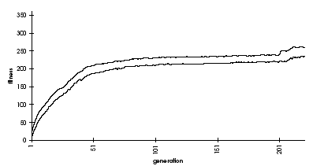
General Solutions (cont’d)
“Conservative Position Noise”
  Perception is as if farther or closer than really are, determined by randomly selected axis
  Reproduces effects caused by illuminations/shadows/etc.
NO NOISE
CONSERVATIVE POSITION NOISE

Slide 6
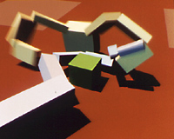
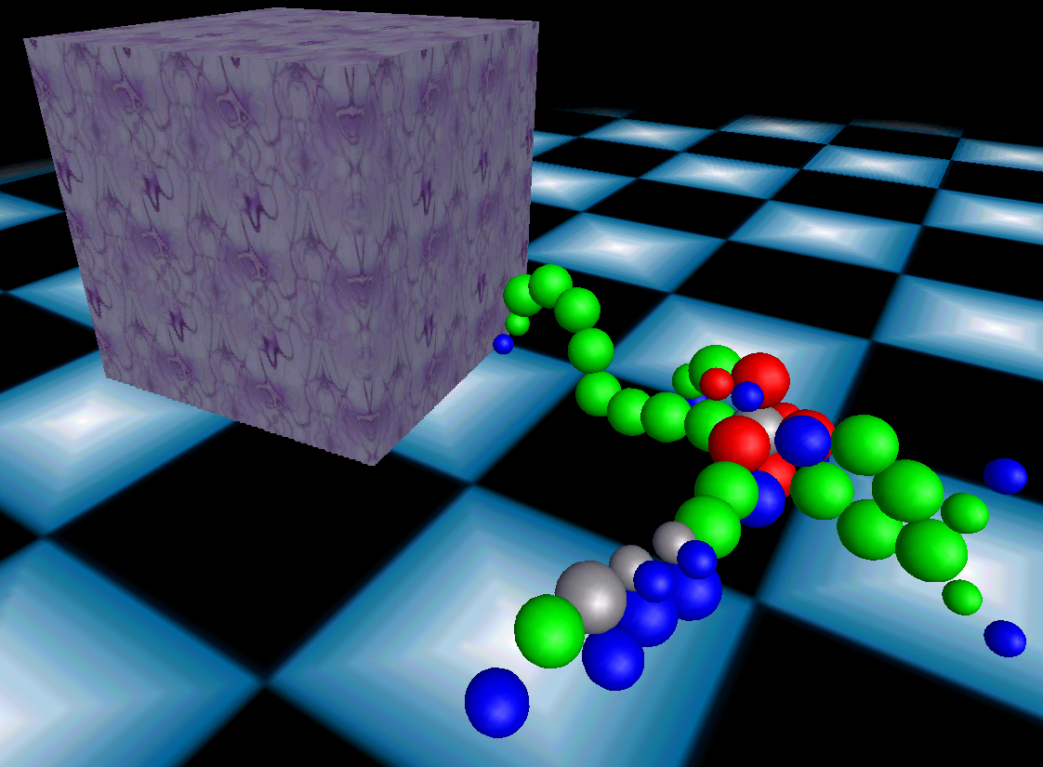
Evolving Morphology (Simulation)
Karl Sims
  Recursive, graph based GA
  Not physically realistic
Josh Bongard
  Physically realistic environment
  “Artificial Ontogeny (AO)”
    Differential gene expression
    Diffused gene products
    Modular (spheres)

Slide 7
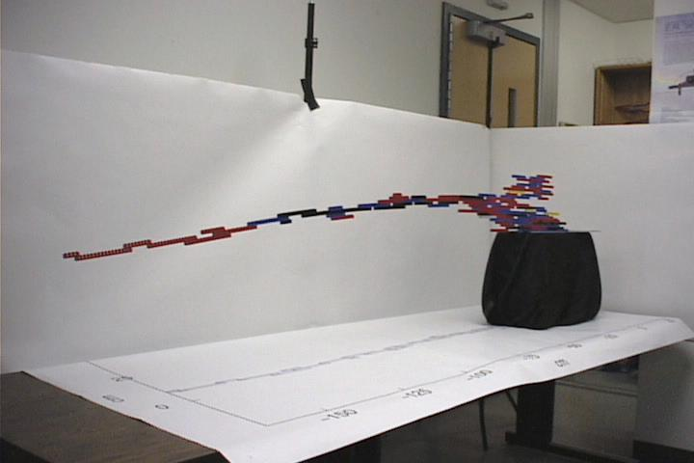
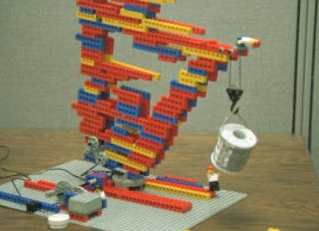
(Simulation -> Real World)
(Jordan Pollack)
[1] Universal [3]Efficient
[2] Conservative [4]Buildable
Morphology w/o Controller

Slide 8
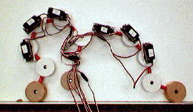
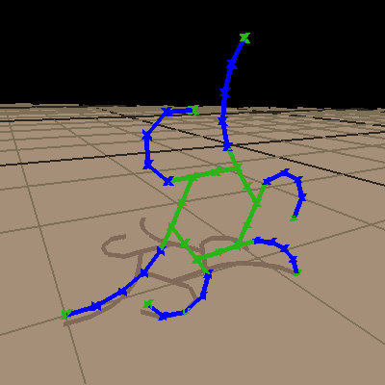
(Simulation -> Real World)
2) 2D modular system from L-System
  Reduction of dimensionality
  Re-usable modules lowers complexity

Slide 9
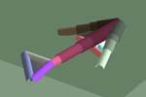
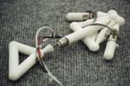
(Simulation -> Real World)
3) Automatic “design and manufacture” of 3D systems
  Large difference between physical and virtual environment
  Closer to evolving w/o human intervention

Slide 10
Relevant Literature
Nolfi S. and Floreano D. (2000). Evolutionary Robotics. Cambridge: MIT Press.
H. Lipson and J. B. Pollack (2000), "Automatic design and Manufacture of Robotic Lifeforms", Nature 406, pp. 974-978.
Funes, P. and Pollack, J. (1999). “Computer Evolution of Buildable Objects”. In Evolutionary Design by Computers. P. Bentley (editor). Morgan Kaufmann, San Francisco. pp. 387-403.
Bongard, J. C. and R. Pfeifer (2003) Evolving Complete Agents Using Artificial Ontogeny, in Hara, F. and R. Pfeifer, (eds.), Morpho-functional Machines: The New Species (Designing Embodied Intelligence) Springer-Verlag, pp. 237-258.
Sims K. "Evolving Virtual Creatures" Computer Graphics (Siggraph '94 Proceedings), July 1994, pp.15-22.

