Slide 1

PDP vs. Symbolic Approaches to AI: The battle rages on . . .
Justin Post

Slide 2

Weak vs. Strong
Searle's distinction.
Hofstadter doesn't like the distinction
Weak is trying to emulate intelligence
Strong is trying to make intelligence

Slide 3

Neats vs. Scruffies
Think “Odd Couple”
One AI researcher is anal and uptight
The other is slovenly and laid back
Neats: “We must learn about thinking
by finding out the logic behind
thought processes.”
Scruffies: “Naw, dude let's just throw
some stuff at the problem and see
what happens.”

Slide 4

Which is better?
Neither is better, everyone has
their favorite.
We'll probably need both
approaches to nail this problem.
There are top-down and bottom-up
control mechanisms in the brain.
Both ways get interesting solutions to different kinds of problems

Slide 5

Problem space
Machine vision
Robotics
Expert systems
Knowledge representation
Machine learning
Natural language processing
Artificial life
Game problems
Mathematical/Logical problems
Pattern matching

Slide 6
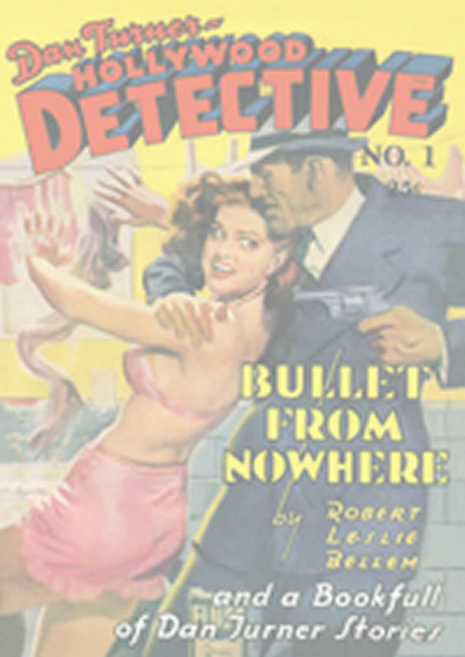
The truth
We are one solution to how
intelligence is made, because we
are the “intelligent” ones that are
asking the question.
Evolution made humans. The
medium was biology.
We should look to nature for good
ideas about making intelligence
because nature is where the only
intelligence we know about came
from.
Here's how nature did it: evolution.
Brains evolved and we can see the
tracks of evolution today.

Slide 7

Being Human
Our neural networks are best at being human. They were evolved for that purpose. We've got the lower levels that other organisms have, but with rational tools as well.
Need to be careful so we can tell the
difference between intelligence that
all people have and intelligence as a
human concept we have created by
generalizing from our own introspective analysis of what we are.

Slide 8

How will we know?
Hofstadter says: “The solution will be emergent phenomena, the new question is 'will we be able to understand it?'”
We need to make sure we can
understand it.
One way to make sure we can
is by building it, but even then some
properties could remain a mystery

Slide 9

Conclusion?
Both empirical and rational methods are great for learning about intelligence, but it's not us that gets to decide which way we do it. The problem sets its own rules.
Connectionism has practical applications and coupled with biological modelling could give us insights into two big questions.
We need to make sure we understand
networks of units that exchange
information. There is some “New
Kind of Science” in there that we can't see very well yet.

