Slide 1
a brief overview of analog
i590 – artifical life
spring, 2005
ryan varick

Slide 2
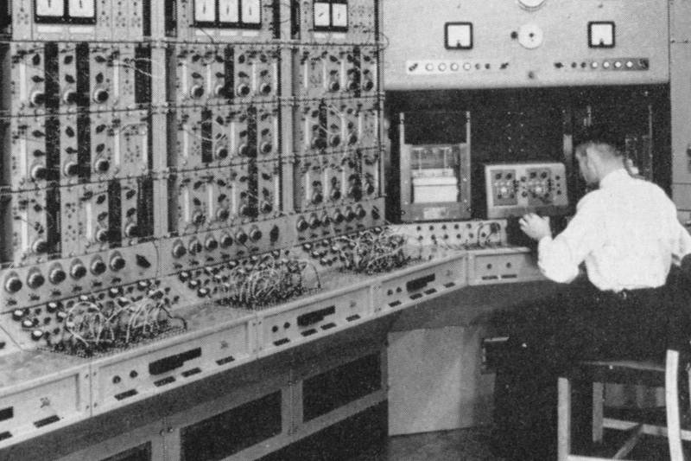
the past: GPACs
- designed not programmed
- continuously valued
- imprecise
- configuring is tough
- limited to ordinary differential equations

Slide 3
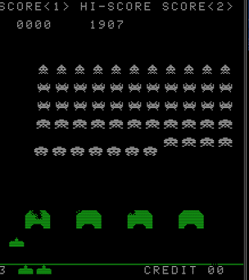
the present: Digital
- small, fast, & cheap
- easy to program
- discrete, algorithmic
- can’t do everything

Slide 4
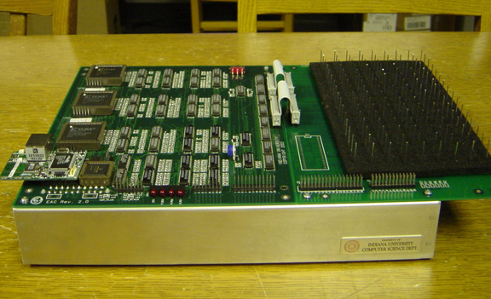
the future: EACs?
- partial differential equations
- cheap, small(er)
- being built here at IU
- getting easier to “program”

Slide 5
all about the EAC…
three characteristics:
- “quintessential boundary value solver” (PDEs)
- lukasiewicz logic arrays
- simulate GPACs

Slide 6
EACs at IU…
http://www.cs.indiana.edu/Facilities/hardware/extended_analog_computer/

Slide 7
EACs at IU…
Partial Differential Equation Solver
http://www.cs.indiana.edu/Facilities/hardware/extended_analog_computer/

Slide 8
EACs at IU…
Lukasiewicz Logic Arrays (LLAs)
Partial Differential Equation Solver
http://www.cs.indiana.edu/Facilities/hardware/extended_analog_computer/

Slide 9
EACs at IU…
Lukasiewicz Logic Arrays (LLAs)
Partial Differential Equation Solver
Digital-to-Analog Converter
http://www.cs.indiana.edu/Facilities/hardware/extended_analog_computer/

Slide 10
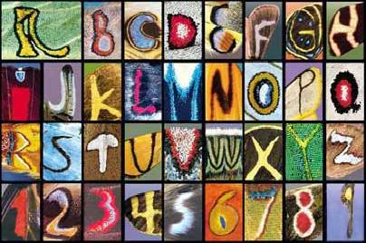
applications: the future is now?
- pattern recognition
- simple neural networks (XOR)
- chaotic systems

Slide 11
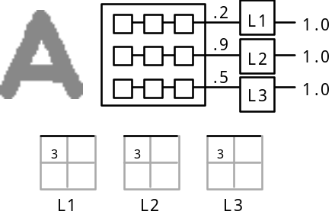
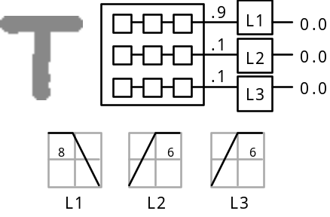
applications: the future is now?
- pattern recognition
- simple neural networks (XOR)
- chaotic systems

Slide 12
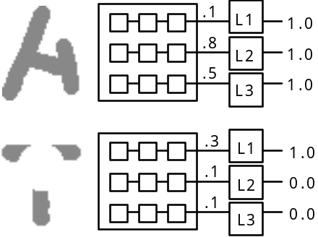
applications: the future is now?
- pattern recognition
- simple neural networks (XOR)
- chaotic systems

Slide 13
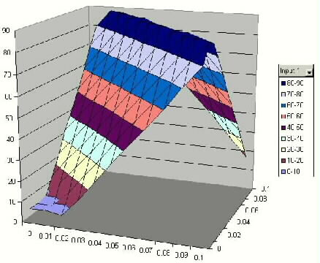
applications: the future is now?
- pattern recognition
- simple neural networks (XOR)
- chaotic systems

Slide 14
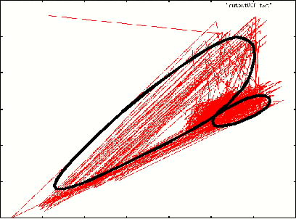
applications: the future is now?
- pattern recognition
- simple neural networks (XOR)
- chaotic systems

Slide 15
references; mostly unpublished :-(
akavipat & tjandra, “designing ‘neural disk’ using simulation inspired by butterfly wing pattern simulation”
allred, bulwinkle, zhang, “analog computing and dynamic feedback”
mills, et. all., “extended analog computers: a unifying paradigm for vlsi, plastic and colloidal computing systems,” pending publication
mills, “the future of extended analog computers,” pending publication
roinestad, viecco, et. all., “study of a model of an extended analog computer,” search on google
uncredited excerpt from an analog reticular simulation

Slide 16
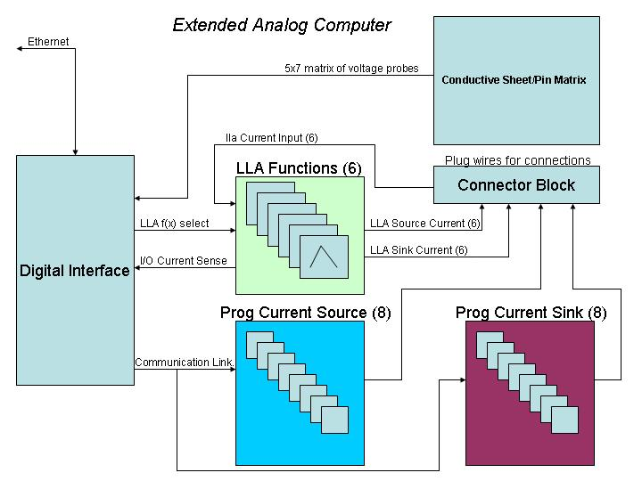
diagram of an EAC
- foam
- silicon
- available online
http://www.cs.indiana.edu/Facilities/hardware/extended_analog_computer/

Slide 17

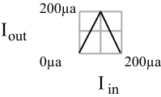
lukasiewicz logic
- kind of confusing

