Slide 1
The Baldwin Effect
A New Factor in Evolution at work in a Simulation
Will Dyar
I400/I590 AL for AI
3.28.05

Slide 2
A Little Evolutionary History…
Two Theories…
Lamarckism
- direct inheritance of characteristics that individuals gained during their lifetime
- evolution happens on occasion in rapid jumps
Darwinism
- evolution can be explained by natural selection coupled with diversity through mutations
- evolution happens in very small steps

Slide 3
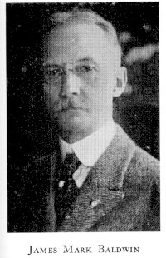
A Little Evolutionary History…
James Mark Baldwin published “A New Factor In Evolution” in 1896
C.L. Morgan and H.F. Osborn proposed some of the same concepts on their own

Slide 4

A Little Evolutionary History
THE BALDWIN EFFECT IS BORN
The Baldwin Effect

Slide 5
How does it work??
There are two steps:
1. phenotypic plasticity present in individual organisms allows them to adapt to partially successful mutations
such as…ability to tan with exposure to the sun, the ability of muscles to increase in strength with exercise, the ability to form a callus with exposure to abrasion, and most of all the ability to learn
If fitness is increased by mutation, this mutation will increase in the population by natural selection
the ability of an organism to adapt to its environment over its lifetime

Slide 6
How does it work??
But…phenotypic plasticity is costly
Costly because…
Learning requires time and energy (trial and error)
Learning is dangerous (experimentation)
It is advantageous to avoid deadly enemies by instinct, or for apes to
be born with calluses on their hands and feet
So…

Slide 7
How does it work??
2. Learned behaviors become instinctive behaviors
- eventually rigid mechanisms replace plastic ones over time
- different from Lamarckian evolution because the genotype is not directly altered
- like Waddington “canalization”
This is all well and good, but how does an organism come to be modified during its life??

Slide 8
On Modification
Three categories that produce modifications, adaptations, or variations
1. Physico-genetic
- “the physical agencies and influences in the environment which work upon the organism to produce modifications of its form and function”
- accidental changes
ex. Chemical agents, changes in temperature, hindrances to growth

Slide 9
On Modification
Three categories that produce modifications, adaptations, or variations
2. Neuro-genetic
- “modifications which arise from the spontaneous activities of the organism itself in the carrying out of its normal congenital functions”
- rising to the occasion
- Morgan called this the selective property of the nervous system
present at birth but not necessarily hereditary; acquired during fetal development

Slide 10
On Modification
Three categories that produce modifications, adaptations, or variations
3. Psycho-genetic
- “the great series of adaptations secured by conscious agency”
- intelligent processes
- lessons
ex. Imitation, pleasure and pain, reasoning, experience
How do these modifications serve Evolution you ask?

Slide 11
Serving Evolution
Somehow organisms are able to find favorable conditions and repeat
adaptive movements
Thus, organisms are able to learn new movements and behaviors that
deal with all three categories, (modify themselves)
These modifications are all combined and employed to keep
organisms alive
So, organisms with useful modifications reproduce more, and…

Slide 12
Serving Evolution
Advantageous variations are used more often in each generation that
follows
In this way, intelligence is preserved, or better, the ability to learn is
preserved from one generation to the next
Another route….

Slide 13
Social Heredity
Other creatures are present in the environment, and neuro-genetic and
psycho-genetic accommodations involve these other creatures
Functions of older creatures are observed and picked up upon by
younger creatures through imitation, experience, or instruction
Only imitative actions that help an organism survive are preserved
Imitative actions that are harmful to an organism, when performed will help natural selection kill that organism (and others like it) off

Slide 14
Social Heredity
Called the concept this for two reasons:
1. physical functions are handed down from generation to generation
2. physical heredity is directly influenced
- variations are kept in existence
- directs ontogenetic adaptation
- the range of possible congenital variations of next generation are set

Slide 15
A Simulation (Bugs!)
Robert French and Adam Messinger showed that the Baldwin Effect
can alter the course of evolution at the genotypic level in a simulation
Plasticity at the phenotypic level produces directed changes at the
genotypic level
How do they show this??

Slide 16
A Simulation (Bugs!)
A discrete time simulation of free-acting agents, or bugs, in a 100x100 matrix
Each cell contains one bug at most
The matrix is populated randomly with bugs that have randomized
genotypes and also food piles with a uniform size
More food is randomly placed at each timestep of the simulation
Each bug has a food counter
- The food counter is decremented for movement, metabolism, and
reproduction
- if it drops below zero that bug dies

Slide 17
A Simulation (Bugs!)
Bugs have ability to sense food piles in the four cells which surround them
Four things are done at each timestep:
1. Metabolize- “existence tax” is subtracted from food count
2. Eat- they eat a pre-specified amount of food if their cell contains
any
3. Reproduce- can be asexual or sexual; bugs can reproduce if their food counter is above a pre-specified reproduction threshold
4. Move- bugs move to the cell with the most food, if all cells have the same amount they move the same way they did before

Slide 18
A Simulation (Bugs!)
Each bug’s genetic code is a fixed-length gene consisting of 1’s or 0’s
One bit pattern is determined to be superior (dubbed the “Good Gene”
The GG corresponds to a GP (“Good Phene”), so
- bugs with the GG will possess the GP
But…bugs can learn the GP
- the closer a bug is to the GG, the easier it is to learn the GP
The GP makes the bug either move, metabolize, or reproduce
more efficiently by reducing how much it is docked for each of these activities

Slide 19
A Simulation (Bugs!)
Reproduction is either asexual or sexual
Asexual:
- if a bug has enough food to reproduce, it copies itself
- there is a mutation rate parameter that determines the probability that a bit will be copied wrong
- a pre-specified amount of food is transferred from the parent’s food counter to the child’s

Slide 20
A Simulation (Bugs!)
Reproduction is either asexual or sexual
Sexual:
- if a bug has enough food to reproduce, it checks for a bug in its surrounding cells
- if it finds a mate, it produces a child whose gene is determined by crossover of the parent’s genes at a random point
- the mutation parameter is included
- pre-specified amount of food is taken from only the moving bug’s food counter, not its mate’s, and is given to the child

Slide 21
A Simulation (Bugs!)
How is learning determined??
Two factors play a role:
1. phenotypic plasticity, how difficult it is to learn the GP
2. how much the bug benefits from learning the GP

Slide 22
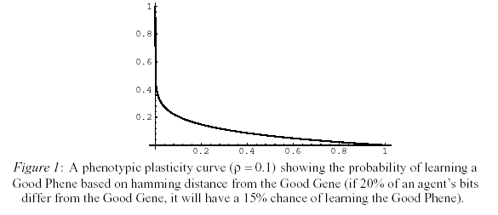
A Simulation (Bugs!)
1. Phenotypic plasticity
- each bug’s genotype is a certain distance from the GG
- using this distance, the probability that a bug will learn the corresponding GP is determined by a phenotypic plasticity curve

Slide 23
A Simulation (Bugs!)
1. Phenotypic plasticity
- X-axis: # of bits differing from the GG/ total # of bits
- Y-axis: probability of learning the GP

Slide 24
A Simulation (Bugs!)
1. Phenotypic plasticity
- if the bug is close to the GG, it will have a better probability of learning the GP
- whether or not is actually learns the GP is done stochastically based upon its probability

Slide 25
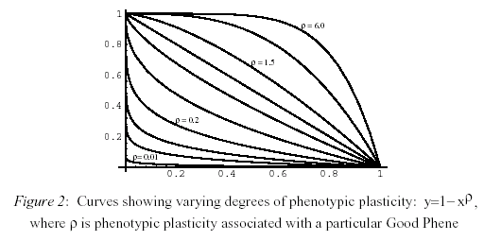
A Simulation (Bugs!)
1. Phenotypic plasticity
- shape of this curve depends upon how easy or difficult the GP is to learn
winking

Slide 26
A Simulation (Bugs!)
2. How much does the bug benefit?
- if the advantage of learning GP is very low, the population of bugs might not move in the direction of the GG
- but, if the advantage is very high, any bug that learns the GP will survive and the GG will be eventually present in all bugs
For example….
- if the GP was “energy taxes drop to zero”, once the GG was found by mutation it would dominate the pop because the bug that found it could survive and reproduce with no food

Slide 27
Results of Bugs!
Simulation 1
- bugs reproduce asexually
- the GP decreased the amount of energy docked by moving
- thus, bugs born with the GG had a GP that allowed it to move around more efficiently than bugs without the GP
- the phenotypic plasticity for the GP was 0.1 (not easy or difficult to learn)

Slide 28
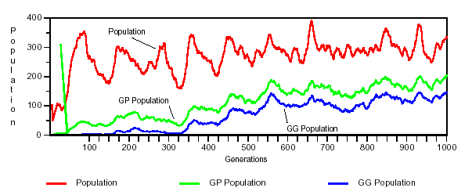
Results of Bugs!
Simulation 1
Graph shows the evolution of a population where the GP is being learned
total population bugs that have GP (learned or born) bugs born with GG

Slide 29
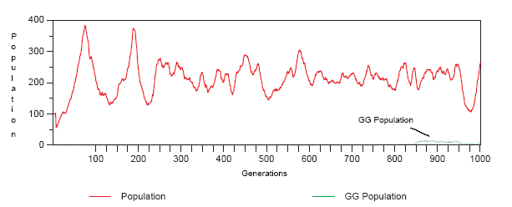
Results of Bugs!
Simulation 1
Graph shows the evolution of same population with no learning
- genotype does not change

Slide 30
Results of Bugs!
Simulation 1
Findings:
- half of the pop learned the GP by about 500 generations
- there is a consistent, overall increase in the total pop which is directly related to the benefit that the GP confers
- the number of bugs that have the GG increases, but is never higher than the number of bugs that have the GP (by being born with the GG or learning it)
- by 5,000 generations almost all bugs have the GP and around 70% have the GG
- once entire pop has the GP, the difference between the total pop and the pop that has the GG is directly proportional to phenotypic plasticity

Slide 31
Results of Bugs!
Simulation 1
So, the Baldwin Effect has been demonstrated because the ability to learn the GP has a significant influence on the evolution of the genotype

Slide 32
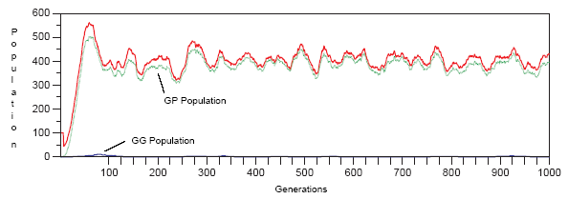
Results of Bugs!
Simulation 2
Findings:
- as phenotypic plasticity increases, there is an increase in bugs with the GG
- but…eventually the number of bugs with the GG starts to decrease
- and…for extremely high plasticity there is not a push towards a GG pop

Slide 33
Results of Bugs!
Simulation 2
Conclusions:
- if plasticity is too high, all bugs will possess the GP, so there is no reason for more genotypic evolution
- as we saw earlier, if plasticity is too low, there is no shift in the pop towards the GG

Slide 34
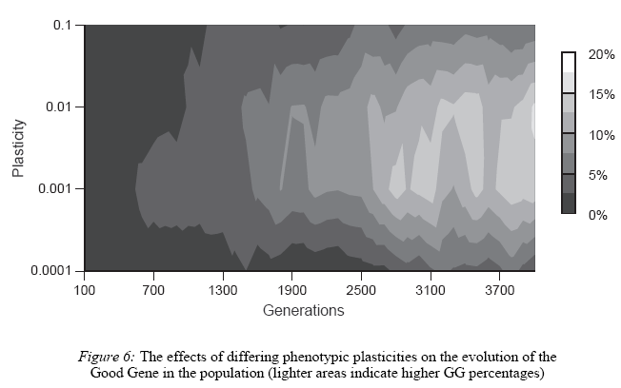
Results of Bugs!
Simulation 2
Shown topographically
- the Baldwin Effect disappears for high and low plasticities

Slide 35
Results of Bugs!
Simulation 3
- Baldwin Effect is affected by selective advantage
- if advantage is non-existent or very small, there will be little or no GG increase in pop
bugs with the GP will not survive better than those without it
- if advantage is very big, even if plasticity is very low, after a few bugs find the GG they dominate the population quickly (next slide)
bugs with the GG have such a better chance of survival

Slide 36
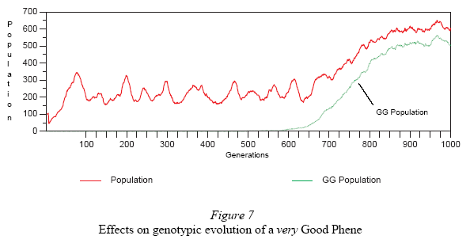
Results of Bugs!
Simulation 3
- Selective advantage is very high and phenotypic plasticity is very low

Slide 37
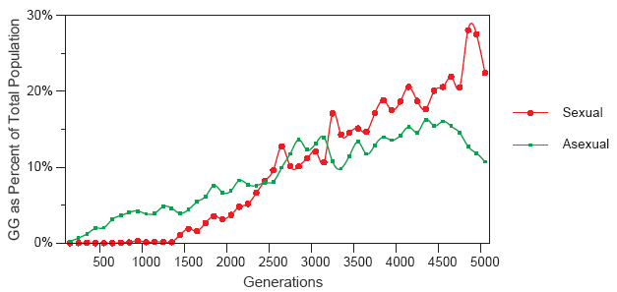
Results of Bugs!
Simulation 4
- sexually reproducing bugs had higher concentration of GG bugs than asexual
- in equal total pops, GG pop increased faster in sexually reproducing pops (graph)

Slide 38
Conclusions from Bugs!
The Baldwin Effect can be demonstrated in a simulated population
- the ability to learn at the phenotypic level effected the genotypic evolution
- phenotypic plasticity and the advantage that the GP confers have an impact on the amount of genotypic change
- moderate levels of plasticity are a lot better at producing genotypic evolution than very high or low levels
- the Baldwin Effect is more pronounced in populations that produce sexually

Slide 39
References
“Genes, Phenes and the Baldwin Effect: Learning and Evolution in a Simulated Population” by Robert M. French and Adam Messinger
http://www.ulg.ac.be/cogsci/rfrench/baldwin.pdf
“A New Factor in Evolution” by James Mark Baldwin
http://spartan.ac.brocku.ca/~lward/Baldwin/Baldwin_1896_h.html
“Evolution, Learning, and Instinct: 100 Years of the Baldwin Effect”
by Peter Turney, Darrell Whitley, and Russell Anderson
http://www.apperceptual.com/baldwin-editorial.html

