Slide 1

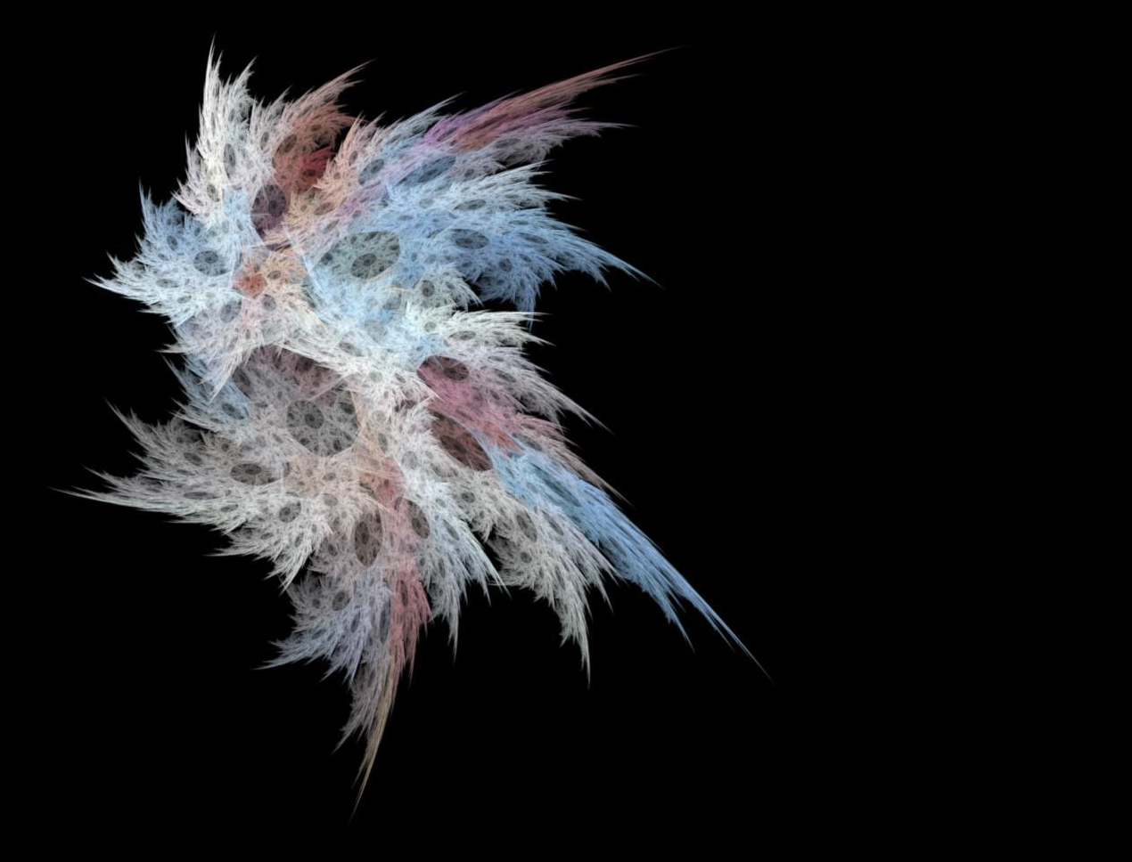
Genetic Algorithms & Art

Slide 2
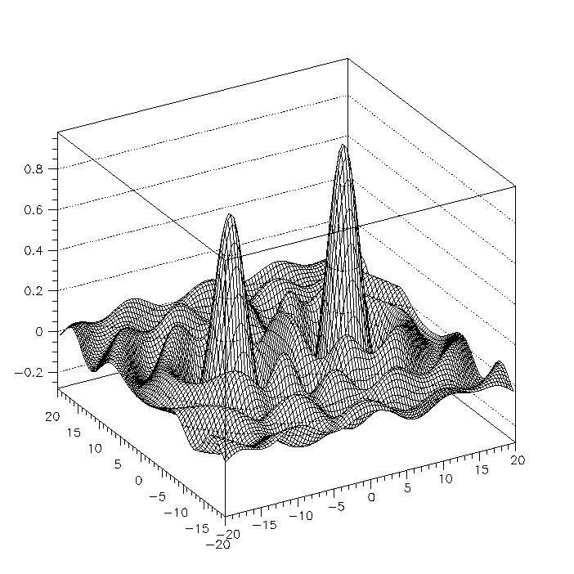
General Advantages
Don’t Need to understand problem thoroughly -- Only need A way to evaluate the result
Work on complex landscapes
Explainable

Slide 3
Solving A Maze
5 x 5 Box maze
Only see current box
Make a decision w/o memory

Slide 4
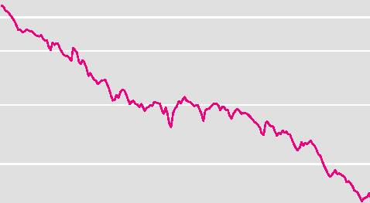
Solving A Maze
Results:

Slide 5
Limitations Of GAs
Need Viable Offspring
Need Fitness Function
Good Fitness Landscape
Relationship between Evolution and Fitness
Needs to be Possible

Slide 6
Viable Offspring
Random Mutation of bits -->Garbage
Solution1 Fixed Length Character Strings + Fixed Expression Rules --> Predefined Dimensional Space
Lisp Expressions / Trees / etc…

Slide 7

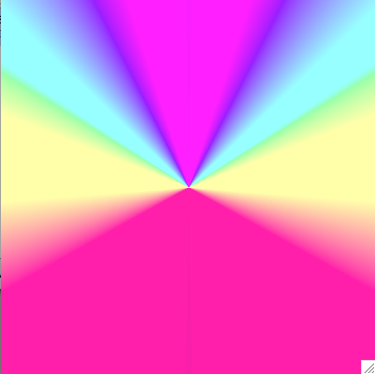
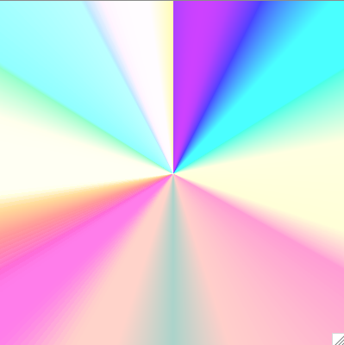

Trees

Slide 8
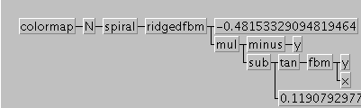
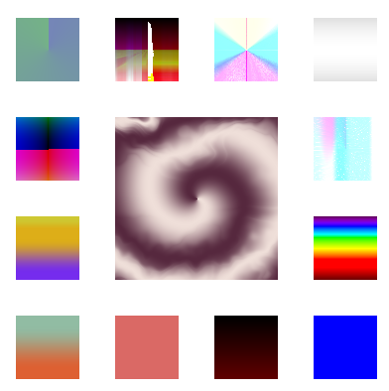
Relationship between Parent and Mutations

Slide 9
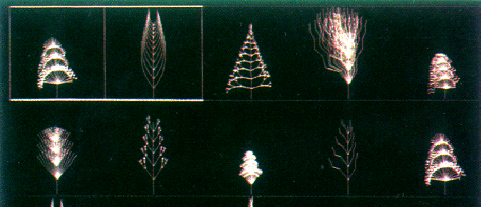
Properties Specific to Aesthetics
No Objective Criteria
Local Maxima can be interesting

Slide 10
3D Plant Structures
21 genetic parameters
Fractal Limits, Branching Factors, Scaling, etc

Slide 11
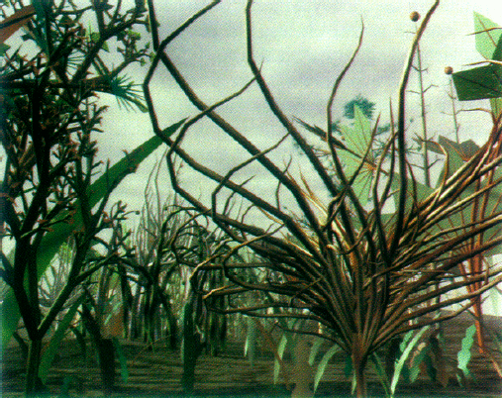

Slide 12
Problems
Solid Boundery on Possible Outcomes
No new Development Rule
No new Parameters
N-dimensional genetic space will remain N-dimensional

Slide 13
Solution
Include Procedural Information in Genotype
(Not just parameter data)
Lisp

Slide 14
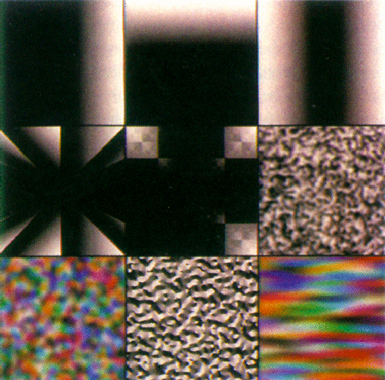
Each Function takes a Specific number of Arguments & returns an image_x0018__x0003_
X
Y
(abs X)
(mod X (abs Y))
(and X Y)
(bw-noise .2 2)
(color-noise .1 2)

Slide 15
Lisp Mutation
Each Funciton can be
1 handed a scalar value -- .4
2 a color (3-element vector) -- (.4 .23 .65)
3 a variable -- X
4 another lisp expression that returns an image

Slide 16
More Mutation
Node --> Random Expression
Value --> Add random amount
Function --> Different Function
Expression --> Argument to new Function
X --> (* X .3)
Argument of Function --> Expression
Node --> Copy of Parent Node
(not necessarily the same node)

Slide 17
General Rules
More Complex --> Harder
(Prevents Arbitrary Large Slow Forms)
Decrease in Mutation over Time
(Stabilizes)
Consider the Computational Expense

Slide 18
Mating
Nodal Crossover
Symbolic Expression Mating:
Parent1: (* (abs X) (sin Y)
Parent 2: (* X (tan Y))
(* (abs X) (tan Y))…

Slide 19
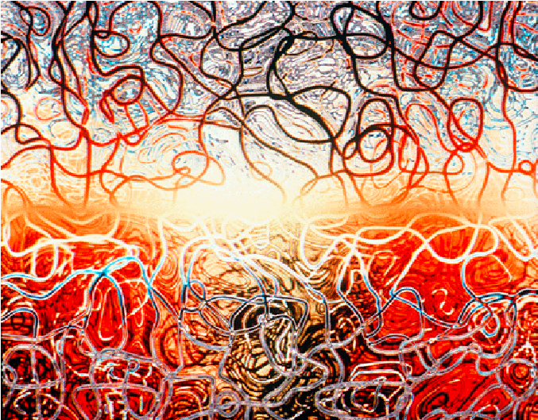
Results

