Slide 1
Simulated Evolution
Spore & Blocky Creatures

Slide 2
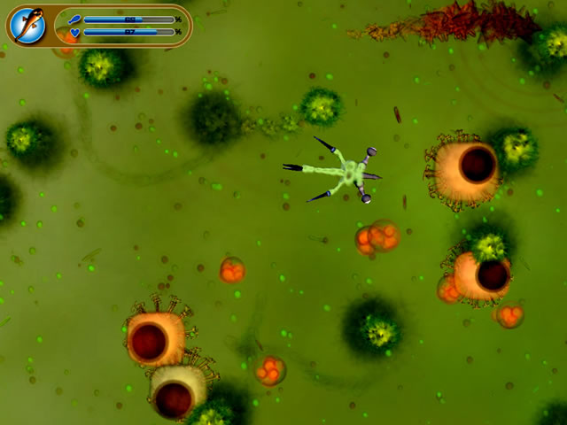
Video

Slide 3
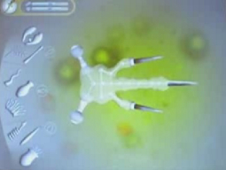
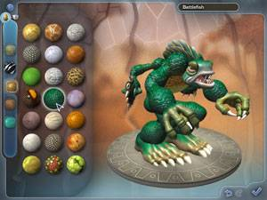
Spore
Evolution Simulation game by Maxis
Not as academic as Tierra or blocky creatures

Slide 4
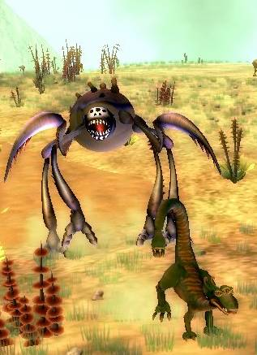
Evolution in Spore
Done by the user, other players, and computer
  Creature Phase
  Space Phase
  Terraforming
Potential for more meaningful experiments
  Coding mutation
  Tweaking fitness functions

Slide 5
Blocky Creatures Competition
Sim2(under extra readings)

Slide 6
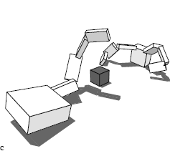
Competition in Blocky Creatures
Light Sources
  One at the center of the block
  One at the center of mass of each creature
  The walking creature
  just wasn’t very
  smart
  The evolution of
  complex behaviors
  may be to
  complicated

Slide 7
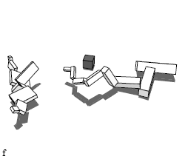
Only a few species utilized light
Most creatures developed and honed one tactic and repeated it regardless of their opponent’s tactics
A few, like this arm creature developed light sensors to follow the blocks movement.

Slide 8
Creatures Were Evolved by Species
During evolution creatures only competed against creatures of the same species.
The best of each species were picked to compete in the tournament
Smarter creatures might have emerged if several species were evolved together.

Slide 9
Questions?

