Slide 1
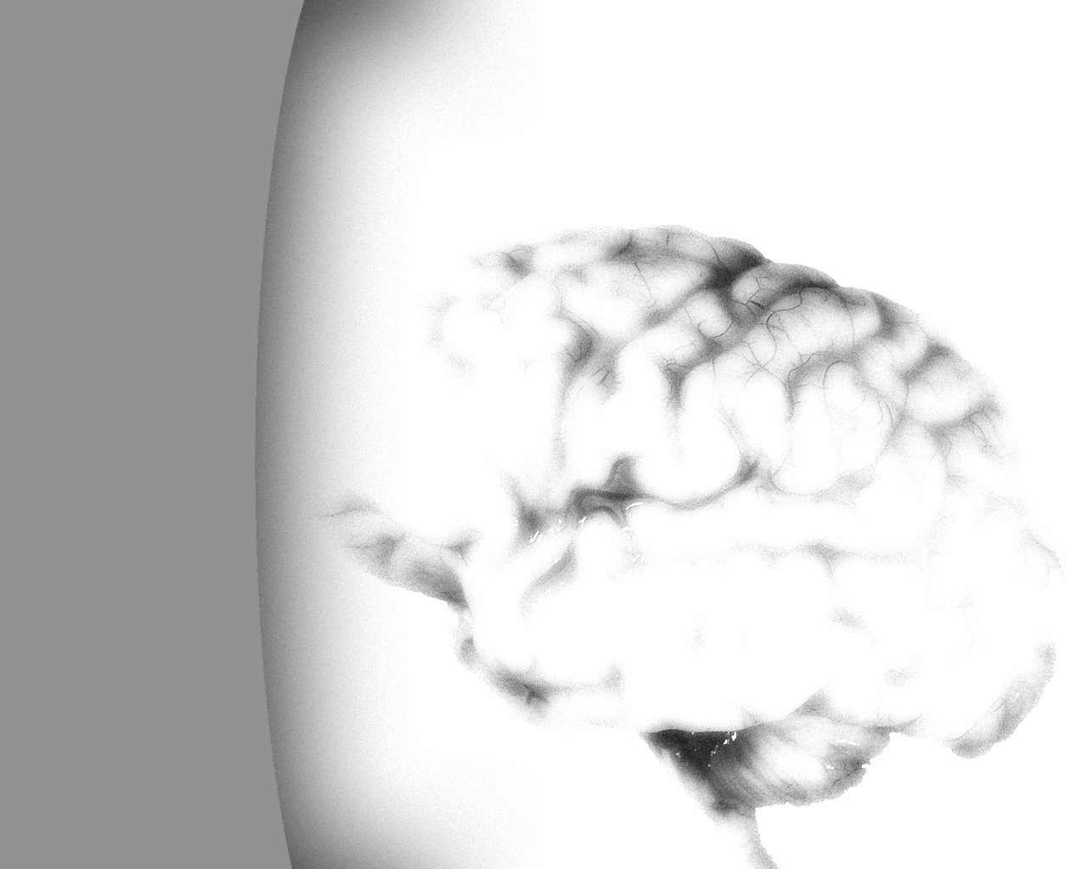
Neural Networks - Intro
Joshua Manns

Slide 2
Structure:
Neurons
Axons
Dendrites
Node of Ranvier
Terminal Fibers
- Myelin/Myelination
Joshua Manns

Slide 3
vs. CPU:
Binary vs. Analog
Gate speed
Parallelism
Joshua Manns

Slide 4
Uses:
Brain well-suited for guesses/conceptual
CPUs good for logic/fine detail
The shift toward parallel computing:
  Why?
  Multi-core CPUs
  Multi-threaded programs/games
  (Migration toward generalization)
Joshua Manns

Slide 5
Concl.:
Enormously complex
Helps imitate more ‘life-like’ behaviors
Example of emergence
Joshua Manns

Slide 6
?’s:
Me first:
  Use of Consciousness?
  (My answer)
  Your ?s…
Joshua Manns

Slide 7
Refs:
James A. Anderson
Joshua Manns

