Slide 1

Stephen Denton
2-13-2007

Slide 2

The most popular learning algorithm for neural networks.
Uses gradient descent on error for learning.
Weights are updated by the method of steepest descent.
  Uses an instantaneous estimate for the slope of the error surface in weight space.
  This is a local computation where only the gradient at the present position of the weights is considered.

Slide 3

Learning times are long because the rate of convergence tends to be relatively slow.
This occurs for two reasons
  The error surface may possess properties that slow convergence.
    Fairly flat along a weight dimension.
    Highly curved causing overshoot.
  The direction of the negative gradient vector may not point toward the minimum of the error surface and thus the algorithm does not always step in the direction of the global minimum of the error surface.

Slide 4

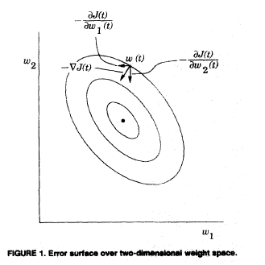

Slide 5

Every parameter (i.e., weight) should have its own individual learning rate.
  One fixed learning-rate may not be appropriate for all parameter dimensions.
Every learning rate should be allowed to vary from one iteration to the next.
  Different regions of the error surface will require different behavior along a single weight dimension.

Slide 6

When the derivative of the error function with respect to a parameter has the same sign for consecutive time steps the learning rate for that parameter should be increased.
When the sign alternates for consecutive iterations of the algorithm, the learning rate should be decreased for the parameter.

Slide 7

With time-varying learning rates, the network is no longer performing a steepest descent search.
Adjustments to weights now are based on the estimates of the curvatures of the error surface along each dimension, and not just the partial derivatives of the error surface.

Slide 8

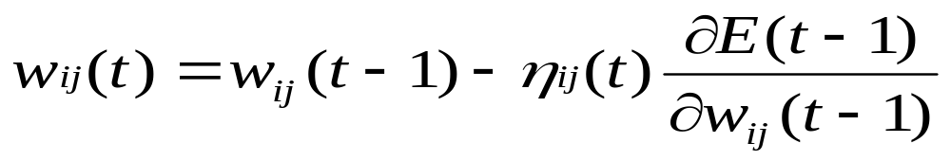
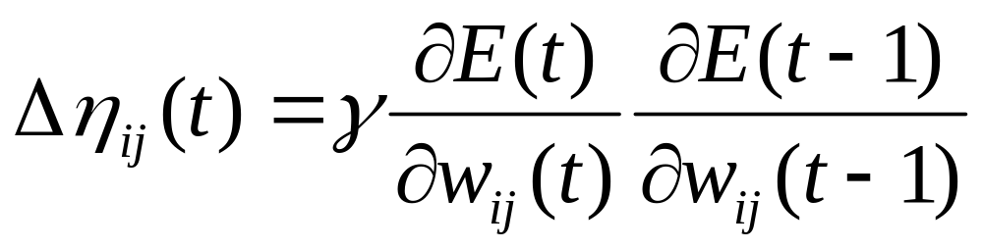
The delta-delta learning rule
The weight update rule is similar to backprop.
Here the learning rates are also updated

Slide 9

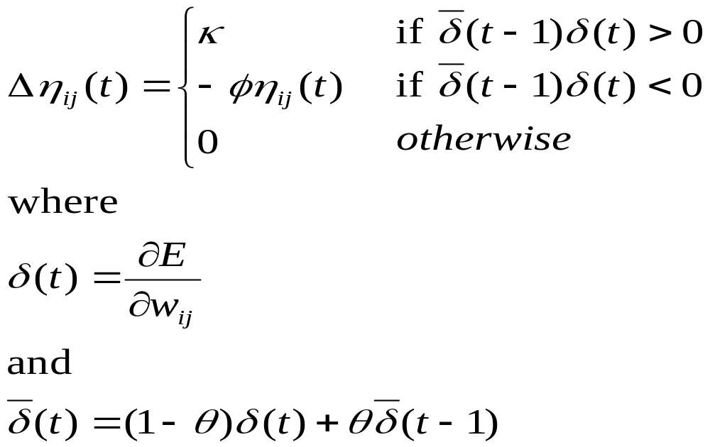
A related algorithm
Notes:
Increments learning rates linearly, but decrements them exponentially.

Slide 10

Faster rate of convergence than the method of steepest descent.
  Takes large steps when the error surface is flat
  Takes smaller steps when the it reaches regions where the error surface is highly curved.
    Less likely to overshoot across the curvature.

Slide 11

Jacobs (1998) evaluated the performance of the delta-bar-delta rule of several tasks.
  Optimization of quadratic surfaces
  Learning the exclusive-or
  Binary-to-local task.
Collectively, these tasks have a wide variety of terrains in their error surfaces.

Slide 12

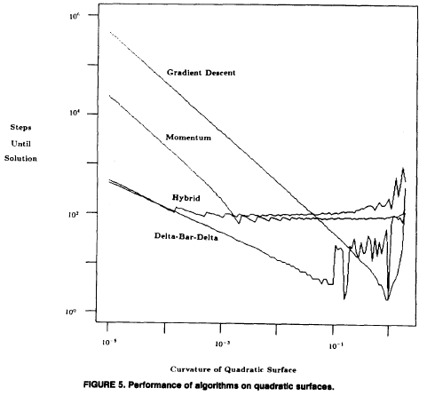
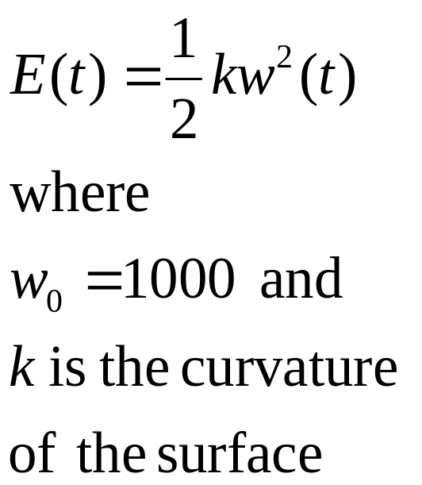

Slide 13
On all the tasks, delta-bar-delta performs better than steepest descent.
  More networks reached a solution
  The number of epochs to solution was much lower
    For example in the binary-to-local task the mean epochs until solution was 58,144 for steepest descent, whereas it was only 2,154 for delta-bar-delta.

Slide 14

The four heuristics appear to be useful in achieving faster rates of convergence.
The implementation of the four heuristics in the form of the delta-bar-delta learning procedure consistently out-performed steepest decent algorithms in simulations.

