Slide 1
Neural Networks
An Information Theoretic Approach
By Matthew Zurschmeide

Slide 2
Neural Networks
Neural networks in animals
  Simplicity
  Similarity
Information
  Spike train
  Time-dependent input/output flow
  Encoded signal
Perception
  Perception of own neural signals
  Noise
    Must be able to separate noise from signal with high degree of accuracy

Slide 4
Neural Networks in Animals
Spike Train
  Is data in brain a time-dependent stream of signals?
    Possibly – Signal of a single neuron can be represented as a train of up and down signals
    Brain “pushes” back the other way with stimulation or lack of stimulation
    Wave function therefore does not necessarily look much like the up and down signals of spike train
    Each neuron must be able to translate its signals and reproduce an equivalent set of signals.

Slide 5
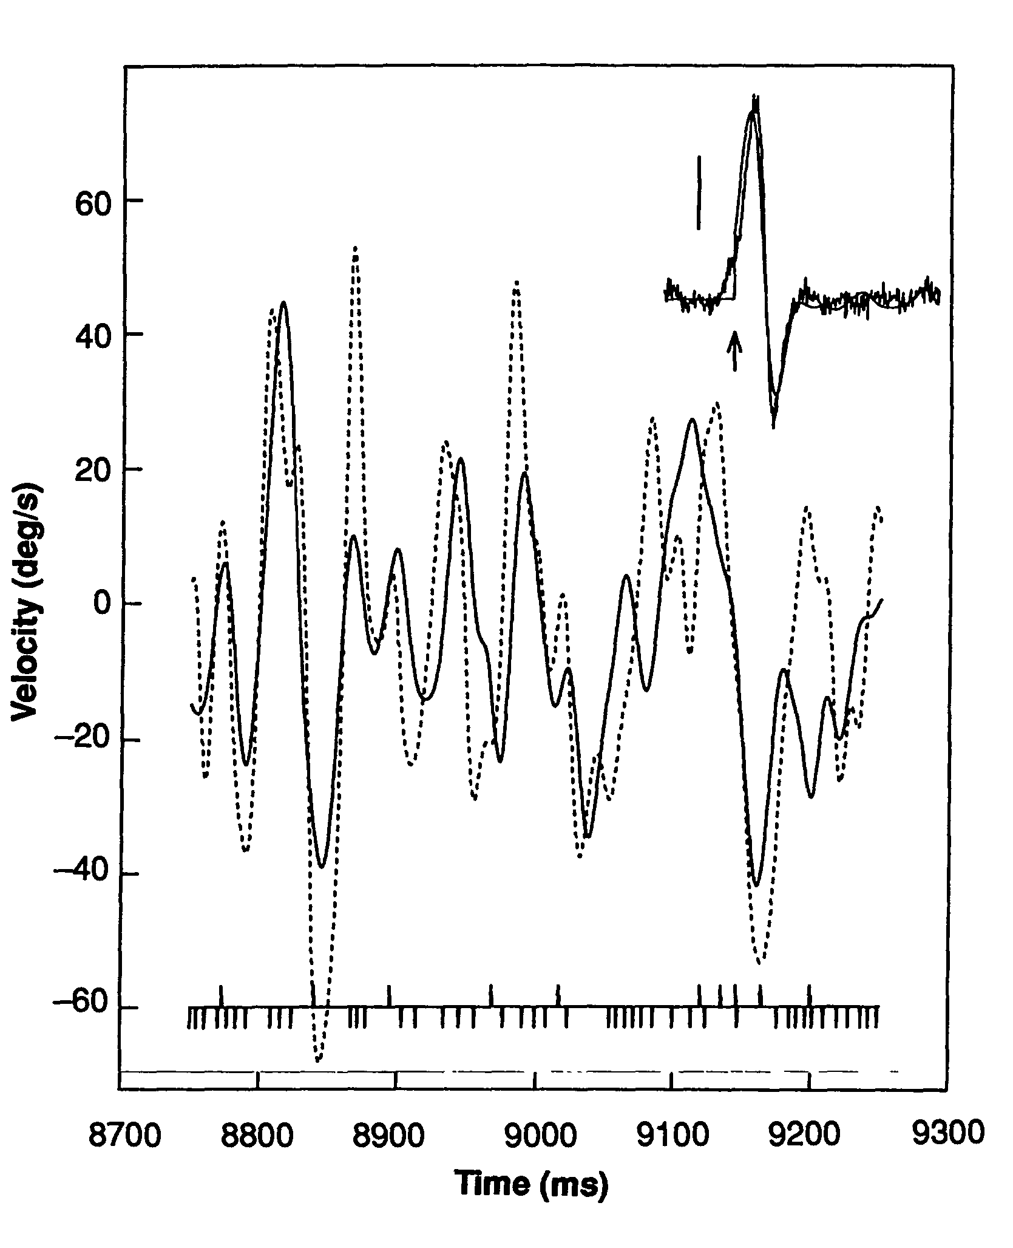
Spike Train
Spike Train
  Solid line is first-order reconstruction from integration over duration of experiment
  Dotted line is actual stimulation
  Lines at bottom are a representative spike train

Slide 6
How much information?
Not insignificant amount
  A neuron from the visual system of a Calliphora erythrocephela, or blowfly, has an output of 64 +/- 1 bits per second
    Time-varying input/output of a neuron
    It is impossible to tell from recording a single neuron, as is common, if they are computing with time advances.
  Spike timing is an established way for electric fish to convey information in electrosensory system, bats in echolocation, and flies, as mentioned, in visual system

Slide 7
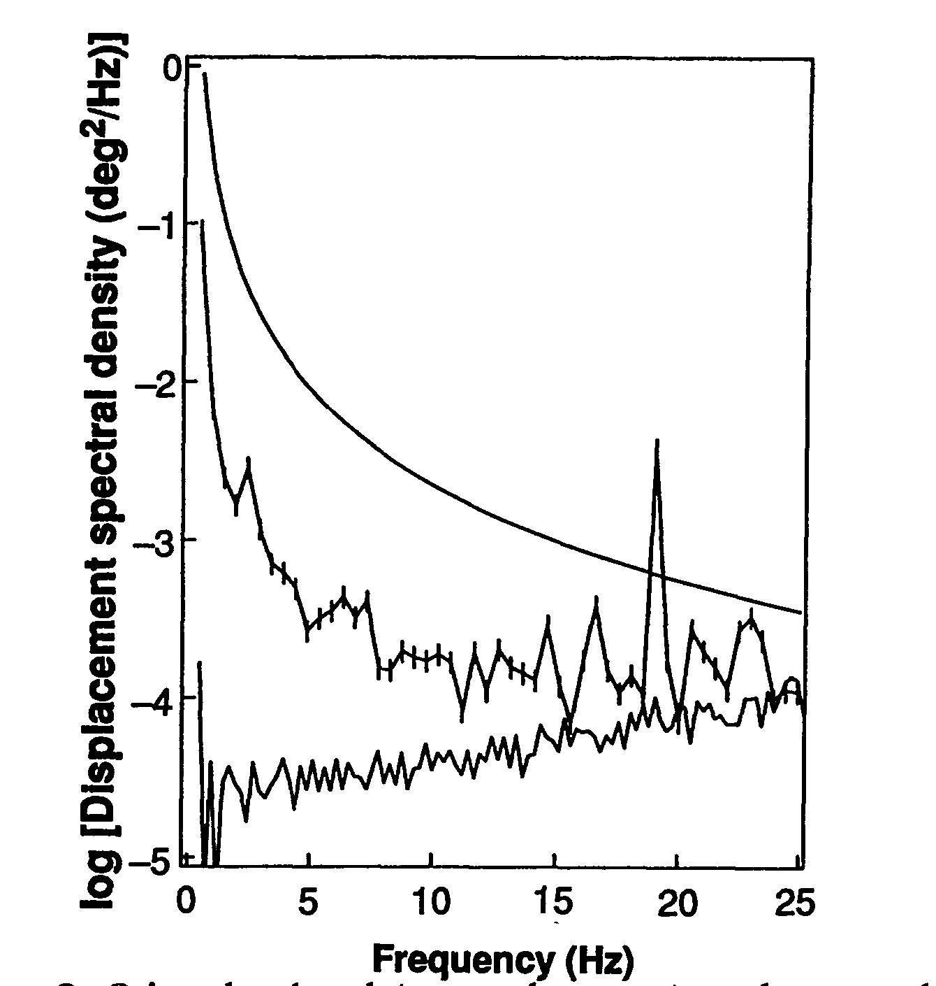
Noise
In order to get good data, must separate signal from noise
  In general, noise-to-signal ratio better than 5:1
Top is stimulus level
Middle is spectral density of displacement noise
Bottom is limit to small noise

