Slide 1
Evolution and Learning
“Exploring Adaptive Agency I/II”
Miller & Todd, 1990

Slide 2
Learning as an adaptive process
In the not too distant past, learning was assumed to be a generalized process that:
  Was a (the?) primary adaptive process that could even be seen to “guide” evolution
  Could be understood in a vacuum:
  “the prevailing view of human learning is [still] that it is almost wholly general-purpose in character and can be understood without reference to biological or ecological considerations.” (Estes, 1984)

Slide 3
Ecological learning theory
Instead of assuming a generalized learning process that always provides benefit to the organisms that learn, one must look at the specifics of the environment and the adaptive pressures on the creature and consider how learning may (or may not) provide an advantage.

Slide 4
Learning is a puzzle
“Given the already powerful adaptive process of evolution by natural selection, what could learning really add?”
The first question shouldn’t be “how does learning work?” but rather “Why do creatures learn at all?”

Slide 5
Most creatures don’t
“considering this great [supposed] advantage of learning…it is rather curious in how relatively few phyletic lines genetically fixed behavior patterns have been replaced by the capacity for the storage of individually acquired information.” (Mayr, 1974)

Slide 6
The downside of learning
Longer infancy and adolescence
Delayed reproductive maturity
Increased parental investment
Neural “bookkeeping costs” – additional neurons, connections, memory…all of this requires resources
The ability to make mistakes and/or learn the wrong things

Slide 7
So learning is bad, then?
Learning allows a creature to let the environmental regularities control the construction of behaviors
Learning allows for behaviors that are based on the integration of historical data, thus extending the “view” of the environment
Learning allows for faster adjustment of behaviors as compared to natural selection

Slide 8
An exploratory simulation
Use a GA to evolve very simple neural network architectures that are capable of learning about their environment
Set up two “niche” environments so that natural selection alone will not be able to hard-wire the proper behavior for a creature in advance

Slide 9
Which learning mechanism?
“Years of learning by “being taught” instill in us intuitions about the utility of corrective feedback to guide learning. But such intuitions make it easy to overlook the fact that it is at least as difficult for creatures to evolve the ability to perceive feedback signals from the environment to guide their learning, as it is to evolve the perception of any other complex external cue.”

Slide 10
The (very simple) scenario
A creature is born into one of two different niches
  In one, the good food is green and the poison is red
  In the other, the good food is red and the poison is green
  Food always smells sweet and poison always smells sour. …but the smell sense is not 100% accurate.
Eating food increases fitness, eating poison decreases fitness, not eating does nothing
At the end of a fixed lifespan, creatures reproduce in proportion to their fitness levels

Slide 11
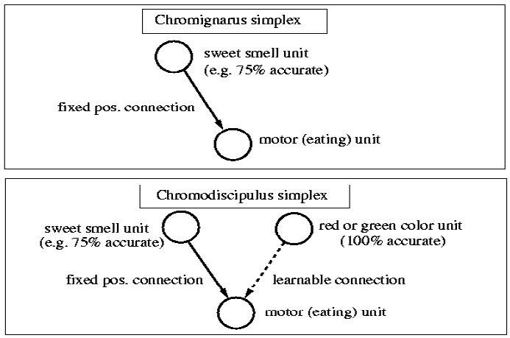
Potential creatures

Slide 12
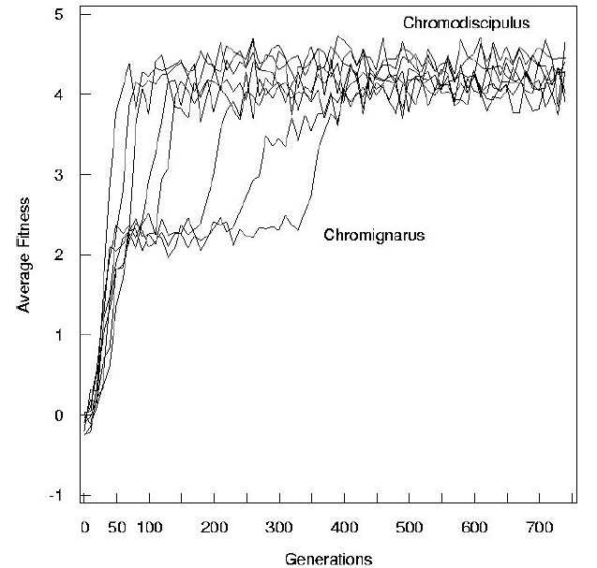
Initial Results

Slide 13
Further Simulation
Run the simulation hundreds of times, varying the accuracy of the smell cue across different runs
Track the population’s fitness to determine when the creatures have evolved to have the hard-wired smell detector and when they have evolved to have a learning color detector

Slide 14
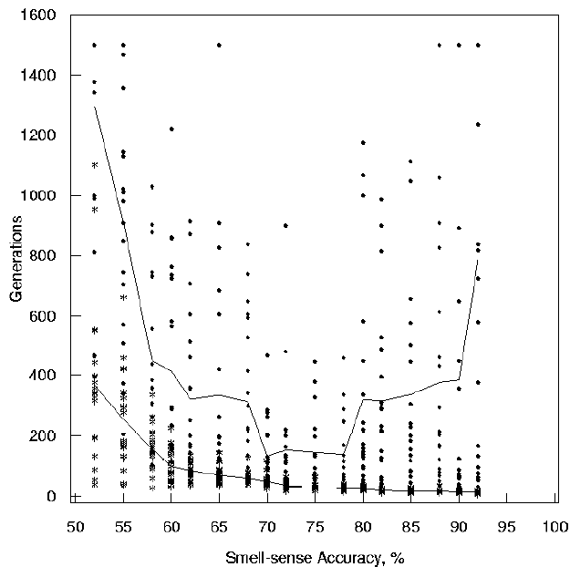
Results

Slide 15
Conclusion
Learning can adaptive and beneficial in some environments. However, there is no a priori need for learning to evolve. Careful consideration of the environmental regularities and biological constraints must be considered before the adaptive value of learning can be accurately assessed.

