Slide 1

Genetic Algorithms
gone whacky
Rebecca Ingram, Jason Yoder, Michael Zlatkovsky

Slide 2
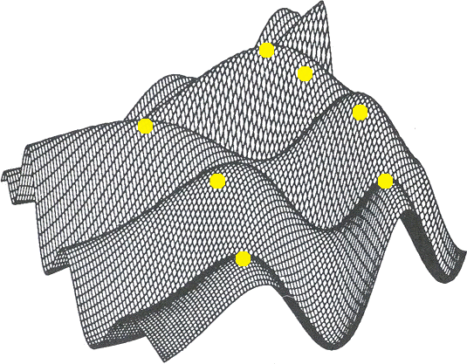

Slide 3
Basic Genetic Algorithm Outline
1) Choose initial population
2) Evaluate fitness
3) Prune population
4) Select best-ranked individuals
5) Reproduce (& occasionally mutate)
6) Repeat from #2 until done*
*"done" = ran out of time, hit maximum generations, fitness reached a plateau, threshold satisfied.

Slide 4
"Interpretive Dance"

Slide 5
"Interpretive Dance"
just kidding!

Slide 6
"Interpretive Dance"
actually, we're not...

Slide 7
Group exercise

Slide 8
Did you get it?
1) Choose initial population
2) Evaluate fitness
3) Prune population
4) Select best-ranked individuals
5) Reproduce (& occasionally mutate)
6) Repeat from #2 until done*
*"done" = ran out of time, hit maximum generations, fitness reached a plateau, threshold satisfied.

Slide 9
Practical genetic algorithms

Slide 10
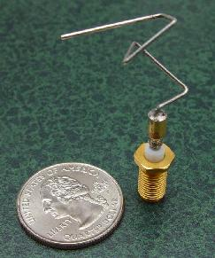
Evolved Antenna
NASA evolved for ST5 mission
-was evolved to meet a challenging
set of mission requirements
-more difficult to construct, but had
fewer components and was more
effective
-two fewer man-months to complete first prototype
(ti.arc.nasa.gov/projects/esg/research/antenna.htm)

Slide 11
FPGA Voice Recognition
"uses far fewer cells than anything a human engineer could have designed, and it does not even need the most critical component of human-built systems - a clock. How does it work? Thompson has no idea ... In fact, out of the 37 logic gates the final product uses, five of them are not even connected to the rest of the circuit in any way - yet if their power supply is removed, the circuit stops working. It seems that evolution has exploited some subtle electromagnetic effect of these cells to come up with its solution" (http://www.talkorigins.org/faqs/genalg/genalg.html)

Slide 12
Genetic Algorithms for simulating human motion
TED Talk: http://www.ted.com/talks/torsten_reil_studies_biology_to_make_animation.html

