Slide 1
Artificial Life
(+ swarm robotics
& embodied evolution)
solving problems by looking at nature
Iñaki Fernández Pérez
Postdoctoral Researcher Univ. Toulouse
fernandezperez.inaki@gmail.com @InakiFdezPerez

Slide 2
Iñaki Fernández Pérez
Me
B.Sc. CS Valladolid, ES (06-10)
Erasmus Nancy, FR (10)
  Semantic Web, …
Research Engineer (10-11)
M.Sc. Artificial Int. (11-13)
Ph.D. Collective Rob. (13-17)
My circumstance
Postdoc. researcher
  Univ. Toulouse 3
Bioinsp. optimization and more
  Depl. intervention teams
  Collective robot behavior
  Comunic. in bact. colonies
Vice chair ISALStud. group
  Intern. Soc. for Artif. Life
Teaching, outreach, pedagogy

Slide 4
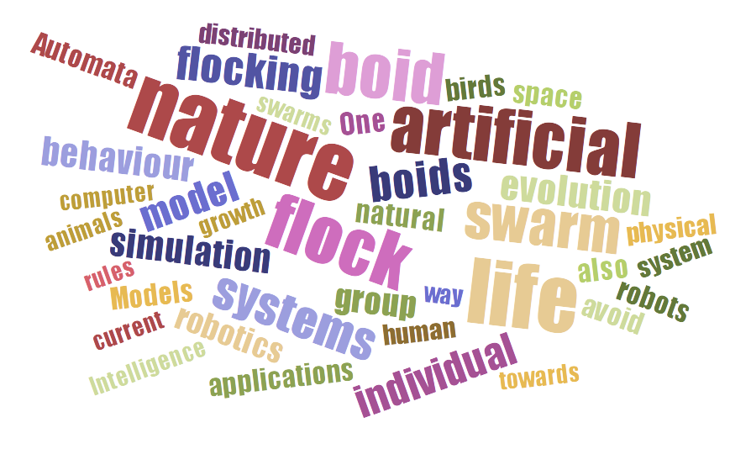

Slide 5
Structure of this talk
What is nature? Examples
What is Artificial Life? Examples
Swarm Robotics + Embodied Evolution
My global view on Artificial Life

Slide 6
In nature, we look for….
1) Patterns 2) Self-organization
Let’s see some examples….

Slide 7


Slide 8
Hopetoun Falls, Victoria, Australia (Wikimedia Commons)

Slide 9
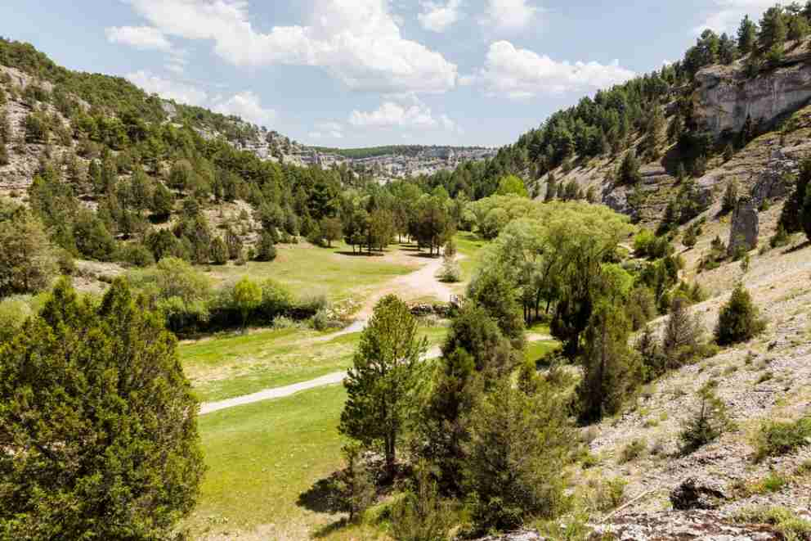

Slide 10
Cañón del Rio Lobos, Soria, Spain (Wikimedia Commons)

Slide 11
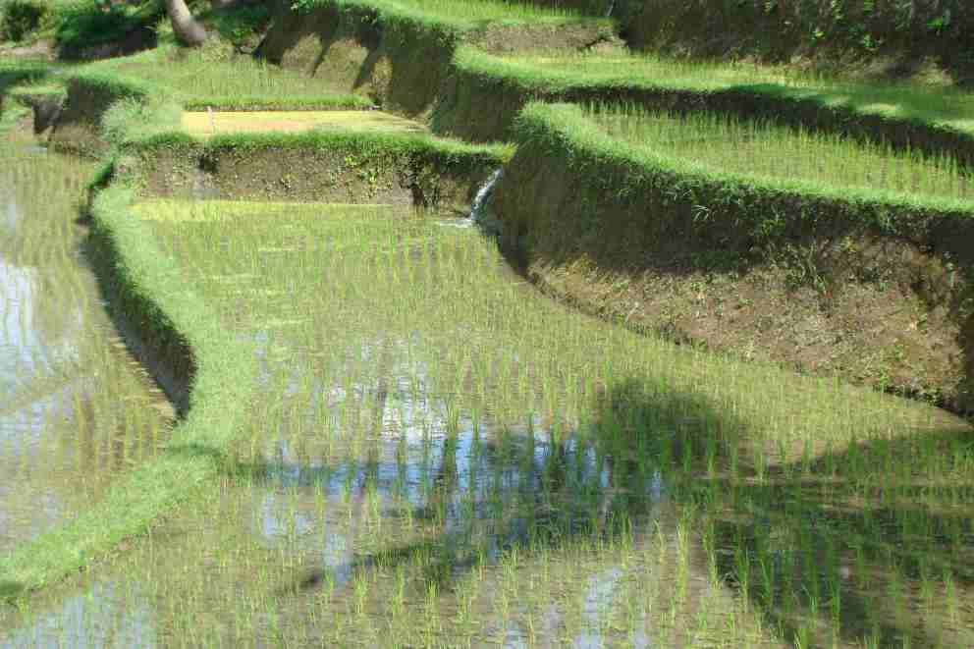

Slide 12
Rice Terraces, Bali, Indonesia (Wikimedia Commons)

Slide 13


Slide 14
Rinjani Volcano Eruption (1994), Lombok, Indonesia (Wikimedia Commons)

Slide 15
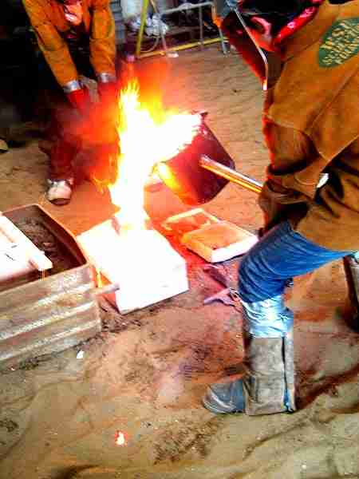
Metal casting (Wikimedia Commons)

Slide 16
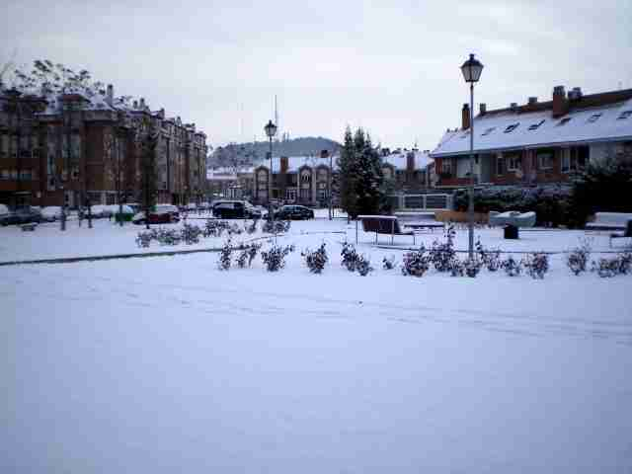
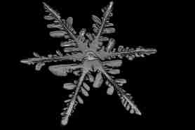

Slide 17
La Cistérniga (winter 2009), Valladolid, Spain (Wikimedia Commons)

Slide 18
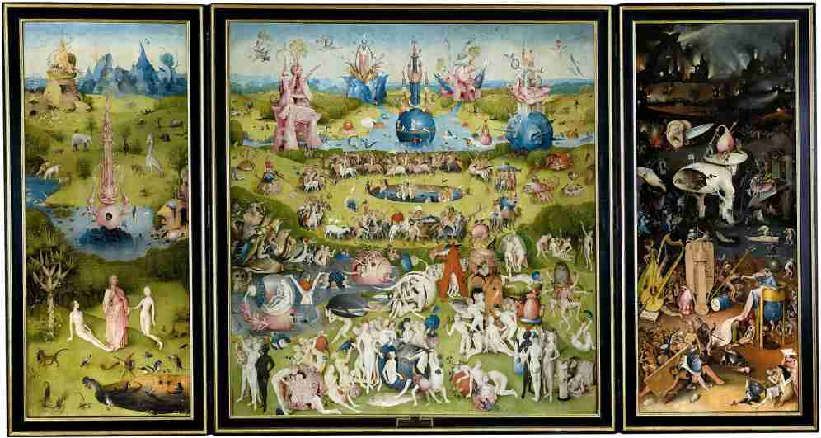
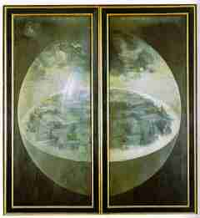

Slide 19
The Garden of Earthly Delights, Hieronymus Bosch - El Bosco (circa 1500)
(Wikimedia Commons)

Slide 20
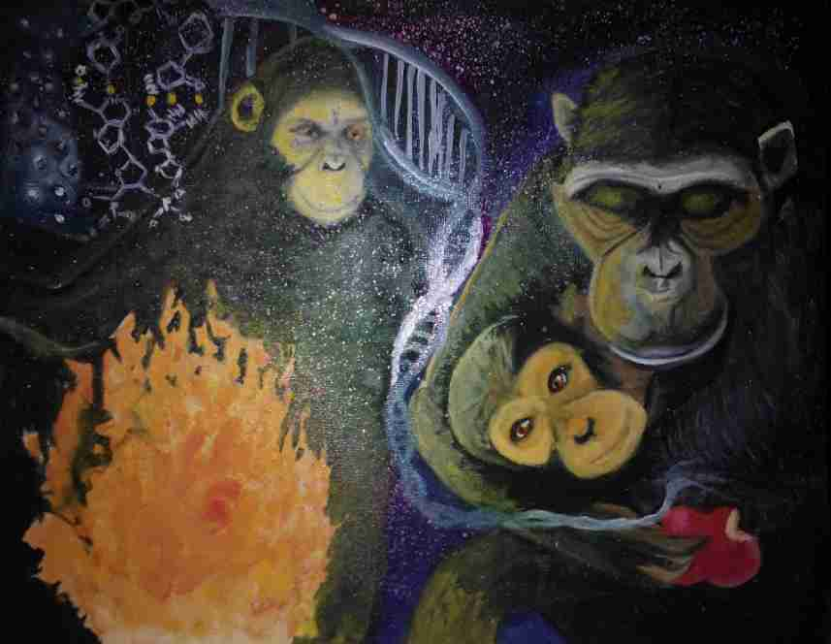
Reconciling Science [and Religion], Harishbabu Laguduva, 2013 (Wikimedia Commons)

Slide 21
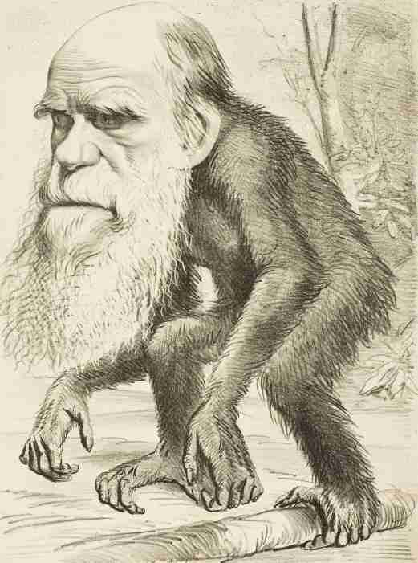
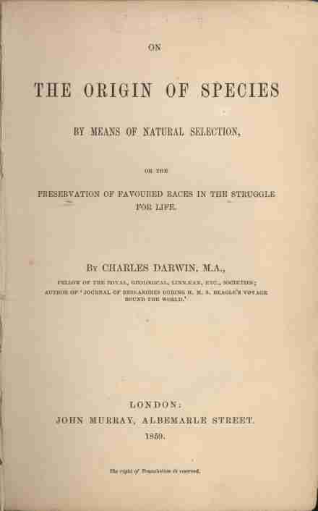

Slide 22
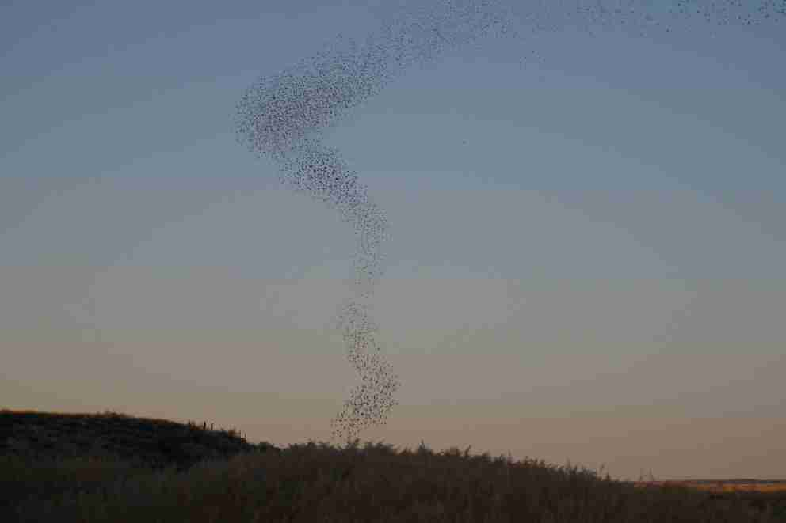
Flock of starlings (murmuration) (Wikimedia Commons)

Slide 23
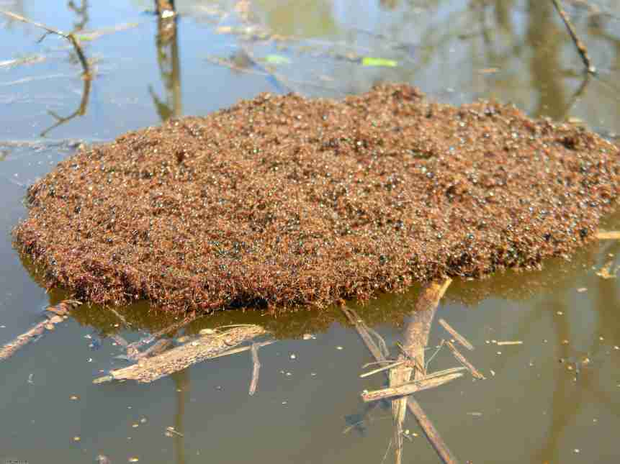
Fire ant raft (Wikimedia Commons)

Slide 24
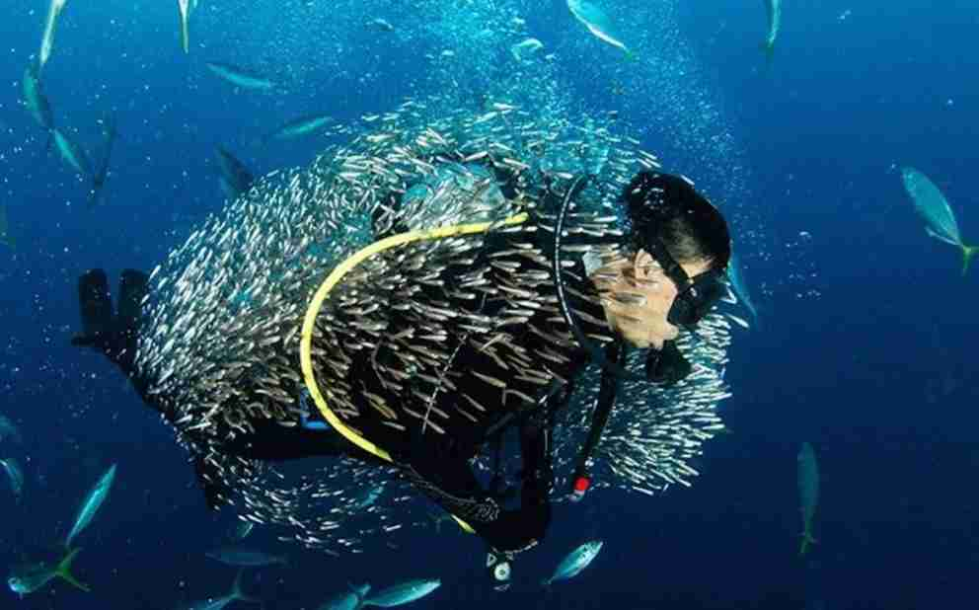
Bait ball (Wikimedia Commons)

Slide 25
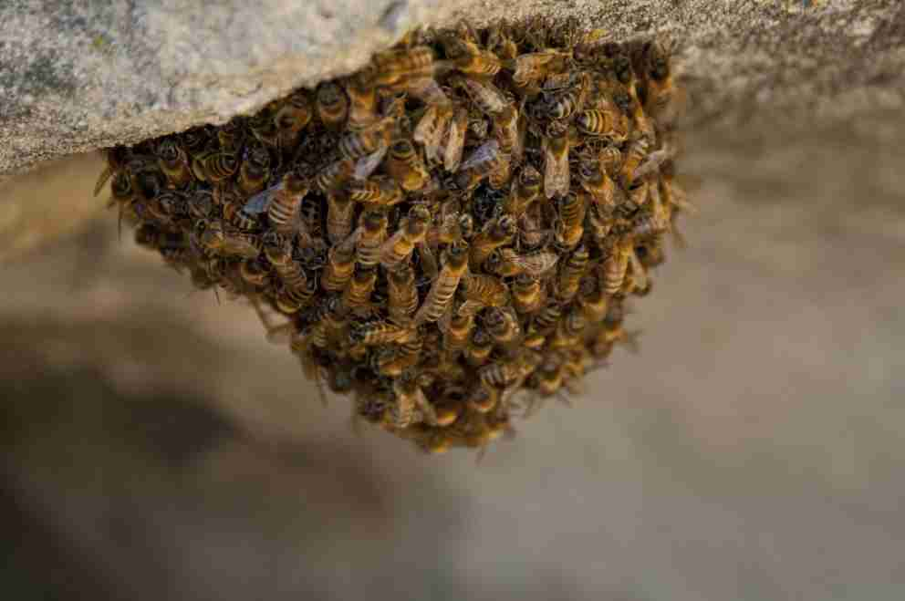
Bee hive (Wikimedia Commons)

Slide 26
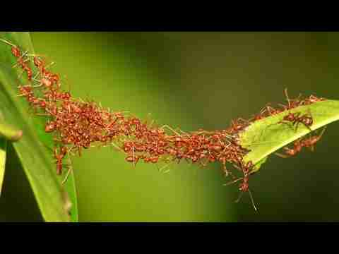
Ant bridge (Wikimedia Commons)

Slide 27
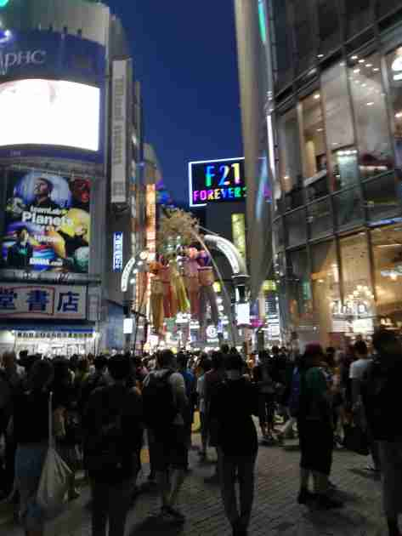
Shibuya crossing, Tokyo, Japan, 2018

Slide 28
Posted on Twitter by Francisco Boni (@boni_bo)

Slide 29
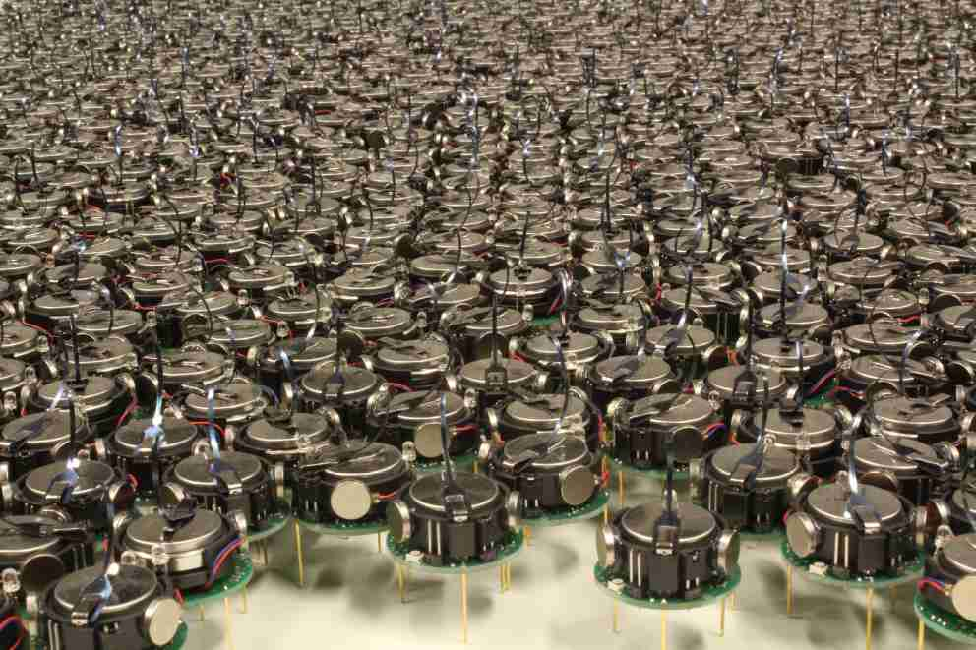
Kilobots, Radhika Nagpal Self-organizing Systems group, Harvard

Slide 30
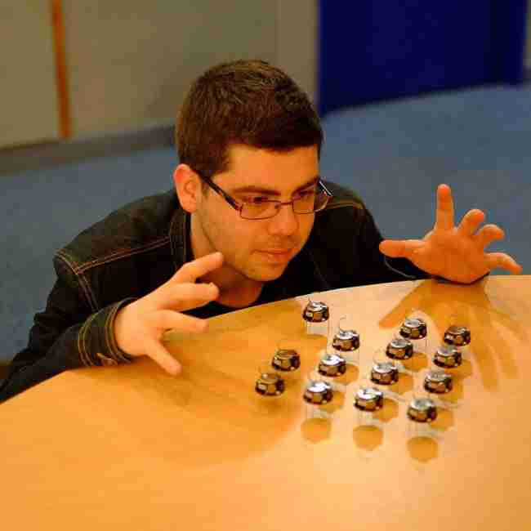
Me, playing with the toys during my Ph.D. at LORIA/Inria lab

Slide 31
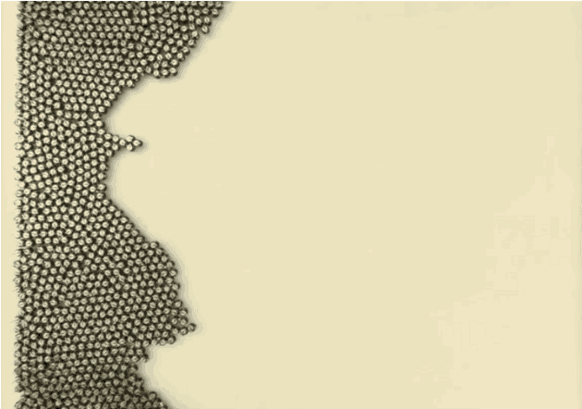
Self-organizing kilobots forming a star shape, Nagpal lab

Slide 32
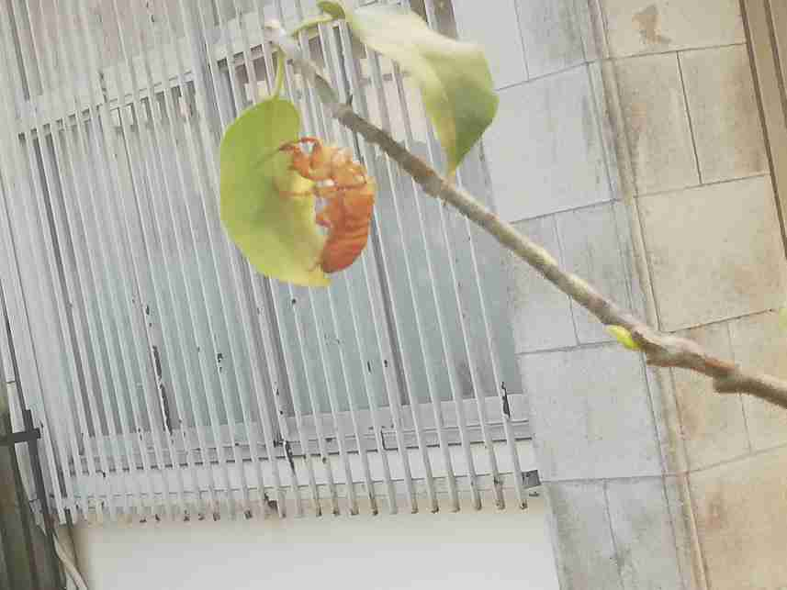
Semi bug (cicada), Chiyoda, Tokyo, Japan, 2018

Slide 33
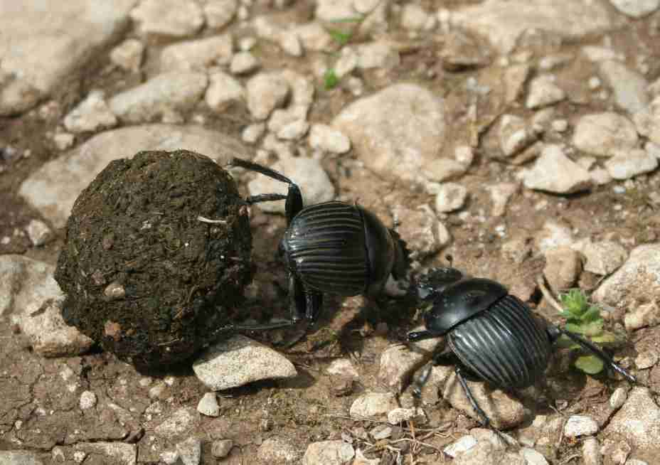
Dung beetles fighting (Wikimedia Commons)

Slide 34
So….
What is Artificial Life?
Some videos….

Slide 35
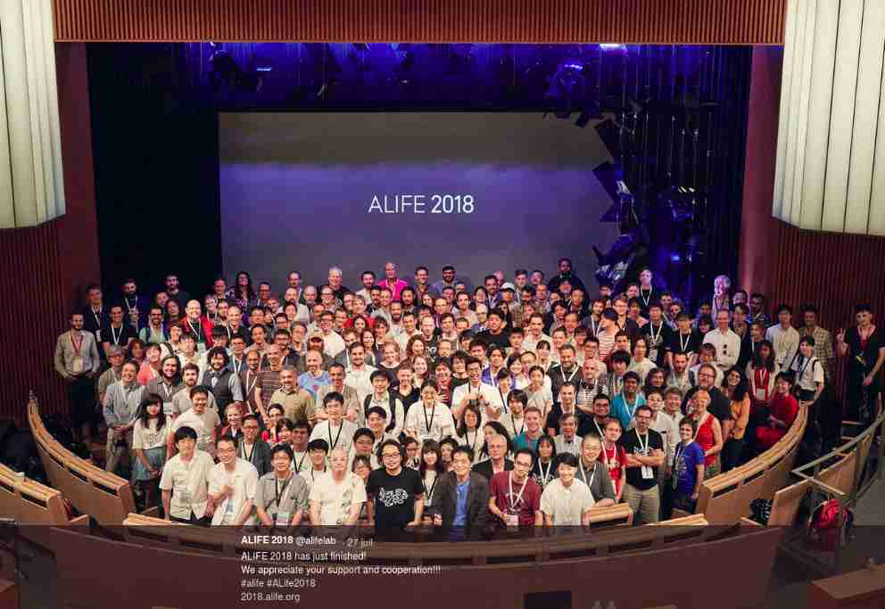

Slide 36
(not really Alife per se) Spot Robot, Boston Dynamics
https://www.youtube.com/watch?v=M8YjvHYbZ9w

Slide 37
Swarm boids
Maruyama, N., Hashimoto, Y., Mototake, Y., Saito, D., & Ikegami, T. (2017).
Revisiting Classification of Large Scale Flocking. In SWARM 2017 (pp. 307–310)
Thanks to Lana Sinapayen for providing the support
Spot Robot, Boston Dynamics
https://www.youtube.com/watch?v=M8YjvHYbZ9w

Slide 38
W. Noguchi, H. Iizuka, and M. Yamamoto, Adaptive Behavior 25.3 (2017): 129-146
Cognitive map self-organization from subjective visuomotor experiences in a hierarchical recurrent neural network
Thanks to Wataru Noguchi for providing the support

Slide 39
Hiroki Sayama, 2018 Conference on Artificial Life, Tokyo, Japan
Seeking Open-Ended Evolution in Swarm Chemistry II: Analyzing Long-Term Dynamics via Automated Object Harvesting
Thanks to Penny Faulkner Rainford for providing the support

Slide 40
Autonomously Shaping Natural Climbing Plants: A Bio-hybrid Approach
M. Wahby, M. K.Heinrich, D. N. Hofstadler, E. Neufeld, I. Kuksin, P. Zahadat, T. Schmickl, P. Ayres, H. Hamann
Royal Society Open Science 2018
Thanks to Payam Zahadat for providing the support

Slide 41
subCULTron project - Cultural Development as a Tool in Underwater Robotics, T. Schmickl et al.
http://www.subcultron.eu/
Thanks to Payam Zahadat for providing the support

Slide 42
H. Haraldsen Roen, B. Bocquillon, S. Hoebeke, S. Nichele, K. Bergaust, H. Dahlsveen, H. Lieng
Emergence of Collective Intelligence: an Artificial Pheromone-Based Swarm Robotic System
The 3rd Open Fields Conference, RIXC Art Science Festival 2018 (IN PRESS)
Thanks to Stefano Nichele for providing the support

Slide 43
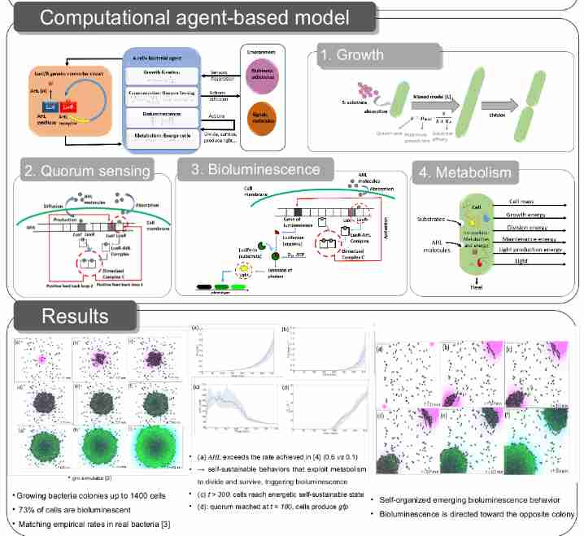
Simulation of Bioluminescent Bacteria Colonies Tweeting via Quorum-Sensing Molecules,
Djezzar, Fernández Pérez et al., late-breaking poster at Alife 2018

Slide 44
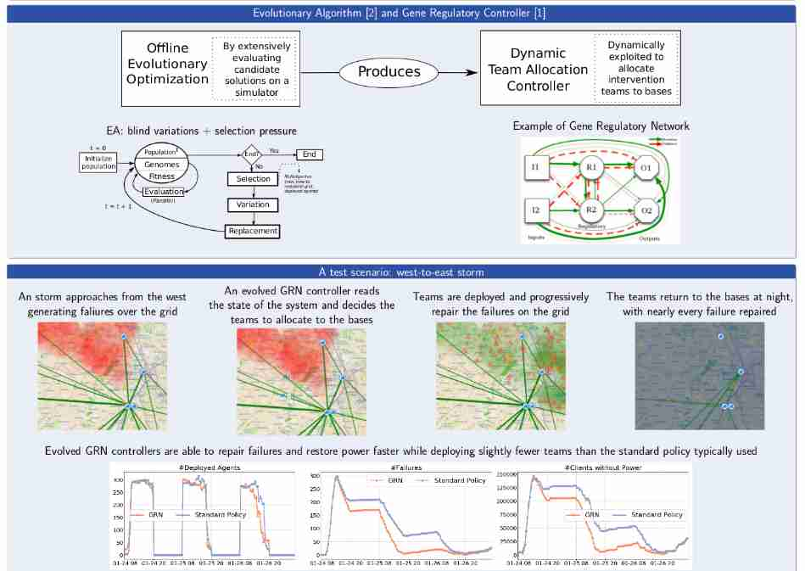
Dynamic Resource Allocation using Evolving Gene Regulatory Networks, Fernández Pérez et al., late-breaking poster at Alife 2018

Slide 45
Learning Collaborative Foraging in a Swarm of Robots using Embodied Evolution
I. Fernández Pérez et al. ECAL 2017, Lyon
Nominated to best paper award at ECAL17 Lyon (4 nominees among 100+ papers)

Slide 46
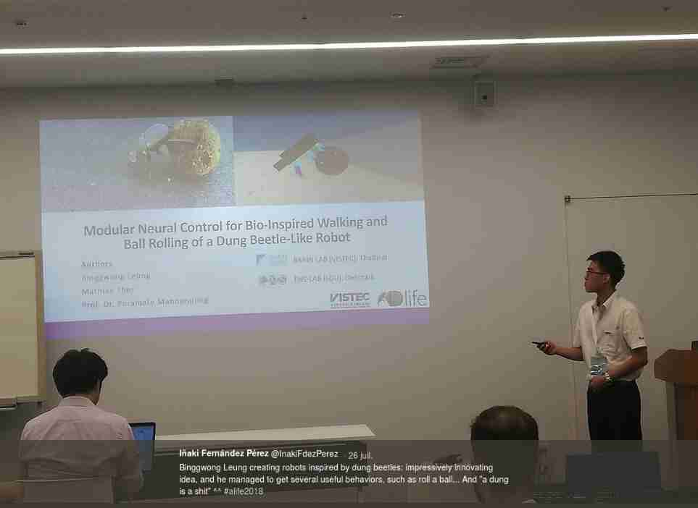

Slide 47
Leung, B., Thor, M., & Manoonpong, P. (2018).
Modular Neural Control for Bio-Inspired Walking and Ball Rolling of a Dung Beetle-Like Robot.
2018 Conference on Artificial Life, Tokyo, Japan (pp. 335–342)

Slide 48
Leung, B., Thor, M., & Manoonpong, P. (2018).
Modular Neural Control for Bio-Inspired Walking and Ball Rolling of a Dung Beetle-Like Robot.
2018 Conference on Artificial Life, Tokyo, Japan (pp. 335–342)

Slide 49
Leung, B., Thor, M., & Manoonpong, P. (2018).
Modular Neural Control for Bio-Inspired Walking and Ball Rolling of a Dung Beetle-Like Robot.
2018 Conference on Artificial Life, Tokyo, Japan (pp. 335–342)
Thanks to Binggwong Leung for providing the support

Slide 50
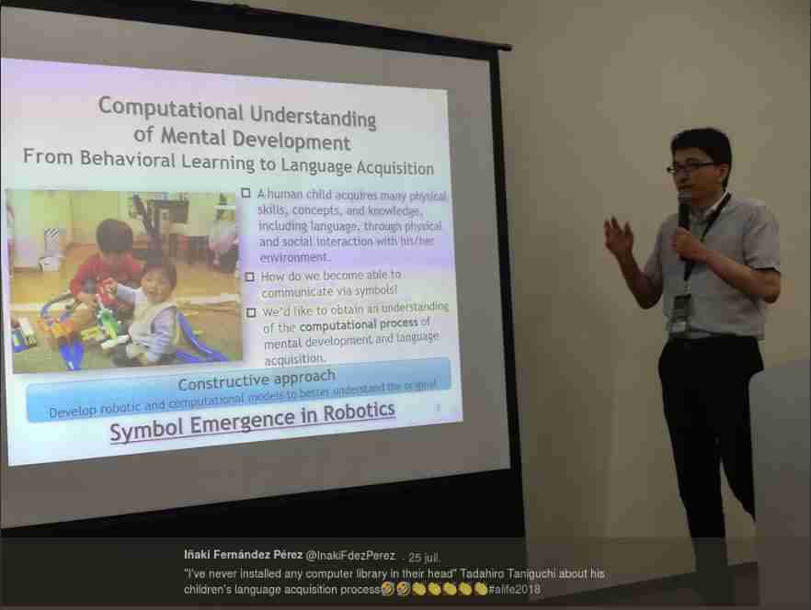
Tadahiro Taniguchi about Symbol Emergence at EVOSLACE workshop, Alife 2018

Slide 51

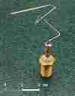
Examples of applied ALife
Neural nets (~1955-…), deep learning (~2005-...)
  Clasification, identification, decision, regulation,….
Design via genetic algorithm (e.g. antenna Hornby et. al.)
  Deployed in 3 NASA satellites (2006)
Other metaheuristic optimization algorithms
  Ant Colony Optimization, Artificial Immune Systems, Particle Swarm Optimization
Annual HUMIES competition at GECCO conference
  Applications of genetic alg. with human-level perfomance
Virtual scene generation, social modelling, bioinformatics,...

Slide 52
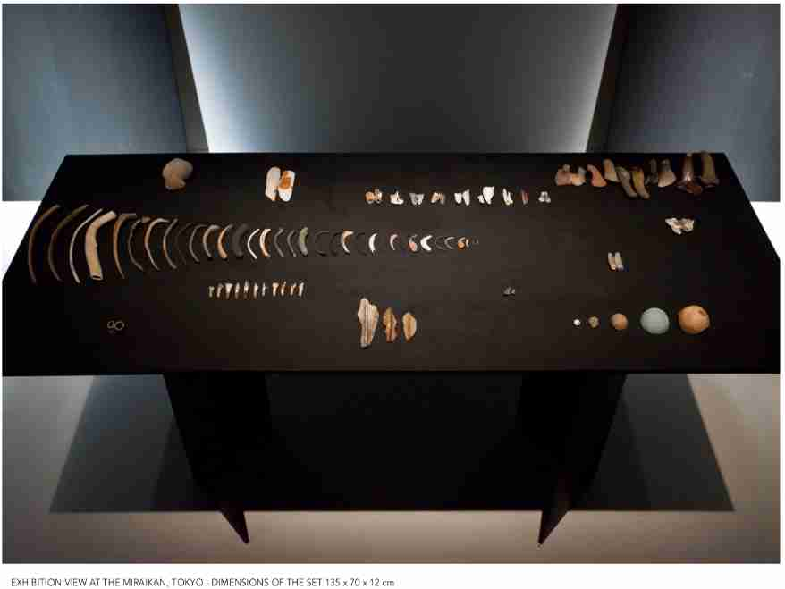
Art competition winner at Alife 2018, Tokyo, Japan: Thamesiology by Olivia Guigue

Slide 53
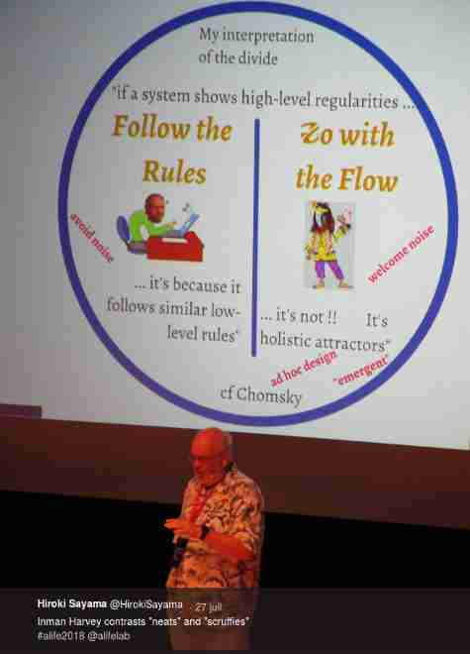
Inman Harvey’s keynote at Alife2018: scruffy and neat approaches to Alife research
Tweet by @HirokiSayama

Slide 54
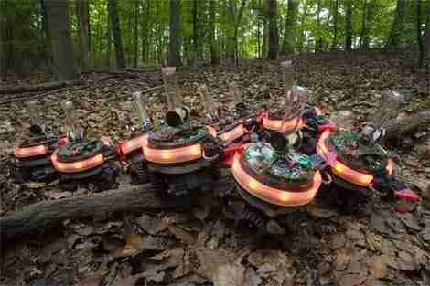
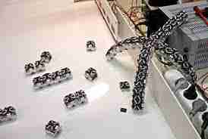
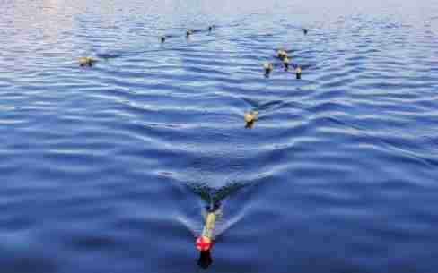
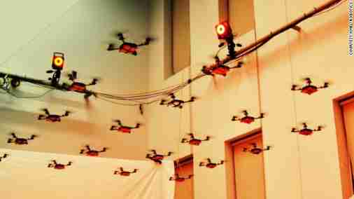
Swarm Robotics

Slide 55
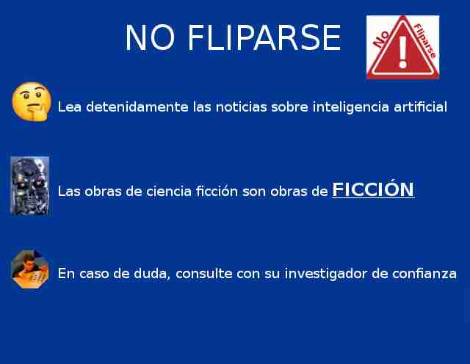
Don’t go overboard
Read carefully the news on A.I.
SciFi is FICTION
In case of doubt, check with your trusted researcher

Slide 56
Swarm Robotics
Collective and adaptive robot systems
Self-organized and distributed behavior
  Without central element / bottleneck
Emergent global properties
    ….from simples rules and interactions
Robust, scalable, flexible,…, systems
…. but difficult to design

Slide 57
Sensorimotor loop
A simple reactive robotic agent and its sensorimotor loop

Slide 58

Evolutionary Algorithms

Slide 59
(Distributed) Embodied Evolution

Slide 60
(Distributed) Embodied Evolution

Slide 61
(Distributed) Embodied Evolution

Slide 62
(Distributed) Embodied Evolution

Slide 63
Evolution of Collaboration
Learning Collaborative Foraging in a Swarm of Robots using Embodied Evolution
I. Fernández Pérez et al. ECAL 2017, Lyon
Nominated to best paper award at ECAL17 Lyon (4 nominees among 100+ papers)

Slide 64
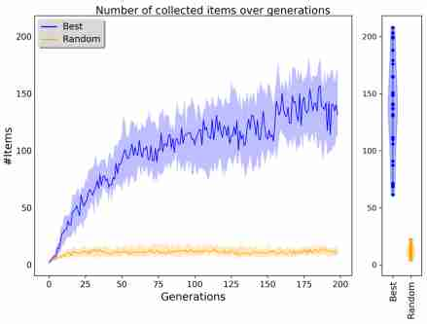
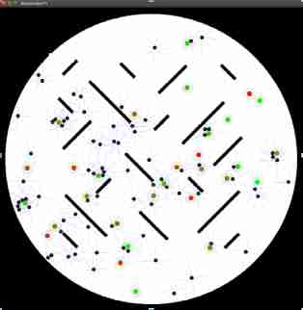
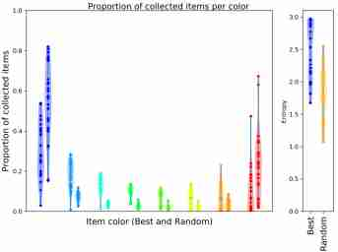
Evolution of Collaboration

Slide 65
Mantaining Diversity over the Swarm
Diversity → positive for adaptation
  To unknown environments, changes, diff. tasks,….
Centralized vs. distributed Evolutionary Algorithm
Or seen otherwise:
    1) global comunication
    2) long distance
    3) medium distance
    4) short distance
  Which one mantains more (useful) diversity,
  improving adaptation in the swarm?

Slide 66
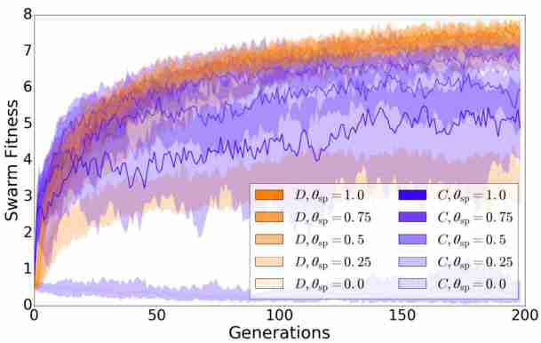
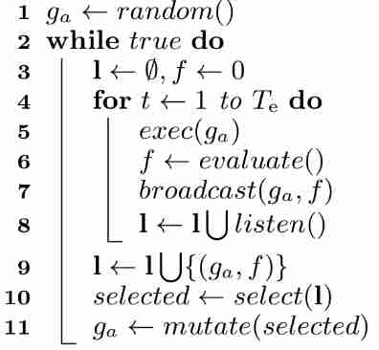
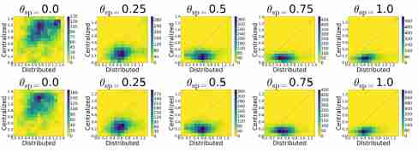
Mantaining Diversity over the Swarm
Paper at ANTS, Rome (October 2018)

Slide 67
But then.…
What is Artificial Life exactly?

Slide 68
A definition of Artificial Life?
Artificial life is the study of artificial systems that exhibit
behavior characteristic of natural living systems. It is the quest to explain life in any of its possible manifestations, without restriction to the particular examples that have evolved on earth. This includes biological and chemical experiments, computer simulations, and purely theoretical endeavors. Processes occurring on molecular, social, and evolutionary scales are subject to investigation.
The ultimate goal is to extract the logical form of living systems.
Christopher Langton, Artificial Life, 1989

Slide 69
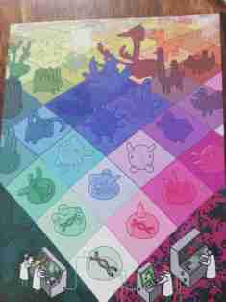
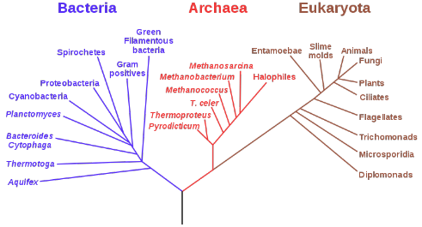
Biology
Study
Use
Nature
Artificial Systems
Phylogeny of Life on Earth (Wikimedia Commons)
Postcard, Insil Choi, Alife 2014
Inspiration (++)
Engineering
Build

Slide 72
ALife: tools and methods shared (and developed) by the community
Study of systems (evo/devo, social, cellular,…)
Soft, hard and wet Alife (digital, robotic or biosynthetic)
Tools: statistical, mathematical, simulation,…
Experimental and analytic approaches, scientific method
Disclaimer: I say this, others may have a different view

Slide 73
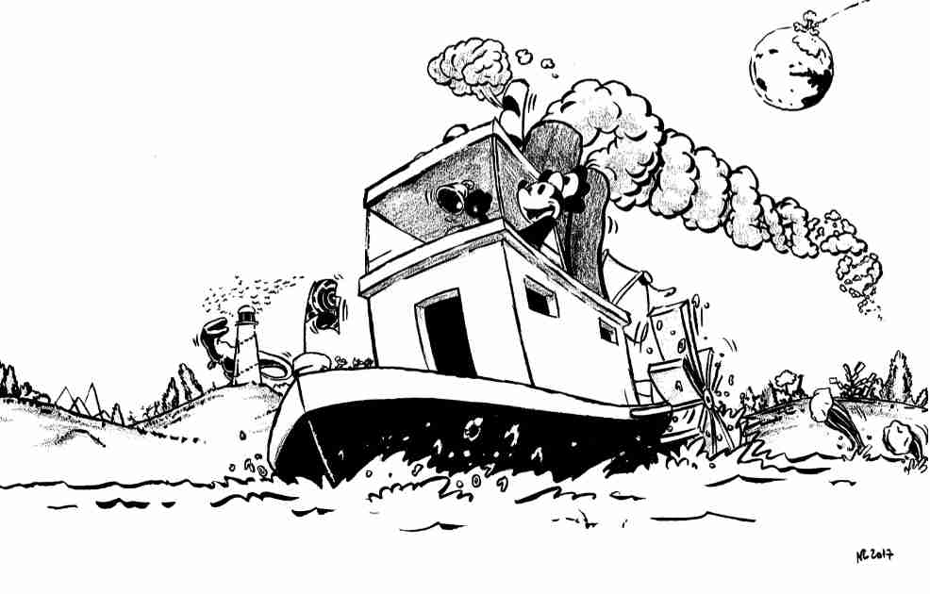
Alife references in drawing by staff member at closing ceremony of ECAL 2017, Lyon

Slide 74
Nature is optimized for efficiency
fernandezperez.inaki@gmail.com @InakiFdezPerez www.irit.fr/~Inaki.Fernandez-Perez
@ISALStudents and postdoc:
  Diverse activities in Alife: journal club, thematic discussions, collaborations, annual award, events in conferences, ISAL board representative, upcoming Artificial Life journal column
  http://isalstudents.org/
Draw inspiration even from below rocks
And investigate the subject of study in a thorough manner: scientific method

