Slide 1
Adaptive Systems
Ezequiel Di Paolo
Informatics
Lecture 1: Overview

Slide 2

Organisation of the Course
Lectures
  Ezequiel Di Paolo (ezequiel@sussex.uk)
  Monday 9:00-10:00
  Monday 10:00-11:00
Seminars
  Run by Marieke Rohde (mr58@sussex.ac.uk)
  and Thomas Buehrmann (tb30@sussex.ac.uk)
  Weeks 4-6
Lab Class
  Week 7 (PG)

Slide 3
Resources
Course webpage linked from:
www.informatics.sussex.ac.uk/users/ezequiel/teaching.html
Includes: Lecture notes, list of online resources, last minute information, advice on choice of programming projects, questions, reading material

Slide 4

Assessment (Undergraduates)
Exercise 1 (50%)
  Programming exercise: Based on a robot or GA project. A 2000-word report to be handed in
Exercise 2 (50%)
  A 3000-word essay on a relevant topic of your choice (list of topics will be made available)

Slide 5
Assessment (Postgraduates)
Programming project (100%)
  A 5000-word term paper (topic to be agreed) based on programming or robotic project and containing essay elements
Advice
  You are encouraged to seek feedback on your choice of topic. Suitable topics and format advice will be made available

Slide 6
Objectives
To gain some familiarity with a number of different approaches to modelling and understanding adaptive processes in natural and artificial systems. In particular, to gain some understanding of approaches (old and recent) to generating adaptive behaviours in autonomous robots.

Slide 7
Rationale
This course will cover theoretical aspects of biological adaptation and recent work in AI which is geared towards understanding intelligence in terms of the generation of adaptive behaviour in autonomous agents acting in dynamic uncertain environments. Adaptation will be studied at both the evolutionary and the lifetime scale.

Slide 8
Rationale
Lectures will give a general coverage. Seminars and exercises will guide you deeper into certain topics. You are expected to engage in background reading and follow up references mentioned in the lectures.
No single textbook. But lots of books, book chapters, articles, online material, etc.

Slide 9
Contents
The first part of the course will look at conceptual issues in studying and modelling natural adaptive systems (roughly the first 7 lectures). The rest of the course will concentrate on evolutionary techniques, particularly as applied to the design of artificial adaptive systems (robots).

Slide 10
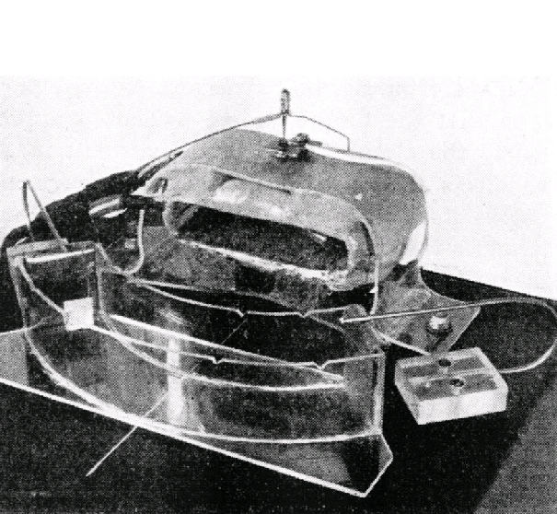
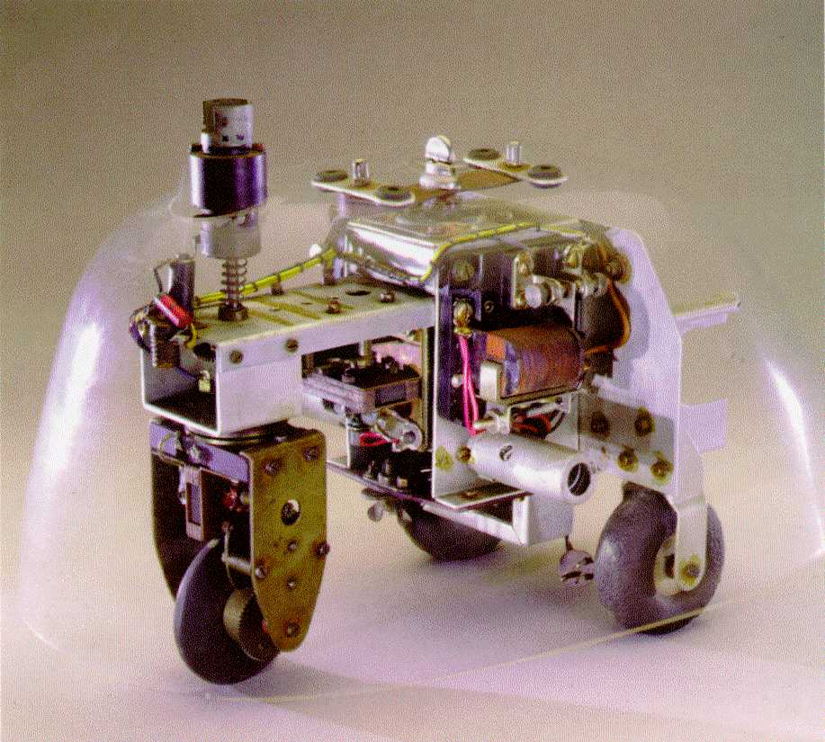
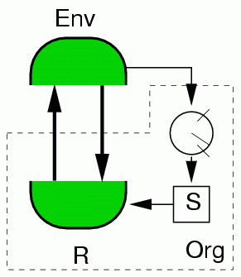
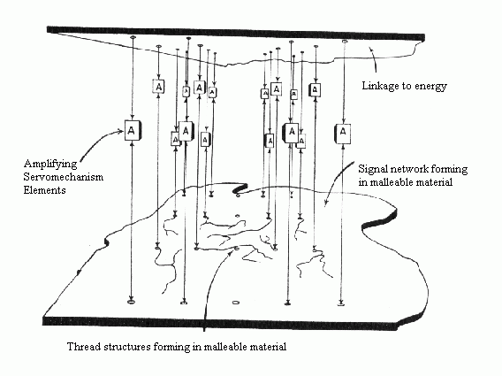
Contents: Cybernetics

Slide 11
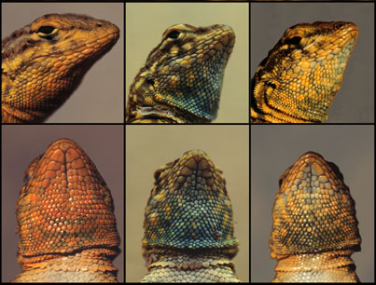

Evolution

Slide 12
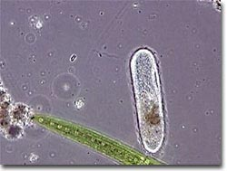
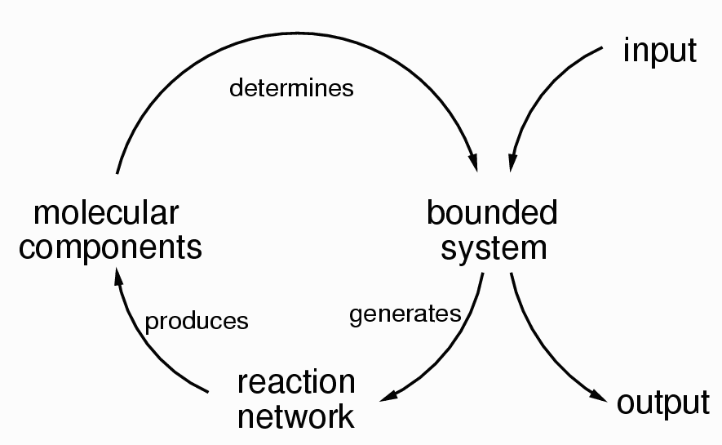
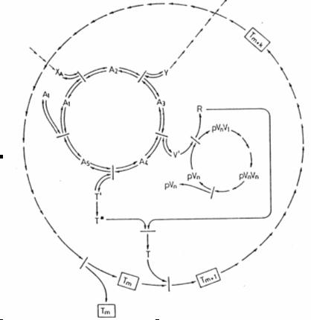
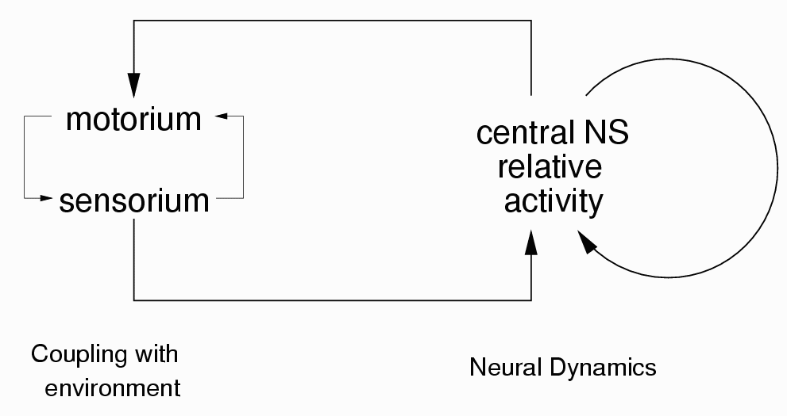
Autopoiesis, minimal living systems

Slide 13
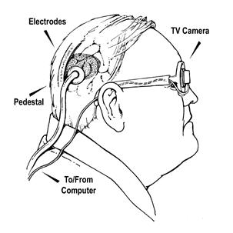

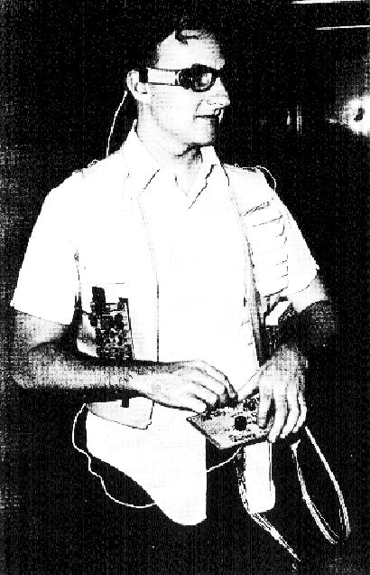
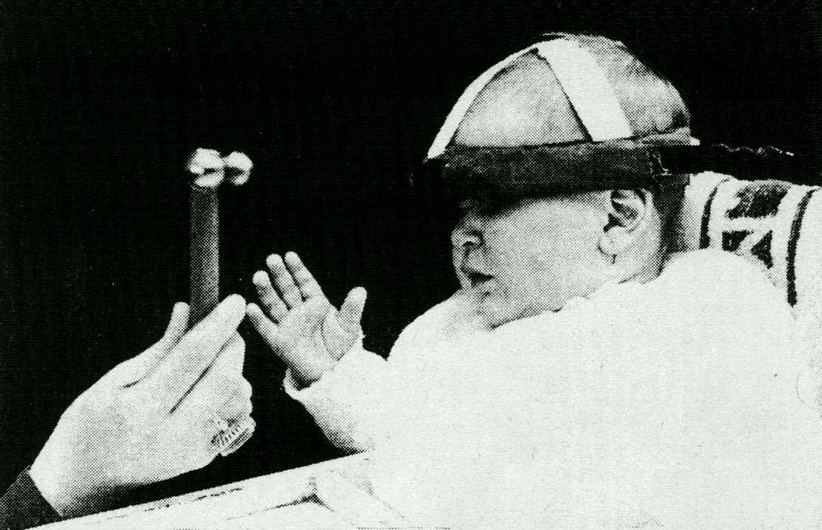
Sensory substitution

Slide 14


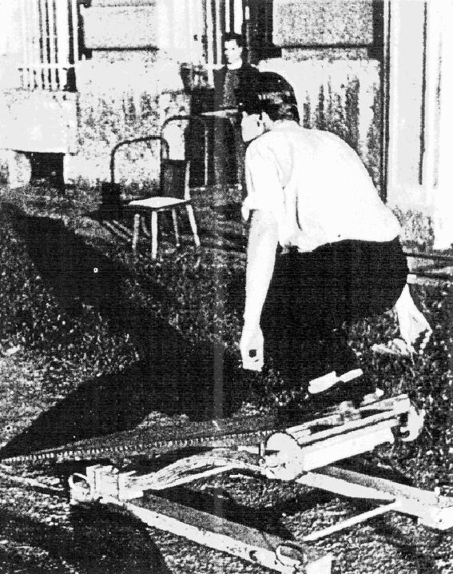
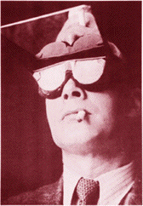
Distorted perception

Slide 15
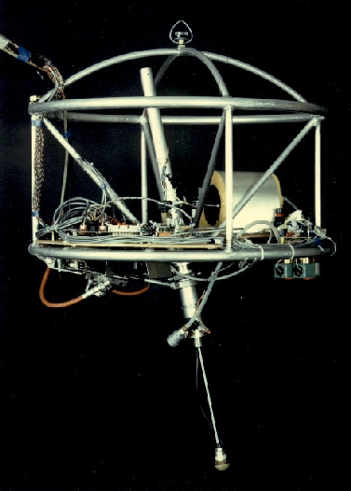
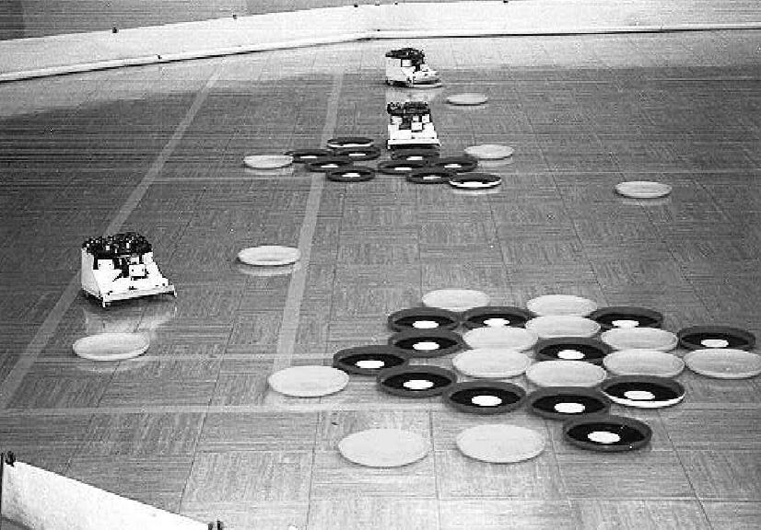
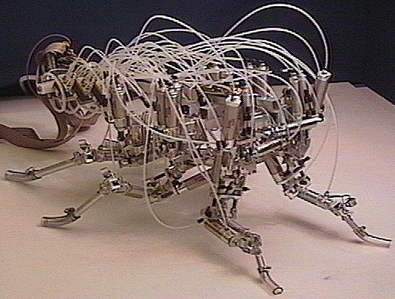
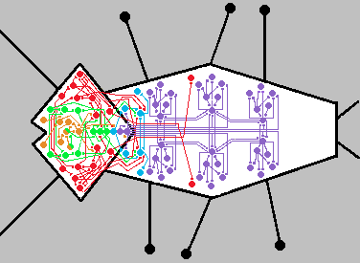
Robotics

Slide 16
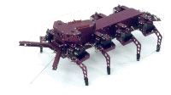
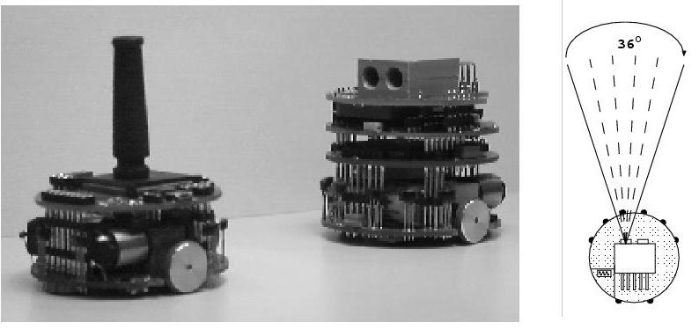
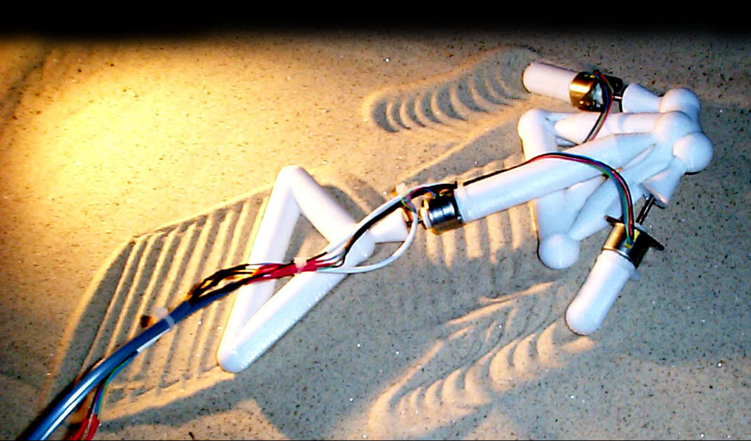
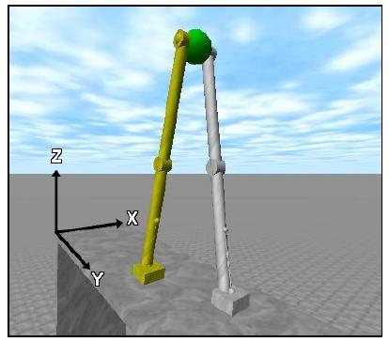
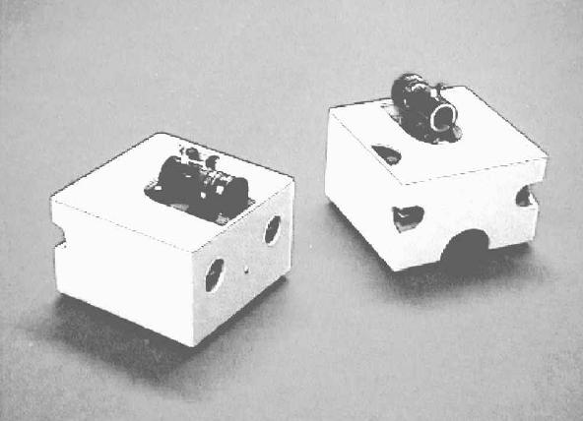
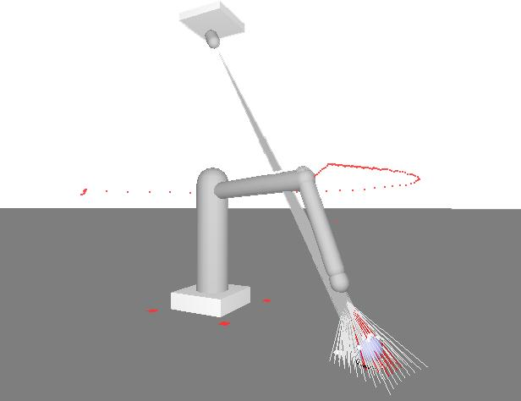
Evolutionary robotics

Slide 17
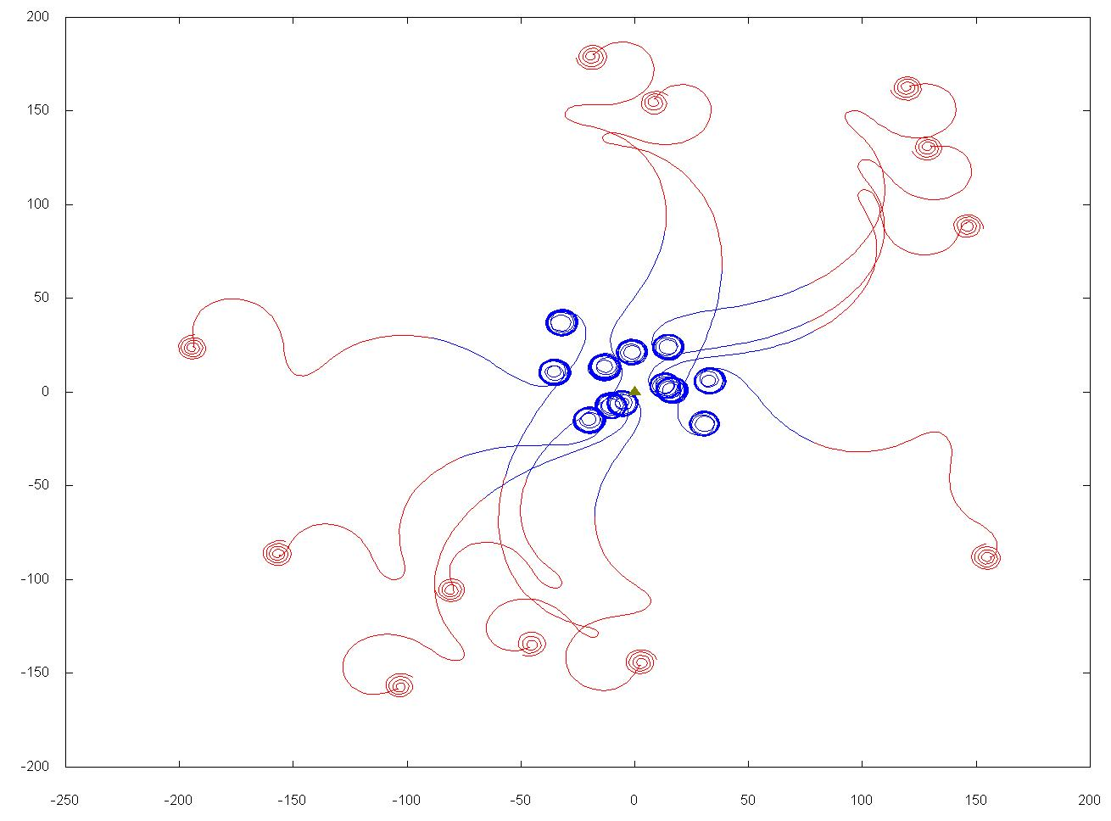
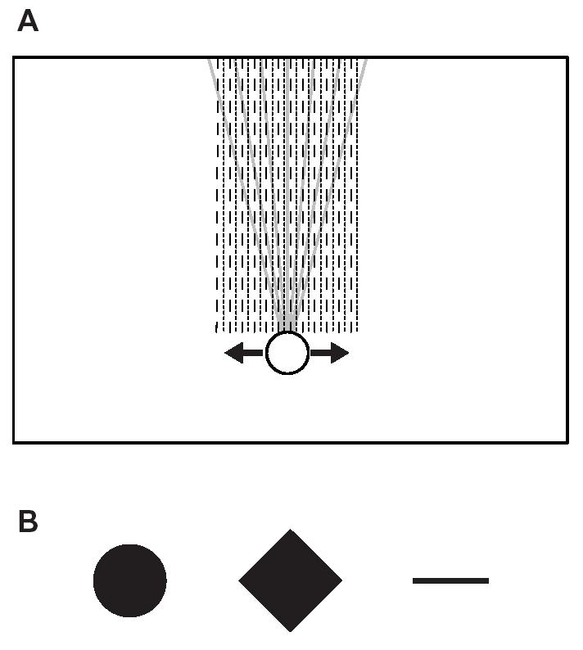
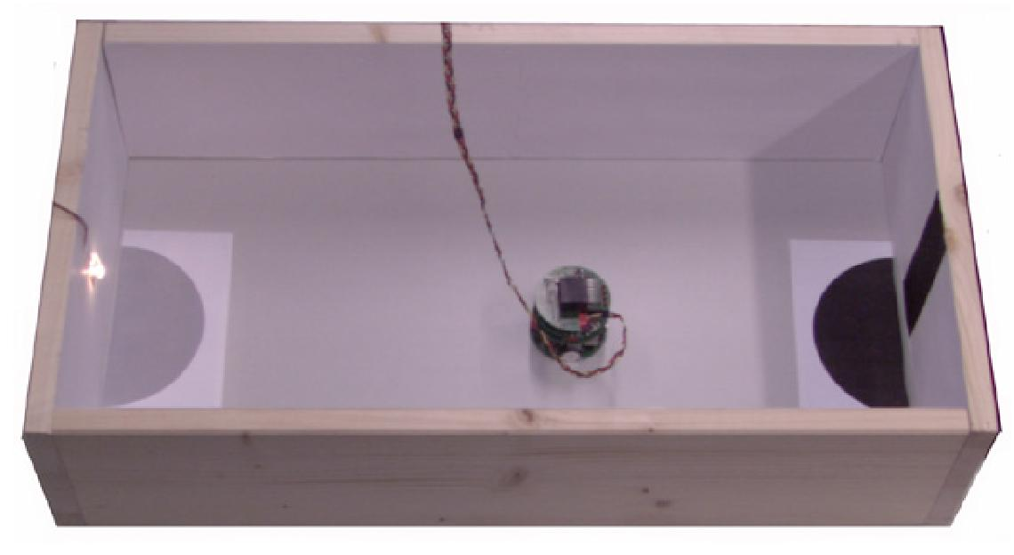
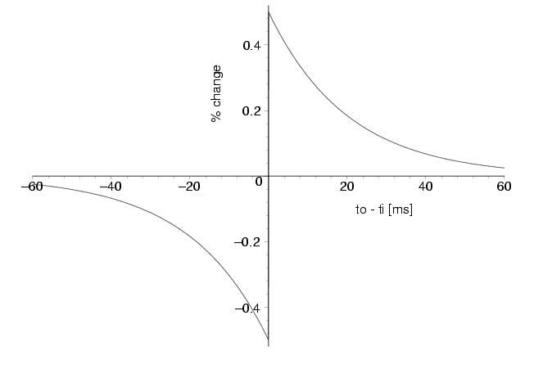
Minimal cognition, neural systems

Slide 18
Contents
Cybernetic roots of AI
Adaptation and stability (Ashby)
Evolutionary theory
Evolutionary computing
Somatic adaptation, sensory substitution
Autopoiesis, autonomy
Co-adaptation and social behaviour
Adaptation in artificial systems
Autonomous robotics
Embodiment, situatedness
Dynamical approaches to cognition
Evolutionary robotics (basics, hot topics)

Slide 19
What is an adaptive system?
A system that changes in the face of perturbations (e.g., changes in the environment) so as to maintain some kind of invariant (e.g., survival) by altering its properties (e.g., behaviour, structure) or modifying its environment.
Operationally speaking: a system that maintains some kind of invariant by responding to perturbations in this manner.

Slide 20
Changes…
The observed change may be due to changes in the structure or internal mechanisms of the system or may stem from its intrinsic dynamics. (A very fine line distinguishing both cases.)

Slide 21
Adaptivity …
… (the ability to adapt) depends on the observer who chooses the scale and granularity of description.
Obstacle avoidance may count as adaptive behaviour if we describe navigation at a microscale where obstacles appear rarely in largely open and unobstructed segments of the environment. If the “normal” environment is viewed at a macroscale as obstacle-rich, then avoidance becomes part of the “normal” behaviour rather than an adaptation.

Slide 22
Different meanings of adaptation
Adaptation means change, but not just any change. It means appropriate change. Adaptation implies a norm.
Different meanings of “appropriate” correspond to different meanings of “adaptation”.

Slide 23
Kinds of adaptation
Task-based: changes that allow the completion of a goal when this is challenged. (Most common meaning when dealing with artificial systems).
Sub-organismic: a system/mechanism within the organism that maintains some internal property (homeostasis in individual cells, etc.) Can give rise to organismic level phenomena such as habituation (which may be non-adaptive at this higher level).
Organismic: changes that maintain essential properties of the organism (e.g., those that guarantee survival, identity, autonomy).

Slide 24
Kinds of adaptation
Ecological: changes that maintain certain patterns of behaviour of one or many organisms. Recovery of sensorimotor invariants and habitual behaviour. Radical adaptation to body reconfiguration. Includes social invariants, group behaviour, social norms, institutions, economies, etc.
Evolutionary: changes in distribution of phenotypes due to differential rates of survival and reproduction. Resulting phenotypic properties can be said to be adapted. Occurs at population level.

Slide 25
Normativity
In all cases, to say that a change is appropriate means that we are using a framework of normativity. We are saying when things are right and when they are wrong.
In some cases this framework is easy to obtain. In task-based scenarios it is arbitrarily defined by the designer as the goal to be achieved (a wholly external norm). In other scenarios the situation may be more complicated (co-dependent norms).

Slide 26
Normativity
Task-based thinking should not be applied uncritically to organismic or evolutionary adaptation. We theorize about what the organism should do; if it manages to achieve a goal when challenged we say it has adapted. We propose an external norm, but we could be wrong... An organism may adapt by discarding the achievement of the goal as necessary for “its purposes” (the norm may change). However, applying task-based thinking is what is usually done. (cf. optimality assumptions in biology).

Slide 27
Normativity
Some normativity frameworks may prove useful and yet lead to unintuitive results, (e.g., the maintenance of ecological patterns of behaviour/perception could be used to describe substance addiction as an adaptation which may work against organismic survival).

Slide 28
Observer-dependence
Scale and granularity of description
Multiple levels and kinds of adaptation
Alternative valid frameworks of normativity
All this points to the observer-dependence of adaptation. Yet, observer-dependence does not mean arbitrariness…

Slide 29
Reasons for studying adaptation
Theoretical
  nervous systems and the generation of behaviour/perception
  natural intelligence
  multi-level processes (physiological/ecological/historical)
  social behaviour, social institutions,
  evolutionary dynamics
  complex multi-component systems (economies, linguistic communities, etc.)

Slide 30
Reasons for studying adaptation
Practical
  solving complex search problems
  designing new tools for scientific enquiry
  building autonomous robots
  risky mission robotics
  a path towards AI
  intelligent software agents
  adaptive interfaces as body enhancers
  Medical (rehabilitation, addiction treatment, prostheses, sensory substitution)

Slide 31
Modelling systems
Variables/Parameters
  A system is defined as a set of variables. These can be chosen arbitrarily, but only a few choices will be significant (state-determined systems). Factors affecting the system which are not variables are called parameters.
State/Transformation
  The values of the system's variables at a given instant define the state of the system. States can change thus introducing a temporal dimension or transformation.

Slide 32
Modelling systems
Dynamical Law/Constraints
  Regularities in the transformations of a system can often be described as a special case of a general law. General laws can be applied to particular systems by specifying a set of constraints that describe the relations that hold between variables and derivatives.
Continuous/Discrete
  Some variables may vary continuously and some may have a discrete set of allowed values. (Some variables may be continuous but fruitfully approximated as discrete).

Slide 33
Modelling systems
Coupling
  Two or more systems identified as distinct may interact. This is described as coupling: variations in the parameters of one system depend on the value of variables in other system. A useful description if we wish to maintain a distinction between the systems, otherwise they can be seen as a single larger system.
Autonomy
  Non-autonomous system: when some parameter or constraint is an independent function of time (e.g., systems driven by some external factor). Otherwise, autonomous. Technical sense (not exactly as will be used in this course, but still relevant).

Slide 34
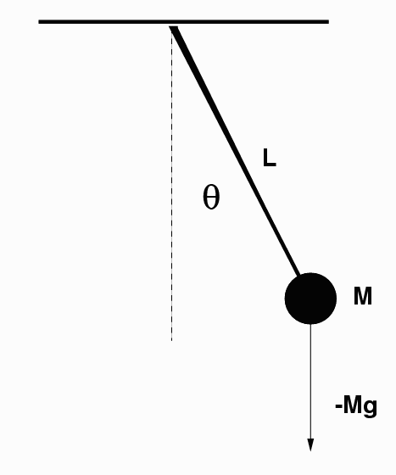
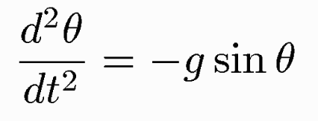
Example: a pendulum
Variable: Angle to the vertical θ
Parameters: Length of string, mass, elasticity, air resistance…
Law: Gravitation, Newton's 2nd law
Constraints: Position of mass always at a fixed distance from origin; fixed origin.
Description of dynamics: a differential equation that expresses changes in angular velocity as a function of the dynamical laws and constraints.
Solution of dynamics: angle as a function of time θ(t), given an initial condition.

Slide 35
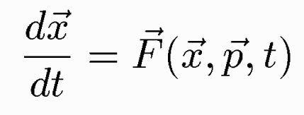
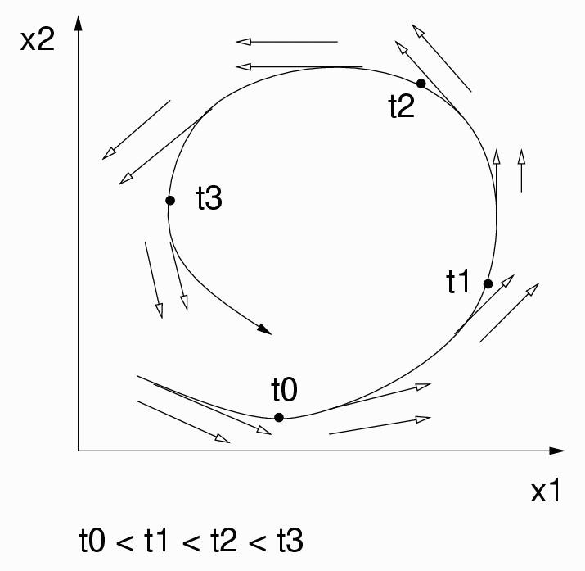
State space, vector fields
Generalised equations of motion
Trajectory in state-space, vector field

Slide 36
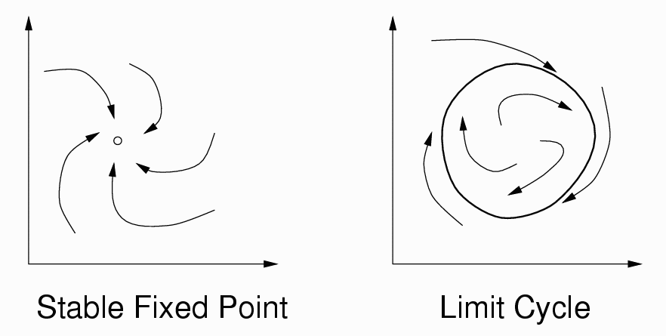
Attractors
Attractors: Asymptotic dynamics (t→∞) Valid concept for autonomous, closed systems.
The whole picture becomes more complex if we add noise or uncertainty: Stochastic processes, distribution of states, etc. For open systems: metastable states, bifurcations, itinerancy.

