Slide 1
Adaptive Systems
Ezequiel Di Paolo
Informatics
Autopoiesis, Autonomy, Adaptation

Slide 2
Aims of this lecture
To introduce some key concepts and terms involved in the theory of autopoiesis.
To facilitate the negotiation of a difficult but important literature.
To help you spot misapplication of these concepts
To give a glimpse of a different way of thinking about biology
To open the question of the scientific usefulness of these ideas.

Slide 3
Not the aims of this lecture
To give a full account of autopoiesis
To derive all its implications for human evolution, social systems, cognitive science, etc.
To convince you that autopoiesis is the right way of thinking about biology or cognition.

Slide 4
Nobel thoughts about biology
“There is now a crisis developing in biology, that completely unstructured information does not enhance understanding. What people want is to understand, which means you must have a theoretical framework in which to embed this." -Sydney Brenner, 2002 Nobel Prize Winner
"We’ve got to start thinking. We have all these individual components behaving in different ways, that interact in different ways, and we’ve got to somehow extract the general principles from that behavior." -Paul Nurse, 2001 Nobel Prize Winner

Slide 5
Autopoiesis sans frontières
The downside of fame: “Autopoiesis and …”
Life, Evolution, Law, Society, Journalism, Art, Science, Culture, Coevolution, Medicine, Ontology, Ecology, Software, Mathematics, Self-organisation, Entropy, Cybernetics, Robotics, Enaction, Communication, Language, Spirituality, Time, Psychotherapy, Logic, Vision, Aristotle, Music ...
Question 1: How to distinguish the interesting stuff from the Really Unnecessary Bits of Boring Information (SH)
Question 2: Is it worth the effort?

Slide 6
Things autopoiesis fans say
Evolution is not necessary for life. Natural selection is a consequence of evolution, not its cause.
Life cannot exist without physical boundaries
Genotypes do not determine phenotypes
The mind is not in the head. The brain is not a computer
Cognition = Life
The nervous system does not process information
Internal representations are a categorical mistake
Communication is not transfer of information
Artificially life is logically possible only if it is embodied and metabolizing.

Slide 7

What is autopoiesis
Two referents:
  A set of interconnected ideas aimed a providing definitions and explanations for life and biological phenomena. (aka “Autopoietic theory”)
  A central concept in this set of ideas; the defining property of living systems.

Slide 8
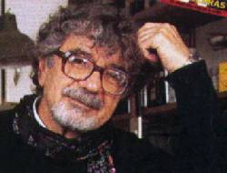
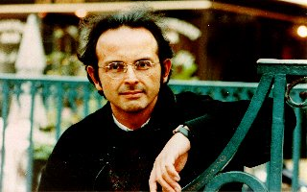
Origins
Conceived in the 70s by Humberto Maturana (1928 -) and Francisco Varela (1946-2001)
Roots in Cybernetics, influence on various fields; hot topic in Alife and embodied, dynamical approaches to cognitive science

Slide 9
Basic axioms
Structural determinism. Life is not magic; the dynamics of a system are determined only by its own structural composition, following operational laws, (the laws of physics). (cf Ashby)
Everything said is said by an observer. It is not possible to do science without a point of view and a language that influence what the observer chooses to distinguish in her observations. This must be taken into account (self-reflective science). For instance, the concept of “behaviour” involves the observer as much as the behaving entity and its environment.

Slide 10
Defining Life
The shopping list approach.
“Life is the capacity of (add or remove items until you're pleased):
Growth, reproduction, metabolism, adaptation, irritability, evolution, autonomy, genetic heritability, evolution, self-organisation, entropy reduction, self-modification”
How long a list do we need? First, we must know what a living system is to find out.

Slide 11
Defining Life
The operational approach
What is the invariant feature across all living systems which can be found by reference to the systems in themselves as they are in the present? (No notions of purpose, future states, other systems, etc.)
Answer: The fact that these systems produce themselves physically so as to remain distinct from their backgrounds. If they stop doing this, they die.

Slide 12
Αυτόσ = self, Ποιειν = to produce
Autopoietic system: a system organised as “a network of processes of production, transformation, and destruction of components that produces components which: (i) through their interactions and transformations regenerate and realize the networks of processes (relations) that produced them; and (ii) constitute it [the system] as a concrete unity in the space in which they [the processes] exist by specifying the topological domain of its realization as a network”.

Slide 13
A kind of organisational homeostasis. The organisation of living systems is such that this organisation is actively maintained. Its structure can (must) change. (A virus is excluded.)
metabolism + boundary
↓
produces
↓
metabolism + boundary
↓
produces
↓

Slide 14
Two perspectives
Allopoietic: the system is viewed as an input/output device. The fact that it is a living system is obscured from this viewpoint.
Autopoietic: the system is viewed as a self-producing, closed network. It interacts with the medium but does not transform inputs into outputs. It is alive.
Either perspective can be adopted at a given time, but only the second can bring forward the fact that the system is living.

Slide 15
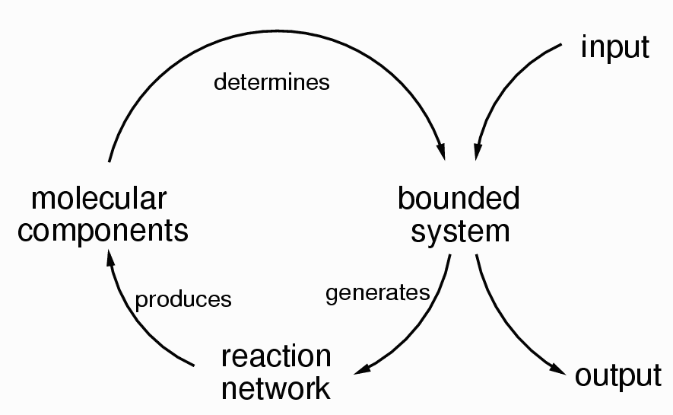

Slide 16
Biological autonomy
Similar idea, only extended to any process, not just processes of physical production of components. Autonomous systems are organisationally closed:
“That is, their organization is characterized by processes such that (1) the processes are related as a network, so that they recursively depend on each other in the generation and realization of the processes themselves, and (2) they constitute the system as a unity recognizable in the space (domain) in which the processes exist.” (Varela, 1979, p. 55).
Examples: autocatalytic networks, immune and nervous systems, communication networks, economies.

Slide 17
Adaptation
Organisational closure implies conservation of identity, i.e., the system is always identifiable. Its interactions with its environment are subordinated to this condition (structural coupling). Permitted interactions are those that conserve autopoiesis (or autonomy as a general case). This is called a relation of adaptation. If broken, the system ceases to exist as such. In other words:
Adaptation = Viability

Slide 18
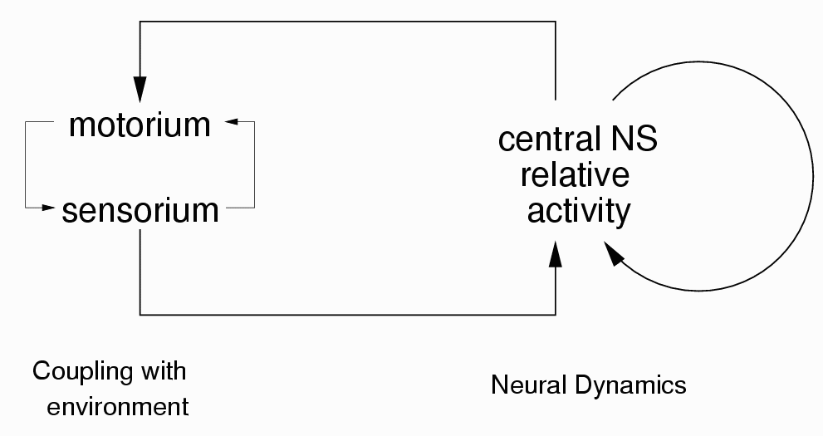
Closure of the nervous system
Neuron activity depends only on the structure of the whole NS and its current state of activity. A “sensory input” (say, photons changing the structure of proteins in a photoreceptor) only modulates nervous activity. The NS interacts with the rest of the organism (through hormone release, muscle activation, etc.)

Slide 19
The distinction between internal and external causes of a given state of the NS can only be made by relating the NS with the contextual state of the organism and its environment; that is, it is an observer-dependent distinction that cannot play any causal role in the operation of the NS.
It makes no sense to localize components of the NS as generating a given property belonging to the organism as a whole in relation to its environment (like language, visual perception, intelligent behaviour, etc.) It's like looking for a “speed” component inside a car engine.

Slide 20
For the same reason, the idea of an internal representation as a causal component in the NS is a categorical mistake. Only a whole agent is capable of representing, not a component of it, for representing is a kind of behaviour (a relation between agent and environment).
A representation is relational, hence representation-talk is always functional talk, never mechanistic, never operational.

Slide 21
Social behaviour
Animal communication is often functionally defined in biology as the evolutionarily advantageous alteration of behaviour in others. This leads to a “shopping list” situation and some logical fallacies.
Formal concept of information (Shannon) is only applicable once we already have communication going, i.e., cannot explain it or be used to define it.

Slide 22
Information metaphor (informal) is misleading and not operational
Structural coupling: organism/environment mutual perturbation without loss of autopoiesis (autonomy). Interaction: Structural coupling between organisms.
Coordination: Coherence of behaviour arising due to interaction but not immediately obvious in the interactive pattern, (song synchronization in antiphonal duetting, global synchronized action after an alarm call, wolf pack behaviour).

Slide 23
Structural Congruence: Perturbations induce plastic changes. If those changes reduce the chances of further interaction, coordination will be disrupted. If they enhance those chances repeated coordination will follow. After some time, coordination is facilitated because the structures of both organisms have changed towards a congruent state. (Can explain pair-specific behaviour in monogamous species, social learning and some cases of imitation).

Slide 24
Criteria for autopoiesis
Is the system self-bounded?
Is the system self-generating?
Is the system self-perpetuating?

Slide 25
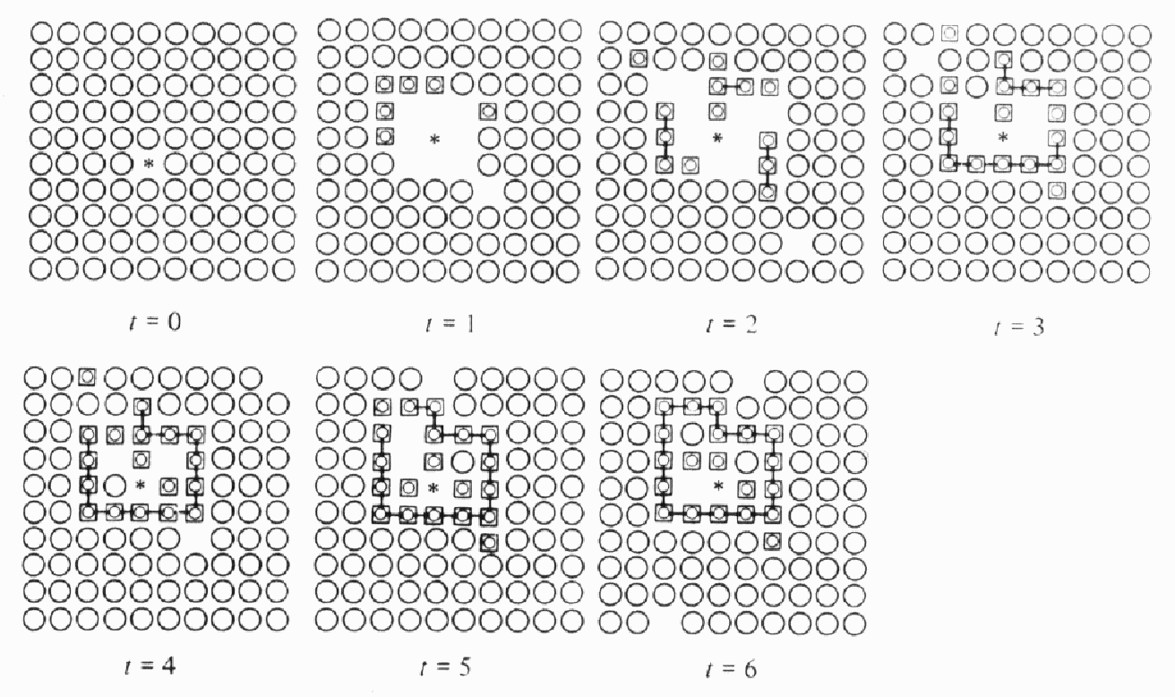
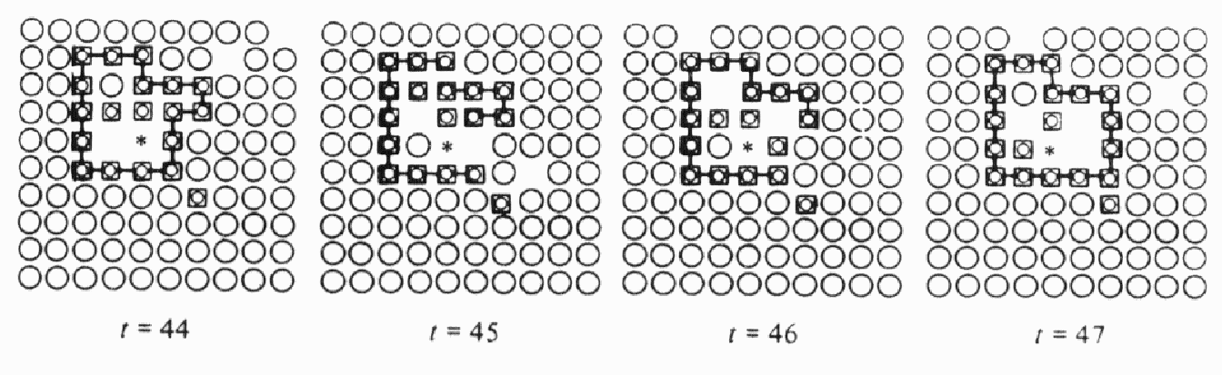
Computational autopoiesis
Cellular Automata simulation: 1974. A catalyst (*) produces substrate elements that can bond and form a boundary (which can decay and self-repair).
Boundary formation
Self-repair

Slide 26
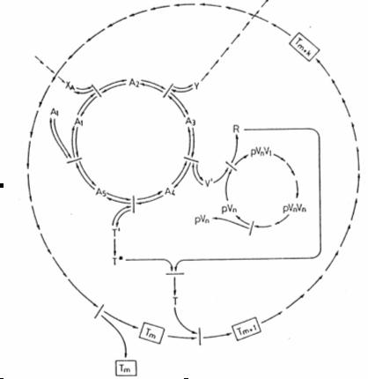
Ganti’s Chemoton
A framework for minimal living systems developed by Tibor Ganti in the early 70’s
Very similar to autopoiesis, more detailed in the addition of a regulatory template system
Prevents osmotic catastrophe.

Slide 27
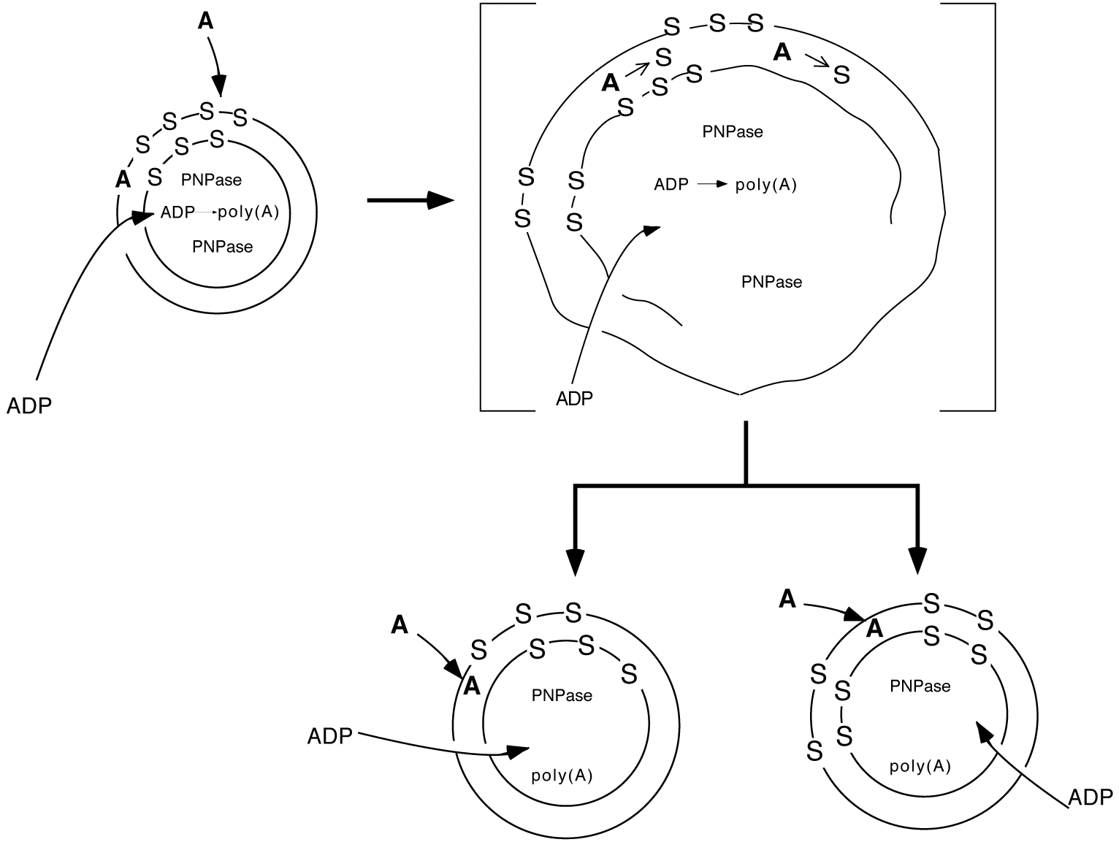
Chemical autopoiesis
Work by P. Luisi Luigi and colleagues aimed at constructing a minimal chemical autopoietic system capable of replication. (Self-replication of micellar systems and vesicles.)

Slide 28
Related ideas
Kant’s view of organisms as self-organised natural purposes (Critique of Judgement)
J. Dewey. Similar ideas regarding life as self-producing, as well as the relation between organism and environment. (Experience and Nature, 1929)
W. R. Ashby. Adaptation as viability, homeostasis.
J. von Uexküll. Umwelt. The perceptual world and the world of action are relative to the state of the organism.

Slide 29
M. Heidegger. First use of the term `autopoiesis' (in a different context), in The question concerning technology.
M. Merleau-Ponty. Strong influence on Varela's thought. Many implications of autopoiesis are compatible with his phenomenological approach.
H. Jonas. Existentialist philosopher. Metabolism is the essence of life as a novel ontological category. Non-substantial identity. (The Phenomenon of Life, 1979)

Slide 30
P. Weiss. Autonomous activity in the brain
R. Rosen. Theoretical biologist, has a fairly abstract definition of life as “closure under efficient causation” (Life itself, 1991)
J. Piaget. Cognition as biological. Sensorimotor invariants, adaptation as equilibration between assimilation and accomodation (e.g., Biologie et Connaissance, 1967)

Slide 31
Final word
Things we are saying nothing about:
  Development, evolution as natural drift, immune networks, social systems, language, observation, self-awareness.
Is autopoiesis a scientific theory?
Not quite, it's more like a redescription of biological phenomena from an unorthodox perspective. It cannot be disproved, it can only be shown be adequate or inadequate. It's like a kind of language.

Slide 32
Can it make any difference, then?
Definitely. Change your perspective and you see solutions where others see problems (and problems where others do not see them!)
Is it worth it?
That depends. The primary literature is difficult to get into, and the secondary literature is extremely divergent and less than strict. One can try to invest a little effort in becoming aware of the main concepts and see if that introduces an improvement in the way one faces problems. This is often the case for people thinking about biology and the design of autonomous adaptive systems.

