Slide 1
Adaptive Systems
Ezequiel Di Paolo
Informatics
Ecological Adaptation

Slide 2
Ideas in progress/regress
Ashby did an excellent job in showing how adaptation could be the observable outcome of a system able to reconfigure itself so as to find new internal stability in the face of environmental disturbance.
But we saw there were some problems that would prevent the use of this framework to account for every possible instance of adaptation (e.g. the problem of mal-adaptation).

Slide 3
How serious are these problems? Maybe it's only a question of taking the spirit of Ashby's ideas and extend them so that they would be a special case of a more general scenario for explaining adaptation.
This is ongoing work, and many ideas are half-baked. Lots of room for improvement. Lots of things to throw out. (Hopefully not all of it!) Better taken as issues to think about.
Precursors to some of these ideas: John Dewey, Maurice Merleau-Ponty, Kurt Goldstein, Jean Piaget, Ivo Kohler, Erich von Holst (see resources webpage for literature).

Slide 4
A problem with viability
Ashbyan and autopoietic notions of adaptation are based on the idea of survival or continuity of viability.
Mal-adaptation, as a durable state, makes little sense as the risk of death cannot be tolerated for long periods and requires prompt adaptation.
Strictly speaking, it is not entirely clear how an organism could be mal-adapted and not dead.
If mal-adaptation means death, then what is the point of talking about adaptation. Shouldn't we simply talk about life and death?

Slide 5
A problem with viability
Are we missing something?
Normal behaviour is underdetermined by the viability condition. Many behaviours are possible but only a few are actually observed.
Why is that? Could that be the key for a description of mal-adaptation?

Slide 6
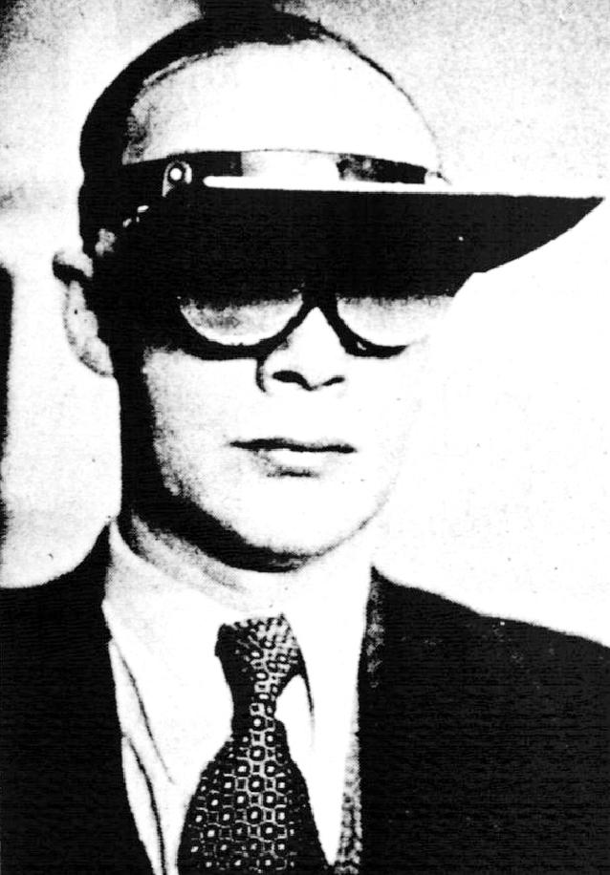
The world upside-down
Experiments on the distortion of the visual field (Stratton, Ewert, Kohler, Taylor, Dolezal) show that over long periods of perceptual disturbance in human subjects, gradual behavioural and perceptual adaptation occurs. (Similar experiments in animals and with other sensorimotor disruptions).

Slide 7
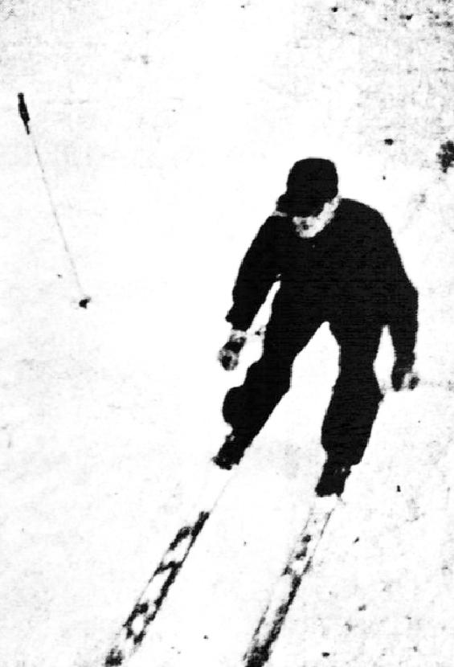
Adaptation is linked to patterns of activity, and may be confined only to those patterns (i.e., no adaptation by sitting and waiting).
Adaptation to grasping objects in an inverted visual field can happen by repeated trials at grasping. Adaptation to walking, by trying to walk. These work more or less independently.

Slide 8
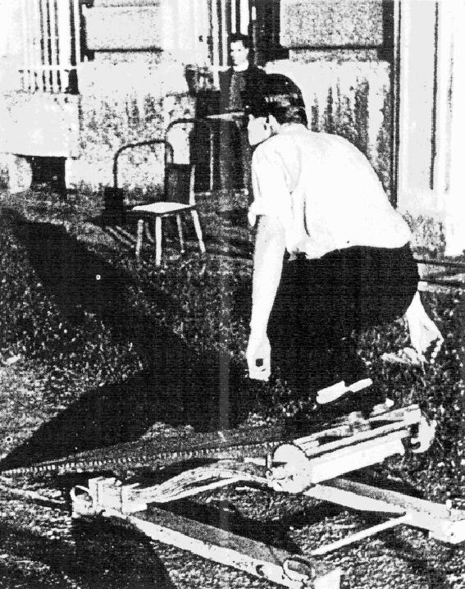
Re-adaptation is needed after taking off the distorting device.
Distortions: up/down, left/right, prisms, bi-colour, etc.
Similar experiments with auditory perception.

Slide 9
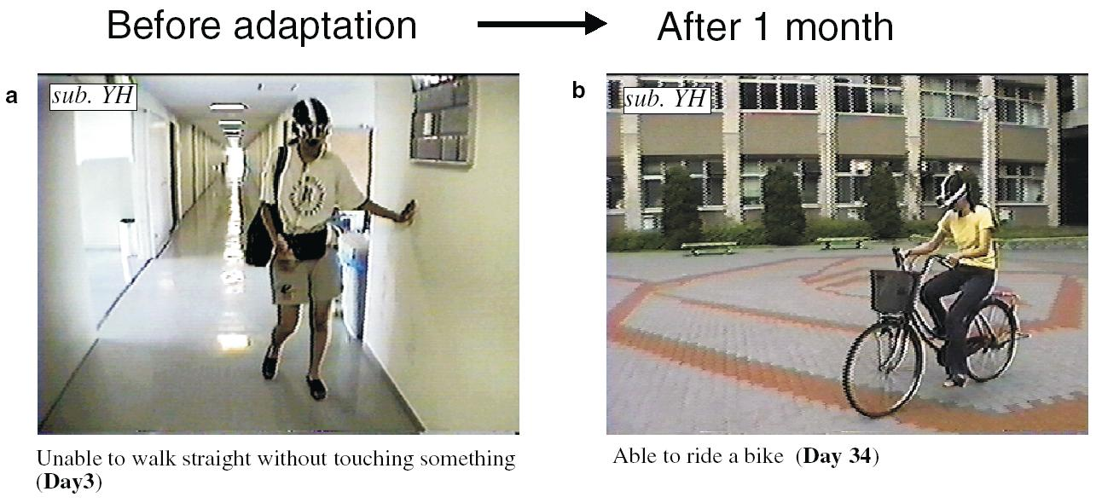
Recent replication by Sekiyama, Nature, 407, pp 374-377, (2000)

Slide 10
The case for mal-adaptation
Mal-adaptation happens.
All you need to do is to introduce disruptions in your body that do not impede your normal physiological functioning and yet make normal patterns of behaviour/perception difficult or impossible. (Less extreme cases exist as well, e.g. injuries, environmental changes, etc.)

Slide 11
Prismatic distortion of the visual field will not kill you. It's not use to argue that it would eventually kill you if you were not able to adapt, because that would be a functional argument. It's not evolutionary adaptation that we are concerned with here.
How can we describe this durable state of mal-adaptation? Why does it eventually lead to adaptation?
If not directly putting survival at risk, how are distortions affecting the normal flow of organic activity? This is the key question. Can we still use some notion of essential variables, Ashby-style?

Slide 12
Circular processes and invariants
An aside.
As a rule of thumb, or general hypothesis, whenever you have complex, durable processes with circular or reciprocal causality, you will observe the formation of some spontaneous invariant organisation. (Otherwise the processes will not be durable and/or distinguishable).
Examples: Nest building, pheromone trails (products constrain production). Stigmergy. (also called historical processes)

Slide 13
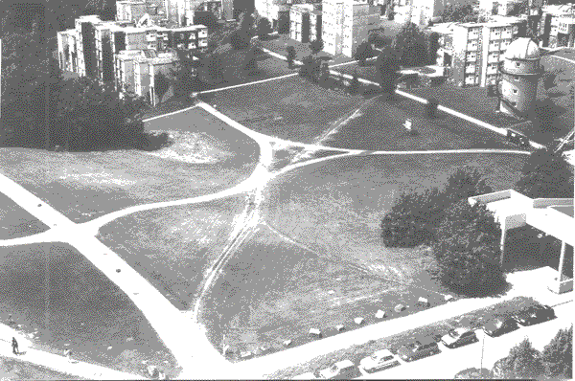
Trails on grass

Slide 14
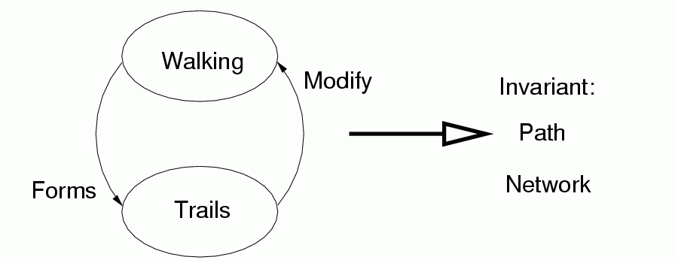
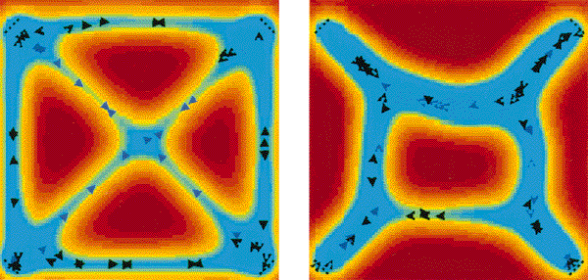
Trails on grass
Model by Helbing et al. Nature, 388, pp 45 – 50, (1997). (Remember Pask’s ear)

Slide 15
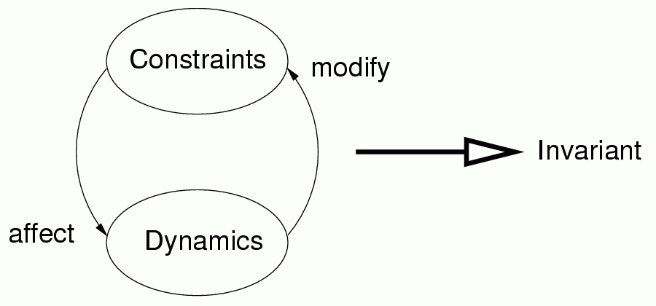
Historical processes

Slide 16
Sensorimotor coordination
Can be viewed as a process of reciprocal causation. But it’s difficult to be aware of it.
Fluid behaviour becomes less and less conscious as it starts to rely on coherences of SM coordination.
Surprise originates only when SM coordination is broken. (An unexpected obstacle, a contradiction between movement and proprioception, etc.)
SM coordination can be organised into layers (individual movements, whole acts, chains of activity, etc.)

Slide 17

Ecological invariants
The behavioural/perceptual manifestations of sensorimotor invariants. (Ecological: they involve organism and environment).
  Preferred postures (Draw a circle in the air)
  Self-coordination
  Perceptual invariants (e.g. angle of horizon, size and colour constancy)
  No flow associated with voluntary eye movements
  3D objects (visual flow + self-generated kinaesthetic information)
  Ritualized relational patterns (wolf ritual fights, coordinated flight, duetting, flocking)

Slide 18
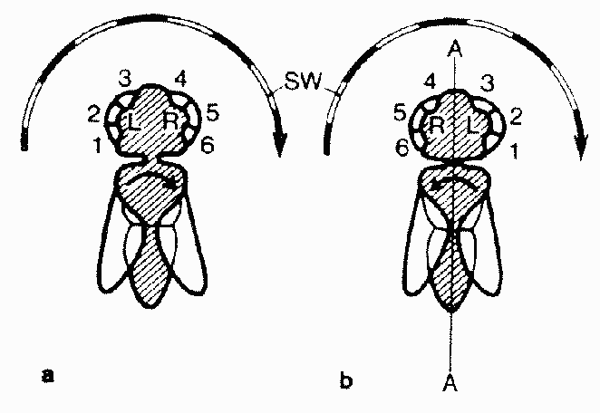
E.g. Image centring (von Holst)
Coordination can often be the result of simple feedback mechanisms. (Re-afference)

Slide 19
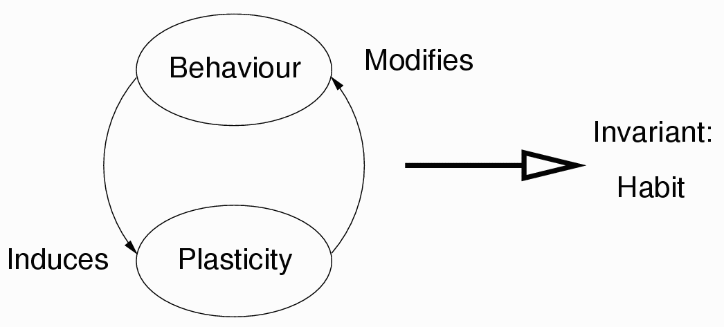
Beyond the organism: Habits
K. Goldstein, J. Dewey, W. James, M. Merleau-Ponty, P. Guillaume, N. Berstein, I. Kohler and others have used the term “habit” to describe how the body, as an ecological entity, sets itself into preferred patters of action and perception.
“Preferred” does not imply teleology. Behaviour induces plastic changes which facilitate further behaviour, which induces plastic changes,..., and so on, until a behaviour pattern is found that induces little or no plastic change.

Slide 20
Breakdown and recovery
Habits have different degrees of organisation. From sensorimotor coherences to the concatenation of movement into whole acts, and further.
Small disturbances can be compensated for, due to the stability of the invariant structure; but radical disruptions may either lead to the total loss of the habitual pattern or may allow for the conservation of some invariant residue of the original organisation. From this a modified organisation may “grow”.

Slide 21
Example: Grasping with inverted vision. The original organisation of grasping is disrupted (vision is perturbed).
But much of the habit remains: proprioception and particularly the culminating event of touching and grasping the object.
This could be the invariant that guides sensorimotor re-organisation.
Another case: walking along a corridor. (Invariant: don't bump into walls.)

Slide 22
Adaptation: habit re-organisation
An extended framework for adaptive behaviour, to account for mal-adaptation.
Ashbyan-like theory: an invariant guiding change.
Instead of essential variable for survival, essential variables that maintain the residual organisation (e.g., the culminating event of grasping). Keep changing until these variables return to their “normal” values (until you start grasping again).

Slide 23
Key difference: Physiology does not stop, so Ashbyan adaptation starts as soon as the disturbance is introduced. In contrast, a behaviour pattern may not be constantly enacted which means that no habitual adaptation will occur without action.
Fits with data as only certain habits show adaptation: those that the subject tries to re-enact.
Re-organization can mean the partial loss of the original habit which would explain why re-adaptation is necessary once you take the goggles off.
(But it is possible to adapt to both conditions depending on the schedule for wearing the goggles. This could also be accounted for by this framework)

Slide 24
Whence plasticity?
In the above examples it is clear that sensorimotor re-organisation occurs by means of plastic changes within the organism. But this need not be so. The framework is more general.
What “adapts” is not the individual but the action/perception pattern. In other words, the habit as a distinct ecological entity.

Slide 25
Plasticity could occur anywhere: in the environment or in other organisms:
  Storage, use of space, (e.g., Philip Agre's record collection). Things you use more often tend to be more accessible (which contributes to their more frequent use)
  Relative coordination (e.g., an adult an a child, or two robots, walking at the same speed)
  Mother-infant interaction (coordination of infant movements with mother's speech, facilitation, etc.)

Slide 26
Many open questions
How can we define a habit in a useful manner?
What is the completion of an act?
How can we identify the invariants that modulate re-organisation? What is residual organisation?
Would this extended Ashbyan framework suffice to explain every case of adaptation?
Could we design habitual patterns of behaviour as we can design robotic architectures?
Is Ashby's Homeostat already an ecological adapting machine?
Are we not sliding back unwittingly into teleology?

Slide 27
We are leaving out the consequences of these ideas for explaining social adaptation, the formation of social structures, norms, hierarchies, Bourdieu ‘s habitus, Vygotsky, etc.
The most interesting implication in this area is that the process of adaptation needs not be directly beneficial for the organisms involved. As long as they survive, the invariant may take control of the underdetermination of their behaviour

Slide 28
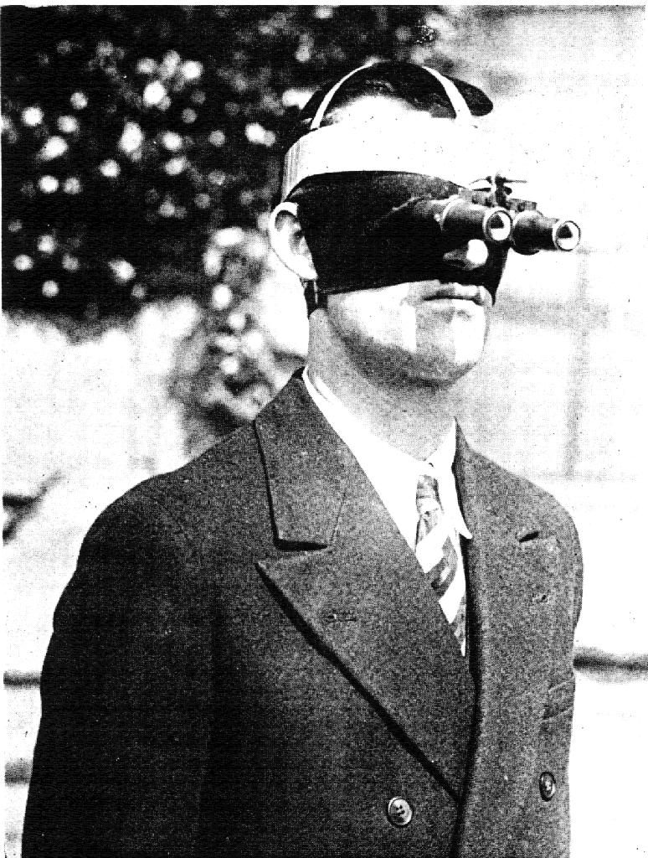
But never, never wear this…

