Slide 1
Artificial Life Autumn 2010
Today: First, some general Admin/info announcements
Then, a whirlwind tour of 2000 years of Alife
Overall plan: First 66% of course intended to cover all main topics that everyone should become familiar with.
By then people should have selected the field of interest for their programming project, and started work on it seriously.
Last 33% of course will depend to some extent on feedback: going back into some topics in greater depth, filling in gaps.
Artificial Life Lecture 1
5 October 2010

Slide 2
Assessment
The assessment for the course is based on a programming project (of your choice, subject to agreement that it is suitable) plus a 3,500 word essay, to be handed in near the beginning of next term, January 2010.
Note: Lecture times and places are
Mon 10:00 Fulton-103
Tue 09:00 Pevensey1-2A12
Artificial Life Lecture 1
5 October 2010

Slide 3
Coursework
There will be a Genetic Algorithm exercise as coursework, to be announced later.
There will also be an exercise associated with the robot lab classes in week 5.
Around week 7 you will be asked to submit your proposal for your final Alife project. You will get feedback on these.
Around week 8 you will be asked to give online feedback on the course – Questionnaire via your Study Direct page
Artificial Life Lecture 1
5 October 2010

Slide 4
Web version
Lectures in Powerpoint go up on the web via my home page – three formats, pdf, html and powerpoint.
http://www.informatics.susx.ac.uk/users/inmanh/easy/alife10/
Seminar details, also available on the web: times, who is in which group, which papers to read before the seminars.
Seminars: in one group OR 2 subgroups (depends on numbers?)
Tue 11:00 Fulton-102 (B) Thu 11:00 Fulton-207
CHECK: who has timetable clashes for either of these times?
Artificial Life Lecture 1
5 October 2010

Slide 5
Seminars (1)
Firstly: everyone will be asked to briefly (30 seconds to 60 seconds max!) mention any reading (or programme, or news item or …) they have come across relevant to Artificial Life
Is it interesting?
Is it readable?
Any doubts about it?
Do you recommend it?
(Purpose: to make clear that you are doing the
work in seminars, to expand sources of info)
Artificial Life Lecture 1
5 October 2010

Slide 6
Seminars (2)
Secondly: some arranged relevant paper/chapter should have been previously read by everybody, and one person (you all get turns during term) will give a 5 minute presentation on that work.
Summarise
Analyse
Criticise
Suggest extensions/improvements
Most weeks 2 people will give such a presentation,
Artificial Life Lecture 1
5 October 2010

Slide 7
First seminar(s) this week
Will be today Tuesday 11:00 in Fulton-102 – and [possibly, depends on numbers, split 50/50] Thu 11:00 in Fulton-207
The issue for discussion will be:-
You land on Mars and find a strange object. You have to decide whether it is alive or not.
Briefly state the criteria you will use.
After you have decided it is alive, you then turn it over and see a small label
'Product of Sony Corporation, Mars'
Will this change your mind? Why? Or why not?
Artificial Life Lecture 1
5 October 2010

Slide 8
Sources: Journals
Journals in Main Library:
Artificial Life
Adaptive Behavior
Evolutionary Computation
Behavioral and Brain Sciences, Nature, …. …. ….
In Life Sciences Library:
JTB Journal of Theoretical Biology
TREE Trends in Ecology and Evolution
Biological Cybernetics … … …
In Physics Library: Physica D … … …
Artificial Life Lecture 1
5 October 2010

Slide 9
Sources: Alife Conferences
Conference Proceedings: Artificial Life
AL87: Artificial Life, C. Langton (ed) Addison Wesley 1989
AL90: Artificial Life II, Langton et al (eds) Add Wes 1992
AL92: Alife III, Langton (ed) Add Wes 1993
… …
…every 2 years (even numbers)
… …
AL08: Winchester, UK
AL10: Odense, Denmark (August 2010)
MIT Press
Artificial Life Lecture 1
5 October 2010

Slide 10
Sources: ECAL
European Conf. on Artificial Life
ECAL91 PARIS MIT Press 1992
ECAL93 BRUSSELS
… …
ECAL97 Fourth Eur Conf on Artificial Life, Husbands and
Harvey (eds) MIT Press 1997 - BRIGHTON
…every 2 years (odd numbers)
… …
ECAL09: BUDAPEST
ECAL11: PARIS (8-12 Aug 2011, www.ecal11.org)
Artificial Life Lecture 1
5 October 2010

Slide 11
Sources: SAB
More conference proceedings:
Simulation of Adaptive Behavior SAB conferences
All proceedings entitled 'From Animals to Animats'
SAB90: FAtA, Meyer & Wilson (eds) MIT Press 1991
SAB92: FAtA 2, Meyer, Roitblat, Wilson (eds) MIT Press 1994
SAB94: FAtA 3, Cliff, Husbands, Meyer, Wilson (eds) MIT Press
…every 2 years (even numbers)
… …
SAB08: Osaka
SAB10: Paris
Artificial Life Lecture 1
5 October 2010

Slide 12
More Sources
Genetic Algorithm conferences/workshops (many)
Newsgroups comp.ai.alife comp.ai.genetic
Tech reports
Usually available over the web -- learn to use a good web search engine efficiently!
( www.google.com and citeseer.nj.nec.com/cs and Google Scholar)
Ezequiel Di Paolo's online Alife bibliography
http://www.cogs.susx.ac.uk/users/ezequiel
Artificial Life Lecture 1
5 October 2010

Slide 13
General Books
Pop science -- enjoy but treat with caution! Often good
for rapid shallow surveys, but on specific topics you are
far better off going to the original work.
Artificial Life Lecture 1
5 October 2010

Slide 14
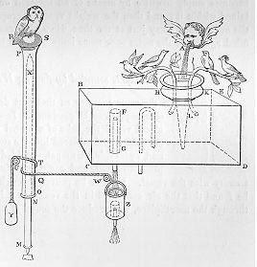
Early Artificial Life
A whirlwind tour through 2 millennia.
*** Chapter 1 of Artificial Life, Chris Langton (ed), Addison Wesley 1989. Proc of First workshop on Artificial Life..
Automata
Started with the Ancient Greeks.
1st century AD, Hero of Alexandria described working models of animals and humans, using
hydraulics and pneumatics.
Artificial Life Lecture 1
5 October 2010

Slide 15
Middle Ages
From around 14th Century AD, development
of clocks allowed more sophisticated automata.
Early Alife quote:
"For seeing life is but a motion of Limbs, the
beginning whereof is in the principal part within;
why may we not say that all Automata (Engines
that move themselves by springs and wheeles as
doth a watch) have an artificiall life?"
Thomas Hobbes in Leviathan (1651)
Artificial Life Lecture 1
5 October 2010

Slide 16
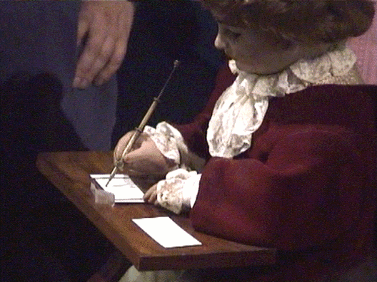
18th C Automata
Made by Jaquet-Droz and son, 1772-1775
Artificial Life Lecture 1
5 October 2010

Slide 17
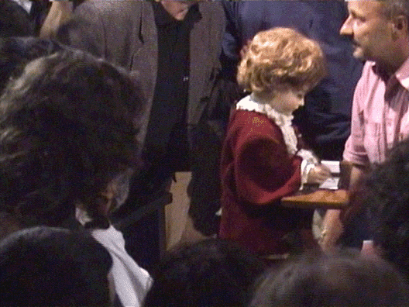
18th C Automata (2)
Artificial Life Lecture 1
5 October 2010

Slide 18
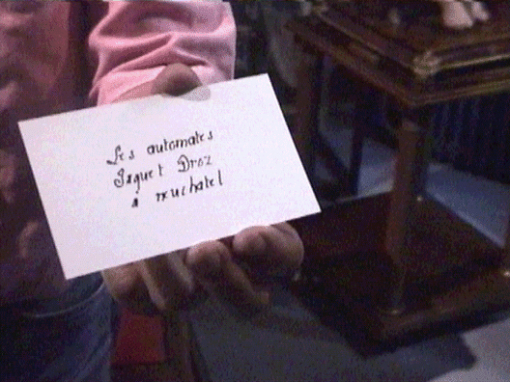
18th C Automata (3)
Artificial Life Lecture 1
5 October 2010

Slide 19
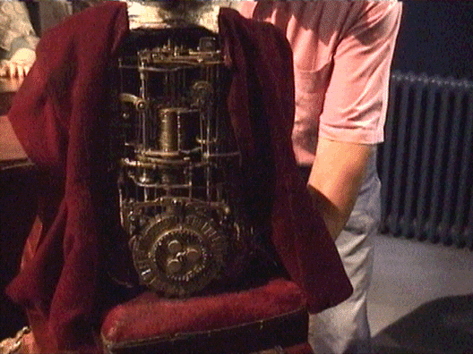
18th C Automata (4)
Artificial Life Lecture 1
5 October 2010

Slide 20
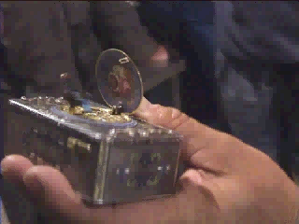
18th C Automata (5)
Artificial Life Lecture 1
5 October 2010

Slide 21
Jump to 20 C
2nd World War – Cybernetics "the study of control and communication in the animal and machine" N Wiener.
Aiming of anti-aircraft fire -- notion of Feedback
A lot of important early work in Cybernetics in 1940/50s that got rather forgotten in the rise of Computing.
Well worth searching for this early Cybernetics work
-- I consider Design for a Brain, by W Ross Ashby,
Wiley & Sons 1952, enormously important.
Artificial Life Lecture 1
5 October 2010

Slide 22
And Computing
Then came computing ... ... the classical AI approach
... disembodied abstract reasoning.
Computing has been enormously successful for
abstract problem solving, but led to this insidious
popular view that humans and animals think and
behave like problem-solving computers.
Artificial Life Lecture 1
5 October 2010

Slide 23
Embodied behaviour before abstract rationality
From several directions, particularly in the last decade, has come the realisation that humans are the product of 4 billion years of evolution, and only the last tiny fraction of this period has involved language and reasoning.
If we don’t understand the capacities of simple organisms, how can we hope to understand human capacities?
Cf. Rod Brooks, robot subsumption architecture.
This is one motive for doing A-life.
Artificial Life Lecture 1
5 October 2010

Slide 24
OK, so what is Artificial Life?
"Artificial Life is the study of man-made systems that exhibit behaviors characteristic of natural living systems. It complements the traditional biological sciences concerned with the analysis of living organisms by attempting to synthesize life-like behaviors within computers and other artificial media. By extending the
empirical foundation upon which biology is based beyond the carbon-chain life that has evolved on Earth, Artificial Life can contribute to theoretical biology by locating life-as-we-know-it within the larger picture of life-as-it-could-be."
Chris Langton (in Proc. of first Alife conference)
Artificial Life Lecture 1
5 October 2010

Slide 25
Alife as conscious echo of AI
Note 2 meanings of 'Artificial':
(1) = fake (eg artificial snow)
(2) = made by artifice, an artefact, but not fake
(eg artificial light)
Two positions you will come across:
Weak Alife: computer programs as useful simulations
of real life
Strong Alife: ditto as actually living
Artificial Life Lecture 1
5 October 2010

Slide 26
Is A-life more than Theoretical Biology?
“This paper examines A-Life as theoretical biology, as a set of computer simulation methods that may prove useful to biologists given their native concerns. I will not address A-life as engineering, entertainment, pedagogy, philosophy of biology, or runaway post-modern cult."
*** Geoffrey Miller in 'Artificial Life as Theoretical Biology:
How to do real science with computer simulation'
COGS CSRP 378 Available on web
Artificial Life Lecture 1
5 October 2010

Slide 27
Yes it is more!
The position I take is:
Alife can be used for theoretical biology
  --- but then make sure you are working on a problem
  biologists are interested in.
  cf: first explicit Alife paper in Nature v400 12 Aug 1999
  Lenski et al pp. 661-664
  And others since
Artificial Life Lecture 1
5 October 2010

Slide 28
Such as …
But Also Alife can and should cover (contra Miller)
engineering,
entertainment,
pedagogy,
philosophy of biology,
and indeed runaway post-modern cult!
There are many strong differences of views in this field.
During these lectures I shall try and be honest but I
shall definitely not be impartial.
Artificial Life Lecture 1
5 October 2010

Slide 29
Alife topics covered will include …
Cellular Automata - 'Game of Life', edge of chaos
Autocatalytic sets - origin of life
Search spaces - Genetic Algorithms
Game theory - Iterated Prisoner's Dilemma
Evolution of communication
Gaia theory - the Earth as an organism?
Artificial Life Lecture 1
5 October 2010

Slide 30
More Alife topics
Digital organisms - Tierra and Avida
Developmental models - morphogenesis
Evolutionary Robotics
Evolvable Hardware
Evolutionary dynamics - Neutral Networks
....
....
Artificial Life Lecture 1
5 October 2010

Slide 31
Robotics
The Alife course also includes sessions building robots
Everybody gets some hands-on experience
… …
Some may choose to take further with projects
Artificial Life Lecture 1
5 October 2010

Slide 32
Next lecture on Evolution and Genetic Algorithms …
Next week Monday Lec 2 Fulton-103 : First Lec on GAs
Seminar(s) Week 2:
Read about the 'Blind Watchmaker' program in either: "The Evolution of Evolvability" -- Richard Dawkins
in Artificial Life, C. Langton (ed) Addison Wesley 1989
OR
in the book "The Blind Watchmaker" Richard Dawkins.
Online version via my webpage. Nominees to give a brief presentation.
Artificial Life Lecture 1
5 October 2010

Slide 33
Seminar arrangements for Week 2
www.informatics.susx.ac.uk/users/inmanh/easy/alife10/
Keep an eye on these webpages for updates, links to notes etc.
Artificial Life Lecture 1
5 October 2010

