Slide 1
Artificial Life Lecture 12
This will look at 3 aspects of Evolutionary Algorithms:
Genetic Programming – GP
Classifier Systems
Species Adaptation Genetic Algorithms -- SAGA
Artificial Life Lecture 12
15 Nov 2010

Slide 2

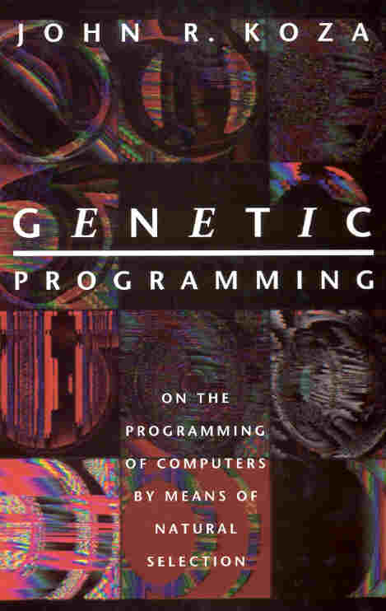
Genetic Programming
GP (a play on General Purpose) is a development of GAs where the genotypes are pretty explicitly pieces of computer code.
This has been widely promoted by John Koza, in a series of books and videos, eg:
Genetic Programming, John Koza,
MIT Press 1992
Followed by volumes II and III
Artificial Life Lecture 12
15 Nov 2010

Slide 3
GP
At first sight there are a number of problems with evolving program code, including
(1) How can you avoid genetic operators such as recombination and mutation completely screwing up any half-decent programs that might have evolved?
(2) How can you evaluate a possible program, give it a fitness score?
Artificial Life Lecture 12
15 Nov 2010

Slide 4
GP solution to problem 1
Both these 2 problems were basically cracked in work that predated Koza:
N. Cramer A representation for the adaptive generation of simple sequential programs In J Grefenstette (ed)
Proc of Int Conf on Genetic Algorithms, Lawrence Erlbaum, 1985.
(1) Use LISP-like programs, which can be easily pictured as rooted point-labelled trees with ordered branches.
Artificial Life Lecture 12
15 Nov 2010

Slide 5
Picturing a Lisp program
(OR (AND (NOT D_0) (NOT D_1)) (AND D_0 D_1)
OR
AND
AND
NOT
NOT
D_0
D_1
D_0
D_1
Artificial Life Lecture 12
15 Nov 2010

Slide 6
Recombining 2 Lisp programs
Picture each of 2 parent Lisp programs in tree form.
Then recombination between 2 parents involves taking their 2 trees, choosing random points to chop off sub-trees, and swapping the sub-trees.
This maintains the general form of a program, whilst swapping around the component parts of programs.
Artificial Life Lecture 12
15 Nov 2010

Slide 7
Mutating a Lisp program
Mutation in GP is rarely used:
"Nonetheless, it is important to recognize that the mutation operator is a relatively unimportant secondary operation in the conventional GA", says Koza
(op. cit. p. 105), citing Holland 1975 and Goldberg 1989.
When it is used, it operates by randomly choosing a subtree, and replacing it with a randomly generated new subtree.
Artificial Life Lecture 12
15 Nov 2010

Slide 8
GP solution to problem 2
How do you measure the fitness of a program? (this was the 2nd problem mentioned earlier)
Usually, fitness is measured by considering a fixed number of test-cases where the correct performance of the program is known.
Put a number on the error produced for each test-case, sum up the (absolute) value of these errors => fitness.
Artificial Life Lecture 12
15 Nov 2010

Slide 9
Normalising fitness
Often there is some adjustment or normalisation, eg so that normalised fitness nf ranges within bounds 0 < nf < 1, increases for better individuals, and sum(nf)=1.
Normalised fitness => fitness-proportionate selection
Artificial Life Lecture 12
15 Nov 2010

Slide 10
A typical GP run
has a large population, size 500 up to 640,000
runs for 51 generations (random initial + 50 more)
has 90% crossover -- ie from a population of 500, 450 individuals (225 pairs) are selected (weighted towards fitter) to be parents
and 10% selected for straight reproduction (copying)
no mutation
maximum limit on depths of new trees created
selection is fitness-proportionate
Artificial Life Lecture 12
15 Nov 2010

Slide 11
Different problems tackled by GP
Koza's GP books detail applications of GP to an
enormous variety of problems.
Eg finding formulas to fit data
control problems (eg PacMan)
evolution of subsumption architectures
evolution of building blocks (ADF automatic definition
of (sub-)functions)
etc etc etc
Artificial Life Lecture 12
15 Nov 2010

Slide 12
Choice of primitives
In each case the primitives, the basic symbols available to go into the programs, must be carefully chosen to be appropriate to the problem.
Eg for PacMan:
Advance-to-Pill
Retreat-from-Pill
Distance-to-Pill
... ...
IFB(C D) If monsters blue, do C, otherwise D
IFLTE(A B C D) If A<=B, do C, otherwise do D
Artificial Life Lecture 12
15 Nov 2010

Slide 13
Criticism of GP
GP has been used with some success in a wide range of domains. There are some criticisms:
Much of the work is in choice of primitives
Successes have not been in General Purpose ('GP') programming -- very limited success with partial recursive
programs (eg those with a DO_UNTIL command)
Artificial Life Lecture 12
15 Nov 2010

Slide 14
Lack of success with partial recursion
The most complex partial recursive program done with GP faster than with random search (as far as I know) is
Highest Common Divisor, by Lorenz Huelsbergen.
This is a trivial program
MOD(r0,r1);
MUL(r2,r5);
SUB(r1,r0);
LSR(r3,r1);
DEC(r10);
JNZ(r0,-7);
CLEAR(r11);
OR(r2,r5);
MUL(r10,r6);
XOR(r5,r1);
JNZ(r3,+15);
JG(r0,+6);
MUL(r4,r8);
OR(r2,r5);
J(+11);
INC(r2);
Artificial Life Lecture 12
15 Nov 2010

Slide 15
ADATE
Exception to this scepticism about evolving programs
ADATE: Automatic Design of Algorithms Through Evolution
Roland Olsson
http://www-ia.hiof.no/~rolando/adate_intro.html
Impressive – can e.g. do strstr()
Significantly different from GP, and currently is probably the best such system around
Artificial Life Lecture 12
15 Nov 2010

Slide 16

Wide and short, not long and thin
GP practitioners such as Koza typically use very large populations such as 640,000 for only 51 generations.
This is closer to random search than to evolution.
Very WIDE and SHORT
Artificial Life Lecture 12
15 Nov 2010

Slide 17
Classifier Systems
Just a brief mention here of an alternative GA approach to evolving things-a-bit-like-programs.
A classifier is an if-then rule such as
001##0:101010
# is interpreted as 'wild card' or 'dont-care' character
So for example 001000 or 001110 both match the classifying condition 001##0 on the left.
Artificial Life Lecture 12
15 Nov 2010

Slide 18
More Classifier Systems
There is a 'blackboard' with a starting set of strings such as 001000, and a set of classifiers can be applied to the strings on the blackboard. Any that match are replaced by the RHS of the classifiers -- then one starts again looking for new matches.
This can be seen as a kind of program, which could (eg) be used for robot or agent control.
For further details see Goldberg (1989), or follow up useful citations on the comp.ai.genetics FAQ
http://www.cs.cmu.edu/Groups/AI/html/faqs/ai/genetic/top.html
Artificial Life Lecture 12
15 Nov 2010

Slide 19
SAGA
SAGA, for Species Adaptation Genetic Algorithms, is in many respects the very opposite of GP. Papers on my web page
http://www.informatics.susx.ac.uk/users/inmanh/
Best reference is:
I. Harvey (2001): Artificial Evolution: A Continuing SAGA
It is intended for very long term evolution, for design problems which inevitably take many many generations, quite possibly through incremental stepping-stones.
Artificial Life Lecture 12
15 Nov 2010

Slide 20

Long and thin, not wide and short
So in contrast to GP, there is typically a relatively small population (30-100) for many
generations (eg 1000s or 10,000s).
'Long and narrow' not 'wide and shallow'
The population is very largely 'genetically converged' -- ie all members genetically very similar, like a plant or animal SPECIES.
Artificial Life Lecture 12
15 Nov 2010

Slide 21
Mutation vs. Recombination
Mutation is the main genetic operator, adding diversity and change to the population.
Recombination is only secondary (though useful).
This is completely contrary to the usual emphasis in GP
Artificial Life Lecture 12
15 Nov 2010

Slide 22
Convergence (1)
The term 'convergence' is often used in a confused way
in the GA/GP literature. People fail to realise that it can
be applied with at least two different meanings.
(1) Genetic convergence -- when the genetic 'spread‘ of the population has settled down to its 'normal' value,
which is some balance between:
selection of the fittest -> reduces spread, and
mutation -> increases spread.
Artificial Life Lecture 12
15 Nov 2010

Slide 23
Convergence (2)
(2) convergence of the fitness of the population onto its final value, or (very similarly) convergence of the 'search' of the popn onto its final resting-place.
In sense (2) people talk of 'premature convergence', particularly when they are worried about the population
converging onto a local optimum in the fitness landscape,
one that is very different from the global optimum.
A common, completely false, myth is that convergence in sense (1) implies convergence in sense (2).
Artificial Life Lecture 12
15 Nov 2010

Slide 24
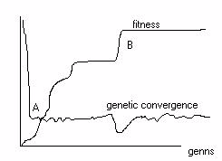
Monitoring Genetic Convergence
B is the point of convergence (defn 2), often after 'punctuated equilibria'
A is the point of genetic convergence (defn 1), which may well be (surprisingly?) within the first 10 or so generations !
Artificial Life Lecture 12
15 Nov 2010

Slide 25
Long term incremental evolution
SAGA was originally developed with a view to long term incremental evolution, where one would start with (relatively) short genotypes encoding (eg) relatively simple robot control systems ...
... then over time evolution would move to longer genotypes for more complex control systems.
In this long term evolution it is clear that the population
will be genetically converged for all bar the very start
Artificial Life Lecture 12
15 Nov 2010

Slide 26
… also long term non-incremental evolution
BUT though SAGA was originally developed with the view of long term incremental evolution (where genotype lengths probably increased from short, originally, to long and then even longer…)
It soon became apparent that the lessons of evolution-with-
a-genetically-converged species were ALSO applicable to any long term evolution, even if genotype lengths remain the same!
Artificial Life Lecture 12
15 Nov 2010

Slide 27
Consequences of convergence (1)
It soon became apparent that even with fixed-length
genotypes, one still has genetic convergence of the population from virtually the start -- even though this is not widely recognised.
Consequences: recombination does not 'mix-and-match‘ building blocks quite as expected -- because typically the bits swapped from mum are very similar to the equivalent from dad.
Artificial Life Lecture 12
15 Nov 2010

Slide 28
Consequences of convergence (2)
Evolution does not stop with a genetically-converged population (GCP) -- eg the human species, and our ancestors, have evolved as a GCP (… or species) for 4 billion years, with incredible changes.
Mutation is the main engine of evolutionary change, and should be set at an appropriate rate – which to a first approximation (depending on selection) is:
… …
Artificial Life Lecture 12
15 Nov 2010

Slide 29
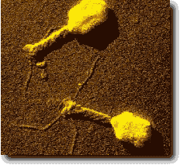
Optimal mutation rate for Binary Genotypes
Binary alphabet or small alphabet eg DNA:-
1 mutation in the expressed (non-junk) part of the
genotype
CF phages with 4500 'characters' in genotype have something of the order of 1 mutation per genotype
And so do humans with 3,000,000,000 'characters‘
Artificial Life Lecture 12
15 Nov 2010

Slide 30
NB: with REAL-valued genotypes it is different
All the above advice is for Binary (or similar) genotypes
A mutation at one locus is then a big change at that locus, 0 -> 1 or 1-> 0
So you don’t have/need many mutations
But with real-valued genotypes, mutation at each locus will be a small creep-mutation, eg. 0.510 -> 0.514, or -> 0.504
So you need lots of such small mutations simultaneously, Cheap Method: add a 'creep' amount from suitable range eg [+0.1, -0.1] to *every* value
Artificial Life Lecture 12
15 Nov 2010

Slide 31
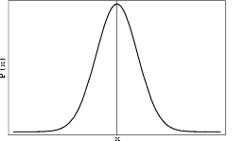
More principled method – mutating real values
Construct a vector in some random direction in n-space (where n is number of dimensions on genotype) and mutate by moving a small distance in this direction. HOW?
ADD n component vectors, one along each axis, lengths drawn from a Gaussian distrn
THEN normalise length of resultant vector to exactly 1.0;
THEN multiply vector length by factor drawn from Gaussian distribution mean 0.0 std.dev. 0.1 (or suitable value);
THIS is your mutation vector – move by this much
Artificial Life Lecture 12
15 Nov 2010

Slide 32
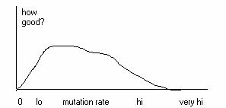
Why should there be an optimal mut-rate?
Mutation rate too low, in limit zero, would mean no
further change, evolution ceases -> no good
Mutation rate too high, eg every bit flipped at random,
implies random search -> no good.
Artificial Life Lecture 12
15 Nov 2010

Slide 33
What decides the ideal rate?
Some ideal rate (or range of rates) inbetween -- but where ?
Very rough version of argument: to a first approximation (tho not a 2nd !) at any stage in evolution some N bits of the genotype are crucial -- any mutations there are probably fatal -- while the rest is junk.
The error threshold shows that maximum mutation rate survivable under these circumstances is of the order of 1 mutation in the N bits
Artificial Life Lecture 12
15 Nov 2010

Slide 34
So what is SAGA?
SAGA is not a specific GA, it is just a set of guidelines for
setting the parameters of your GA when used on any long
term evolutionary problem -- with or without change in
genotype length
Expect the population to genetically converge within the very first few generations
Mutation is the important genetic operator
Artificial Life Lecture 12
15 Nov 2010

Slide 35
… SAGA ctd
Set the mutation rate to [if binary genotypes] something of the order of 1 mutation per non-junk element of the genotype. If abnormal selection pressures, for 1 substitute log(S) where S is the expected no. of offspring of the fittest member [real genotypes: different!]
Often there is quite a safe range of mutation rates around this value -- ie although it is important to be in the right ballpark, exact value not too critical
Recombination generally assists evolution a bit
Expect fitness to carry on increasing for many many generations
Artificial Life Lecture 12
15 Nov 2010

Slide 36
Any other implications ?
Yes, Neutral Networks may well be crucial -- as covered in a previous lecture – and these SAGA ideas on mutation rates are completely consistent with such NNs.
Time for Questions?
Artificial Life Lecture 12
15 Nov 2010

