Slide 1
Artificial Life Lecture 14
Tierra and Avida [Plus PDW]
This line of Alife investigation can be traced back to early games of COREWARS -- A.K. 'Kee' Dewdney,
1983 and in Sci American columns..
Competing assembly language programs:-
'My aim is for my program to over-write and destroy yours.'
Obvious connection with computer viruses.
Artificial Life lecture 14
22 Nov 2010

Slide 2
Assembly language
In 1950s, 60s, memory was on ferromagnetic cores,
1 bit per core. Programs are written in a simplified
Assembly language Redcode, and run in a virtual
computer memory of 8000 addresses.
Two human competitors write their own Assembly language
programs, which are placed in memory at random
positions. Two 'program counters' execute one
instruction of each program in turn, with consequent
writing into other parts of memory, and jumping
execution position according to whatever instructions
are met.
Artificial Life lecture 14
22 Nov 2010

Slide 3
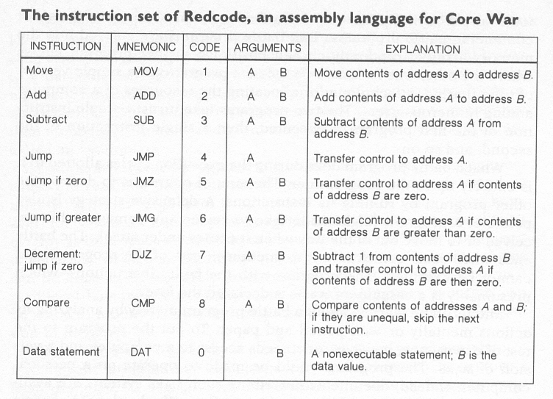
Redcode
Artificial Life lecture 14
22 Nov 2010

Slide 4
Partial Recursion
Note that there are conditional jumps -- this provides enough for partial recursive programs, ie the works!
Variation
Add to the above list a 10th SPL instrn = split
-- this then allows programs to multiply.
One needs rules such as 'each players share of CPU time is divided between all their various programs'
Artificial Life lecture 14
22 Nov 2010

Slide 5
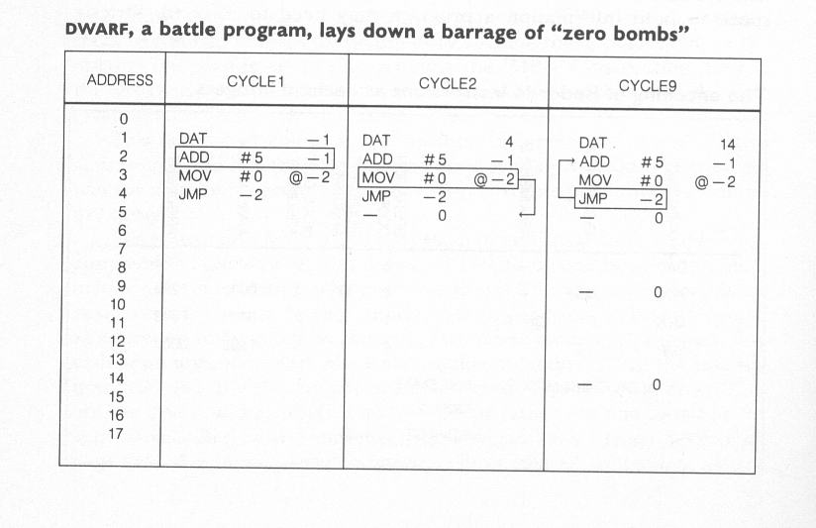
Dwarf
Artificial Life lecture 14
22 Nov 2010

Slide 6
Dwarf versus Imp
From AK Dewdney "The Armchair Universe"
WH Freeman 1988.
The simplest one-line battle program 'IMP':-
MOV 0 1
just chomps through memory. What happens when
INP fights against DWARF ?
Here is an IMP factory :-
SPL 2
JMP -1
MOV 0 1
Artificial Life lecture 14
22 Nov 2010

Slide 7
A bit of pre-history
Actually, 1983 Core Wars was preceded by a much earlier piece of what must be the earliest version of such work -- almost completely forgotten.
Nils A.Barricelli's 'Symbioorganisms' -- paper by him
"Symbiogenetic evolution processes realized by artificial methods", Methodos 9 (35-36) 1957.
Other papers by him reprinted in
"Evolutionary Computation: The Fossil Record"
DB Fogel (ed) IEEE Press, New York 1998.
Artificial Life lecture 14
22 Nov 2010

Slide 8
Old classics
This work demonstrated, at such an early date, evolution within a computer program, crossbreeding, growth and self-repair, parasitism ...
I accidentally came across a reference to this decades ago, which triggered my own interest in the area -- and then never saw any discussion of this work again until "Darwin Among the Machines" GB Dyson Addison Wesley 1997.
Well worth looking at some of these early papers.
Artificial Life lecture 14
22 Nov 2010

Slide 9
Tierra
At the second Alife Conference, Santa Fe Feb 1990,
proceedings in "Artificial Life II" eds Langton, Taylor, Farmer, Rasmussen, Addison Wesley 1992
Steen Rasmussen and co-authors presented an updated version of Core World in an Alife context -- see paper in those proceedings.
But also Tom Ray presented Tierra for the first time -- all the breakthrough work had been in the preceding month or so on his Toshiba laptop (20 MHz). TS Ray "An Approach to the Synthesis of Life“ in same proceedings.
Artificial Life lecture 14
22 Nov 2010

Slide 10
Tom Ray
Tom Ray is an ecologist who learnt to program, so
as to see if computer-virus-like things could evolve
in a computer, in virtual memory.
Actually the Barricelli work (of which he was unaware)
prefigured some of the ideas -- but the results Ray got,
with 1990 computer power, made an enormous
impression.
Artificial Life lecture 14
22 Nov 2010

Slide 11
Tierra code set
32 assembly language instructions, each of which can be represented by 5 bits including operands
(unlike redcode).
cf DNA 64 codons, 20 amino acids.
Uses stack (push and pop) and registers
Artificial Life lecture 14
22 Nov 2010

Slide 12
nop_0 no op pop_ax pop into ax
nop_1 pop_bx
or1 flip bit of cx pop_cx
sh1 shift left cx pop_dx
zero zero cx jmp to template
if_cz if zero jmpb backward
sub_ab call call procedure
sub_ac ret return
inc_a mov_cd
inc_b mov_ab
dec_c mov_iab mov instrn
inc_c adr adrs of templ
push_ax onto stack adrb search backwd
push_bx adrf search fwd
push_cx mal alloc memory
push_dx divide 'SPLIT'
Artificial Life lecture 14
22 Nov 2010

Slide 13
Tierra code features
This is a very small instruction set, but computationally complete.
Addressing by template
Each JMP instrn is followed by a sequence of NOPs, a mix of NOP_0s or NOP_1s.
To find the right place to jump to, a search is made for nearest set of complementary NOPs -- 0010 matches 1101
Artificial Life lecture 14
22 Nov 2010

Slide 14
Tierra World
The world
is virtual memory, eg 60,000 bytes, linear (and circular)
Organisms
are each blocks of memory where exclusive write access has been reserved for its own code – though other organisms can read and execute code that is not theirs
Reproduction
can arise from a mal instruction, allocating new memory for a daughter cell; followed by a divide -- which gives daughter cell its own instruction pointer
Artificial Life lecture 14
22 Nov 2010

Slide 15
Tierra Dynamics (1)
Time-sharing
At any one time there will be many organisms running their own code, with their own boundaries (tho can execute code outside their 'cell walls').
Multi-tasking allocates share of CPU time to each organism in turn
The Reaper
The world is a limited resource, fixed size of memory. Natural copy instrns fill up memory, 'the Reaper' kills organisms at random when too full -- leaving their dead code in the soup.
Artificial Life lecture 14
22 Nov 2010

Slide 16
Tierra Dynamics (2)
Mutation
Background 'cosmic rays' flip bits of memory at random (at a low rate). During any copying, there are replication errors at random, at a higher rate.
Kick-off
Ray designed by hand an 80-instruction 'ancestor‘ designed to be self-replicating. Put one in, and let it replicate (with mutations).
Wait and Watch
Artificial Life lecture 14
22 Nov 2010

Slide 17
What happened
Memory filled up with copies, mutants appeared.
Smaller self-replicating mutants were favoured, because of the way CPU time was shared.
Then parasites appeared -- only 45 instrns long, not capable of self-replication but manage to 'borrow' the replication code of their neighbours
(-- organisms can read or execute others code).
Artificial Life lecture 14
22 Nov 2010

Slide 18
Parasites and hyper-parasites …
An ecology of different organism types builds up.
Some immunity to parasites appears in some self-replicators
Hyper-parasites 'steal the instruction pointers‘ from parasites
Social parasites...
hyper-hyper-parasites...
etc etc...
Artificial Life lecture 14
22 Nov 2010

Slide 19
Macro-dynamics
Tierra is a rich experimental domain for watching a diverse ecology grow, possible parallels to situations in the real world.
For each organism, the 'physical world' consists of 'energy' (CPU time = sunlight) and 'space' in memory, which is limited.
But above all, the environment which affects their fitness includes the other organisms around.
Ray was interested in looking for such features as punctuated equilibrium (punk eek), and any light that could be shed on the Cambrian explosion of diversity.
Artificial Life lecture 14
22 Nov 2010

Slide 20
…still going on…
This work has been a fruitful source of ideas, has spawned a whole industry, Tierra on the Internet 'with patterns of activity following the night around the globe'
etc etc.
Personally, I consider the early Tierra work was truly exciting and mind-opening, but I am not so sure about the continuation...
Artificial Life lecture 14
22 Nov 2010

Slide 21
Avida
Several variations spun off from Tierra, with varying motives.
Avida is one of these, coming out of more a physics background than a biology one. Chris Adami, Titus Brown and others
"Introduction to Artificial Life" Christoph Adami
Springer-Verlag New York 1998
Plus (as with Tierra) many publications online on www
Artificial Life lecture 14
22 Nov 2010

Slide 22
Main differences with Tierra
The linear memory of Tierra is replaced with a 2-D grid.
It is claimed that Tierra to some extent lacked 'locality',
since a new offspring could result in death (via Reaper)
of any other organism anywhere else.
Each cell on the grid can contain a complete
program -- the instrn pointer loops back from end of
program to beginning, unless a 'template-match' jmp
takes into neighbouring cell/program.
Artificial Life lecture 14
22 Nov 2010

Slide 23
More Avida
There are 8 nearest neighbours, and a preferred 'facing' direction for searching for template-matches.
Cell-division -- the divide command splits off the code and places it in a neighbouring cell, replacing whatever was there.
Avida has a local geometry, and a local reaper queue.
Artificial Life lecture 14
22 Nov 2010

Slide 24
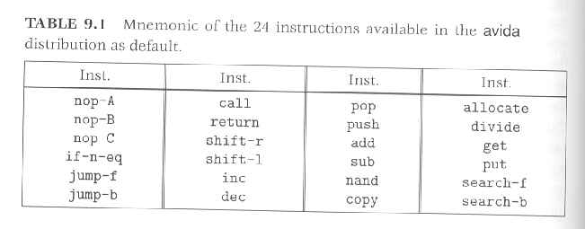
Instruction set
The instruction set is smaller than Tierra, just 24, but there is a very clear family resemblance
Artificial Life lecture 14
22 Nov 2010

Slide 25
Use made of Avida
This is designed to look at the evolution, and spread, of artifical life-forms in a space with 2-D toroidal (wrap-around) geometry, cells with neighbourhoods.
Conceptually, the designers see the execution of the programs within each cell as an artificial chemistry.
Programs can be rewarded if perform very simple computational tasks initially input/output capability, then simple Booleans of 1 or 2 inputs --- 'A or B'.
Artificial Life lecture 14
22 Nov 2010

Slide 26
Dynamics of Evolution
This gives a 'fitness landscape', some programs artifically fitter than others.
In particular, the experimenters are interested in the dynamics of evolution in such a complex artificial world -- such factors as speciation, propagation of genetic 'information' through a population, etc etc.
Generally, as physicists, they were asking different sorts of questions from Tierra. In recent years, collaborating with a Microbial Evolutionary person, Rich Lenski, and testing biological ideas – fruitful collaboration.
Artificial Life lecture 14
22 Nov 2010

Slide 27
EG some Avida-based publications
Adaptive Radiation from Resource Competition in Digital Organisms;
S.S. Chow, C.O. Wilke, C. Ofria, R.E. Lenski, C. Adami. Science 305 (2004) 84-86
The Evolutionary Origin of Complex Features; R.E. Lenski, C. Ofria, R.T. Pennock, and C. Adami, Nature 423 (2003) 139-145.
Evolution of Digital Organisms at High Mutation Rate Leads To Survival of the Flattest; C.O. Wilke, J.L. Wang, C. Ofria, R.E. Lenski, and C. Adami, Nature 412 (2001) 331-333.
Genomic Complexity, Robustness, and Genetic Interactions in Digital Organisms R.E. Lenski, C. Ofria, T. C. Collier, C. Adami, Nature 400 (1999) 661-664.
Artificial Life lecture 14
22 Nov 2010

Slide 28
References – Tierra and Avida
Tierra publications
http://www.his.atr.co.jp/~ray/pubs/
More general on Tierra
http://www.his.atr.co.jp/~ray/tierra
Avida publications
http://dllab.caltech.edu/avida/
Artificial Life lecture 14
22 Nov 2010

Slide 29
Change of topic …
Time for a few slides relating to Passive Dynamic Walking and beyond.
Cf. work by Eric Vaughan, www.droidlogic.com
Artificial Life lecture 14
22 Nov 2010

Slide 30
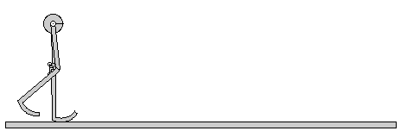
Walking without a nervous system
Artificial Life lecture 14
22 Nov 2010

Slide 31
applied to humanoid walking
Passive Dynamic Walking is an equivalent of a glider
You could add more knees ….
Or you could progressively add Control and Power
All work by Eric Vaughan, www.droidlogic.com
Artificial Life lecture 14
22 Nov 2010

Slide 32
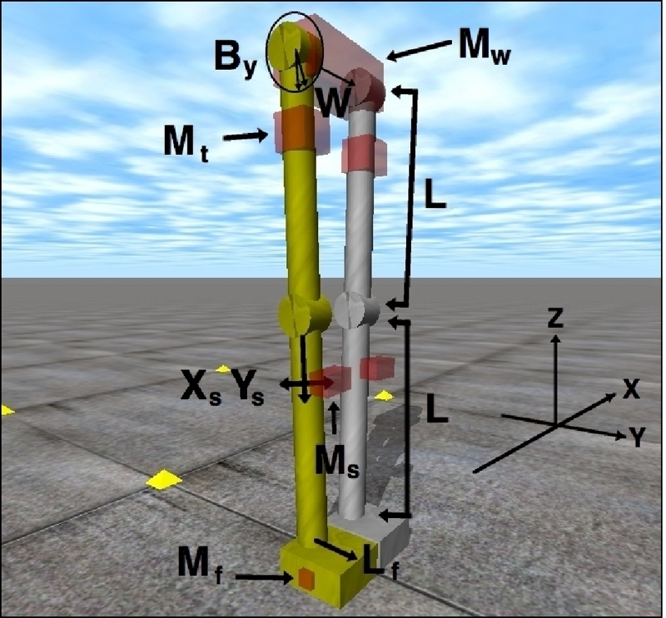
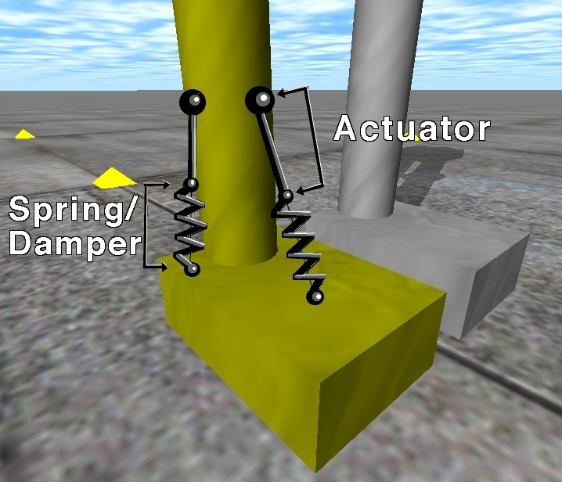
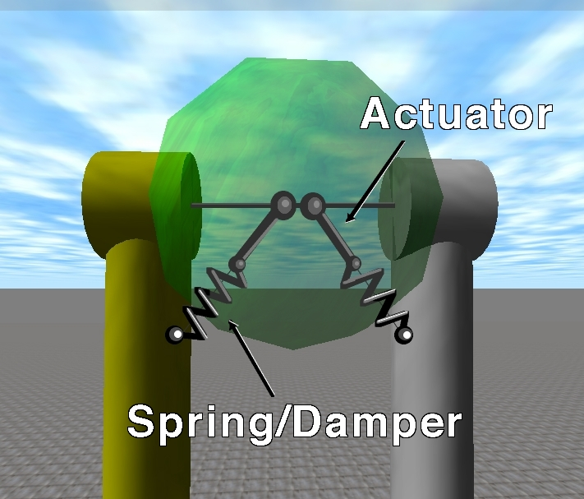
10 degrees of freedom version
Damped ankle and hip springs
Artificial Life lecture 14
22 Nov 2010

Slide 33
Some examples
Walking back and forward (2D version, 6 DoF)
Balancing on a moving platform
Powered walking on the flat
All work by Eric Vaughan, www.droidlogic.com
Artificial Life lecture 14
22 Nov 2010

Slide 34
ODE
These simulations are done within a ‘Physics Engine’ – that takes over most of the hard work of calculating how component parts move under forces of gravity, of motors, of meeting the ground or other objects.
We often use ODE (Open Dynamics Engine – Russell Smith and others)
http://www.ode.org/
Artificial Life lecture 14
22 Nov 2010

Slide 35
Natural Motion
Natural Motion http://www.naturalmotion.com/
Torsten Reil – EASy MSc 1998/99
Artificial Life lecture 14
22 Nov 2010

