Slide 1
Artificial Life lecture 18
Evolution and Learning
Evolution of Learning
The Baldwin Effect (this week’s seminars)
A teaser …
Artificial Life Lecture 18
6 December 2010

Slide 2
Evolution and Learning
Exploring Adaptive Agency II: Simulating the Evolution of Associative Learning
Peter Todd and Geoffrey Miller, pp. 306-315 in
From Animals to Animats, J-A Meyer & S. Wilson (eds)
MIT Press 1991 (Proc of SAB90)
Looking at some aspects of the relationship between
evolution and learning.
ALSO: look at how the model is simplified as far as is
reasonably possible – lessons for your Alife project
Artificial Life Lecture 18
6 December 2010

Slide 3
Evolution and Learning
Darwinian Evolution is done by a population (which may, or may not, be composed of learning individuals).
As shorthand, one might talk of a population ‘learning’ to adapt to changed environmental conditions (eg climate change) through evolution.
But usually it avoids confusion if one talks of a population evolving, an individual learning.
Artificial Life Lecture 18
6 December 2010

Slide 4
Why bother to Learn - 1?
Todd & Miller suggest 2 reasons:
(1) Learning is a cheap way of getting complex behaviours, which would be rather expensive if 'hard-wired' by evolution.
Eg: parental imprinting in birds –
'the first large moving thing you see is mum, learn to recognise her'.
Artificial Life Lecture 18
6 December 2010

Slide 5
Why bother to Learn – 2?
(2) Learning can track environmental changes faster than evolution.
Eg: it might take millennia for humans to evolve so as to speak English at birth, and would require the English language not to change too much.
But we have evolved to learn whatever language we are exposed to as children -- hence have no problems keeping up with language changes.
Artificial Life Lecture 18
6 December 2010

Slide 6
Learning needs Feedback
Several kinds of feedback:
Supervised -- teacher tells you exactly what you should have done
Unsupervised -- you just get told good/bad, but not what was wrong or how to improve.
(..cold...warm...warmer...)
Evolution roughly equates to unsupervised learning
-- if a creature dies early then this is negative feedback as far as its chances of 'passing on its genes' are concerned -- but evolution doesn’t 'suggest what it should have done'.
Artificial Life Lecture 18
6 December 2010

Slide 7
Evolving your own feedback?
However, it may be possible, under some circumstances, for evolution to create, within 'one part of an organism', some subsystem that can act as a 'supervisor' for another subsystem.
Cf.DH Ackley & ML Littman.
Interactions between learning and evolution. In Artificial Life II, Langton et al (eds), Addison Wesley 1991.
Later work by same authors on
Evolutionary Reinforcement Learning
Artificial Life Lecture 18
6 December 2010

Slide 8
The Todd & Miller model
Creatures come across food (+10 pts) and poison (-10)
Food and poison always have different smells, sweet and sour. BUT sometimes smells drift around, and cannot be reliably distinguished. In different worlds, the reliability of smell is x% where 50 <= x <= 100.
Food and poison always have different colours, red and green. BUT in some worlds it is food-red poison-green, in other worlds it is food-green poison-red. The creatures’
vision is always perfect, but 'they dont know whether
red is safe or dangerous'.
Artificial Life Lecture 18
6 December 2010

Slide 9
The model – ctd.
Maybe they can learn, using their unreliable smell?
Todd & Miller claim that simplest associative learning
needs:
(A) an input that (unreliably) senses what is known to be
good or bad (smell)
(B) another sensor such as that for colour, above
(C) output such that behaviour alters fitness.
(D) an evolved, fixed connection (A)->(C) with the
appropriate weighting (+ve for good, -ve for bad)
(E) a learnable, plastic connection (B)->(C) which can be
built up by association with the activation of (C)
Artificial Life Lecture 18
6 December 2010

Slide 10
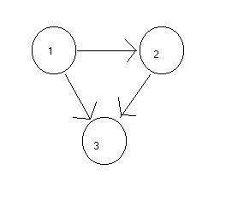
Their ‘Brains’
Creatures brains are genetically specified, with exactly
3 neurons connected thus:
Artificial Life Lecture 18
6 December 2010

Slide 11
Genetic specification
The genotype specifies for each neuron whether it is
input sweet-sensor
input sour-sensor
input red-sensor
input green-sensor
hidden unit or interneuron
output or decision unit: eat/dont-eat
and for each neuron the bias (0, 1, 2, 3) (+/-)
and for each link the weight (0, 1, 2, 3) (+/-)
and whether weight is fixed or plastic
Artificial Life Lecture 18
6 December 2010

Slide 12
Plastic links
Some of the links between neurons are fixed, some are plastic.
For plastic weights on a link from P to Q, Hebb rule:
Change in WEIGHTPQ = k * A_{P} * A_{Q}
where A_{P} is the current activation of neuron P.
I.e.:- if the before and after activations are the same sign (tend to be correlated), increase strength of link
If opposite sign (anti-correlated), decrease strength
Artificial Life Lecture 18
6 December 2010

Slide 13
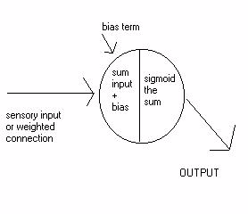
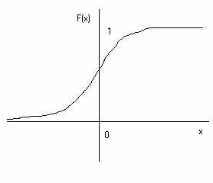
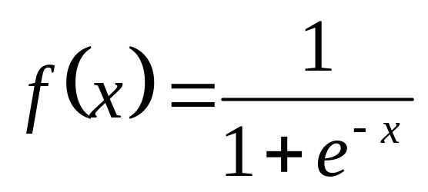
Within each neuron
The sigmoid is a 'squashing function' such as
Artificial Life Lecture 18
6 December 2010

Slide 14
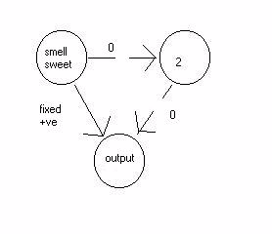
Possible brains
So one possible genetically designed brain would be this:
colour-blind eater – this is not a learner.
Whatever neuron 2 is, the links are 0, hence it can be ignored.
This depends purely on smell, and has the
connection wired up with the right +ve sign, so that it eats things that smell sweet.
Artificial Life Lecture 18
6 December 2010

Slide 15
Is a colour-blind eater any good?
This creature depends purely on smell, and has the
connection wired up with the right +ve sign, so that it eats things that smell sweet.
Though it may occasionally ignore food that (noisily)
smells sour, and eat poison that (noisily) smells sweet,
on average it will do better than random.
So evolving within a population, this
(non-learning) design will do better than
random, and increase in the population.
Artificial Life Lecture 18
6 December 2010

Slide 16
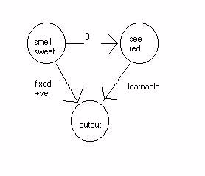
A learning brain
This different possible design is a
colour-learner
If this one is born in a world where smell is 75% accurate, and food is red, then (more often than not) seeing red is associated with the positive output.
Artificial Life Lecture 18
6 December 2010

Slide 17
Is a colour-learner any good?
… seeing red is associated with the positive output.
So, with Hebbs rule, the RH connection gets built up +ve more strongly, until it fires the output on its own -- it can even over-rule the smell input on the 25% of occasions when it is mistaken.
Contrariwise, if it is born in a world where food is green, then Hebbs rule will build up a strong –ve connection -- with the same results.
So over a period, this will do better than the previous one
Artificial Life Lecture 18
6 December 2010

Slide 18
Evolutionary runs
Populations are initialised randomly.
Of course many have no input neurons, or no output neurons, or stupid links
- these will behave stupidly or not at all.
The noise level on smell is set at some fixed value between 50% accurate (chance) and 100% accurate.
Then individuals are tested in a number of worlds where (50/50) red is food or red is poison.
Artificial Life Lecture 18
6 December 2010

Slide 19
Keeping statistics
Statistics are kept for how long it takes for colour-blind eater to turn up and take over the population; and for colour-learner likewise.
[Statistics: multiple runs to reduce chance elements, keep record of standard deviations]
When smell noise-level is 50%, then there is no available information, no improvement seen.
When smell is 100% accurate, then colour-learning is unnecessary.
What happens between 50% and 100% ?
Artificial Life Lecture 18
6 December 2010

Slide 20
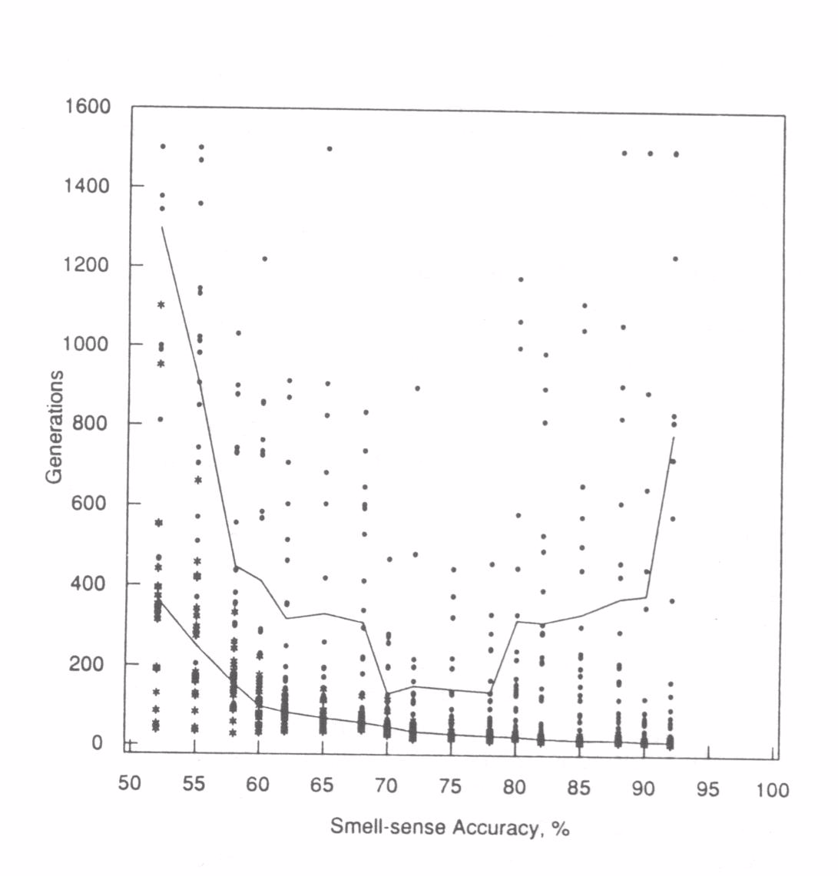
Results on a graph
Colour-learner= top line colour-blind eater=bottom line
Artificial Life Lecture 18
6 December 2010

Slide 21
U-shaped curve
As smell-sense accuracy goes from 50% (left) to
100% (right), average number of generations needed to evolve colour-blind eater decreases steadily (lower line)
But average number of generations needed to evolve
colour-learner goes through the U-shaped curve
(upper line)
Artificial Life Lecture 18
6 December 2010

Slide 22
Lessons for doing (Alife) projects
Make your model as simple as possible whilst still showing the phenomenon of interest.
More complicated models, with lots of bells and whistles,
Are more difficult to get to work AND
If they do work, they prove less than the simple model! Because it is not clear (without further investigation) which bit of your model actually was crucial, and which bit is unnecessary.
Artificial Life Lecture 18
6 December 2010

Slide 23
More lessons
Do comparisons: your preferred model versus a simple variant (appropriate for the task) – e.g. compare with random search (if appr), or with one part disabled (if appr), or with a standard textbook method (if appr), or …
Graphs can be very informative -- provided the axes and scales are clearly labelled, and the caption or text explains them fully.
Usually it is appropriate to report mean (average) of several runs, and also to report standard deviations.
Artificial Life Lecture 18
6 December 2010

Slide 24
Baldwin Effect – more detail in seminar
A much more subtle and interesting interaction between Learning and Evolution is the Baldwin effect -- named after Baldwin (1896).
Roughly speaking, this is an effect such that, under some circumstances, the ability of creatures to learn something guides evolution, such that in later generations their descendants can do the same job innately, without the need to learn.
Artificial Life Lecture 18
6 December 2010

Slide 25
Speaking English at birth?
Human children are born with the capacity to learn a language within their first few years.
Pick up the local language, English, Japanese, Inuit etc …
But suppose that within 1000 years everybody speaks English – then it won’t be necessary to work out “what happens to be the local language”
Artificial Life Lecture 18
6 December 2010

Slide 26
Saving energy …
If any child has a mutation that predisposes it to saying “mummy, daddy” earlier than the other children
Then on average it will do slightly better at kindergarten --- at school --- in life --- have more children – this mutation could be expected to spread.
That child would have less learning to do, which would save energy and increase its fitness
Artificial Life Lecture 18
6 December 2010

Slide 27
In the long term
All human children will be born speaking good English at birth!
OK, where are the problems, what is in the small print?
Artificial Life Lecture 18
6 December 2010

Slide 28
Ostrich bums
Development and learning are in some sense much the same .
Often development is on a longer time-scale than learning, and development is constrained to just one (or a few) pathways, whereas learning may have many possible pathways (eg many different languages).
In the ‘everyone speaks English’ scenario, what was originally learnt becomes a standard developmental pathway – like ostrich bums
Artificial Life Lecture 18
6 December 2010

Slide 29

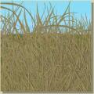

Ostriches, long grass, sharp rocks
Artificial Life Lecture 18
6 December 2010

Slide 30
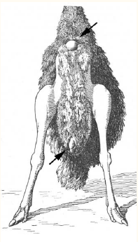
Callosities
Figure 4 |
The callosities on the ventral
surface of the ostrich. The callosities are
depicted by arrows. How did they become
assimilated into the genome?
Artificial Life Lecture 18
6 December 2010

Slide 31
Is it Lamarckian?
This sounds like Lamarckism -- "giraffes stretched their necks to reach higher trees, and the increased neck-length in the adults was directly inherited by their children".
Lamarckism of this type is almost universally considered impossible -- why ??
The Baldwin effect gives the impression of Lamarckism, without the flaws.
To be pursued in seminar
Artificial Life Lecture 18
6 December 2010

Slide 32
Feedback on Alife course?
Any verbal feedback now? And in seminars.
What was missing that you expected?
And a teaser (cf ‘Circular causation’…)
Artificial Life Lecture 18
6 December 2010

Slide 33
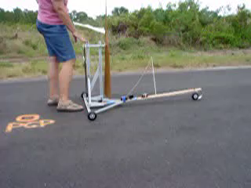
Circular Causation poser …
A cart with its wheels linked through gears to a propellor.
Can it run directly downwind faster than the wind?
Artificial Life Lecture 18
6 December 2010

