Slide 1
Artificial Life Lecture 9
Gaia Theory, and Daisyworld Models
Be aware that in many scientific circles Gaia theory is seen as deeply unscientific, associated with hippies with flowers in their hair dancing naked in the woods under the full moon.
Enlightened unblinkered scientific opinion (... You can guess how to translate that...) considers that Gaia theory is completely serious scientific work, asking interesting questions (and proposing some answers) about aspects of life that other branches of biology have neglected.
Artificial Life lecture 9
2 November 2010

Slide 2
Gaia
A ripe field for Alife-style research – [Summer projects?]
and strangely neglected.
Gaia = Greek for Earth Goddess
(modern Greek pronunciation is 'Yeah'!)
"Our planet is in some sense a living, self-regulating organism"
... but in what sense?
Artificial Life lecture 9
2 November 2010

Slide 3
Some references
Pop: by J Lovelock
Gaia, a new look at Life on Earth (1979) OUP
The Ages of Gaia (I988) OUP
(JL now slightly disowns the first, prefers the second)
LE Joseph, Gaia the growth of an idea (1990) Penguin
Not so pop:
Dawkins, The Extended Phenotype, contains criticism
WD Hamilton Gaia's Benefit, New Scientist (1996) 151, pp 62-63
New !:
Harvey, Homeostasis and Rein Control: From Daisyworld to Active Perception, Alife9, webpage. [seminar]
Artificial Life lecture 9
2 November 2010

Slide 4
More references
Serious: Authoritative statement of current position of
Gaia theory,
Tim Lenton Gaia and Natural Selection
Nature, v394, 30 July 1998
PT Saunders Evolution without Natural Selection:
Further Implications of the Daisyworld Parable
J Theor Biol (1994) 166, pp 365-373 [seminar]
S Stocker Regarding Mutations in Daisyworld Models
J Theor Biol (1995) 175, pp 495-501
Artificial Life lecture 9
2 November 2010

Slide 5
Origins of Gaia Theory
Jim Lovelock, with a background in atmospheric chemistry, was employed by JPL (Jet Propulsion Lab) in California in 1968, when NASA was looking for funding to send a rocket to Mars looking for life.
JL worked out that if he was on Mars, wondering about life on Earth,, he could just look through a telescope and see evidence that the gases in the Earth's atmosphere are in a persistent state of disequilibrium
-- driven by living organisms.
Artificial Life lecture 9
2 November 2010

Slide 6
Biosphere
Conversely, looking at Mars' atmosphere, it is in a state of chemical equilibrium -- no need to waste money on rockets. Just look at the infrared signature.
He realised that the interactions between living organisms, and all the different aspects of the physical environment, within the bounded world of a planet, formed a complete biosphere in which all affected everything else
-- and then he started to notice some regularities...
Artificial Life lecture 9
2 November 2010

Slide 7
The Gaian Hypothesis
Together with Lynn Margulis (a biologist who fought to get symbiosis recognised as significant to the development of life) Lovelock wrote papers in 1974 stating the original hypothesis:
"the biosphere - atmosphere, oceans, climate, Earth's crust and biota, living organisms, is regulated as a homeostatic system in conditions comfortable for the living organisms"
Artificial Life lecture 9
2 November 2010

Slide 8

Context of the Original Daisyworld model
One example :- Our Sun is heating up, it was say 30% less luminous 3.8bn years ago. By rights, it should have been far too cold for life then, and far too hot now (e.g. 290⁰C)
But it seems the Earth’s surface temperature has been maintained at around 20⁰ C for aeons. A nice temperature!
HOW ?
Artificial Life lecture 9
2 November 2010

Slide 9
Scepticism
Initially there was no theory or model as to how this might work, so it received a lot of scepticism.
It was only around a decade after the first hypothesis that Lovelock and Watson created the Artificial Life model of Daisyworld that people started to take a bit more notice.
A typical story of resistance to new ideas …
Artificial Life lecture 9
2 November 2010

Slide 10
Resistance to new ideas
Lynn Margulis' ideas on symbiosis -- that eukaryotes like plants and animals owe their origin to a symbiotic relationship between bacteria and cells -- went though the classic cycle with the neo-Darwinians:
(1) for a decade or 2 -- "nonsense, evolution is all about competition, you cant get anything serious going with such collaboration, what about cheaters?"
(2) for a decade or 3 -- "hmm, maybe your ideas might shed light on a thing or 2"
(3) eventually -- "of course we can incorporate this within our theory, we have forgotten that we ever disagreed with you".
Artificial Life lecture 9
2 November 2010

Slide 11
Resistance to Gaia Theory
Resistance to Gaia theory has currently reached about stage (2), with the prime arguments against being
(A) This implies teleology, foresight, Earth Goddess
(... hippies, crystals etc...)
(B) The Earth is not a unit of selection, so the Earth cannot have evolved, so how could such regulatory properties have come about?
Artificial Life lecture 9
2 November 2010

Slide 12
The Teleology Problem
In earlier versions of the Gaia theory (or hypothesis), it was implied that the conditions such as climate of the Earth were regulated (around life-favourable values) 'by and for the biota'.
This formulation suggests the cause of the regulation lies in the biota, the living organisms, and rang all sorts of alarm bells
'why did they do it, how did they know what level to aim for,??'.
Worries about CHEATS -- if most of them 'expended some effort or energy' in doing their bit for the regulation business, how come the rest who cheated, benefited from the global climate without doing their share, didn’t expand and wipe out the altruists?
Artificial Life lecture 9
2 November 2010

Slide 13
Reformulation of Gaia
AS a consequence of these initial criticisms of Gaia theory, there was a reformulation:
It is the system as a whole, organisms and environment, that forms a closely-coupled self-regulating system
Causes for the regulation are at the level of the whole system rather than individual isolated parts.
Artificial Life lecture 9
2 November 2010

Slide 14
The ‘Gaia is alive’ problem
When Lovelock said that 'in some sense the Earth is a living organism' he fell foul of a whole lot of biologists with a vested interest in some particular senses of the term 'alive'.
In particular (a) scientists against woolly New Age thinking, and
(b) neo-Darwinist focusing their attention on evolutionary aspects of life.
The Earth cannot have evolved, as there is no reproduction of planets, with selection and variation.
Artificial Life lecture 9
2 November 2010

Slide 15
A different core definition of life
But Lovelock was (quite innocently) taking a different, ecological, geophysiological view of 'life', seeing the whole biosphere as having these specific properties of living creatures: the homeostatic ability to self-regulate.
Having seen the fuss his earlier words made, Lovelock, and others, are now more careful in their statements
[“Geophysiology” -- the orthodox name is now “Earth Systems Science”]
Artificial Life lecture 9
2 November 2010

Slide 16
Response to criticism
The Daisyworld model was built, by Lovelock and Andrew Watson, as a direct response to the criticism of being woolly and unscientific.
It is, of course, a metaphor, a very simplified model for how any of many different life-affecting conditions on our planet can be intimately bound up in circular interactions, as both cause and effect, resulting -- so it is claimed -- in self-regulation
Artificial Life lecture 9
2 November 2010

Slide 17
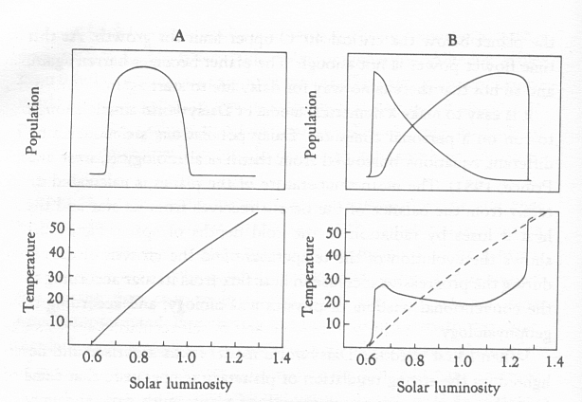
Daisyworld
A Grey Planet around a Sun which gets warmer over time.
Black and white daisies, same limits to temp under which they can grow 5 to 40 C, with optimum 22.5 C.
Artificial Life lecture 9
2 November 2010

Slide 18
Maintenance of a comfortable temperature
When Planet is cold, any white daisies are cooler than surrounds, hinder their own growth. Any black ones absorb the sunlight, warm up their surrounds, and enhance their growth. In doing so they warm up the whole planet.
When planet is hot, the reverse happens, and white daisies dominate.
Throughout a change in solar input equivalent to 45 C, the whole planet temp is maintained within a few degrees of the optimum 22.5 C.
Artificial Life lecture 9
2 November 2010

Slide 19
Different views (1)
On left, how biologists and physicists, thinking independently, would expect things to change as sun heats up: planet temp increases, and with this daisy population rises and falls as optimum growing temp is passed.
Artificial Life lecture 9
2 November 2010

Slide 20
Different views (2)
On right, Gaian view, with competitive growth of dark and light daisies, which in turn affects planetary temperature.
Artificial Life lecture 9
2 November 2010

Slide 21
Revised Kindergarten DW version
In Jan 2004 I applied the standard rule of thumb for doing a project – “let’s simplify the whole system as much as possible, retaining only the very basics”
Harvey, I., (2004). Homeostasis and Rein Control: From Daisyworld to Active Perception
Proceedings of the Ninth International Conference on the Simulation and Synthesis of Living Systems, ALIFE'9, Pollack, J., Bedau, M,. Husbands, P., Ikegami, T., and Watson, R.A. (eds), pp. 309-314. MIT Press, Cambridge MA.
Available on my webpage
Artificial Life lecture 9
2 November 2010

Slide 22
New Kindergarten Daisyworld
“Let’s model the Black Daisies as in one Grey daisybed, the White in another, no longer competing for space”
S = Temp of Sun
“Let’s assume heat flows depend linearly on temp diff (S-T), modulated by Daisybed albedo, and on temp diff (T-0) to deep space”
T
Temp deep space = 0
Artificial Life lecture 9
2 November 2010

Slide 23
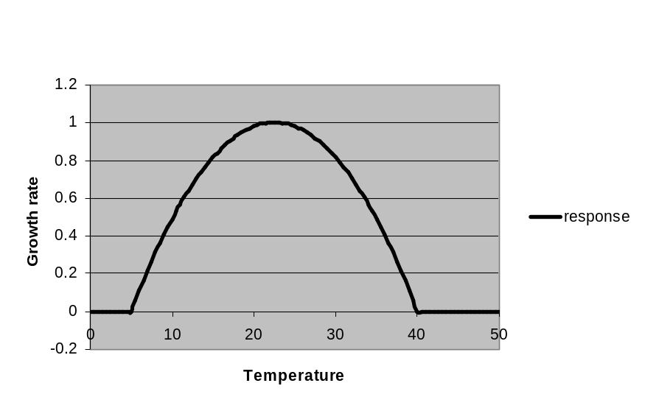
Hat Functions
Homeostasis goes with viability
“The Daisy viability function, as temperature varies, is a Hat-shaped function.”
GROWTH RATE
OF DAISIES
TEMPERATURE
“Any Hat function will do”
“Let’s use a Witch’s Hat, directly for the number of Daisies, not Growth Rate”
NUM OF DAISIES
TEMPERATURE
Artificial Life lecture 9
2 November 2010

Slide 24
Consider just the Black Daisybed
Positive effect
+
S
D_{B} = Number
of Black Daisies
D_{B}
T_{B} = Temp of
Black Daisybed
T_{B}
0
Hat Function
Artificial Life lecture 9
2 November 2010

Slide 25
The Maths says Temperature settles at … …
NUM OF DAISIES
Where the Hat function is crossed by …
TEMPERATURE
WHAT TEMP
WOULD BE
WITH NO
RESPONSE
SLOPE
…a “Response” straight line, whose slope is given by sign/strength of response
MORE MEANS …
… MORE +VE EFFECT ON T
Artificial Life lecture 9
2 November 2010

Slide 26
So Possible Temperatures are … …
NUM OF DAISIES
B
C
The Interesting One
A
TEMPERATURE
A is a low temperature, with no Black Daisies alive
B turns out to be an unstable equilibrium
C is a stable equilibrium, the +ve effect from Black Daisies brings Daisybed temperature within the viable range
Artificial Life lecture 9
2 November 2010

Slide 27
This extends the Zone of Viability
Viable zone with the positive feedback
Viable zone with no feedback
Shifting this slope left or right corresponds to changes in the external forcing of the Sun’s luminosity – let’s see how far it can shift and still intersect RHS of Hat Function … …
There is a bigger range of sun luminosities (extended left) that can support viable daisy temperatures, because of the positive response from Black Daisies absorbing extra heat.
Artificial Life lecture 9
2 November 2010

Slide 28
White Daisies give Negative Response
All Grey Black Daisies
White Daisies
Similarly, on a White Daisybed, the more White against the Grey background, the more negative response.
This gives a line with a negative slope, but similarly extends (now to the right) the range of viability of a White Daisybed.
Artificial Life lecture 9
2 November 2010

Slide 29
So both Positive and Negative Response works
There is no need to suppose God, or Evolution (in the real world), or some Trickery (in the Daisyworld model) has cunningly put in the “right kind of response” to make this homeostasis work.
Because ANY kind of response, positive or negative, when combined with a Viability Hat-function, gives this type of homeostasis :- extends the range of viability beyond what it would be without any feedback.
Artificial Life lecture 9
2 November 2010

Slide 30

Terminology: “Positive and Negative Feedback”
Within each Daisybed, temperature T affects Daisy quantity D via a Hat-function. In turn, there is an effect feeding back from D to T that is either +ve (Black) or –ve (White daisies)
+ or -
But this doesn’t mean that this circuit as a whole is a (+ve or –ve) feedback control circuit – because the Hat-function is a crucial part !
D
T
Artificial Life lecture 9
2 November 2010

Slide 31


Daisyworld ≠ Negative Feedback Circuit
Conventionally you need a “Negative feedback control circuit” for homeostasis – using a Set Point (eg “desired temp”) and Negative Feedback to compensate for any Error …
-
+
… and Positive feedback leads to instability
This Daisyworld homeostasis is very different – for a start, there is no Set Point, only a viability range !
+/-
And both “Hat-plus-Positive feedback” and “Hat-plus-Negative feedback” work, to give regulation.
Artificial Life lecture 9
2 November 2010

Slide 32
Different timescales
Fast response to small perturbations
Num daisies
temperature
Num daisies
temperature
Artificial Life lecture 9
2 November 2010

Slide 33
Stability
For any fixed value of the external “Big Perturbation” – ie Sun luminosity – and fixed slanting line, there will be fast negative feedback to any local noisy perturbations around the circled stable equilibrium points; and positive feedback around the starred unstable equilibrium.
But the DW feedback is at a different timescale – it is response to (slower) changes in the “Big Perturbation”.
Artificial Life lecture 9
2 November 2010

Slide 34
Daisyworld and Evolution
What happens if there is not just competition between black and white daisies, but potential for heritable variation, for evolution?
A common cry against Gaia Theory was 'what about cheats that disrupt self-regulation by benefiting from what others do without contributing themselves?'
Lovelock showed that a grey daisy with an energy-advantage did not destroy self-regulation.
Artificial Life lecture 9
2 November 2010

Slide 35
Daisyworld and Evolution (ctd)
Tim Lenton (see Nature paper) introduced an initial population of grey daisies, which could mutate in small steps to be blacker or whiter -- similar self-regulation appeared in the model.
There is scope for many further models and experiments, using Alife-style models.
Artificial Life lecture 9
2 November 2010

Slide 36
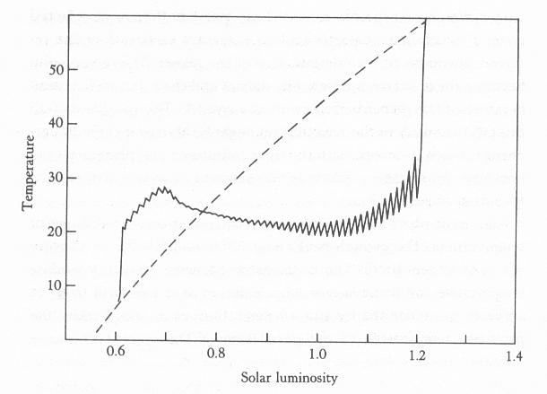
Response to Perturbation
From JL 'The Ages of Gaia':
10 species of daisies evolving, range of shades. Suppose you have perturbations, periodic plagues killing 10% of all daisies.
Stability of system is dodgiest near the beginning and end of the 'horizontal' regulated range.
Artificial Life lecture 9
2 November 2010

Slide 37
Ecology and Biodiversity
It is a commonly held belief that 'more biodiversity is good' for an ecology, in that it makes it more stable to perturbations. More is better?
Actually this is scientifically controversial. Robert May (recent Govt Chief Scientist) many years ago came out with widely-accepted mathematical models indicating that under very general conditions ecologies with many interacting species are less stable than ones with fewer.
Less is better?
Artificial Life lecture 9
2 November 2010

Slide 38
Ecology, Biodiversity and Gaia ?
Possibly, the introduction of the Gaian geophysiological assumptions, that the evolution of living organisms and their physical environment should be considered together -- possibly this may change the picture.
Tim Lenton certainly suggests in his Nature paper (Box 3) that this may be the case -- worth further investigation.
‘Damworld’ model – Peter Henderson.
Artificial Life lecture 9
2 November 2010

Slide 39
What practical implications of Gaia?
Without Gaia Theory, an observer visiting a planet and seeing that the plants had a preferred temperature that corresponded to the actual temperature – would assume that the plants had evolved their physiology to match a pre-ordained temperature.
But now, with Gaia Theory, there is the new possibility that cause and effect was the other way round!
Or some combination.
Artificial Life lecture 9
2 November 2010

Slide 40
Takehome message
It is easy to pay lip-service to the idea that living organisms affect their environment, without really appreciating the extent and importance of this.
On Earth, our temperature, the oxygen in our atmosphere, the constituents of our rocks cycling through the ocean floor into the earth's mantle and out through volcanoes, all interact with the biota, in what seems to be in some sense a self-regulating system.
Artificial Life lecture 9
2 November 2010

Slide 41
Alife models?
This is a fertile area for ALife style models, plenty of fresh research to be done, potentially bringing important new insights.
Gaia Theory is still at an early stage, by no means is all understood.
TL: "The implications may be far-reaching; simple principles suggest that environmental regulation can emerge at all levels from the individual to the global"
Artificial Life lecture 9
2 November 2010

Slide 42
New Model
Jamie McDonald-Gibson, EASy MSc thesis 2006.
McDonald-Gibson, J., Dyke, J., Di Paolo, E. and Harvey, I. (2008). Environmental Regulation can arise under minimal assumptions
JTB Journal of Theoretical Biology
In this model: (1) daisies have all different ‘preferred-temps’ and all different +/- effects (both evolvable) (2) Uniform temp across planet (ext perturb from ‘Sun’)
--- and you still get homeostasis, with punk eek
Explanation is in terms of Rein control,
Artificial Life lecture 9
2 November 2010

