Slide 1

Genetic Algorithms
Matt Whitehead
Sept. 13, 2005

Slide 2
Outline
Quick Overview of GAs
  Pseudocode
Example Simple Applications
  Introductory Examples
  Music
  GA for GAs?
Genetic Programming
Setting up a GA
  Traveling Salesman Problem

Slide 3
GA Pseudocode
pop = init_random_population(size)
while avg_fitness(pop) < fit_threshold:
pop = select_good_ones(pop)
pop = crossovers(pop)
pop = mutations(pop)

Slide 4
Quick Overview of GAs
Optimization technique
  Some set of parameters that needs to be optimized
The key element: Fitness Function
  How is fitness determined?
  Defining an appropriate fitness function is essential

Slide 5
Show Simple Examples

Slide 6
Genetic Programming
Grow your own programs
Programs are represented as trees of instructions
  (Think Lisp or Scheme)
Crossover is performed by two programs trading subtrees
Mutation is the alteration of a single instruction or value to another

Slide 7
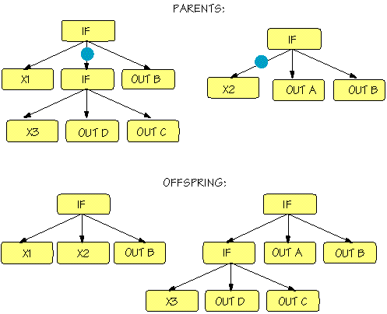

Slide 8
Traveling Salesman
Classic NP-hard problem
Problem statement:
  Given the distances between each pair of cities in a set, what is the fastest way to visit each city once and return to the starting city?
Applications
  shipping goods by plane, truck, etc.
  movement of troops
  er, traveling salesmen

Slide 9
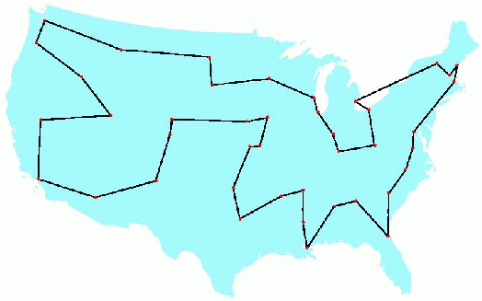

Slide 10
How would you use GAs to solve this problem?
What would/could chromosomes in the population look like? (How is the information encoded?)
What would the fitness function be like?
Would a GA have any problems with your setup?
  Repeated cities, relative fitness rankings, etc.

Slide 11
References
GP image: http://sawww.epfl.ch/SIC/SA/publications/SCR95/7-95-24a.html
Music: http://www.lilypond.org/web
TSP: http://www.tsp.gatech.edu/
GP: http://www.genetic-programming.com

