Slide 1
Simulated Evolution in the Avida Virtual Machine
Joshua Walgenbach
I400/I590

Slide 2
History of Artificial Life VMs
Core World
Tierra
Avida
Notes:
Core World - Steen Rasmussen 1990
Inspired by Core Wars
Mutation via flawed copy
Failed experiment
Programs would initially replicate, and then copy code into each other. Settled into a non-living state.
Tierra - Thomas Ray (1991)
Big advances -- write protected memory and copy by template
System would optimize code (e.g. unrolling loops)
Ray theorized in his paper about inserting code for optimization into an ancestor creature and letting evolutionary pressure within the system optimize the code.
Avida (1993) Chris Adami, Charles Ofria and C. Titus Brown
1992 Chris Adami started experimenting with Tierra. Attempted to get it to evolve simple mathematics. If an organism successfully performed a desired operation, it received extra time to execute. If the extra time was greater than the time needed by the operation, it conferred a competitive advantage.
1993 started the Avida project. Avida is a more sophisticated AL Virtual Machine.

Slide 3
Avida Features
Configurable instruction sets
Advanced specialized VM design
Secondary fitness function
Notes:
Default instruction set can be configured to change the CPU cost of each instruction and the cost of failed instructions, first time cost (used to reduce diversity within a genome) and redundancy (used to alter the probability of an instruction being mutated to). Totally new instructions can be added at compile time.
Advances features include a dual stack system, write, read, and flow heads. Input and out
The fitness function of evolution in the VM is more than just competition against other organisms and replication. You can add a boolean test of response to an input and output

Slide 4
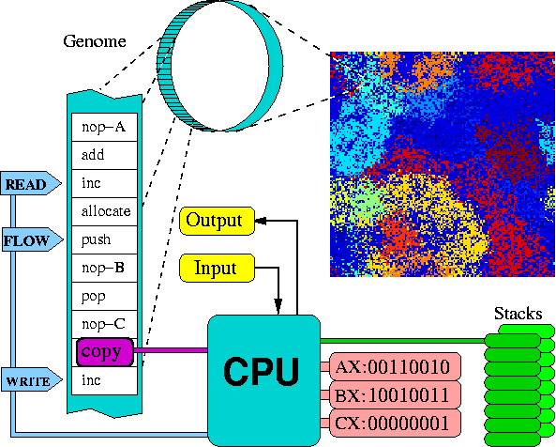
Avida VM Design
Notes:
# A memory that consists of a sequence of instructions, each associated with a set of flags to denote if the instruction has been executed, copied, mutated, etc.
# An instruction pointer (IP) that indicates the next site in the memory to be executed.
# Three registers that can be used by the organism to hold data currently being manipulated. These are often operated upon by the various instructions, and can contain arbitrary 32-bit integers.
# Two stacks that are used for storage. The organism can theoretical store an arbitrary amount of data in the stacks, but for practical purposes we currently limit the maximum stack depth to ten.
# An input buffer and an output buffer that the organism uses to receive information, and return the processed results.
# A Read-Head, a Write-Head, and a Flow-Head which are used to specify positions in the CPU's memory. A copy command reads from the Read-Head and writes to the Write-Head. Jump-type statements move the IP to the Flow-Head.

Slide 5
Differences from Tierra
Avida creatures have no read access to other creatures
Dual stack design
Read, write, and flow heads
Input/Output buffers

Slide 6
Differences from Tierra (ctd)
Multiple data stacks
Default 26 instruction set
  3 NOPs for templates
  NOPs alter instruction behavior
Notes:
Multiple data stacks -- theoretically infinite, practically limitted to 10 deep.
Nop-a, nop-b, and nop-c -- used for creating templates and altering instruction behavior
Also alters behavior of instructions e.g.

Slide 7
Differences from Tierra (ctd)
NOPs as modifers
  inc followed by a nop-a increments value in the AX register
  mov-head followed by nop-a moves the flow head (nop-b moves read head, nop-c moves write head)

Slide 8
Differences from Tierra (ctd)
Dynamic allocation of memory
  No need for an organism to know its size
Replication results in two daughter cells
  Copy mutation (affects only the replicated daughter)
  Point mutations (affect both daughters)
    Can occur at any time, but only take affect after replication
Notes:
A species in Avida (by default) is defined as a phenotype with a population of at least three.
Upon replication the parent is reset, point mutations are implemented and any benefit the parent has accrued is implemented for both parent and daughter (in effect making them both daughter cells).

Slide 9
Copy procedure
15 instructions
  Allocate space
  Set write, read and flow heads
  Copy until end template found
  Divide
Notes:
Default organism is a simple 15 instruction.
# --- Setup ---
h-alloc # Allocate space for child
h-search # Locate the end of the organism
nop-C #
nop-A #
mov-head # Place write-head at beginning of offspring.
nop-C #
# --- Copy Loop ---
h-search # Mark the beginning of the copy loop
h-copy # Do the copy
if-label # If we're done copying....
nop-C #
nop-A #
h-divide # ...divide!
mov-head # Otherwise, loop back to the beginning of the copy loop.
nop-A # End label.
nop-B # End label.

Slide 10
Time Slicing
Simple case, all virtual CPUs run at the same speed
  different instructions can have different cost
More complex case
  each CPU is given a merit based upon its performance
  merit can be earned by performing secondary fitness functions
Notes:
Each organism has associated with it a value called merit. The merit indicates how fast the CPU should run. Merit is a unitless quantity, and is only meaningful when compared with the merits of other organisms. Thus, if organism A has twice the merit of organism B, then A should execute twice as many instructions in any given time frame as B.

Slide 11
Environment
An Avida environment is described by
  a set of resources
  a set of reactions that can be triggered to interact with those resources
Notes:
Resources are earned by organisms performing the prescribed functions (secondary fitness functions).
Resources are translated to merit at gestation time.
Avida performs logic functions as its default resources. Correctly performing a logic functions on one or a pair of 32 bit strings alters the merit of the organism (taking effect at gestation).

Slide 12
Environment (ctd)
A reaction is defined by
  a merit effect on the organism
  a by-product resource if one should be produced

Slide 13
Merit
How fast the CPU runs
  Set at gestation time
  Determined by the resources gathered by the parent
Both daughters get benefit when parent divides.
Notes:
Merit is the speed at which the CPU runs -- set permanently at gestation. Both daughters benefit from merit.
Merit is determined by the amount of resources gathered by the parent process (how well it performs in the fitness tests inside the Avida environment).
If the merit (CPU speedup) is greater than the cost of performing the resource function, it confers a competitive advantage.

Slide 14
Experiments
Experiments in evolving complex functions
  Initial ancestor (50 instructions) could replicate but not perform logic functions

Slide 15
Phylogenic Results
Notes:
Graph shows the phylogenic depth against the time.
Final organism could perform all nine of the default logic functions used for resources, and is 344 phylogenic steps from the original ancestor parent. The blue line shows the direct descent from the original ancestor to the 83 instruction final organism.
The colors show relative abundance of the genotypes. Yellow is more abundant than red.
This final dominant type was 344 steps removed from its ancestor. That is, an offspring differed genetically from its parent in 344 of the many thousands of generations leading to this final type.

Slide 16
Efficiency Vs Merit
Notes:
Replication efficiency is the ratio of genome length to the energy necessary to run a single instruction
There are drops in efficiency but are associated with an increase in computational merit. Deleterious mutations (in terms of replication) are offset by an increase in fitness due to merit. The payoff of the extra work to perform the logic functions (in initial mutations) is worth it, and replication efficiency ends up increasing as the logic functions are optimized.

Slide 17
Similarities Shown Between Digital and Organic Evolution
pleiotropy
  one mutation affects multiple traits
epistasis
  multiple mutations interact to determine the same trait
Evolution acts on organisms - not genes

Slide 18
Other Experiments with Avida
Phylogenic reconstruction method
Adaptive radiation with regards to competition
Molecular evolution
etc

Slide 19
Resources
Avida: A Software Platform for Research in Computational Evolutionary Biology
Ofria C and Wilke CO
Journal of Artificial Life 10:191-229 (2004).
The Evolutionary Origin of Complex Features
Lenski RE, Ofria C, Pennock RT, and Adami C
Nature 423:139-144 (2003).
The Avida Technical Manual
Ofria C, Brown CT, and Adami C
Published in Introduction to Artificial Life by Christoph Adami
Telos Springer Verlag, New York 1998, pages 297-350.
The Devolab at Michigan State University
http://devolab.cse.msu.edu

