Slide 1
Evolution and Learning
I400/I590 Artificial Life as an approach to Artificial Intelligence
By Paul McDonald

Slide 2
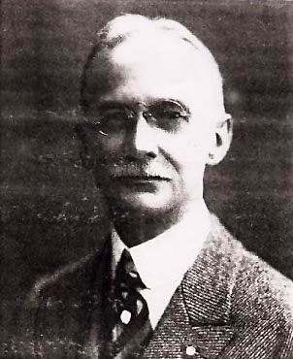
History
James Mark Baldwin
Conwy Lloyd Morgan
Henry Fairfield Osborn
Conrad Hal Waddington
1896 – Proposes A New Factor in Evolution
Phenotypic Plasticity - an organism has the ability to adapt to its environment within its lifetime
The “Baldwin Effect” – if these adaptations are useful and allow an organism to survive and reproduce, the organism’s fitness will increase and evolution will select organisms that are more and more capable of learning the adaptation
Over a long enough period of time these adaptations become innate to save energy and time, and are selected through the evolutionary process

Slide 3
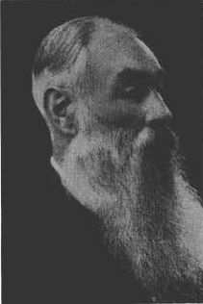
History
James Mark Baldwin
Conwy Lloyd Morgan
Henry Fairfield Osborn
Conrad Hal Waddington
1896 – Publishes Habit and Instinct
“To what extent must natural selection be supplemented by the inheritance of acquired habits in order to account for the evolution of complex instinctive behavior patterns? 'Is the greater relative perfection in the instinctive flight of some insects,' for example, 'due to the inheritance of acquired skill on the part of their ancestors? Or is it due to the fact that there has been among insects more elimination of those who failed in congenital power of flight, and hence a survival through natural selection of those in which the instinctive flight was better developed?”
Independently came up with a about the same idea as Baldwin

Slide 4
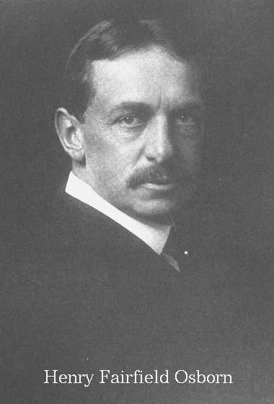
History
James Mark Baldwin
Conwy Lloyd Morgan
Henry Fairfield Osborn
Conrad Hal Waddington
1896 - Publishes A mode of evolution requiring neither natural selection nor the inheritance of acquired characteristics
“Adaptive evolution may not require neither natural selection nor the inheritance of acquired characteristics, but may use natural selection in some cases.”
He also independently came up with the same idea as Baldwin

Slide 5
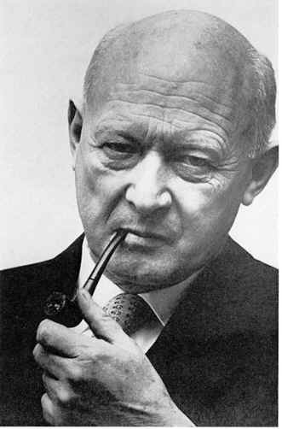
History
James Mark Baldwin
Conwy Lloyd Morgan
Henry Fairfield Osborn
Conrad Hal Waddington
1942 - Publishes Canalization of Development and the Inheritance of Acquired Characters
"The main thesis is that developmental reactions, as they occur in organisms submitted to natural selection, are in general canalised. That is to say, they are adjusted so as to bring about one definite end-result regardless of minor variations in conditions during the course of the reaction".
The idea of canalization is also known as “genetic assimilation”

Slide 6

How Learning Can Guide Evolution
Geoffrey E. Hinton and Steven J. Nowlan (1987)
“Learning alters the shape of the search space in which evolution operates and thereby provides good evolutionary paths towards sets of co-adapted alleles.”
By adding learning to the evolutionary search a large zone of increased fitness forms around the good net. Whenever the genotype falls within the zone its fitness will increase.
“It is like searching for a needle in a haystack when someone tells you when you are getting close.”
The neural net has 20 potential connections, and the genotype has 20 genes, which has 3 alleles: 1 connection should be present , 0 connection should be absent , and ? Connection contains a switch which can be open or closed
There is a random combination of switch settings for each trail, and if they ever produce the good net the switch settings are frozen.

Slide 7
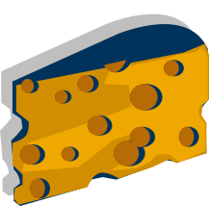
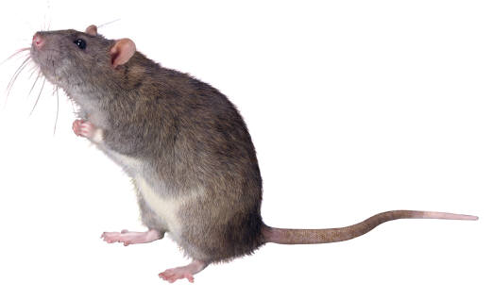
Learning, Behavior, and Evolution
Domenico Parisi, Stefano Holfi, and Federico Cecconi (1991)
Learning can accelerate the evolutionary process for learning tasks that are correlated with the fitness criterion and for learning tasks that are not
The ability to learn a task can emerge and be transmitted evolutionarily for both types of tasks as well
Self-selection of stimuli can influence evolution
Organisms (O) live in a bidimensional environment that contains randomly distributed pieces of food
Sensory inputs are the angle and distance to the nearest food (values scaled from 0.0 to 1.0)
Motor output units are additional input at time t+1
Outputs are encoded representations of movement (go ahead, turn left, turn right, and stay still)
Food
Organism

Slide 8
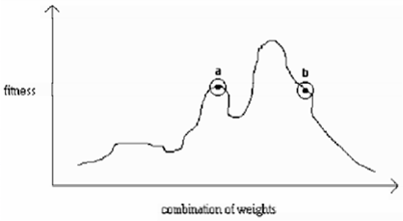
Learning, Behavior, and Evolution
Domenico Parisi, Stefano Holfi, and Federico Cecconi (1991)
They ran three different experiments: without learning (static weights), with learning that is correlated to fitness criterion (food prediction), and with learning that is not correlated to the fitness criterion (XOR)
Learning allows the exploration of the fitness landscape
Without learning or the exploration of the fitness landscape a and b would have an equal chance of selection
With learning evolution can select the genotype that will produce fitter phenotypes
This means that evolution will select b because b can produce fitter offspring

Slide 9
The Evolution of Learning: An Experiment in Genetic Connectionism
David J. Chambers (1991)
Using evolution the process of learning can evolve
Chambers will view evolution as a type of second-order adaptation and learning as a first-order adaptation
Evolves a supervised learning algorithm for a neural network with a single layer of weights
Local Information:
a_{j} = the activation of the input unit j
o_{i} = the activation of the output unit i
t_{i} = the training signal on output unit i
w_{ij} = the current value of the connection strength from input j to output i
The genome must encode a function F, where
Δ w_{ij} = F(a_{j}, o_{i}, t_{i}, w_{ij})

Slide 10
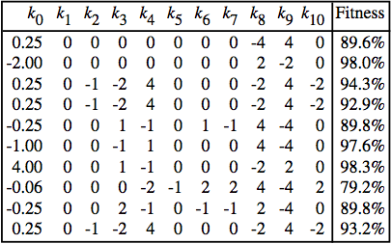
The Evolution of Learning: An Experiment in Genetic Connectionism
David J. Chambers (1991)
On the first and second runs the Delta Rule shows up
On the sixth and seventh runs a slight variation of the Delta Rule shows up
Overall the Delta Rule was discovered on 20% of all runs with similar parameters
The best learning algorithms produced on 10 evolutionary runs
The average fitness of the 10 final learning algorithms on the 20 tasks in their environment was 92.3%, while the average of the tasks not present in the environment was 91.9%
This means that the evolutionary environment was sufficiently diverse and didn’t encourage task-specific mechanisms to evolve

Slide 11
Implications of Evolution and Learning in IST (Instructional Systems Technology)
One aspect of IST is learning through interactive software (ie: video games)
A limited amount of AI research currently involves games
The possibility of an evolving AI that could be used to teach students at an individual level would be a very useful tool
Games are being used more commonly as educational tools
Games have also started to focus more on game play and player experience, rather than just graphics
This focus has created the need for more advanced AI in games

Slide 12
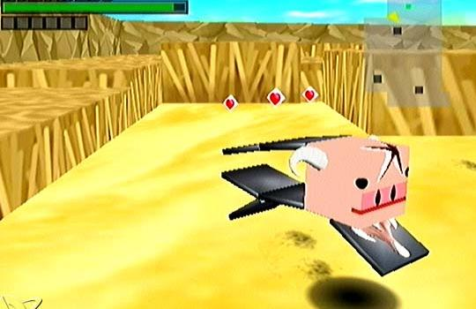
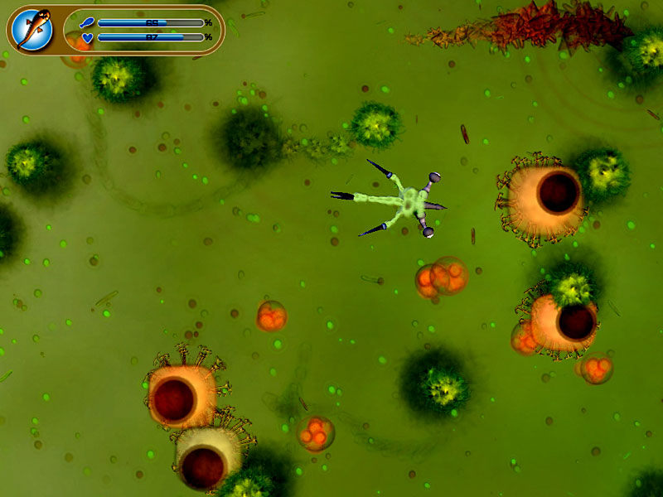
Cubivore: Survival of the Fittest
A game that takes the idea of Karl Simms “blocky creatures” and makes a bizarre and addictive game about evolution
The object of the game is to mutate in a desirable manner by eating weaker creatures
The better you mutate, the more you will be allowed to mate and propagate your species
Spore
A dynamic evolution simulation game that starts you off at the cellular level and lets you evolve to the point of interstellar dominance
This is a game by Will Wright that comes out for pc sometime during Q3 of 2006

Slide 13
Resources:
Evolution, Learning, and Instinct: 100 Years of the Baldwin Effect
Conwy Lloyd Morgan: Habit and Instinct
Organisms can be proud to have been their own designers
Conrad H. Waddington’s contributions to avian and mammalian development
Evolution & Learning
The Evolution of Learning: An Experiment in Genetic Connectionism
Learning, Behavior, and Evolution
How Learning Can Guide Evolution

Slide 14
