Slide 1
Danny Hillis and Co-evolution Between Hosts and Parasites
I 590
4/11/2005
Pu-Wen(Bruce) Chang

Slide 2
Motivation
D Hillis, 'Co-evolving Parasites Improve Simulated Evolution as an Optimization Procedure'
Using a Genetic Algorithm Model to Solve an Optimization Problem in Computer Science: Finding the Smallest Size Sorting Network for n=16 Elements.

Slide 3
What is a Sorting Network?
Suppose we want to sort two numbers according their order, here is one way to do it:
inputs
outputs
x
min(x, y)
y
max(x, y)
Figure 1

Slide 4
Sorting Network continued
Let’s sort 4 numbers:
Network 1:
inputs
outputs
Figure 2

Slide 5
Sorting Network continued
Network 2:
inputs
outputs
Figure 3

Slide 6
Sorting Network continued
Both networks can successfully sort any 4 numbers, no matter their initial order, but…
There are only 5 comparison-exchange operations in network 2, so it is more desirable than network 1.
Therefore, among those networks that can successfully sort n numbers, we can ask which one requires the least number of comparison-exchange operations, i.e., we want to find the smallest size sorting network.

Slide 7
Sorting Network continued
One interesting case is n=16.
In 1962, Bose and Nelson came up with a network that requires 65 operations.
In 1964, Batcher, and independently, Floyd and Knuth discovered a network that requires 63 operations.
In 1969, Shapiro found a network that requires 62 operations.
The best network so far is found by Green, which requires only 60 operations.

Slide 8
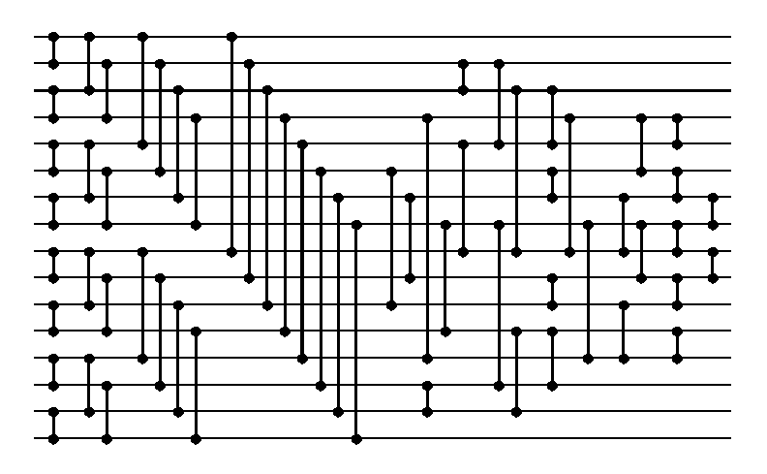
Green’s Network for 16 inputs
Figure 4

Slide 9
The GA Simulation and Encoding
The idea is using GA to find the smallest network for 16 inputs.
The genotype of each possible sorting network consists of 15 pairs of chromosomes: 30 strings of chromosomes.
Each string then consists of 4 pairs of codons: 8 codons.

Slide 10
Genetic Encoding
Each codon is a 4-bit number, representing one of the 16 input positions. Therefore, a pair of codon encodes one comparison-exchange operation.
Diploid encoding:
The codon pair looks like this or this:
-------------- --------------
(first pair) .... .... 0011 0101 ( means [3 5] test) ... 0011 0101 ...
(second pair) .... .... 0011 1000 ( means [3 8] test) ... 0011 0101 ...
The first pair = the second pair: homozygous
The first pair ≠the second pair: heterozygous

Slide 11
Genetic Encoding Continued
Following this, a genotype can encode between 60(15×2×2)(known smallest sorting network: completely homozygous genotype) and 120 (15×2×2 ×2)(completely heterozygous genotype) comparison-exchange operations.
But each phenotype generated from the genotype will begin with the same pattern of 32 exchanges, because most of the known optimal networks share this pattern. After that, encoding is randomized.

Slide 12
Testing and Evolving the Networks
Once the first generation population is generated, each phenotype (the individual network) is scored according to how well it sorts a random test case (the percentage it sorts the test case correctly).
Only the best scoring half can enter the reproductive stage.

Slide 13
Testing and Evolving the Networks Continued
Hillis evolves the networks on a two-dimensional grid and decides the mate to be found spatially.
The offspring of two mates is generated by crossover among 15 pairs of chromosomes. One randomly chosen crossover point per pair of chromosomes.
Mutation: one mutation per 1000 sites for each generation

Slide 14
The Result of Evolution
Evolving on populations of 2¹⁶ = 65536 individuals for up to 5000 generations.
The optimal result is a sorting network with 65 comparison-exchange operations.
Two shortages of this procedure: (1) the problem of local optima comes from selecting the mate locally;(2) The local optima was already reached after early generations. Possible contributions from later generations were wasted.

Slide 15
Co-evolution between the Hosts and Parasites
In order to increase the diversity among the offspring networks, Hillis takes advantage of the competitive relationship between the hosts and parasites.
The sorting networks play hosts and the test cases play parasites.
An individual parasite consists of 10 to 20 test cases, using similar encoding method mentioned above.

Slide 16
Co-evolution Continued
Two populations evolve on two different grids.
Again, the hosts are scored according to how well they sort the test cases.
The parasites are scored according to how well they make the sorting networks fail the test cases.
Therefore, the success of one means the failure of the other.

Slide 17
The Benefits of Co-evolution
Co-evolution prevents sorting networks getting stuck in local optima. The surviving pressure pushes the sorting networks to adopt different evolutionary strategies. Populations evolve constantly.
The contributions of later generations are also noticeable.

Slide 18
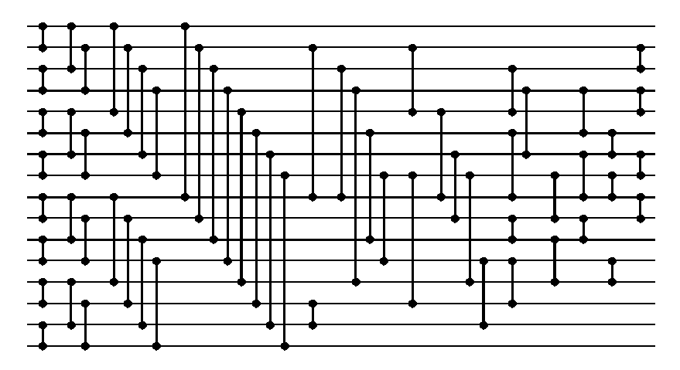
The Result of Co-evolution
An optimal sorting network with only 61 comparison-exchange operations.
Figure 5

Slide 19
Some Reflection Questions
Hillis sets the evolving target at 60 operations and adopts accordingly a particular genetic encoding. How can we use similar encoding to evolve even more optimal sorting network for 16 inputs?
Can we use GAs to generate optimal sorting networks for more than 16 inputs?

Slide 20
Credits
Figure 1 from http://www.paradise.caltech.edu/cns188/Handouts/cns188-02-04-2004.ppt#316,1,Sorting and Counting
Figure 4 and 5 from http://www.cs.brandeis.edu/~hugues/sorting_networks.html
The genetic encoding on slide 10 is from http:// www.cogs.susx.ac.uk/users/ inmanh/easy/alife02/alifeppt/lec13.ppt

Slide 21
References
D Hillis, 'Co-evolving Parasites Improve Simulated Evolution as an Optimization Procedure‘ In: Emergent Computation: 228-234.
http://www.mdx.ac.uk/www/psychology/cog/psy3260/
http:// www.cogs.susx.ac.uk/users/ inmanh/easy/alife02/alifeppt/lec13.ppt
http://www.paradise.caltech.edu/cns188/Handouts/cns188-02-04-2004.ppt#316,1,Sorting and Counting
http://en.wikipedia.org/wiki/Sorting_network
http://www.cs.brandeis.edu/~hugues/sorting_networks.html

