Slide 1
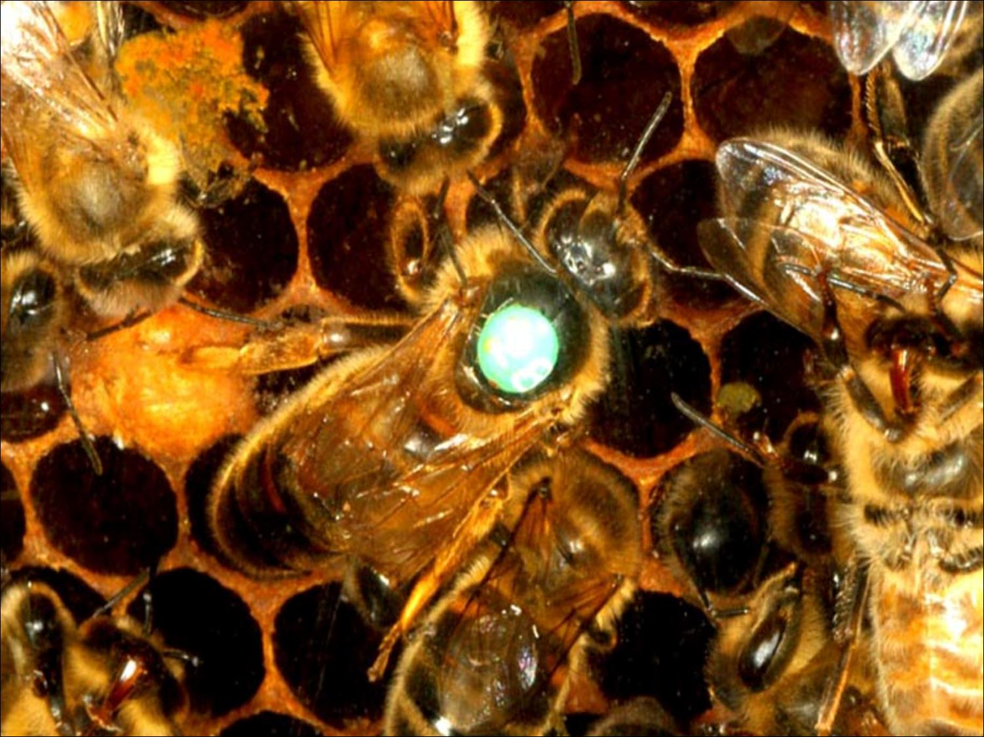



Slide 2
Overview
Historically, invertebrates have not been granted with possessing higher cognitive faculties
Instead, they have been thought to rely on reflexes, instincts, or other “hardwired” tendencies
However, recent research on honeybees (Apis mellifera) has shown them to be capable of learning basic concepts, categorizing visual stimuli according to several criteria, and even discriminating between human faces
These findings have broad implications for artificial life, neuroscience and cognitive science

Slide 3
Why Bees?
Bees are highly social insects with complex social organizations and communication systems, including a dance language that is “second only to human language in its ability to communicate information” (Gould 2002)
They are central-place foragers, which means they have to return to their hives after foraging, and they often navigate over long distances of up to several kilometers in doing so (Benard et al. 2006)
They are flower-constant—that is, they feed off of flowers of one species—requiring them to discriminate between different flower species but also to generalize between slightly different flowers of the same species (ibid.)
Notes:
As discussed in class last week, bees have been shown to form concepts of “sameness” and “difference”

Slide 4
Categorization in Honeybees
Honeybees have shown an ability to categorize visual stimuli based on angle of orientation (van Hateran et al., 1990), bilateral symmetry (Giurfa et al., 1996), and radial symmetry (Horridge & Zhang, 1995)
More recently, Stach et al. (2004) showed that honeybees can distinguish between sets of complex patterns that could not be categorized according to just one parameter (e.g., angle of orientation, symmetry, etc.)

Slide 5
Bilateral Symmetry
Bees were first trained on sets of three stimuli, one symmetric and two asymmetric (or vice versa)
During training, bees were rewarded for choosing the symmetric pattern and not rewarded for choosing either of the two asymmetric ones (or vice versa, with one asymmetric pattern and two symmetric ones)
They were then tested using novel stimuli
The bees performed at chance levels over the first several test trials, but after approximately the seventh trial, they showed an ability to understand the task and to distinguish between symmetric and asymmetric patterns

Slide 6
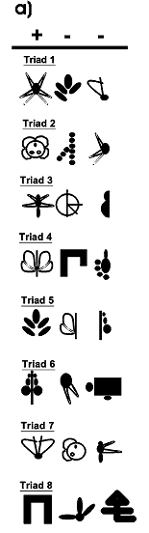
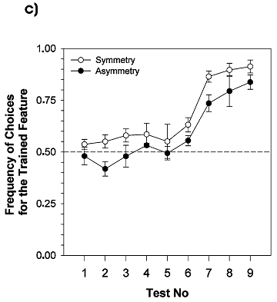
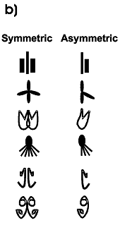
Bilateral Symmetry
Training Stimuli
Test stimuli
Acquisition curve

Slide 7
Bilateral Symmetry
Bees that were rewarded for choosing symmetric patterns hovered longer in front of the symmetric patterns than the bees rewarded for asymmetric patterns did in front of the asymmetric patterns
This evidence suggests a predisposition (learned or otherwise) for symmetry in bees, which makes sense biologically
However, even if this predisposition were assumed to be strictly “hardwired,” Gould (2002) notes that “we are still left to wonder what sort of mental leap allowed these bees to understand that this particular concept was the one that the experimenters wanted them to key in on”
The presence of a “learning curve”—with an abrupt increase after seven trials—suggests that some sort of “mental leap” did in fact take place with the bees

Slide 8
Categorizing Multiple-Feature Sets
More recently, bees have been shown to be able to generalize from sets of complex patterns and then to distinguish between novel stimuli belonging to these sets
The bees’ success at these tasks suggest they are able to “build generic pattern representations” and to remember these patterns’ orientations “simultaneously in their appropriate positions” (Benard et al., 2006)
This ability is impressive because these patterns cannot be categorized according to just one criterion
Notes:
“This ability is impressive because these patterns cannot be categorized according to just one criterion.” Duh…

Slide 9
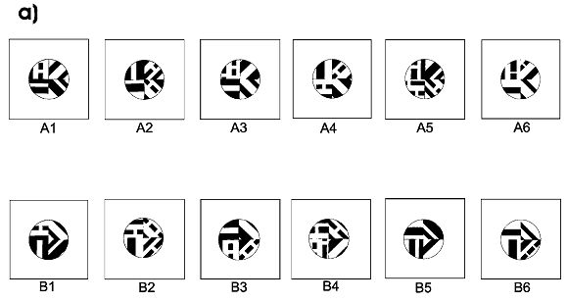
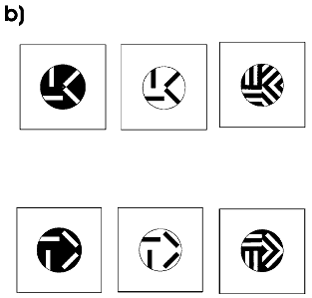
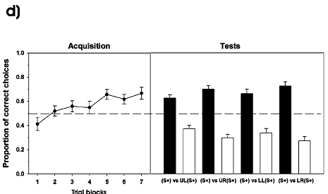
Categorizing Multiple-Feature Sets
Training stimuli
Test stimuli
Acquisition curve

Slide 10
Human Facial Discrimination
Dyer et. al (2005) trained bees to “visit target facial stimuli and to avoid similar distractor stimuli from a standard face recognition test used in human psychology”
As with the earlier tests, bees were rewarded for correct “responses” during training with a sucrose solution, but unlike with other tests, they were also punished for incorrect responses using a quinine solution
The bees that did show evidence of learning during the training period (five of the original seven) were able to distinguish target faces from distractors at a rate of 80% or better
However, the bees—like humans—performed much worse when both the target and distractor faces were turned upside-down
Notes:
Note that two of the seven bees they tested did not learn the task and thus lost interest because of the repeated punishment.

Slide 11
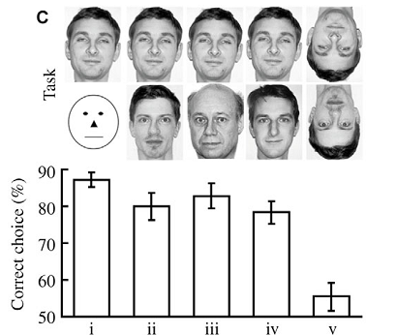
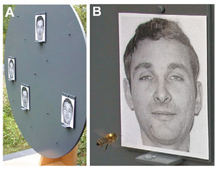
Human Facial Discrimination
Foraging setup for bees
“Hmmm…” (A bee evaluates one of its choices.)
Target stimuli (top row) vs. distractor stimuli (bottom row); percent correct for each target/distractor column

Slide 12
Human Facial Discrimination
The authors note that previous studies had shown bees to be capable of recognizing and distinguishing flower types—and even the faces of their conspecifics—but that “to our knowledge this current study is the first report that invertebrates have sufficient neural flexibility to learn how to discriminate between and recognise faces of other species.”
Given the extensive research on facial recognition in humans, these finding are interesting because they suggest that “face recognition is a task that can be solved, at least to a certain level, by a general neural system that has a reasonable degree of plasticity“—and one that is several orders of magnitude smaller (in terms of the number of neurons involved) than that of humans
Notes:
Plasticity as opposed to modularity

Slide 13
So What?
“This is all very well,” one might say, “but learning to recognize patterns or faces is a fairly trivial performance, especially if it is done the hard way, by reward and punishment. It would be a different matter if these creatures could form their own concepts in quiet meditation, without an external tutor telling them what is important. But they never will, because abstraction is one of the powers that is unique to the human mind.”

Slide 14
So What?
“But look,” says another philosopher, “I just watched an abstraction being made by one of these creatures. Or if you wish, we can say that a generalization has taken place from particular patterns indicating bilateral symmetry (or whatever else) to the general concept ‘bilateral symmetry.’”
And so on…

Slide 15
Double Standards?
The previous dialogue (“:adapted” from pp. 31-32 of Braitenberg’s Vehicles) warns against adopting double standards, whether in terms of machines or lower animals such as bees
On this note, Gould (2002) has suggested three possibilities regarding cognition in lower animals versus cognition in humans and non-human primates (or mammals, or vertebrates):
  Cognition has evolved as needed among animals, independent of size, number of legs, etc. Cognitive differences between species are quantitative, not qualitative.
  Behaviors that require cognition in humans , primates, rodents, etc., are “innate” or “hardwired” in “lower” animals such as bees. Thus it could be that [such behaviors in bees are] hardwired; in rodents and primates, on the other hand, the ability is genuinely cognitive--that is, it is not a consequence of innate preparation.”
  Certain human capacities—such as categorization, abstraction, etc.—that we commonly label as “cognitive” are perhaps not so “cognitive” after all. Or perhaps the definition of “cognition” isn’t so clear after all.
Notes:
“Adapted” = “stolen” …

Slide 16
Closing Points
Given the available evidence, it seems wise to view intelligence (like life, or consciousness) as existing along a continuum rather than on a binary, “yes or no” scale
The questions raised by research on animal cognition, much like Braitenberg’s Vehicles, parallel some of the main philosophical issues in cognitive science, e.g., “What are concepts?” “What is cognition?”
In terms of artificial life and neuroscience, findings from research on honeybees could be seen as encouraging. They have shown that certain complex behaviors can be achieved by nervous systems that are much smaller and “simpler” than those of humans, primates, or other vertebrates.
Thus, these organisms can serve as valuable models for neuroscience, and their behaviors make for worthy (if not exactly easy) goals for artificial life to try to emulate

Slide 17

References
Benard, Julie, Silke Stach and Martin Giurfa. 2006. “Categorization of Visual Stimuli in the Honeybee Apis mellifera.” Animal Cognition 9 (4): 257-270.
Braitenberg, Valentino. Vehicles: Experiments in Synthetic Psychology. 1984. Cambridge, Mass.: MIT Press.
Dyer, A. G., Neumeyer, C. and Chittka, L. 2005. “Honeybee (Apis mellifera) Vision Can Discriminate Between and Recognise Images of Human Faces.” J. Exp. Biol. 208: 4709 -4714.
Giurfa, M., B. Eichmann and R. Menzel. 1996. “Symmetry Perception in an Insect.” Nature 382: 458–461.
Gould, J. L. 2002. “Can Honey Bees Create Cognitive Maps?” In M. Bekoff and C. Allen (eds.), The Cognitive Animal: Empirical and Theoretical Perspectives on Animal Cognition. Cambridge, Mass.: MIT Press.
Hateren, J.H., M.V. Srinivasan, and P.B. Wait. 1990. “Pattern Recognition in Bees: Orientation Discrimination.” J. Comp. Physiol. A 197: 649-654.
Horridge, G.A. and S.W. Zhang. 1995. “Pattern Vision in Honeybees (Apis mellifera): Flower-like Patterns with No Predominant Orientation.” J. Insect Physiol. 41: 681–688
Background images taken from www.wikipedia.org.

