Slide 1
Evolution and Learning

Slide 2
Prisoner’s Dilemma
Two agents.
Decision of cooperating or defecting.
Payoff Matrix (T > R > P > S)
Fitness Function = Overall Reward

Slide 3
Strategies
Tit for tat (TFT)
Win-stay lose-shift (WSLS)
Genetic algorithm (GENET)
Neural Network (ANNET)

Slide 4
Tit For Tat
Hard Wired
Agent’s actions are responses to opponent.
Cooperation from both = cooperation next turn. Stuck until mutation.
If opponent defects then defect. Gets stuck until mutation.
Simple, predictable, aggressive.

Slide 5
Win-Stay, Lose-Shift
Self-focused. Doesn’t rely on partner’s response (in a way).
Evolves out of TFT.
Durable and sustained.

Slide 6
GENET
Started either completely hostile or random. Then evolved into a form of TFT, then WSLS.
Genotypes: Conciliation (P), Forgiveness(S), Remorse(T), Prudence(R)
Payoff: R=3, P=1, S=0, T=5

Slide 7
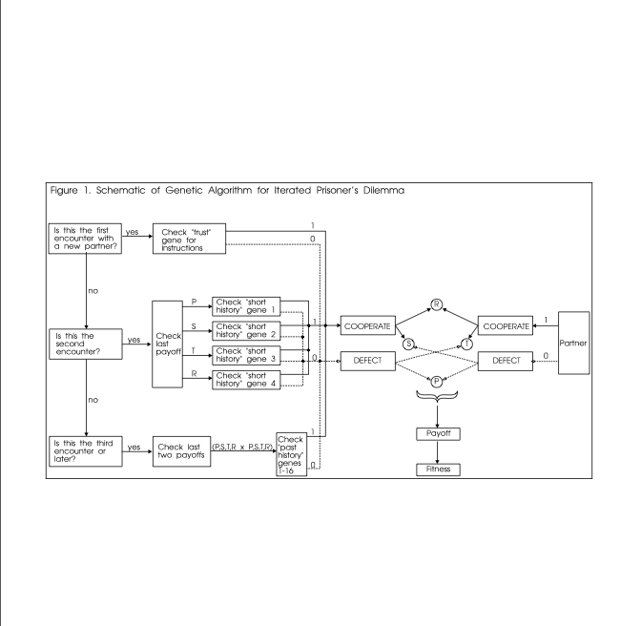

Slide 8
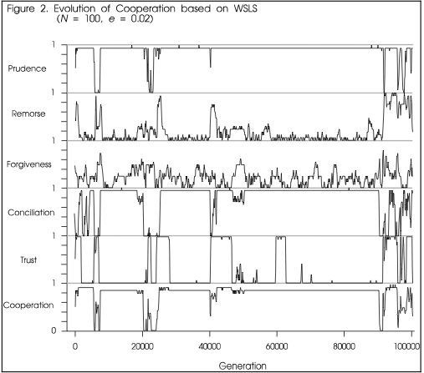

Slide 9
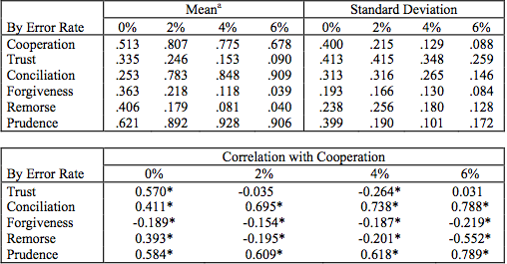

Slide 10
ANNET
Does not perform well with uncertainty (mutation)
Has ability to change its phenotype
Cooperative system (Dyad)
Reproduces by teaching
Fitness Function = Cooperation

Slide 11
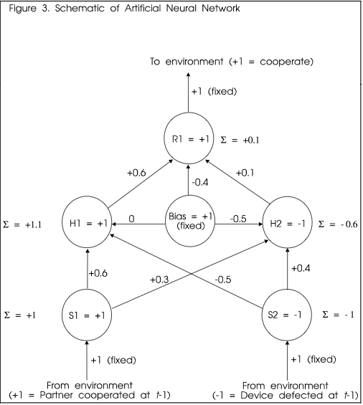

Slide 12
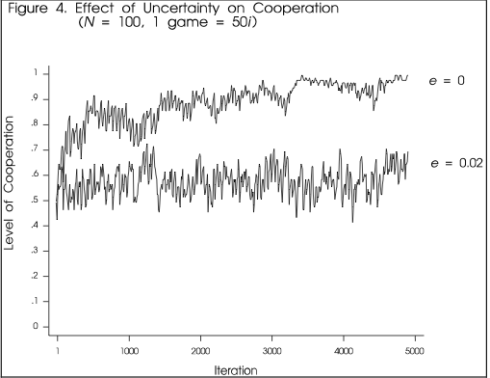

Slide 13
TOMMY
Blocked inputs.
Knows how often to cooperate but not when.
Outperformed ANNET

Slide 14
Social vs. Natural
Softwired = Adaptive learning of social situation
Hardwired = Innate response (Biological)
Ideally, combine the two.

Slide 15
Sources
Natural Selection and Social Learning in Prisoner’s Dilemma: Co-Adaptation with Genetic Algorithms and Artificial Neural Networks by Michael Macy

