Slide 1
Alife – Lecture 4
Models of Growth and Development
But first -- something on Dynamical Systems language
A Dynamical System is any System you wish to define with a specified list of a finite number of variables PLUS a set of laws specifying how each variable changes over time, depending on values of the other variables.
Acknowledgment: some later L-system slides borrowed from Gabriela Ochoa: http://www.biologie.uni-hamburg.de/b-online/e28_3/lsys.html
Artificial Life Lecture 4
18 October 2010

Slide 2
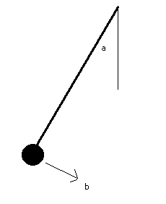
An example of a Dynamical System
EG a pendulum swinging across a wall has 2 variables that will specify its STATE at time t, namely
a = current angle of string with vertical, and
b = current angular velocity, speed of swing
Some dynamics textbooks will give you formulae,
using values for gravity and amount of friction, such that
rate of change of a = da/dt = f1(a,b)
rate of change of b = db/dt = f2(a,b)
..don't worry here exactly what formulae f1 and f2 are.
Artificial Life Lecture 4
18 October 2010

Slide 3
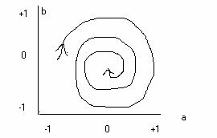
Dynamical Systems
With this simple DS with only 2 variables, you can plot how they change over time on a graph.
This graph shows the STATE SPACE (or phase space) of the DS -- any particular state of the pendulum corresponds to a particular point on this graph.
The particular line shown with arrows is a TRAJECTORY through state space, determined by the laws of (in this case) gravity and friction.
Artificial Life Lecture 4
18 October 2010

Slide 4
Attractors
With this pendulum, all trajectories, from any starting point in state space, will finish up with a=0 and b=0
I.e. with the pendulum straight down and stationary
That end-point of all trajectories in the state space
of the pendulum DS is a POINT ATTRACTOR
You can have repellors as well -- eg the DS of a stick standing on its end (upside-down pendulum), and there may be more than one point attractor in a DS.
Artificial Life Lecture 4
18 October 2010

Slide 5
More Attractors
There are other kinds of attractors -- eg cyclic
attractor when a trajectory winds up in a
repetitive, never-ending cycle of behaviour.
And strange attractors.
Artificial Life Lecture 4
18 October 2010

Slide 6
Continuous or Discrete DSs
The pendulum is a 2-dimensional continuous dynamical system. You can have 100-dim or 1000-dim DSs. And they need not be continuous.
A Cellular Automaton is a discrete dynamical system.
If there are 100 cells, then it is a 100-dim DS with a deterministic trajectory (following all the update rules) -- strictly you need a 100-dim graph to picture it.
Artificial Life Lecture 4
18 October 2010

Slide 7
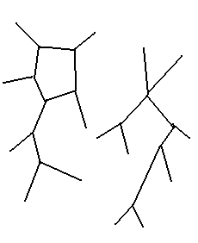
Basins of Attraction
A CA with a finite number of cells has 'only' a finite
number of possible states-of-the-system (finite but usually enormous). Since rules are deterministic, there are one-way arrows giving trajectory from any one state to the next (for the next CA timestep).
Hence with a CA all trajectories end in point attractors or limit cycles. All trajectories that wind up in the same attractor form a BASIN of ATTRACTION.
Artificial Life Lecture 4
18 October 2010

Slide 8
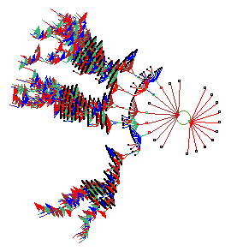
Garden of Eden States
Starting points of trajectories with no possible ancestors are 'Garden of Eden states'.
cf. Andy Wuensche's work on basins of attraction
Artificial Life Lecture 4
18 October 2010

Slide 9
Is this relevant to Development ?
Someone like Waddington would say yes.
(cf. Waddington 'Towards a Theoretical Biology')
Why does an egg always end up as a hen (or cock)?
Despite different conditions, food, environment etc.
The developmental process is like a Dynamical System with an attractor (or 2 attractors, hen and cock), which are (nearly) always reached despite disturbances.
A bit like the pendulum, though much more complex!
Artificial Life Lecture 4
18 October 2010

Slide 10
Perturbations
Sometimes disturbances to developmental processes
(natural or through nasty scientists) result in abnormal or misplaced structures (eg legs replace antennae in flies). These are not random structures, but usually 'sensible ones in the wrong place'.
Basins of attraction:- disturbances can possibly divert
trajectories into a different basin.
No longer fully deterministic in the sense of a formal CA.
Artificial Life Lecture 4
18 October 2010

Slide 11
Morphogenesis
... the origin of shape or form, is another name for this kind of development. (Beware: 'development' means something else to eg psychologists)
How does one cell, at conception, split and double, time and time again, and differentiate into all the cells of a plant, animal or human ? All the cells of a body have the same DNA, but different genes are 'turned on' in different cells, so some are skin, some liver, some blood ... ....
cf. Kauffman's NK Random Boolean Networks.
Artificial Life Lecture 4
18 October 2010

Slide 12
‘Recipe’ or Description ?
General assumption: the DNA does not specify 'as some kind of description' the final form of the body.
More like 'a recipe' for baking a cake.
Note: some people, such as Kauffman and Brian Goodwin ("How the Leopard changed its spots" 1994)
emphasise 'generic constraints' on possible forms as
at-least-as-important as the DNA. Others differ.
Artificial Life Lecture 4
18 October 2010

Slide 13
Morphogenesis in Alife
Biological morphogenesis has been the great black hole in biological theory -- though some see promising signs of real progress in the last decade or so.
A typical Alife approach is to look at possible, very general,
ways to generate complex forms from relatively simple rules -- often very abstract.
See many references in Proceedings of Alife conferences
Artificial Life Lecture 4
18 October 2010

Slide 14
French Flag problem
Eg. Lewis Wolpert's 'French Flag problem'
Consider a 'worm' which is a linear string of cells
which can be Red White or Blue (French Flag)
RRRRRRRRRRWWWWWWWWBBBBBBBBBBBB
If you cut this worm in half, the cells change state
(change colour) in the appropriate way
RRRRRWWWWBBBB RRRRRWWWWBBBBBB
Artificial Life Lecture 4
18 October 2010

Slide 15
Exercise
Exercise: what is the simplest set of rules in each cell (treated as cells within a CA, inputs from left and right)
that can produce this effect?
Do you need something like a 'chemical gradient' from left to right?
Artificial Life Lecture 4
18 October 2010

Slide 16
Lindenmayer L-Systems
Aristid Lindenmayer
Herman & Rosenberg , 'Developmental Systems
and Languages' 1975
Prusinkiewicz.
Simple rewrite rules to model development in
plants, initially specifically branching structures.
Artificial Life Lecture 4
18 October 2010

Slide 17
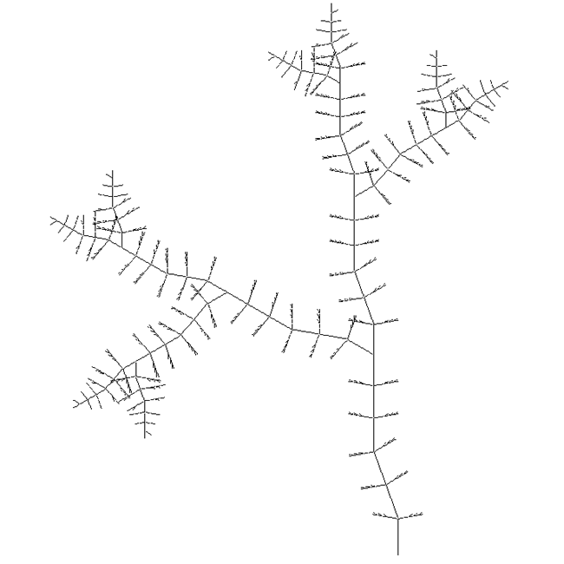
L-Systems
A model of morphogenesis, based on formal grammars (set of rules and symbols)
Introduced in 1968 by the Swedish biologist A. Lindenmayer
Originally designed as a formal description of the development of simple multi-cellular organisms
Later on, extended to describe higher plants and complex branching structures.
Artificial Life Lecture 4
18 October 2010

Slide 18




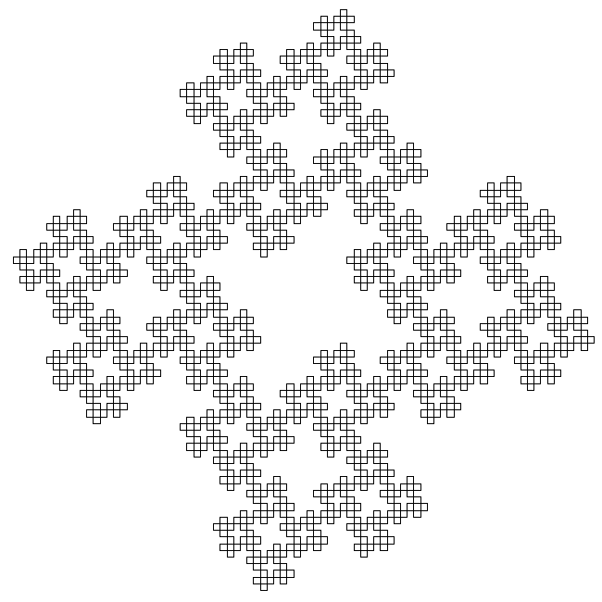
Self-Similarity
“When a piece of a shape is geometrically similar to the whole, both the shape and the cascade that generate it are called self-similar” (Mandelbrot, 1982)
The recursive nature of the L-system rules leads to self-similarity and thereby fractal-like forms are easy to describe with an L-system.
Artificial Life Lecture 4
18 October 2010

Slide 19
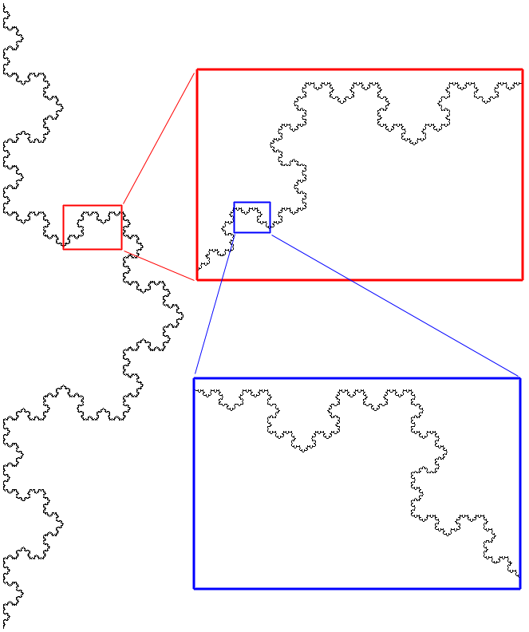
Self-Similarity in Fractals
Exact
Example Koch snowflake curve
Starts with a single line segment
On each iteration replace each segment by
As one successively zooms in the resulting shape is exactly the same
Artificial Life Lecture 4
18 October 2010

Slide 20
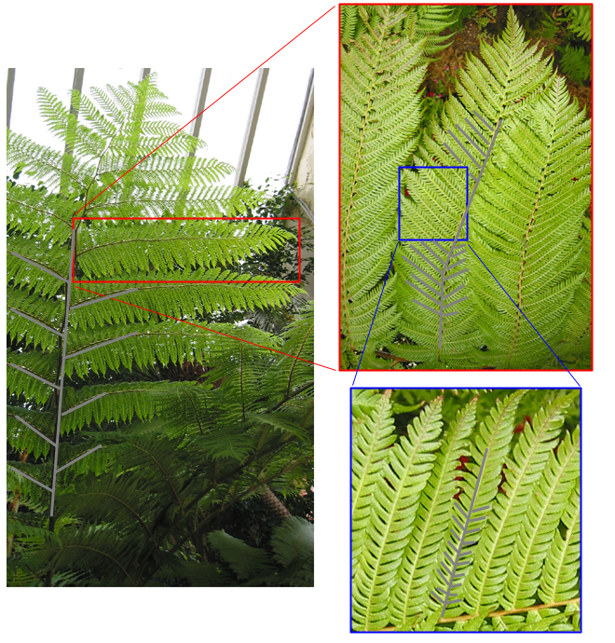
Self-similarity in Nature
Approximate
Only occurs over a few discrete scales (3 in this Fern)
Self-similarity in plants is a result of developmental processes, since in their growth process some structures repeat regularly. (Mandelbrot, 1982)
Artificial Life Lecture 4
18 October 2010

Slide 21
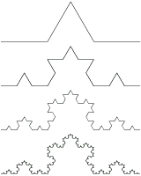
Rewriting
Define complex objects by successively replacing parts of a simple object using a set of rewriting rules or productions.
Example: Graphical object defined in terms of rewriting rules - Snowflake curve
Construction: recursively replacing open polygons
First four orders of the Koch Curve
Artificial Life Lecture 4
18 October 2010

Slide 22
Rewrite rules
Example Rewrite Rules:
A -> CB use all rules in parallel
B -> A
C -> DA
D -> C
Example Seed: A
A -> CB -> DAA -> CCBCB -> ...
Artificial Life Lecture 4
18 October 2010

Slide 23
L-Systems and Plant Growth
Need some convention for branching Left or Right
( ) for a left branch
[ ] for a right branch
Example Rule Set:
A -> C [ B ] D
B -> A
C -> C
D -> C ( E ) A
E -> D
From a seed A, this grows:
A -> C[B ]D -> C[A]C(E)A -> C[C[C]D]C(D)C[B]D
Artificial Life Lecture 4
18 October 2010

Slide 24
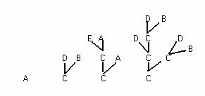
Looking like …
Artificial Life Lecture 4
18 October 2010

Slide 25
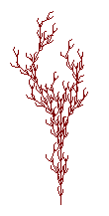
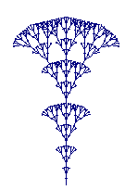
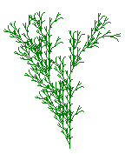
Modelling plants with L-systems
See Gabriela Ochoa's useful website (ex-COGS) mirrored at
http://www.biologie.uni-hamburg.de/b-online/e28_3/lsys.html
When to branch, what angle, when to produce a leaf or a flower.
Use in computer animation techniques, Hollywood. Computer Art -- Karl Sims, William Latham
Artificial Life Lecture 4
18 October 2010

Slide 26
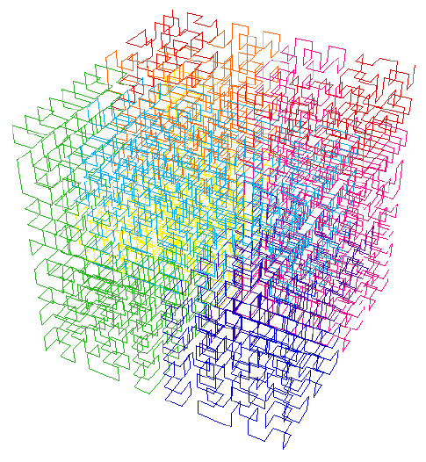
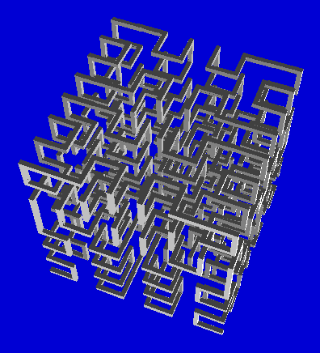
3D L-Systems
Artificial Life Lecture 4
18 October 2010

Slide 27
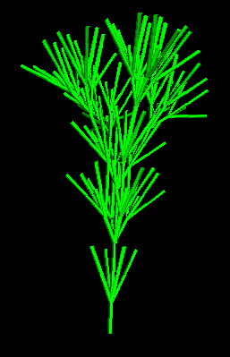
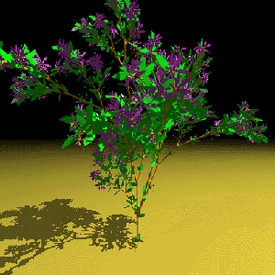
3D Bracketed L-Systems
Artificial Life Lecture 4
18 October 2010

Slide 28
Developmental rules for Neural Networks - 1
Firstly, biological neural networks:
there is simply not enough information in all our DNA to specify all the architecture, the connections within our nervous systems.
(nervous system is part of our body, whereas
the term 'brain' is usually contrasted with body)
So DNA (... with other factors ...) must provide a developmental 'recipe' which in some sense (partially) determines nervous system structure -- and hence contributes to our behaviour.
Artificial Life Lecture 4
18 October 2010

Slide 29
Developmental rules for Neural Networks - 2
Secondly, artificial neural networks (ANNs):
we build robots or software agents with (often) ANNs which act as their nervous system or control system.
We can either design (or evolve) the architecture of an ANN explicitly
OR
We can design (or evolve) a ‘recipe’ for developing the architecture.
Artificial Life Lecture 4
18 October 2010

Slide 30
Developing ANNs - Gruau
Two of the earliest people to look at developmental
programs for ANNs were Frederick Gruau, and Hiroaki Kitano.
Gruau invented 'Cellular Encoding', with similarities to L-Systems, and used this for (eg) evolutionary robotics.
Eg see
Cellular Encoding for Interactive Evolutionary Robotics
Gruau & Quatramaran paper as a gzipped ps file
http://cogslib.informatics.scitech.susx.ac.uk/csr_abs.php?type=csrp&num=425
Or (easier link) as a pdf file: http://drop.io/alergic => csrp425.pdf
Artificial Life Lecture 4
18 October 2010

Slide 31
Developing ANNs - Kitano
Kitano invented a 'Graph Generating Grammar'
This is a Graph L-System that generates not a 'tree',
but a connectivity matrix for a network.
Eg see
Designing Neural Networks Using Genetic Algorithms
with Graph Generation System.
Hiroaki Kitano. Complex Systems, 4(4), 1990.
http://www.complex-systems.com/Archive/volume04/issue4/article06/abstract.html
Artificial Life Lecture 4
18 October 2010

Slide 32
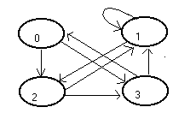
Graph Generating Grammar
Genes encode the rewrite rules that are repeatedly
applied to a seed, creating a matrix of 0s and 1s
0 1 2 3 0 0 0 1 1 1 1 0 1 0 2 0 1 0 1 3 1 1 0 0
If the matrix is 4x4, this can specify all the possible connections between nodes ('neurons') in an ANN with 4 nodes -- specifies the architecture, not the weights.
1=connection, 0 = no connection
Artificial Life Lecture 4
18 October 2010

Slide 33
From Genotype string to graph
Gene: sabcd b0011 a1c01 c001e d1100 e1001
Rules: s-> ab a-> 1c b->00 c->00 d->11 e->10
cd 01 11 10 00 01
Growth: s ab 1c00
cd 0111
0011
1000
01234567
0 11000000
1 11100000
2 00111111
3 00111111
4 00001111
5 00111111
6 11000000
7 11000000
Artificial Life Lecture 4
18 October 2010

Slide 34
References
In the seminars we can discuss suitable reading matter and I can make further suggestions
– but I am hoping that you will actively seek out appropriate sources and recommend them to each other (and indeed to me !)
Artificial Life Lecture 4
18 October 2010

Slide 35
Reminder – Seminars (and GA ex)
Current details always available on http://www.informatics.susx.ac.uk/users/inmanh/easy/alife10/seminars.html.
Please swap times only after
consultation – need to swap
people to keep numbers
balanced
inmanh@susx.ac.uk
… and please hand me your GA exercise for feedback by Tue lec – one possible way of doing the exercise will be posted on website.
Artificial Life Lecture 4
18 October 2010

