Slide 1
Artificial Life Lecture 5
Towards the more concrete end of the Alife spectrum is robotics.
Alife -- because it is the attempt to synthesise -- at some level -- 'lifelike behaviour‘.
AI is often associated with a particular style of robotics – here the emphasis may be different.
A Dynamical Systems approach, and one of the methodologies being Evolutionary Robotics.
Artificial Life Lecture 5
19 October 2010

Slide 2
Evolutionary Robotics
ER can be done
for Engineering purposes - to build useful robots
for Scientific purposes - to test scientific theories
It can be done
for Real or
in Simulation
Here we shall start with the most difficult, robots
with Dynamic Recurrent Neural Nets, tested for Real.
Then we shall look at simplifications and simulations.
Artificial Life Lecture 5
19 October 2010

Slide 3
The Evolutionary Approach
Humans are highly complex, descended over 4 bn yrs from the 'origin of life'.
Let's start with the simple first - 'today the earwig'
(not that earwigs are that simple ...)
Brooks' subsumption architecture approach to robotics is 'design-by-hand', but still inspired by an incremental, evolutionary approach:
Get something simple working (debugged) first
Then try and add extra 'behaviours'
Artificial Life Lecture 5
19 October 2010

Slide 4
What Class of ‘Nervous System’
When evolving robot 'nervous systems' with some form of GA, then the genotype ('artificial DNA') will have to encode:
The architecture of the robot control system
Also maybe some aspects of its body/motors/sensors
But what kind of robot control system, what class of possible systems should evolution be 'searching through' ?
Artificial Life Lecture 5
19 October 2010

Slide 5
… could be a classical approach ?
PERCEPTION
REPRESENTATION
IN
WORLD MODEL
-- REASONING
ACTION
Artificial Life Lecture 5
19 October 2010

Slide 6
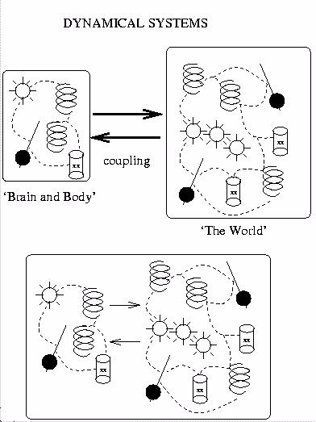
… or a Dynamical Systems Approach
Artificial Life Lecture 5
19 October 2010

Slide 7
‘Reasoning all the way down’
The Classical AI approach, obsessed with reasoning and computing, assumed that even something as simple as walking across the room, maintaining one’s balance, required reasoning and computation … …
… … “Sense Model Plan Action” …
… … Brain controlling muscles
But look at this ---
Artificial Life Lecture 5
19 October 2010

Slide 8
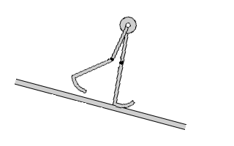
Passive Dynamic Walking
‘Natural walking behaviour', stable to small perturbations, can emerge from 'all body and no brain' !
It is the dynamics that count, whether the dynamics arise with or without a coupled nervous system.
Dan Jung’s walker movie -- see selection from
http://ruina.tam.cornell.edu/research/topics/robots/index.html
"Passive Dynamic Walking", from Tad McGeer
Artificial Life Lecture 5
19 October 2010

Slide 9
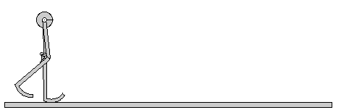
Walking without a nervous system
Artificial Life Lecture 5
19 October 2010

Slide 10
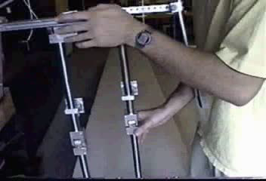
For real …
Artificial Life Lecture 5
19 October 2010

Slide 11
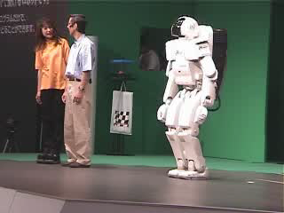
Compare with the Honda Humanoid
Artificial Life Lecture 5
19 October 2010

Slide 12
Dynamic skills all the way up?
Perhaps rather than ‘Reasoning all the way down’ …
… we should think in terms of ‘Dynamic skills all the way up’
Artificial Life Lecture 5
19 October 2010

Slide 13
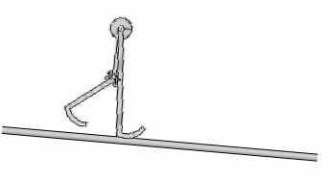
Two initial lessons -- cognition is
Situated: a robot or human is always already in some situation, rather than observing from outside.
Embodied: a robot or human is a perceiving body, rather than a disembodied intelligence that happens
to have sensors.
Artificial Life Lecture 5
19 October 2010

Slide 14
Dynamical Systems
Artificial Life Lecture 5
19 October 2010

Slide 15
DS approach to Cognition
cf R Beer 'A Dynamical Systems Perspective on Autonomous Agents' Tech Report CES-92-11. Case Western Reserve Univ. Link via http://vorlon.ces.cwru.edu/~beer/pubs.html also
Beer, R.D. (2000). Dynamical approaches to cognitive science. Trends in Cognitive Sciences 4(3):91-99.
In contrast to Classical AI, computational approach, the DS approach is one of 'getting the dynamics of the robot nervous system right', so that (coupled to the robot body and environment) the behaviour is adaptive.
Brook's subsumption architecture, with AFSMs
(Augmented Finite State Machines) is one way of doing this.
Artificial Life Lecture 5
19 October 2010

Slide 16
Dynamic Recurrent Neural Networks
DRNNs (and one specific kind: CTRNNs = Continuous Time Recurrent Neural Networks) are another (really quite similar way).
You will learn about other flavours of Artificial Neural Networks (ANNs) in Adaptive Systems course.
-- eg ANNs that 'learn' and can be 'trained'.
These DRNNs/CTRNNs are basically different -- indeed basically just a convenient way of specifying a class of dynamical systems
-- so that different genotypes will specify different DSs, giving robots different behaviours.
Artificial Life Lecture 5
19 October 2010

Slide 17
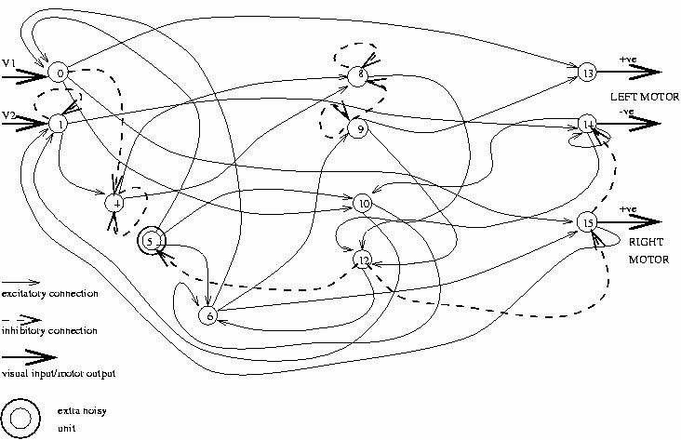
One possible DRNN, wired up
This is just ONE possible DRNN, which ONE specific genotype specified.
Artificial Life Lecture 5
19 October 2010

Slide 18
Think of it as …
Think of this as a nervous system with its own
Dynamics.
Even if it was not connected up to the environment
(I.e. it was a 'brain-in-a-vat’), it would have its own dynamics, through internal noise and recurrent connections)
Artificial Life Lecture 5
19 October 2010

Slide 19
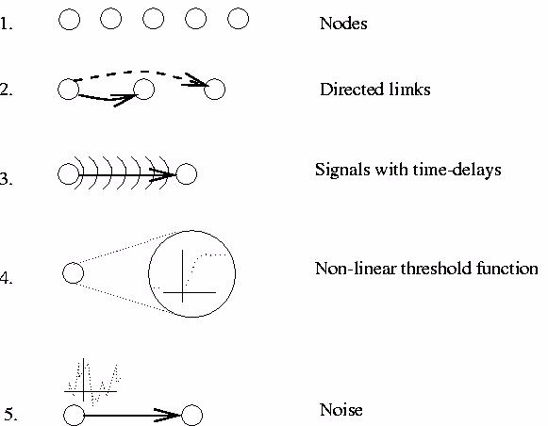
DRNN Basics
The basic components of a DRNN are these
(1 to 4 definite, 5 optional)
Artificial Life Lecture 5
19 October 2010

Slide 20
ER basics
The genotype of a robot specifies
(through the encoding genotype->phenotype that WE decide
on as appropriate)
how to 'wire these components up' into a network connected to sensors and motors.
(Just as there are many flavours of feedforward ANNs, there are many possible versions of DRNNs – in a moment you will see just one.)
Then you hook all this up to a robot and evaluate it on a task.
Artificial Life Lecture 5
19 October 2010

Slide 21
Evaluating a robot
When you evaluate each robot genotype, you
Decode it into the network architecture and parameters
Possibly decode part into
body/sensor/motor parameters
Create the specified robot
Put it into the test environment
Run it for n seconds, scoring it on the task.
Any evolutionary approach needs a selection process, whereby the different members of the population have different chances of producing offspring according to their fitness
Artificial Life Lecture 5
19 October 2010

Slide 22
Robot evaluation
(Beware - set conditions carefully!)
Eg: for a robot to move, avoiding obstacles -- have a number of obstacles in the environment, and evaluate it on how far it moves forwards.
Have a number of trials from random starting positions
take the average score, or
take the worst of 4 trials, or
(alternatives with different implications)
Deciding on appropriate fitness functions can be difficult.
Artificial Life Lecture 5
19 October 2010

Slide 23
DSs -> Behaviour
The genotype specifies a DS for the nervous system
Given the robot body, the environment, this constrains the behaviour
The robot is evaluated on the behaviour.
The phenotype is (perhaps):
the architecture of the nervous system(/body)
or ... the behaviour
or even ... the fitness
Artificial Life Lecture 5
19 October 2010

Slide 24
Robustness and Noise
For robust behaviours, despite uncertain circumstances, noisy trials are needed.
Internal noise (deliberately put into the network) affects the dynamics (eg self-initiating feedback loops) and (it can be argued) makes 'evolution easier'
-- 'smooths the fitness landscape'.
Artificial Life Lecture 5
19 October 2010

Slide 25
Summarising DSs for Robot Brains
They have to have temporal dynamics.
Three (and there are more...) possibilities are:
(1) Brook's subsumption architecture
(2) DRNNs as covered in previous slides
(3) Another option to mention here: Beer's networks (= CTRNNs)
see Beer ref. cited earlier, or "Computational and Dynamical Languages for Autonomous Agents", in Mind as Motion, T van Gelder & R. Port (eds) MIT Press
Artificial Life Lecture 5
19 October 2010

Slide 26
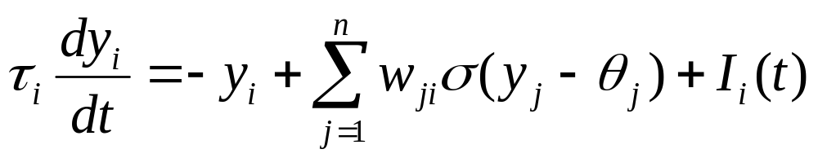
Beer’s Equations
Beer uses CTRNNs (continuous-time recurrent NNs), where for each node (i = 1 to n) in the network the following equation holds:
y_{i} = activation of node i
_{i} = time constant, w_{ji} = weight on connection from node j to node i
(x) = sigmoidal = (1/1+e^{-x})
_{i}= bias,
I_{i} = possible sensory input.
Artificial Life Lecture 5
19 October 2010

Slide 27
Applying this for real
A number of different examples will be given in the reading for the Week 4 seminars (Floreano paper and Sussex paper)
One issue to be faced is:
Evaluate on a real robot, or
Use a Simulation ?
On a real robot it is expensive, time-consuming -- and
for evolution you need many many evaluations.
Artificial Life Lecture 5
19 October 2010

Slide 28
Problems of simulations
On a simulation it should be much faster
(though note -- may not be true for vision)
cheaper, can be left unattended.
BUT AI (and indeed Alife) has a history of toy, unvalidated simulations, that 'assume away' all the genuine problems that must be faced.
Eg: grid worlds "move one step North"
Magic sensors "perceive food"
Artificial Life Lecture 5
19 October 2010

Slide 29
Principled Simulations ?
How do you know whether you have included all that is necessary in a simulation?
-- only ultimate test, validation, is whether what works in simulation ALSO works on a real robot.
How can one best insure this, for Evolutionary Robotics ?
Artificial Life Lecture 5
19 October 2010

Slide 30
‘Envelope of Noise’ ?
Hypothesis: -- "if the simulation attempts to model the real world fairly accurately, but where in doubt extra noise (through variations driven by random numbers) is put in, then evolution-in-a-noisy-simulation will be more arduous than evolution-in-the-real-world"
Ie put an envelope-of-noise, with sufficient margins, around crucial parameters whose real values you are unsure of.
"Evolve for more robustness than strictly necessary"
Problem: some systems evolved to rely on the existence of noise that wasnt actually present in real world!
Artificial Life Lecture 5
19 October 2010

Slide 31
Jakobi’s Minimal Simulations
See, by Nick Jakobi:
Evolutionary Robotics and the Radical Envelope of Noise Hypothesis (csrp457) http://drop.io/alergic ➔ csrp457.pdf
(2) The Minimal Simulation Approach To Evolutionary Robotics
http://citeseer.nj.nec.com/116192.html
also see
Csrp497 http://drop.io/alergic ➔ csrp497.pdf
Minimal simulation approach developed explicitly for ER – the problem is often more in simulating the environment than the robot.
Artificial Life Lecture 5
19 October 2010

Slide 32
Minimal Simulation principles
Work out the minimal set of environmental features needed for the job -- the base set.
Model these, with some principled envelope-of-noise, so that what uses these features in simulation will work in real world
-- 'base-set-robust'
Model everything ELSE in the simulation with wild, unreliable noise -- so that robots cannot evolve in simulation to use anything other trhan the base set
-- 'base-set-exclusive'
Artificial Life Lecture 5
19 October 2010

Slide 33
Guidelines for robotic projects
Working with real robots is very hard - maintenance.
When using simulations be aware of the shortcomings of naive, unvalidated simulations
Worry about Grid worlds, Magic sensors ... ...
There are now simulations, here and elsewhere (eg Khepsim)
that have been validated under some limited circumstances - through downloading/testing some control systems on real robot.
Artificial Life Lecture 5
19 October 2010

Slide 34
Agent projects
Useful robotics projects can be done with such careful simulations.
Then there is still a role for more abstract simulations for tackling (eg) problems in theoretical biology
-- but then these are not robotics simulations
Many useful Alife projects are of this latter kind – but then it is almost certainly misleading to call these ‘robotics’.
‘AGENTS’ is a more general term to use here.
Artificial Life Lecture 5
19 October 2010

