Slide 1
Artificial Life Lecture 6
Co-evolution – with animats in pursuit-evasion
… and in an application to ‘sorting networks’
*** Think about how you would set about re-implementing either of these as a project of your own
Artificial Life Lec 6
25 October 2010

Slide 2
Coevolution of Pursuit and Evasion
D. Cliff and G. F. Miller
``Co-Evolution of Pursuit and Evasion II: Simulation Methods and Results''. In
P. Maes, M. Mataric, J.-A. Meyer, J. Pollack, and S. W. Wilson (eds) From Animals to Animats 4
MIT Press Bradford Books, pp.506-515, 1996.
http://citeseer.ist.psu.edu/cliff95coevolution.html
Or on http://drop.io/alergic as CliffMiller96.pdf
Artificial Life Lec 6
25 October 2010

Slide 3
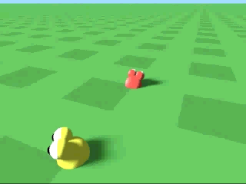
Pursuit/Evasion – gen 200
Artificial Life Lec 6
25 October 2010

Slide 4
Coevolution
Two (or more) species evolve in a situation where the selection pressure on one species (eg the Predators or Pursuers)
depends (at least in part) on the current fitness of the other species (Prey or Evaders) .. .. and vice versa
Arm's Race, or 'Red Queen effect'
-- you run as fast as you can yet stay in same place
(... figuratively !)
This provides very much an implicit fitness function rather than an explicit one.
Artificial Life Lec 6
25 October 2010

Slide 5
This study of coevolution
Studied in deliberately simplified environment - a 2-D infinite plane with no walls or obstacles, just one pursuer, one evader
Animats (animal/robot) - term often used in SAB
Motors:
These animats have left and right wheels. Variable forces can be applied L and R, simple Newtonian physics
Fuel use (from limited fuel tank) proportional to square of force. Friction acts to slow you down.
Artificial Life Lec 6
25 October 2010

Slide 6
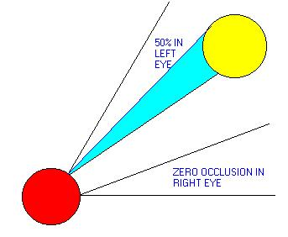
Sensors
Each animat has several (typically 2) simulated 'photoreceptors'. Position (relative to straght-ahead) and angle of acceptance (wide/narrow) is genetically specified -- and hence can co-evolve with the 'brain'
Each sensor returns proportion of of its angle-of-view which is not obscured by any object on horizon
Hence simulation is a very simplified version of real physics, but still has some significant element of physical plausibility.
Artificial Life Lec 6
25 October 2010

Slide 7
Neural Network Control System
The control system is a CTRNN
(continuous-time recurrent neural network model),
of precisely the Beer type (see previous lecture).
Fully connected ANN, with (fixed) weights and biases that are genetically specified -- ie evolved.
2 neurons connected to 'eyes', 2 to motors.
Artificial Life Lec 6
25 October 2010

Slide 8
Evolution
A Genotype for any one Animat specifies -
the sensory morphology
the architecture (weights etc) of the ANN
The Genetic Algorithm evolves 2 completely distinct populations
('species')
Spatially distributed GA -- individuals in the population are spread
out over a 'mating' grid, and will only mate, and replace, close
neighbours on this grid.
Artificial Life Lec 6
25 October 2010

Slide 9
Evaluation
Evaluation:
All in the population of pursuers are tested against the same
best-of-last-generation evader.
And vice versa.
Several trials from random starts:
Evader fitness = how long before caught
Pursuer fitness = ++ for 'approaching evader'
+ bonus for hit , sooner the bigger
Artificial Life Lec 6
25 October 2010

Slide 10
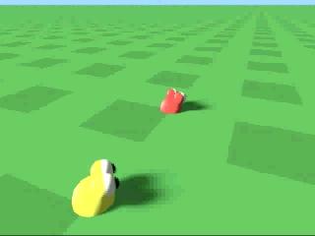
Random Start – gen 0
Artificial Life Lec 6
25 October 2010

Slide 11
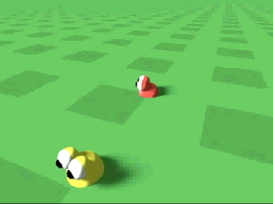
A Successful run – gen 999
Artificial Life Lec 6
25 October 2010

Slide 12
Potential Circular Trap
That last picture showed successful pursuers/evaders from generation 999
But at gen 0, there was a pursuer which failed to catch an evader, and at gen 999 likewise.
So in what sense has there been any 'advance'?
Possibility of 'no real advance' in coevolution
-- cf Stone Scissors Paper game, no strategy can be supreme for ever.
Artificial Life Lec 6
25 October 2010

Slide 13
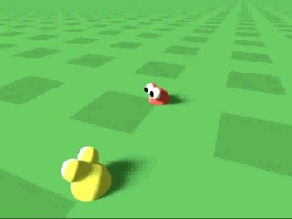
Possible Variations
Test evader from gen 200 against pursuer from gen 999.
Later work extended this idea, of monitoring current gen against best of previous gens. – Does this escape from the circular trap?
Artificial Life Lec 6
25 October 2010

Slide 14
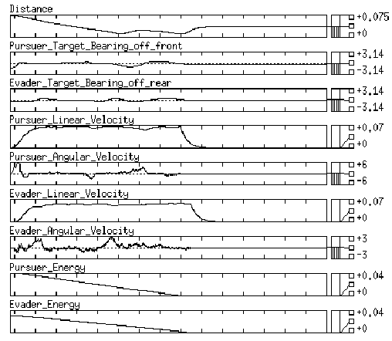
Analysis of behaviour
Artificial Life Lec 6
25 October 2010

Slide 15
Applications
Can coevolution be used for engineering purposes?
Here is an example
Artificial Life Lec 6
25 October 2010

Slide 16
Coevolving Parasites
"Coevolving Parasites improve Simulated Evolution as an Optimization Procedure". W. Daniel Hillis. In
Artificial Life II, Langton Taylor Farmer Rasmussen
(eds) Addison-Wesley (1991) pp 313-322
[Also available in: Physica D, v42, Issues 1-3, pp 228-234, June 1990
-- online version accessible via UoS Electronic Library Catalog ]
Danny Hillis -- Connection machines --powerful very distributed parallel machines.
This work done in late 1980s, 64,536 processors, populations 500 to 1000000, 'about 100 to 1000 generations per minute'
Evolving minimal sorting networks
Artificial Life Lec 6
25 October 2010

Slide 17
Sorting Networks
A sorting network is something that can be given any scrambled list of
N objects with different values (here N=16) --- and it is in effect an algorithm that will systematically sort the list into order by a sequence of ‘compare and maybe swap’s.
The sorting network is a series of pairs of numbers,
[a b] which can be interpreted as:-
Compare the a^{th} and b^{th} items in your scrambled list.
If in wrong order, swap, otherwise leave
Artificial Life Lec 6
25 October 2010

Slide 18
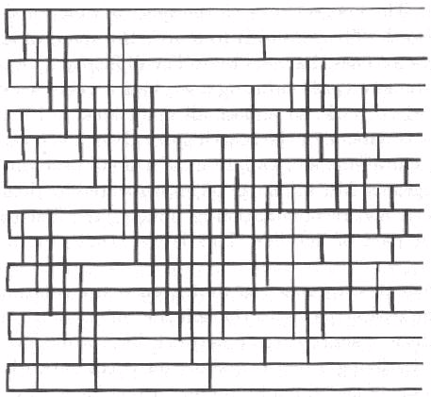
Picturing Sorting Networks
Visual way to represent, 16 rows represent the 16 items to be re-ordered. Starting from left, the vertical bars show rows to be compared/swapped.Numbering rows from 0 to 15, above swaps are:
[0 1] [2 3] ...[14 15] [0 2] [4 6] [8 10] ......
Artificial Life Lec 6
25 October 2010

Slide 19
Minimal Sorting Networks
The previous diagram has a total of 60 swaps and was (in 1991) the shortest-known, discovered by MW Green
It is a perfect sorter, in that if you present it with any scrambled list, after going through all the 60 swaps from left to right then the list comes out perfectly ordered.
[ note: for swaps shown as bars in same vertical column, it will not matter which is done first]
The problem is to find the shortest network, ideally better than this 60, which still sorts anything.
Artificial Life Lec 6
25 October 2010

Slide 20
How to check if it works
Do you have to check if it sorts all possible combinations of numbers in the list – NO!
It can be shown that if a network correctly sorts any scrambled list of 0s and 1s (so that it finishes up with all the 1s at the top, all the 0s at the bottom), then the network will also sort any list of real-valued items.
So can test a 16-network exhaustively with only 2¹⁶ tests (about 32,000) – instead of 16 factorial (about 2x10¹³).
But this is still a lot of tests -- can one save time? – YES!
Artificial Life Lec 6
25 October 2010

Slide 21
Genetic Representation
We need a genetic encoding, so that strings of characters represent possible sorting networks.
But we are not sure how long any sorting network will be before we start – after all, we are looking for the shortest.
Hillis chose a sort-of-diploid encoding
haploid = 1 string
diploid = 2 strings
Artificial Life Lec 6
25 October 2010

Slide 22
Diploid encoding
A codon pair looks like this or this:
-------------- --------------
.... .... 0011 0101 ... ... ... ... ... ... ... ... 0011 0101 ...
.... .... 0011 1000 ... ... ... ... ... ... ... ... 0011 0101 ...
Where top and bottom are different, on left, this means
test/swap [3 5] (binary 0011 and 0101), followed by
test/swap [3 8] --- total 2 test/swaps
Where top and bottom are same, as on right, it is just
test/swap [3 5] --- only one test/swap
Artificial Life Lec 6
25 October 2010

Slide 23
Diploid encoding (ctd)
A full genotype is 60 such codon-pairs,
--- hence encoding between 60 and 120 test/swaps.
cf: homozygous / heterozygous (a bit different !)
Artificial Life Lec 6
25 October 2010

Slide 24
Scoring
The population is initialised with everyone having the same first 32 exchanges (that are known to be sensible),
and thereafter randomised.
Then each network is tested on 'how well it sorts --
the percentage of input test scrambled lists which it sorts correctly.
Rather than testing on all 2¹⁶ test cases, it could be tested on a random sample.
OR (see later) the test cases could be chosen cleverly – coevolution.
Artificial Life Lec 6
25 October 2010

Slide 25
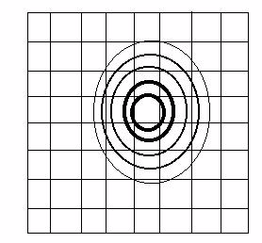
Spatially Distributed GA
Tournaments:
pick pairs of contestants in local neighbourhood
(Gaussian spread,
nearer is more likely)
Artificial Life Lec 6
25 October 2010

Slide 26
(Back to Lec 3 – Microbial GA)
This was the really simple way to get a spatially distributed GA within the Microbial GA
Just modify the way in which guys were selected for tournaments, so that they were ‘close to each other’
Artificial Life Lec 6
25 October 2010

Slide 27
Now with Added Demes !!!!
FROM LEC 3
Last lecture I briefly mentioned demes – partially overlapping sub-populations with local breeding.
Idea from Lee Spector: easiest to do this with a ring-shaped geography of overlapping sub-popns -
Easy within the Microbial one-liner !
Artificial Life Lec 6
25 October 2010

Slide 28
Microbial with demes
FROM LEC 3
Just adjust the choice of b for each tournament. We keep
a=POP*drand48(); but we change the original b=POP*drand48(); to ….
Demes vn 1: b=(a + deme_width*drand48())%POP;
Where the modulo POP (%POP) joins end of popn back to beginning, in a ring. OR…..
Demes vn 2 (recommended): b=(a + 1 +deme_width*drand48())%POP;
Where the +1 ensures b different from a. Choose deme_width as some suitable fraction of POP, eg POP=30, deme_width=10.
Artificial Life Lec 6
25 October 2010

Slide 29
Reproduction
Tournament: from pair of contestants, compare scores,
winner over-writes loser (ie then has 2 copies).
Mating: then select mates locally, with same principles
Recombination to produce offspring
(Hillis actually had 15 crossover points '1 per chromosome')
Mutation: one bit-flip per 1000 sites.
Artificial Life Lec 6
25 October 2010

Slide 30
Results – without coevolution
Typical run like this -- without coevolution -- for up to
5000 generations, with a popn of 64536.
Best scores = sorting networks of 65 exchanges
-- target was 60.
How can one improve this through coevolution ?
Artificial Life Lec 6
25 October 2010

Slide 31
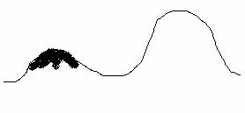
Inefficiencies - 1
Two main sources of inefficiency in the GA without coevolution:
(1) Local optima -- once the population had found a 3/4 decent solution, quite probably all the neighbouring solutions (genetically similar) were
less fit -- so the population would have to cross a valley to reach 'higher ground'.
Artificial Life Lec 6
25 October 2010

Slide 32
Inefficiencies - 2
(2) Inefficiency in testing -- once popn was ¾ decent, they all passed most of the test cases, so little differences in scores.
The answer: co-evolve a separate population of parasite test-cases, which themselves have a fitness function designed to make them
as hard as possible for the sorting networks.
This solves both inefficiencies (1) and (2).
Parasite coevolution can generate genetic diversity
(cf. W Hamilton)
Artificial Life Lec 6
25 October 2010

Slide 33
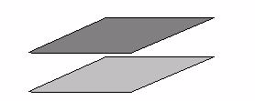
2 populations – sorters and parasites
The population of sorting networks is already spatially distributed on one grid. Have a population of parasites likewise distributed on a similar grid, overlaid.
Each parasite is a genetically specified group of 10 to 20 test cases -- rather than all the 2¹⁶ possible ones.
Artificial Life Lec 6
25 October 2010

Slide 34
Scoring each population
Each sorting network is tested against the parasite that is on corresponding grid square. The score of the sorting network is 'what proportion of tests does it pass'
The score of the parasite is 'how many tests does it fail the sorter on'
Networks get selected, mated, and reproduce on their grid, parasites completely separately on theirs.
Results improved to a minimum size of 61
(has it been beaten since?)
Artificial Life Lec 6
25 October 2010

Slide 35
Benefits of Coevolution
Prevents getting stuck in local optima -- as soon as this happens, the parasites evolve to zap them.
Population is in a constant state of flux.
Second advantage: testing is more efficient --
need only test on a few difficult test cases, which themselves change appropriately according to circumstances.
Hence computationally more efficient.
Artificial Life Lec 6
25 October 2010

Slide 36
The End
Artificial Life Lec 6
25 October 2010

