Slide 1
Artificial Life Lecture 10
Origin of Life
If you mix together paints of all different colours, you get a boring muddy brown. Yet the origin of life -- presumably?? -- started with unorganised mixing of lots of chemicals.
How come on many planets the result has been boring muddy brown, yet on one planet at least, something interesting took off and has sustained itself ever since?
Artificial Life lecture 10
8 November 2010

Slide 2
How improbable?
If you have a pot of chemicals (-- the primaeval soup) where molecules A, B and C react to form molecules D, E and F, etc etc, -- what conditions does it take for some self-sustaining interesting organisation to take off?
How probable are such conditions?
A look at various perspectives such as that of M. Eigen (eg: “Steps Towards Life”), with nods towards Kauffman, Maturana, Varela.
Artificial Life lecture 10
8 November 2010

Slide 3
What do all living beings have in common?
… asks Eigen, and answers:
They all use DNA as a store for their hereditary material and
Legislative → Message → Executive → Function
DNA → RNA → Protein → Metabolism
All varieties of life (..on earth) have a common origin, and the hereditary information is organised according to the same principle
Artificial Life lecture 10
8 November 2010

Slide 4
Balance of change and stability
Necessary conditions for selection:
Individuals are self-replicating
Replication subject to some (small) degree of error
Self-replication far from chemical equilibrium
I.e. need for a continuous supply of chemical energy, and a metabolism.
How can you get stability of hereditary information within such flux?
Artificial Life lecture 10
8 November 2010

Slide 5
Origins
How did the very first self-reproducing molecules originate?
Chicken and egg problem.
Nowadays nucleic acids (help to) ‘direct’ the formation of proteins, but it seems generally agreed that proteins were actually historically the first on the scene (more easily formed).
Amino acids can be formed under pre-biotic conditions – cf
Miller and Urey, 1954, synthesis in a test-tube.
Artificial Life lecture 10
8 November 2010

Slide 6
Catalysis
And then amino acids can condense to make simple protein-like substances that weakly catalyse each other, under pre-biotic conditions.
Catalysis occurs when the presence of one chemical -- the catalyst -- makes possible, or speeds up, some chemical reaction amongst other chemicals. The catalyst itself is merely an 'enabler' and itself remains unchanged.
Artificial Life lecture 10
8 November 2010

Slide 7
Autocatalysis
Enzymes are one example of catalysts. But some enzymes have a further property of, in the right conditions, catalysing their own formation -- this is autocatalysis, and is in some sense the most basic form of reproduction.
Autocatalysis: the product of a reaction is also a catalyst for the same reaction.
You cannot have evolution without reproduction, so understanding autocatalysis looks like an essential for understanding the origin of life.
Artificial Life lecture 10
8 November 2010

Slide 8
Relevant references
M Eigen “Steps towards life” Oxford Univ Press 1992
(Easy reading)
M Eigen "Self-organization of matter and Evolution
of Biological Macromolecules",
Naturwissenschaften v 58, 465, 1971.
S. Rasmussen "Toward a Quantitative Theory of the Origin
of Life", Proc. of Artificial Life 1, ed. Langton, 1988.
S. Kauffman “Origins of Order” Oxford Univ Press 1993.
S. Kauffman “At Home in the Universe” (pop)
Artificial Life lecture 10
8 November 2010

Slide 9
Autocatalytic sets
Life, so Kauffman would claim (much as Eigen), lies in the property of catalytic closure among a collection of molecular species [each has its re-production assured and catalysed by some of the others] in an open thermodynamic system [energy flow from outside to keep the pot stirred and bubbling].
Further claim by Kauffman: once the number of catalytic molecular interactions passes some critical number, then the emergence of collective autocatalysis - ie life -- is almost inevitable. What are the grounds for this claim?
Artificial Life lecture 10
8 November 2010

Slide 10
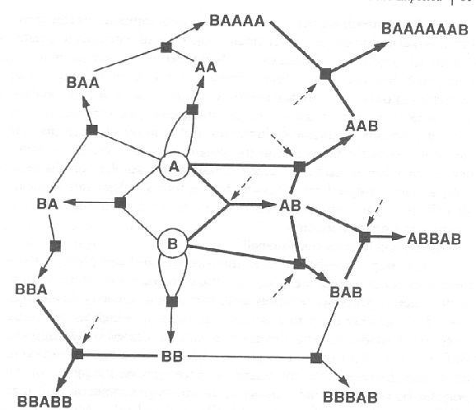
A Catalytic Network
Black squares = reaction sites Dashed lines -> catalysis of reactions
Light lines: possible reactions
Heavy lines: connect substrates and products whose reactions are catalysed
Artificial Life lecture 10
8 November 2010

Slide 11
Origin of an Autocatalytic Network
The pattern of heavy lines indicate a subset of all possible reactions, that subset which can mutually catalyse their own collective production
How likely is it that such an autocatalytic set can
arise naturally, by chance?
Artificial Life lecture 10
8 November 2010

Slide 12
How the Numbers work
Kaufffman claims (.. do you believe him?) that as numbers increase -- ie the diversity of molecules (number of nodes in the network) increases --- the number of possible reactions (the number of edges in the network) increases even faster.
For short polymers (the argument is based on polymers, linear sequences of atoms or 'atomic parts') there are not so many ways of gluing the parts together. But for longer polymers up to max length M, there are plenty of ways in which each can be formed by ligation, gluing together smaller lengths -- but also all those less than M long can also be formed several ways by cleavage, cutting up longer lengths.
Artificial Life lecture 10
8 November 2010

Slide 13
The Maths
Do the maths (Origins of Order p. 302), and as M (sequence length) increases, variety of polymers increases exponentially, but number of possible reactions even more, roughly M times as fast.
IF (big IF) each polymer has a constant probability P of catalysing any reaction, then the number of catalysed reactions also rises fast.
Artificial Life lecture 10
8 November 2010

Slide 14
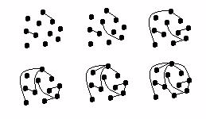
Connectivity of Random Graphs
Kauffman appeals (here as elsewhere) to the generic properties of large random ensembles -- in this case to the connectivity properties of random graphs.
If you have a load of buttons,
and start connecting them at random with strings, then initially they are all separate but at some stage they (nearly) all become connected into one network.
Artificial Life lecture 10
8 November 2010

Slide 15
Threshold
This happens, for large number N buttons, when Edges > N/2.
As Edges > N, cycles start emerging, and then cycles of all lengths have equal chances of occurring.
Connectivity into a giant component happens at the percolation threshold (Erdos and Renyi)
Warning: these results are valid for isotropic random graphs
Artificial Life lecture 10
8 November 2010

Slide 16
The full argument for autocatalysis
... is that IF each arbitrary polymer is a catalyst for
any arbitrary reaction with fixed probability P, then as
the maximum length M of polymers increases :-
Number N of polymers (buttons) increases
exponentially fast
Number of possible reactions increases even faster.
So proportion P of catalysed reactions also increases,
eventually faster than N (these correspond to strings)
So strings increase faster than buttons, eventually
ratio strings/buttons passes any threshold ratio
Artificial Life lecture 10
8 November 2010

Slide 17
Conclusion
So almost any sufficiently complex (N big enough) set of catalytic polymers can be expected to be collectively
autocatalytic.
Hence the claim 'origin of life is almost inevitable if you have a big enough pot of primaeval soup'
BUT: note the assumptions used, assumptions which any sceptic can very easily question.
Artificial Life lecture 10
8 November 2010

Slide 18
AlChemy
These and similar ideas have been pursued in the Alife literature by such as Rasmussen (earlier reference) and in AlChemy (which stands for Algorithmic Chemistry), Walter Fontana, Proc of Artificial Life II, ed Langton, Taylor, Farmer,
Rasmussen, Addison-Wesley 1990.
Artificial Life lecture 10
8 November 2010

Slide 19
Eigen’s paradox
Back to Eigen. There is a paradox arising from the circumstances of early replication of the simplest replicators – such as RNA molecules.
Without any special machinery, just through relatively simple catalysing of its own replication, there will be a high error rate. This will not matter too much for small molecules (with little ‘information’ to copy) but it starts to matter as molecules get bigger ( -- longer, in the case of single-strand molecules)
Artificial Life lecture 10
8 November 2010

Slide 20
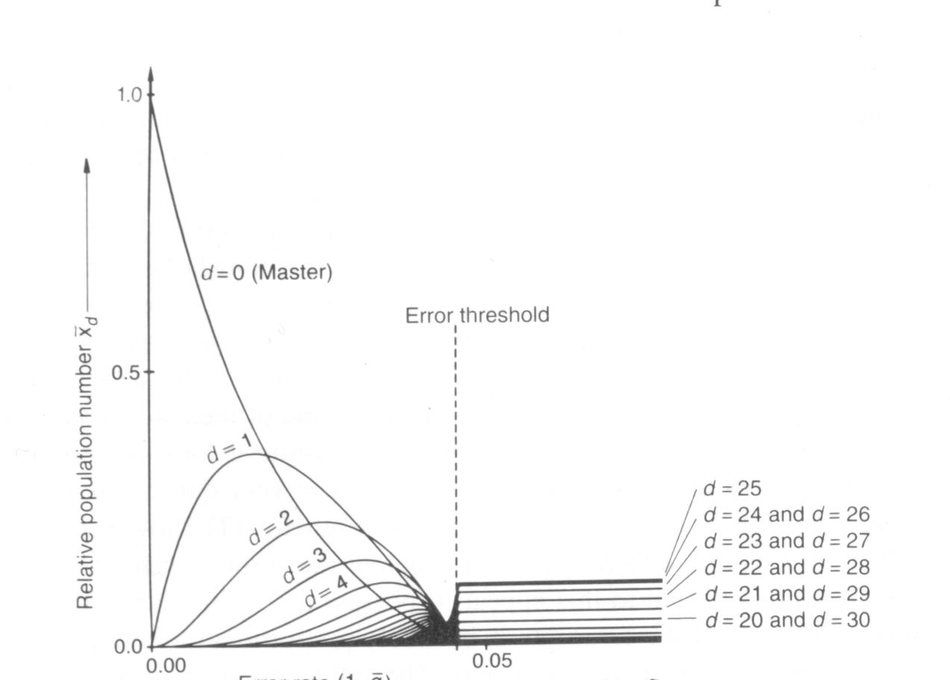
Error Threshold
Artificial Life lecture 10
8 November 2010

Slide 21
Error Threshold (ctd)
Depending on the selection pressure, replication will not be accurate enough to retain the information when the mutation rate is more than about 1 per genotype.
This is basically why that is a plausible guide to rates in GAs!
But if the ‘natural, unassisted’ mutation rate is say 1%, then RNA molecules will never evolve to longer than 100 ‘symbols’.
Sophisticated error-checking might reduce the mutation rate to say below 0.1% -- BUT only RNA more than 1000 long could handle such sophisticated mechanisms.
Artificial Life lecture 10
8 November 2010

Slide 22
The Gap
So this leaves a gap, say crudely between RNA sequence lengths 100 to 1000, where for example:
Seq lengths 500 will need a mutation rate better than 1/500, but cannot code for any error-checking mechanisms to get the rate smaller than (say) 1/100.
This gap is Eigen’s Paradox, and the motivation for the theory of Hypercycles. Maybe a bunch of RNA molecules, each shorter than 100, could co-operate to form a self-replicating super-entity, a Hypercycle?
Artificial Life lecture 10
8 November 2010

Slide 23
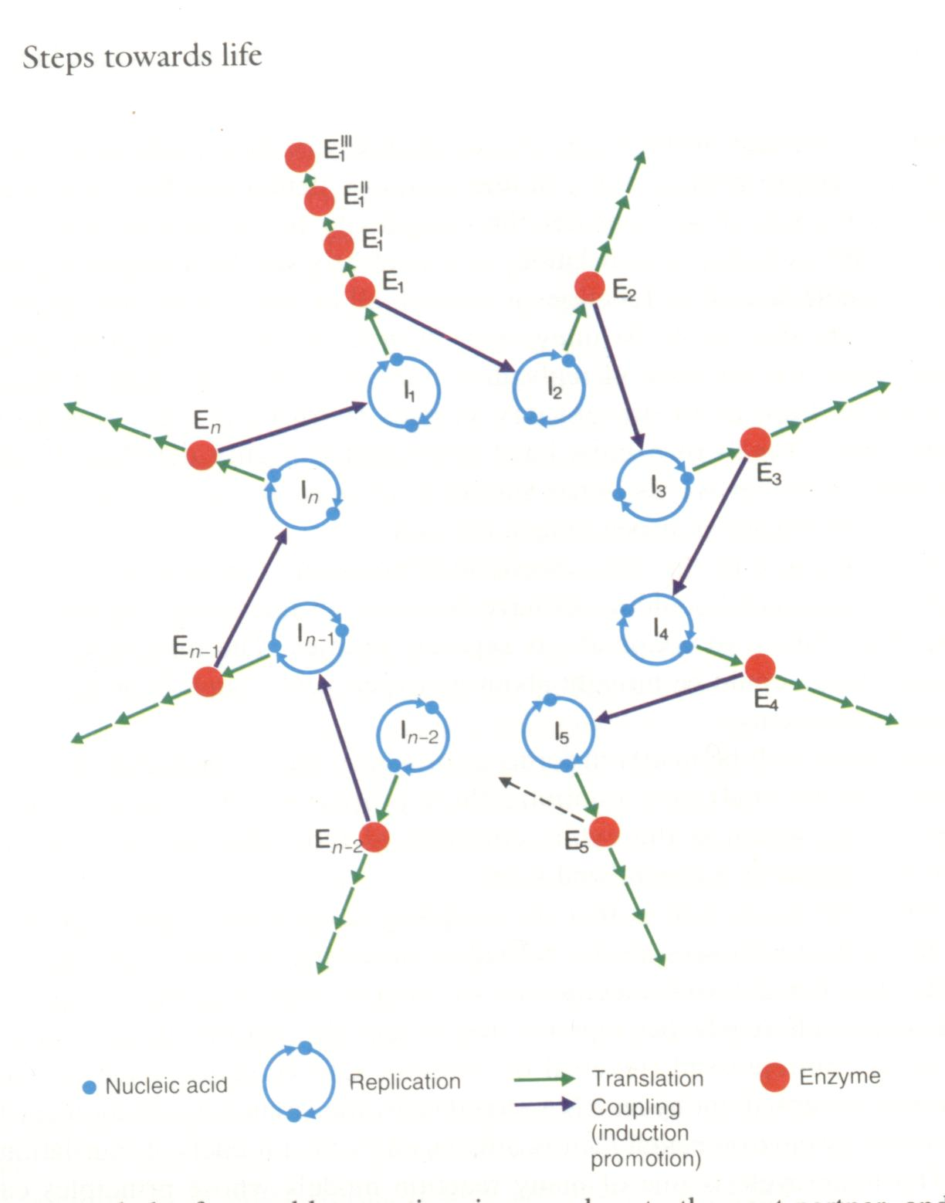
Hypercycles
(Pic from ‘Steps towards Life’)
Cyclic coupling of individual replication cycles.
Cyclically closed so that the feedback needs all the individual members – they are all in the same boat.
Hence it could evolve as a unit.
Artificial Life lecture 10
8 November 2010

Slide 24
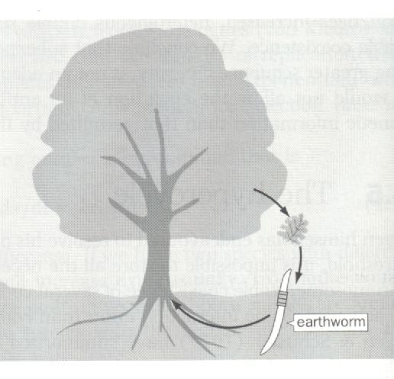
A different hypercycle
An ecological hypercycle
(from “The Major Transitions of Evolution”, J Maynard Smith & E. Szathmary, WH Freeman 1995
Artificial Life lecture 10
8 November 2010

Slide 25
Problems with Hypercycles
The hypercycle-as-a-whole can only retain those mutations (on a component member) that improve that member’s performance for-the-benefit-of the hypercycle.
But it is susceptible to different mutations that improve the fitness of one member at the expense of the whole – to cheats. (JMS)
This is the usual argument that casts doubts on any form of group selection, unless some special case can be made.
Artificial Life lecture 10
8 November 2010

Slide 26
Compartments
Basically the only way Hypercycles can be rescued from this flaw seems to be some method of keeping all the components tightly together in a compartment (eg with a membrane, or perhaps through some other constraints on movement, cf Boerliijst & Hogeweg 1991)
When a compartment divides, a mutant favourable-to-the hypercycle will be passed on, and (if the numbers are right) compartments with the mutant will have more descendants than those without.
Ie vertical transmission of genetic information.
Artificial Life lecture 10
8 November 2010

Slide 27
But
If hypercycles+compartments do the business, it may well be that compartments without the hypercycles might sometimes be enough.
Cf stochastic corrector model in “Major Transitions”.
Population structure facilitates the survival of altruists, potentially binds together joint interests into something of a higher level of selection.
Artificial Life lecture 10
8 November 2010

Slide 28
Autopoieseis
A brief note: auto-poiesis = self-creating. Maturana/Varela
Definition of an autopoietic system --
Self-bounded: system’s boundary is an integral part of the system
Self-generating: all components, including those of the boundary, are produced by processes within the system
Self-perpetuating: all components are continually replaced by the system’s processes of transformation
Artificial Life lecture 10
8 November 2010

Slide 29
Autopoiesis definition
"An autopoietic machine is a machine organised (defined as a unity) as a network of processes of production (transformation and destruction) of components that produces the components which: (i) through their interactions and transformations continuously regenerate and realise the network of processes (relations) that produced them; and (ii) constitute it (the machine) as a concrete unity in the space in which they (the components) exist by specifying the topological domain of its realisation as such a network."
Artificial Life lecture 10
8 November 2010

Slide 30
… translated …
This is in effect an abstract cybernetic description of cell metabolism. Put *very* crudely, it reads something like:
a system is Autopoietic if the bits and pieces of which it is composed interact with each other in such a way as to continually produce and maintain that set of bits and pieces and the relationships between them.
Artificial Life lecture 10
8 November 2010

Slide 31
Stability within flux
Back to Eigen’s original discussion on what remains stable despite flux.
This view of what-it-is-to-be-alive integrates life with cognition. Builds on ideas from Cybernetics, particularly homeostasis.
Though based around single-cell organisms, it fits in with the Dynamical Systems view of Cognition.
Maturana and Varela “”Autopoiesis: The Organization of the Living” Dordrecht 1980
M & V “The Tree of Knowledge” Shambhala Press 1987
Artificial Life lecture 10
8 November 2010

Slide 32
Life = ??
Homeostasis = active maintenance of dynamic equilibrium, tending to offset perturbations
Life = Homeostasis of identity and organisation
??
(Doesn’t mention evolution)
Artificial Life lecture 10
8 November 2010

