Slide 1
Artificial Life Lecture 17
Information & Life & Evolution
The rough picture:
Bits (Binary digITS in the computer/information theory sense) are a measure of how much information there is in a program, in a text file, on a floppy disk
--Megabytes, Gigabytes etc.
Genotypes -- real ones of DNA with an alphabet of size 4 CGAT, or artificial ones with a binary alphabet of 0s and 1s -- can also have their information measured in bits.
Part 2: GasNets
Artificial Life lecture 17
30 Nov 2010

Slide 2
Vague ideas about genetic information
SO...(the vague and imprecise argument goes)...
genotypes can and probably do contain information about something -- I wonder what it is – maybe information about how to build the animal/organism, or maybe information gathered from the environment over many generations, or ....
Can we make any of this vagueness precise ???
Artificial Life lecture 17
30 Nov 2010

Slide 3
Some references
Shannon CE and Weaver W "A Mathematical Theory of
Communication" Univ of Illinois Press 1949
The classic intro to Shannon's information theory
-- though be cautious of Weaver.
Susan Oyama "The Ontogeny of Information"
Cambridge University Press 1985
A very thorough critique of naive ideas of DNA as
information about the phenotype
Artificial Life lecture 17
30 Nov 2010

Slide 4
More references
RP Worden "A Speed Limit for Evolution"
Journal of Theoretical Biology, 176, pp 137-152, 1995
http://dspace.dial.pipex.com/jcollie/sle/index.htm
Important ideas though be cautious.
Chris Adami "Introduction to Artificial Life"
Springer-Verlag (TELOS) 1998
Despite general title, rather specialised within Alife field -- avida (same family as Tierra), information theory, fitness landscapes and error thresholds.
Artificial Life lecture 17
30 Nov 2010

Slide 5
Information
As with most such words, used in lots of different ways,
eg Gregory Bateson
('Information is a difference that makes a difference')
eg JJ Gibson and ecological perception
(information in the environment)
--- but mostly, when people talk of BITS of information,
they are thinking of Shannon's theory.
--- which might be better thought of as a theory of communication rather than just of information.
--- and is vital to telecomms transmission, CD players etc
Artificial Life lecture 17
30 Nov 2010

Slide 6
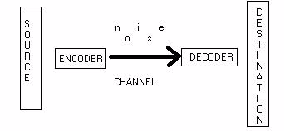
Communication
This kind of information only makes sense in the context of being sent over a CHANNEL from a sender to a receiver
Artificial Life lecture 17
30 Nov 2010

Slide 7
Reducing Uncertainty
Information in bits can best be thought of as a measure of the reduction in uncertainty in the mind of the receiver !
If I am the receiver, and I am expecting from you a single binary digit 0 or 1, and I have no reason to think one is more likely than the other, my uncertainty can be measured as 1 bit (of Shannon entropy or uncertainty).
When I receive a 0 (or a 1) my uncertainty is reduced by this 1 bit.
Artificial Life lecture 17
30 Nov 2010

Slide 8
Context-dependence
Likewise if I know the name you are sending me is either John or Jane, equally likely, my uncertainty is still just 1 bit -- and transmitting the string ‘John‘ is worth just 1 bit of information..
If the name you are sending me is known in advance to be John or Jane or Anna or Paul (and equally likely)
-- then transmitting the string 'john' is worth 2 bits
--ie it is very much context-dependent, on the initially expected (by the receiver) distribution.
Artificial Life lecture 17
30 Nov 2010

Slide 9
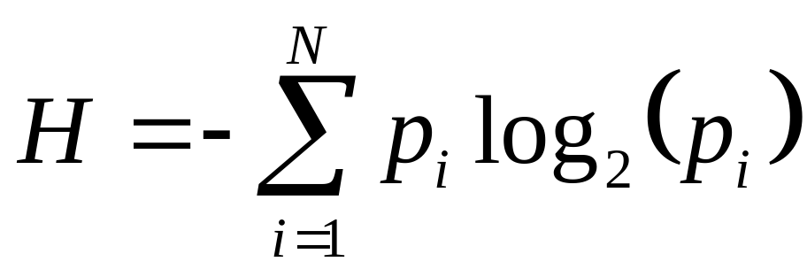
Measuring Shannon Uncertainty
Uncertainty gets bigger, the more possibilities there are.
And we would like uncertainty to be additive (when considering 2 uncertainties about 2 unrelated systems)
If the set of possible signals you are expecting to receive has N different possibilities, and the probability of the i^{th} one is p_{i}, then Shannon entropy (uncertainty)
Artificial Life lecture 17
30 Nov 2010

Slide 10
E.g.
So if a priori probabilities of names were
John p₁= 0.5 Jane p₂= 0.25
Anna p₃= 0.25 Kzwj p₄= 0.0
... all other possibilities 0.0
H = - 0.5 log₂(0.5) - 0.25 log₂(0.25) -0.25 log₂(0.25)
= 0.5 x 1 + 0.25 x 2 + 0.25 x 2
= 1.5 bits
..that’s a bit less uncertainty than the 2 bits for 4 equally likely names
Artificial Life lecture 17
30 Nov 2010

Slide 11
Correlation
Same example
John 0.5
Jane 0.25
Anna 0.25
But if we are told the name is male it must be John
and if we are told female it is now 50/50 Jane/Anna
So there is a correlation between sex and names, and in fact here knowing the sex gives us 1 bit of information – reduces our uncertainty by 1 bit.
Artificial Life lecture 17
30 Nov 2010

Slide 12
Correlation entropy
Technically, one definition of information is the correlation entropy between two (sets of) random variables.
The correlation entropy, or mutual information, is zero if there is no correlation between the sets,
-- but becomes positive (measured in bits) where knowledge of one variable (eg sex) reduces uncertainty about the other one (eg name)
<<It's dangerous to think of information as a commodity>>
Artificial Life lecture 17
30 Nov 2010

Slide 13
Information in genotypes
So it is very easy to say that natural genotypes are strings of characters CGAT, just like artificial genotypes are often strings of binary characters 01, and hence 'worth' respectively 2 bits or 1 bit per character.
This particular way of counting bits only buys you anything if you have no a priori expectation of what the next symbol may be -- typically only true for random or junk DNA !
But maybe you can be careful and set the context up carefully so that it makes Shannon sense ??
Artificial Life lecture 17
30 Nov 2010

Slide 14
Does this make sense?
…but maybe you can be careful and set the context up carefully so that it makes Shannon sense ??
ONE COMMON SUCH ATTEMPT:
"The genotype (many poss variations) is the sender"
"The developmental process is the channel"
"The phenotype (many poss variations) is the
receiver"
"culture, environment etc, makes a difference but is
from one perspective just noise"
Artificial Life lecture 17
30 Nov 2010

Slide 15
Nature vs Nurture
There is some limited sense in which there is a bit of truth in this -- if I know that some DNA is either human or chimpanzee DNA, then roughly speaking I know that (in the appropriate womb) it will develop into either a human or chimpanzee genotype -- that is worth just 1 bit of information to know which is which !
But see Oyama ref. for considerable discussion, particulary on nature vs nurture.
Artificial Life lecture 17
30 Nov 2010

Slide 16
Does DNA give information ?
But many would like to say that human genotype of
3x10⁹ characters of alphabet size 4 contains up to
6x10⁹ bits (or maybe 6x10⁸ bits if 90% is junk ??) of information describing the phenotype.
I have never yet seen any rigorous way of setting up the Shannon information theory requirements -- sender, channel, receiver, decrease in uncertainty -- for this to make sense, and one can doubt whether it is possible.
But Robert Worden makes an attempt (see refs)
Artificial Life lecture 17
30 Nov 2010

Slide 17
A Speed Limit for Evolution ?
Worden talks of GIP (Genetic Information in the Phenotype) as a property of a population, measured in bits.
"A population with some trait narrowly clustered around a central value [inherently improbable in the absence of selection] has more GIP than another population in which the same trait is more widely spread [inherently more random]"
"Halving the width of spread of some trait increases the GIP by 1 bit“ --- How does the population increase its GIP store of bits -- why, through selection!
Artificial Life lecture 17
30 Nov 2010

Slide 18
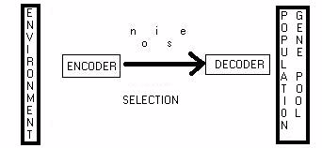
From Environment to the Genepool
This is how Worden sets up the channel of information, so as to talk about Shannon information (or uncertainty).
Artificial Life lecture 17
30 Nov 2010

Slide 19
The Speed Limit
IFyou have selection as channel for 'transmitting information', then it will depend on the selection pressure --
"An intuitive rationale...if an animal has 2³ = 8 offspring and only one survives to maturity, then this event conveys [maximum] 3 bits of information from the environment into the surviving genotype and phenotype" -- Worden
If you have a large popn, and you divide on the basis of fitness into 8 octiles (‘eighths’) -- then selecting the top eighth can [in the right context] convey 3 bits of information.
Artificial Life lecture 17
30 Nov 2010

Slide 20
Caution
All this is to be taken with a lot of salt. BUT Worden's argument attempts to justify such a limit
-- log₂(selection pressure) bits of information down this 'channel' per generation, maximum, this speed limit holding with infinite or finite popns, mutation, recombination etc etc.
Typically log₂(S) is at most a few bits per generation
This has implications for Artificial Evolution
Artificial Life lecture 17
30 Nov 2010

Slide 21
Worden’s deductions …
The first part of Worden's paper is mathematical, justifying the speed limit in different contexts.
He then draws some [rather speculative...] conclusions on such matters as 'Design Information in the Brain'
"Common ancestor of humans and chimps was around 5,000,000 yrs ago, say 350,000 generations, at say log₂(1.5) bits per generation gives something of order of 100,000 bits of GIP…”
Artificial Life lecture 17
30 Nov 2010

Slide 22
…deductions (ctd)
...with some other assumptions (difference in probability to survive and reproduce, dependent on intelligence/brain development, not more than +- 10%) ... useful genetic info in the brain, compared to our common ancestor with chimps, increased by max 40,000 bits or 5Kbytes -- not very much -- cf computer programs“ – says Worden.
Implication -- not all that much design difference!
HEALTH WARNING: this is all rather dodgy, see earlier warnings about information as a commodity !
Artificial Life lecture 17
30 Nov 2010

Slide 23
Avida
A different approach. Chris Adami, looking at Avida, artificial organisms of variable genotype length, and variable complexity, evolved in a virtual soup in a computer.
In "Introduction to Artificial Life" he looks similarly at "the stochastic transfer of information from an environment into the genome"
He investigates the maximum rate at which the population [genepool] absorbs information from the environment.
Artificial Life lecture 17
30 Nov 2010

Slide 24
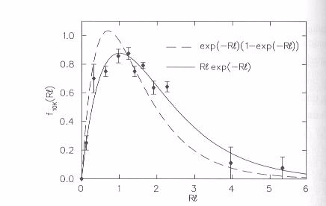
Error threshold
The maximum rate, experimentally, is somewhere near the error threshold, mutation around 1 per genotype.
A tradeoff between informational storage and informational transmission -- too much mutation, stored 'info in the genotype' gets lost --
too little mutation, too little variation in the population for selection to use for transmission of info environment->genepool.
Artificial Life lecture 17
30 Nov 2010

Slide 25
‘Around 1 bit per generation’
Once again, comparably to Worden, from inspection of fitness graphs it looks like an upper limit well below 1 bit per generation, in terms of increase in effective genotype length.
BUT bear in mind earlier warning about being rigorous with Shannon information -- it is still not clear how rigorously Adami's model stands up to this kind of description.
Artificial Life lecture 17
30 Nov 2010

Slide 26
Unsatisfactory conclusion
Information theory and evolution is still a wide open area for rigorous research -- there is all too much of the non-rigorous kind.
It looks like Worden is onto something with his Speed limit, but not rigorously defined yet.
This may well be easier to do with artificial evolution, as indeed Adami makes a start on this.
Artificial Life lecture 17
30 Nov 2010

Slide 27
Engineering spin
My hope: for binary genotypes of length 1000, with a search space of size 2¹⁰⁰⁰, suppose merely 2⁶⁰⁰ genotypes corresponded to successful designs, then finding a successful design equates to 400 bits.
Is something like Worden's speed limit relevant, eg 1 bit per generation (I believe so)? This would be very much an upper speed limit, like the speed of light. Here, minimum 400 gens.
How can we arrange our artificial evolution so as to get as close as reasonable to this speed limit? An important, and very open, research question.
Artificial Life lecture 17
30 Nov 2010

Slide 28
Practical Relevance
You have to expect to run your GA on a serious problem for a seriously long time – inexperienced people frequently underestimate!
Eg the GA+CTRNN exercise, the posted example code runs 100 different trials for every individual, and runs for 10,000*20 individuals.
A total of 20,000,000 trials, each one running for 50/0.1 = 500 update-steps. Total 10 billion update-steps.
This is normal !!!!!!! This is what computers are for !!!!! Optimise your code.
Artificial Life lecture 17
30 Nov 2010

Slide 29
A brief taste of GasNets
Context: relatively recently discovered that the workings of the brain depend not only on “electrical signals down wires between neurons” but also on “gases produced in varying amounts, diffusing locally through the 3-D volume of the brain” – and modulating the behaviour of those neurons that the gas impinges on.
Nitric Oxide being just one example.
This adds a new angle onto the mechanisms of the brain – and inspired a variant ANN -- GasNets
Artificial Life lecture 17
30 Nov 2010

Slide 30
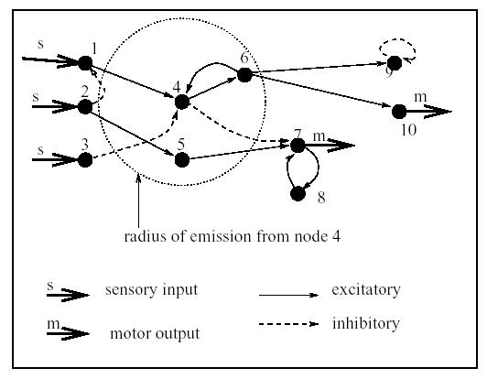
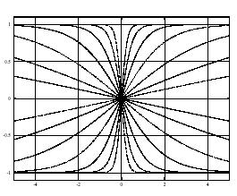
The quick picture
E.g.: Husbands, P., Smith, T.M.C., Jakobi, N. and O’Shea, M.
Better Living Through Chemistry: Evolving GasNets for Robot Control. Connection Science, 10(3-4):185-210.
Neurons are modelled as having a position in 2-D, and potentially emitting/reacting to diffusing gas
“Reaction” = modulating the sigmoid transfer function at one neuron
Artificial Life lecture 17
30 Nov 2010

Slide 31
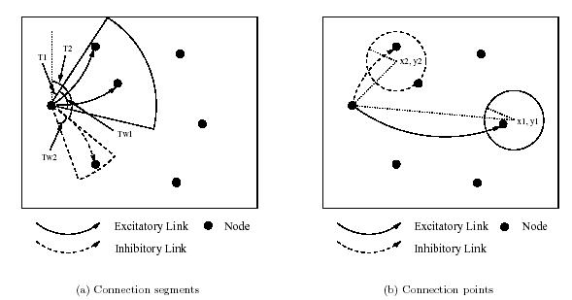
Evolving GasNets
Genotypes specified the NN characteristics through a sort-of developmental process: Gen specified for each neuron
Where in a 2-D plane it was located
Which ‘directions’ it can link to nearby neurons (2 +ve, 2 –ve links)
Under what circumstances (and how far) it may emit a ‘gas’
…and various other more typical characteristics
Artificial Life lecture 17
30 Nov 2010

Slide 32
Temporal aspect of the Gases
A node will start emitting gas when its activation exceeds a (genetically specified) threshold, and continue doing so until it falls below that threshold.
This ‘generation of gas’ builds up the local concentration over time – and when production stops, the gas decays away over time. The gas modulates the behaviour of nearby nodes
Roughly speaking: in these models, this appears to be the only aspect where there are genuinely time-varying aspects to the ANN
Artificial Life lecture 17
30 Nov 2010

Slide 33
Criticism: Is there ‘time’ anywhere else?
As far as I can see: No!!
There are recurrent connections, but there is no sense of ‘how long’ it takes for an ‘electrical’ signal to pass from one node to another; except purely as an accidental artefact of whatever time-update-step is used.
These are not CTRNNs, there is no proper treatment of them as dynamical systems changing over real-time – except solely for one aspect of the ‘gas diffusion’ (as per previous slide).
Artificial Life lecture 17
30 Nov 2010

Slide 34
The comparisons with non-GasNets
Several papers published comparing performance, evolving for robot control systems on a task where time-issues are crucial:-- GasNets versus non-GasNets
But these studies are, in my opinion, crucially flawed. The non-GasNets are just the same GasNets with ‘the gas turned off’. And the gas was the only part where real-time was handled in a reasonably principled fashion.
Regrettably, they made the same mistake that SO MANY people make – misunderstanding time in ANNs
Artificial Life lecture 17
30 Nov 2010

Slide 35
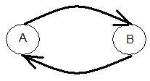
How to think of time in Dynamical Systems
If you are modelling control systems as a DS, then think of the physics first.
All nodes in a CTRNN are varying and affecting each other continuously in real time
If A is influencing B, and also B is influencing A, then do NOT think of this as a cycle where first A changes, then B, then A, then B.
They are both changing continuously and simultaneously
Artificial Life lecture 17
30 Nov 2010

Slide 36
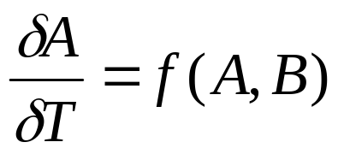
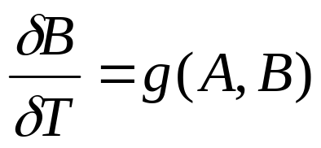
The computational cycle
The only such cycle is in your computational approximation – and this needs to be understood properly.
www.informatics.susx.ac.uk/users/inmanh/easy/alife10/TimeSteps.html
In the computation, you set δT to something as close to zero as reasonable (rule of thumb: 1/10 of the shortest timescale of significance in what you are modelling). Then there are cycles in your simulation – but not in what is being modelled.
Changing your δT to a different reasonable value (eg 1/10 smaller again) should never materially change your results
Artificial Life lecture 17
30 Nov 2010

