Slide 1
Artificial Life Lecture 19
Summing up!
Survey of Artificial Life topics covered
And Alife skills
Recent/current EASy DPhil research
Personal prejudiced list of hot research topics
Time for questions?
Artificial Life lecture 19
7 December 2010

Slide 2
Alife Topics covered - Evolutionary
Evolution, Evolutionary Algorithms
Co-evolution
Evolution of communication
Development, L-Systems, G->P mappings
Fitness Landscapes
Neutral Networks
Information and Life and Evolution
Tierra and Avida
GP and Classifier Systems
Deliberately BROAD range of topics
Artificial Life lecture 19
7 December 2010

Slide 3
Alife topics – DS and robotics, and beyond
Dynamical Systems approach to cognition
Braitenberg vehicles
CTRNNs
Evolutionary Robotics
Passive Dynamic Walking
CAs and RBNs
Models of Genetic Regulatory Systems
Morphogenesis, L-Systems
Homeostasis
Gaia Theory, Daisyworld
Artificial Chemistry
Autocatalysis, autopoiesis
Artificial Life lecture 19
7 December 2010

Slide 4
Alife Skills
Programming a GA
Microbial GA
Programming a CTRNN
Programming a robot
How to prepare a project proposal
(…hopefully…) how to carry through a project
Alife as methodology as much as subject area
Artificial Life lecture 19
7 December 2010

Slide 5
Some recent/current Sussex DPhil theses
Eduardo Izquierdo-Torres 2009
James Dyke 2009
Tom Froese 2009
Nathaniel Virgo 2010
Greg Studer 2010
Marcos Rosetti 2010
Bill Bigge 2010
Matthew Egbert 2011
Allister Furey 2011
Nick Tomko 201x
See CCNR webpages
BROADLY Alife-related
Artificial Life lecture 19
7 December 2010

Slide 6
Eduardo Izquierdo-Torres (2009)
The dynamics of learning behaviour: a situated, embodied and dynamical systems approach
The aim of this thesis is to better understand how learning behaviour can be produced from a situated, embodied, and dynamical agent. To this end, we employ evolutionary techniques to synthesize dynamical system neural controllers on tasks that require learning behaviour. We vary the experimental conditions on several dimensions. First, the stimulus to be remembered is in some tasks discrete and in other tasks continuous. Second, the level of embodiment and situatedness of the model agent varies from none, to minimal, to fully embedded. The scope of the tasks is also varied. We study Hebbian learning, associative learning, object discrimination, coping with visual inversion, imprinting, and coping with changes to body morphology.
No learning algorithm is provided to the internal dynamics of the agent. Evolution has to
'come up' with the mechanisms that can produce the learning behaviour on its own, starting from continuous-time recurrent neural-like components as its building block. We succeed to artificially evolve networks without synaptic plasticity on all of the tasks that we set out to study. For each of the tasks, we go into some depth trying to understand how the learning behaviour is produced by the most successful networks using dynamical systems theory.
Artificial Life lecture 19
7 December 2010

Slide 7
Eduardo Izquierdo-Torres (2009)
The dynamics of learning behaviour: a situated, embodied and dynamical systems approach
[…ctd…]
The work in this thesis demonstrates the ability of small continuous-time recurrent neural
networks to perform learning behaviour under a series of different conditions. All of the work on evolving agents that learn without synaptic plasticity has focused on tasks where the agent is required to act differently in a discrete number of distinct environments, in practice two. The result was agents that swapped between two modes of interaction. We extend the approach to having to act differently in a continuum of distinct environments. Also, all of the work has focused on the role of the internal dynamics of the agent in learning behaviour. By analysing networks evolved in abstract tasks as well as more ecological versions of those same tasks, we show how plasticity can switch from being generated purely as a result of the internal dynamics to arising from the full
brain-body-environment interaction.
Artificial Life lecture 19
7 December 2010

Slide 8
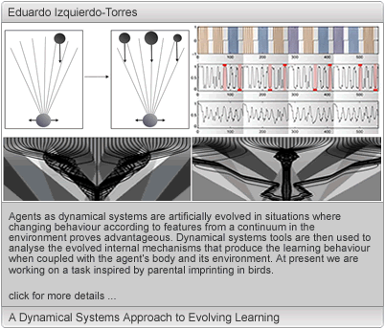
Eduardo
Artificial Life lecture 19
7 December 2010

Slide 9
James Dyke: The Daisyworld Control System
2009
A control system is developed that unlike human engineered control systems could, under certain conditions, arise via natural processes. This control system is responsible for the homeostatic properties of Daisyworld. Daisyworld is a simple mathematical model of a biosphere that exhibits environmental homeostasis in that the global temperature of the planet is maintained within the range that life is able to grow despite external perturbations.
The original Daisyworld model is simplified so that the core homeostatic mechanism, or control system, is identified. This simplification processes also allows insights into the original model and in particular the origins of the model's inverse response to external driving.
The Daisyworld control system is classified as an instance of the much more general notion of rein control. Rein control was developed within a physiological communication and control context. A simple robotic controller that is based on a Daisyworld control system is formulated in order to demonstrate the generality of this mechanism. This highlights a number of initially counter-intuitive but important aspects of Daisyworld and rein control systems in general.
Artificial Life lecture 19
7 December 2010

Slide 10
James Dyke: The Daisyworld Control System
[…ctd…]
It is shown that rein control can operate within populations of organisms that interact with their environment in ways that lead to environmental homeostasis in the face of external perturbations. Contrary to initial criticisms of Daisyworld, environmental homeostasis emerges in evolving populations not despite of but because of natural selection. It is shown that a more complex ecosystem is more stable due to the operation of rein control. Similarities are drawn between rein control models and models developed within the domains of population genetics and theoretical ecology.
Introducing thermodynamic constraints into rein control models results in the maximisation of homeostasis when rates of entropy production are maximised. This is discussed within the context of the maximum entropy production principle.
Artificial Life lecture 19
7 December 2010

Slide 11
Tom Froese 2009
Sociality and the Life-Mind Continuum
The life-mind continuity thesis holds that mind is prefigured in life and that mind belongs to life. Its biggest challenge is the problem of scalability: how can the same explanatory framework that accounts for basic phenomena of life and mind be extended to incorporate the highest reaches of human cognition? So far there has been little systematic response to this „cognitive gap‟. The main argument of this thesis is that the problem appears insurmountable because of the prevalent focus on the individual agent alone, and that it can start to be addressed by an appreciation of the constitutive role of sociality for mind and behavior. This argument is developed in a theoretical, experimental, and phenomenological manner. In terms of theory, the enactive paradigm of cognitive science is developed in a novel direction by highlighting the specific manner in which the dynamics of the interaction process opens up new behavioral domains. This provides the motivation for using an evolutionary robotics methodology to synthesize a set of minimalist simulation models that are based on experiments in social psychology. A detailed dynamical analysis of these models supports the enactive approach; the behavior of the agents is not an individual achievement alone but rather co-determined by their mutual interaction and organized effectively by this multi-agent interaction process. … …
Artificial Life lecture 19
7 December 2010

Slide 12
Tom Froese 2009
Sociality and the Life-Mind Continuum
[…ctd…]
Some phenomenological observations complement these results by indicating that the detached perceptual attitude that is characteristic of adult human perception is essentially an intersubjective and socially mediated ability. Finally, the systemic and phenomenological insights are combined to provide the beginnings of a novel perspective on the origins of cumulative cultural development that gives further support to the main argument of this thesis. It is concluded that the life-mind continuity thesis is a viable working hypothesis even when accounting for specifically human abilities, and that an appreciation of the constitutive role of sociality for life and mind confirms it to be a serious contender for a unified theory of cognitive science.
Artificial Life lecture 19
7 December 2010

Slide 13
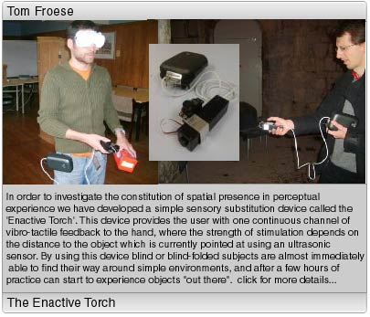
Tom
Artificial Life lecture 19
7 December 2010

Slide 14
Nathaniel Virgo 2010
Thermodynamics and the Structure of Living Systems
Non-equilibrium physical systems, be they biological or otherwise, are powered by differences in intensive thermodynamic variables, which result in flows of matter and energy through the system. This thesis is concerned with the response of physical systems and ecosystems to complex types of boundary condition, where the flows and intensive variables are constrained to be functions of one another. I concentrate on what I call negative feedback boundary conditions, where the potential difference is a decreasing function of the flow.
Evidence from climate science suggests that, in at least some cases, systems under these conditions obey a principle of maximum entropy production. Similar extremum principles have been suggested for ecosystems. Building on recent work in theoretical physics, I present a statistical-mechanical argument in favour of this principle, which makes its range of application clearer.
…
Artificial Life lecture 19
7 December 2010

Slide 15
Nathaniel Virgo 2010
Thermodynamics and the Structure of Living Systems
[…ctd…]
Negative feedback boundary conditions can arise naturally in ecological scenarios, where the difference in potential is the free-energy density of the environment and the negative feedback applies to the ecosystem as a whole. I present examples of this, and develop a simple but general model of a biological population evolving under such conditions. The evolution of faster and more efficient metabolisms results in a lower environmental energy density, supporting an argument that simpler metabolisms could have persisted more easily in early environments.
Negative feedback conditions may also have played a role in the origins of life, and specifically in the origins of individuation, the splitting up of living matter into distinct organisms, a notion related to the theory of autopoiesis. I present simulation models to clarify the concept of individuation and to back up this hypothesis.
Finally I propose and model a mechanism whereby systems can grow adaptively under positive reinforcement boundary conditions by the canalisation of fluctuations in their structure.
Artificial Life lecture 19
7 December 2010

Slide 16
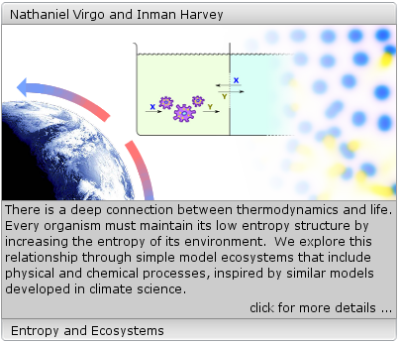
Nathaniel
Artificial Life lecture 19
7 December 2010

Slide 17
Greg Studer 2010
Computing multi-scale organizations built through assembly
The ability to generate and control assembling structures over many orders of magnitude is an unsolved challenge of engineering and science. Many of the presumed transformational benefits of nanotechnology and robotics are directly related to this issue. There are still significant theoretical difficulties associated with building such systems (Bedau et al., 2000; Lenaerts et al., 2005), though technology is rapidly ensuring that the tools needed are becoming available. Many examples now exist of assembling devices, but realizing and controlling scalable behavior across orders of magnitude with realistic devices remains problematic (Yim et al., 2007). In this thesis a general purpose prototype is developed which is capable of unlimited controllable assembly, as well as an additional prototype which, in structures, can emulate any other computing device. These devices are entirely finite-state, each requiring less than 40 bits of memory, and distributed in operation.
A new assembling model of computational organization and regulation over assembly levels (CORAL) provides the necessary framework for this investigation. The constraints of the CORAL model allow for only distributed control and ensure that units cannot be reprogrammed - all reprogramming is done via assembly. … …
Artificial Life lecture 19
7 December 2010

Slide 18
Greg Studer 2010
Computing multi-scale organizations built through assembly
[…ctd…]
Units may be structured into computational objects using a procedural or developmental approach, allowing devices to be built more powerful than the strongly limited core units. Well-defined comparison of computational power between levels of organization is ensured by the structure of the models. An assembling unit is also described which takes this idea further, emulating in combination the core operations of the atomic units themselves.
A comparison of the designed prototypes with examples evolved using an evolutionary algorithm is also discussed. The evolved units are capable of controllable recursive pairing ability, a primitive form of unlimited assembly, and do so via symmetry-breaking operations at each step. Heuristic evidence for a minimal threshold of complexity for scalable assembly is provided by the results, and challenges identified for future evolutionary studies.
Artificial Life lecture 19
7 December 2010

Slide 19
Marcos Rosetti 2010
Exploration of human search behaviour: a multidisciplinary perspective
The following work presents an exploration on human search behaviour, from the biological and computational perspective. Search behaviour is deﬁned as the movements made by an organism to attempt to ﬁnd a resource. This work describes some of the principal ways to record movement, several ways to analyze it and some of the interpretations that can be given to it. Following this, an experimental setup was built and tested to generate the search paths of human participants. The test arena consisted on a football ﬁeld and the targets consisted on an array of 20 golf balls. Two different target distributions were tested and three conspicuity levels were constructed by painting the targets, giving a total of six different experimental conditions. … …
Artificial Life lecture 19
7 December 2010

Slide 20
Marcos Rosetti 2010
Exploration of human search behaviour: a multidisciplinary perspective
[…ctd…]
The search paths of the subjects were collected by a GPS. The paths were analyzed and a minimal decision model was conceived to explain the search patterns. The parameters of the bouncing search model were explored and the inner workings were used as a basis for an optimization procedure attempting to force a systematic search strategy. This work introduces several new methodological aspects to be explored to further understand the decision process involved when humans search. Also it provides an example of an area where the interaction biology and computational science can result in innovative research.
Artificial Life lecture 19
7 December 2010

Slide 21
Bill Bigge 2010
The Programmable Spring: Towards physical emulators of mechanical systems
The way motion is generated and controlled in robotics and automation in general has traditionally been based on a philosophy of rigidity, where movements are tightly controlled and external influences are ironed out. More recent research into autonomous robots, biological actuation and human machine interaction has uncovered the value of compliant mechanisms in both aiding the production of effective, adaptive and efficient behaviour, and increasing the margins for safety in machines that operate alongside people. Various actuation methods have have previously been proposed that allow robotic systems to exploit rather than avoid the influences of external perturbations, but many of these devices can be complex and costly to engineer, and are often task-specific.
This thesis documents the development of a general purpose modular actuator that can potentially emulate the behaviour of various spring damping. It builds on some of the work done to produce reliable force controlled electronic actuators by developing a low cost implementation of an existing force actuator, and combining it with a novel high level control structure running in software on an embedded microcontroller. The actuator hardware with its embedded software results in a compact modular device capable of approximating the behaviour of various mechanical systems and actuation devices… …
Artificial Life lecture 19
7 December 2010

Slide 22
Bill Bigge 2010
The Programmable Spring: Towards physical emulators of mechanical systems
[…ctd…]
Specifying these behaviours is achieved with an intuitive user interface and a control system based on a concept called profile groups. Profile group configurations that specify complex mechanical behaviours can be rapidly designed and the resulting configurations downloaded for a device to emulate.
The novel control system and intuitive user interface developed to facilitate the rapid prototyping of mechanical systems are explained in detail. Two prototype devices are demonstrated emulating a number of mechanical systems and the results are compared to mechanical counterparts. Performance issues are discussed and some solutions proposed alongside general improvements to the control system. The applications beyond robotics are also explored.
Artificial Life lecture 19
7 December 2010

Slide 23
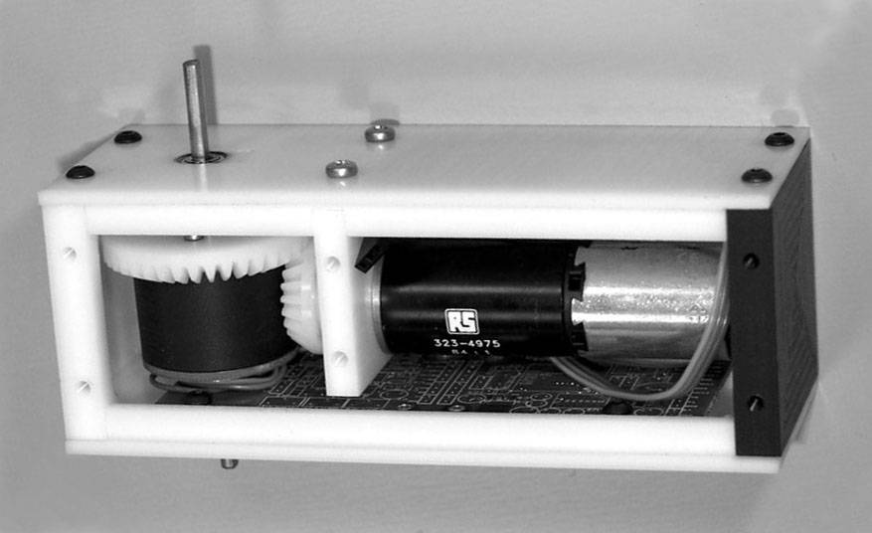
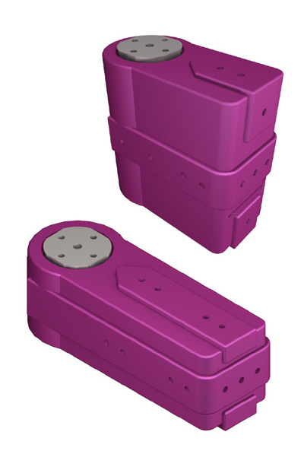
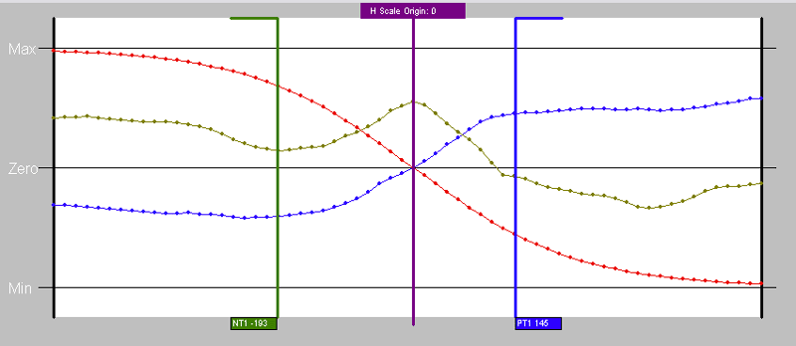
Bill Bigge’s Programmable Springs
Compliant actuators – regulating force rather than position
http://www.informatics.sussex.ac.uk/users/wb23/PGS/Videos.html
Artificial Life lecture 19
7 December 2010

Slide 24
Matthew Egbert 2011
?? Metabolism and (Artificial) Life ??
Metabolism, the transformation of the environment into the very same system that is transforming the environment, has been identified by a number of scientists and philosophers as a definitive characteristic of life (Ganti, 1975; Maturana and Varela, 1980; Rosen, 1991; Kauffman, 2000; Ruiz-Mirazo et al., 2004). All life metabolizes, but what are the implications of this property? All life metabolizes, but is that relevant to the impressive adaptability witnessed in nature? All life metabolizes, but in what ways is metabolism relevant to evolution and the life-time adaptation observed in biological organisms? … …
Artificial Life lecture 19
7 December 2010

Slide 25
Matthew Egbert 2011
?? Metabolism and (Artificial) Life ??
[…ctd…]
This thesis is an investigation into behavioural capabilities unique to these circularly organised systems; behaviours that are only available to systems that create and maintain themselves from their environment. We demonstrate, using computational models, how metabolic mechanisms can form the basis of new forms of adaptive behaviour and how this metabolism-based behaviour can facilitate evolutionary processes.
Artificial Life lecture 19
7 December 2010

Slide 26
Allister Furey 2011
Evolutionary Robotics in High Altitude Wind Energy Applications
This thesis focuses on the use of evolutionary robotics (ER) techniques on a single problem; that of controlling an unstable but steerable tethered wing or kite for the purposes of wind energy conversion.
The problem of autonomous kite control is noteworthy due to the novelty of the task and the challenging nature of the variation of the task’s dynamics, stemming from changes in both the environment and the physical morphology of the wing during flight. The structural warping to which the kite is subjected to, coupled with nontrivial geometry of the kite and the fluid medium in which the kite is situated makes conventional modelling and control techniques very difficult, to the extent that there are no successful implementations of a control algorithm on a real world testing device using conventional techniques in the academic literature. The promise of generating controllers through bio-inspired methods, specifically evolutionary robotics, that may be able to maintain the performance of qualitatively consistent flight control behaviours whilst the wing undergoes structural changes in a changing environment is the motivation behind this work. … …
Artificial Life lecture 19
7 December 2010

Slide 27
Allister Furey 2011
Evolutionary Robotics in High Altitude Wind Energy Applications
[…ctd…]
From the academic point of view, further motivation is provided by the opportunity to test of scalability of the evolutionary robotics approach to particularly variable problems operating on very fast timescales in domains with complex physics, to which they appear inherently suitable, when compared to conventional techniques. Demonstration of the capabilities of ER to control, in the real world, entirely non-rigid bodies operating in environments dominated by fluid/solid interactions is not yet available, so we seek to provide this here. Further to this aim, this specific application allows us to probe the level of fidelity of system modelling that is appropriate or desirable in such complex systems, where a given level of modelling may be essential to capture the dynamics of the system, but where a ‘full’ description would entail such a high level of computational demand that it is rendered implausible with at current computer power:cost ratio.
Artificial Life lecture 19
7 December 2010

Slide 28
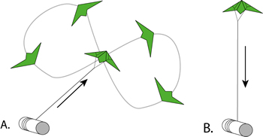
Allister
Movie
Artificial Life lecture 19
7 December 2010

Slide 29
Nick Tomko 201x?
Work in Progress
Metagenomics, the Binomic GA.
Group Selection in GAs.
Harvey, I. and Tomko, N. (2010). Binomics: Where Metagenomics meets the Binary World.
Proceedings of Artificial Life XII, 12th Intl. Conf. on the Synthesis and Simulation of Living Systems. Odense, Denmark, 19-23 Aug. 2010.
Cf my Alergic talk this Wed.
Artificial Life lecture 19
7 December 2010

Slide 30
Personal list of Alife hot topics
Biased, of course
Artificial Life lecture 19
7 December 2010

Slide 31
Hot topics:- Passive Dynamic Walking
This is a very embodied, dynamical systems approach.
So far PDWs have just gone down gentle slopes under gravity. There is scope for adding small amounts of power input for more general walking.
Matt Williamson’s work, associated with Brooks’ COG project, using coupled oscillators, seems a very promising lead that could be applied here.
Eric Vaughan took this a lot further in his thesis – still room for much more work.
Artificial Life lecture 19
7 December 2010

Slide 32
Neutral Networks
Wide open for research.
Barnett’s work shows that in a formally defined class of (binary) fitness landscapes full of NNs in a particular fashion, best strategy is a population of size 1+1, with a fixed number of mutations based on getting expected proportion that are neutral as close as possible to 1/e = 37%.
Adrian Thompson’s hardware evolution supports this
Extensions: noisy fitness evaluations ?
Real valued genotypes?
Artificial Life lecture 19
7 December 2010

Slide 33
Gaia/Maximum entropy?
Relationship between Daisyworld models of homeostasis, and Thermodynamic ideas that :-
“Systems ‘try to organise themselves’ to produce entropy as fast as possible”.
Cf. Kay and Schneider, ‘4th Law of Thermodynamics’.
“Organised systems can dissipate junk entropy faster, and (… speculation…) Life does it better than anything else and hence should naturally occur (… given the right circumstances)”
MEP Maximum Entropy Production Principle
Artificial Life lecture 19
7 December 2010

Slide 34
Homeostasis
Homeostasis seems central to definitions/the core of life/cognition (cf Autopoiesis)
As also does Jim Stone’s work on (… roughly speaking…) what perceptual systems (eg ANNs) have to do in order to sift out higher-level invariants from all the noise.
Roughly:- (1) output of a system should not fluctuate wildy (just echoing the noise is pointless)
But (2) Should not stay still – it should fluctuate over the long term if it is to reflect real things happening in the world.
Artificial Life lecture 19
7 December 2010

Slide 35
Rein Control
Rein Control (originally Manfred Clynes) appears to be a really simple unifying principle to explain
Vanilla Daisyworld
McDonald-Gibson’s DW variant
Homeostasis generally.
Immense scope for research … …
Artificial Life lecture 19
7 December 2010

Slide 36
Complexity versus Stability
Under what circumstances are complex systems – with multiple interacting feedback loops – naturally going to be stable?
Non-linear versus linear feedback.
Hat-functions.
Why Robert May is wrong.
Artificial Life lecture 19
7 December 2010

Slide 37
Adaptive Text Entry methods
The need for easier methods for text entry on mobile phones, on iPods, PDAs etc. Particularly with iPhone, iTouch, iPad.
EASy style approach, adaptive interface.
Fitts’ law.
One finger moving can generate ~14 bits info/sec, hence in theory ~10 characters of English text/sec, ~120 wpm.
Artificial Life lecture 19
7 December 2010

Slide 38
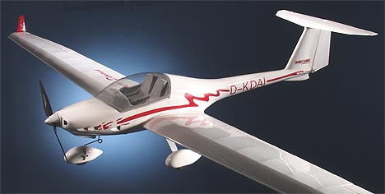
Autonomous Glider
Adding minimal sensors and a relatively simple Braitenberg-like control architecture to a model glider.
Aim: to get autonomous flight gaining lift/power through ridge-soaring.
Minimal optical-horizon sensor, 3 DoF accelerometer, use of optic flow.
Artificial Life lecture 19
7 December 2010

Slide 39
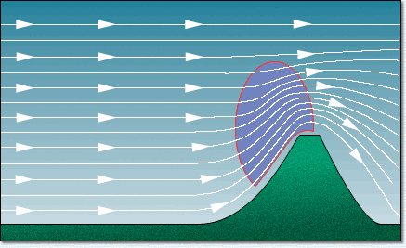
Maintain position relative to a ridge – how?
Compare the optical horizon with the gravity horizon -- should keep you somewhere on the red line.
But you also need to keep within appropriate distances from ridge, on that red line. Use optic flow? Unstructured texture of ground – interesting issues.
Artificial Life lecture 19
7 December 2010

Slide 40
Metagenomics for GAs
Very recently discovered that most natural evolution (bacterial) does not fit the conventional picture, but involves
Horizontal Gene Transfer
And much selection appears to be at the ecosystem level.
Why is unicellular evolution like this?
Why is multicellular evolution different?
Mixed ecosystems?
Why and when should GAs fit the multicellular model, why and when the unicellular model?
Artificial Life lecture 19
7 December 2010

Slide 41
Lots of other possibilities
?
Artificial Life lecture 19
7 December 2010

Slide 42
Summer research projects
Please remember the range of possibilities covered here (..and suggest more…) when it comes to planning your main summer projects.
REMEMBER: Feedback on courses
Via Study Direct !!!
Time for questions ?
Artificial Life lecture 19
7 December 2010

