Slide 1
Artificial Life lecture 8
(A) Braitenberg vehicles as an introduction to …
(B) ... Programming simple basic robots in the Robot Lab.
Rationale:- everyone should have some very basic hands-on experience of the problems involved in building a robot that interacts sensibly with its world.
Difference between reality and simulation.
Then facilities available for those who want to carry on in their own time, or for course projects.
Artificial Life Lecture 8
1 November 2010

Slide 2
Braitenberg Vehicles
Braitenberg (1984), Vehicles: Experiments in Synthetic Psychology, MIT Press.
R. Pfeifer & C. Scheier (1999),"Understanding intelligence" MIT Press
Arkin (1998), Behavior-Based Robotics, MIT Press.
Artificial Life Lecture 8
1 November 2010

Slide 3
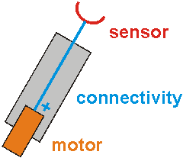
BV
Simplest vehicle has just one sensor and one motor
It can only change its speed according to the stimulus
The +sign means positive excitation
Artificial Life Lecture 8
1 November 2010

Slide 4
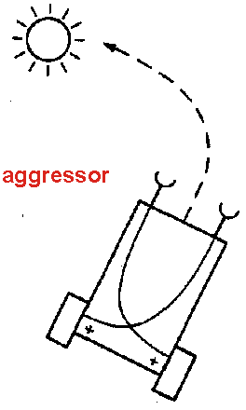
BV
Crossed positive connections mean that it will turn towards the side with the greater stimulus
-- an aggressor
Contra-lateral excitation
Artificial Life Lecture 8
1 November 2010

Slide 5
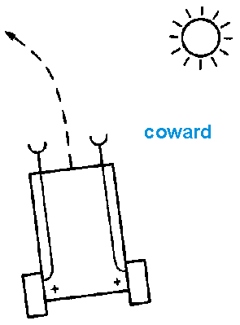
BV
If the connections are not crossed, then it turns away from excitation – coward
Ipsilateral excitation
Artificial Life Lecture 8
1 November 2010

Slide 6
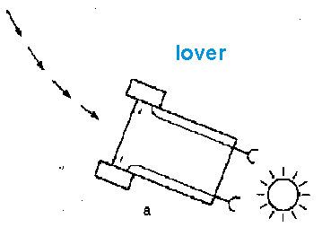
BV
Uncrossed inhibitory connections (note the –sign) give ipsilateral inhibition:
Turns towards the light and slows down as it gets close
Note: there will need to be some constant positive signal to the motors as well, that gets inhibited by the effects of the stimulus
Artificial Life Lecture 8
1 November 2010

Slide 7
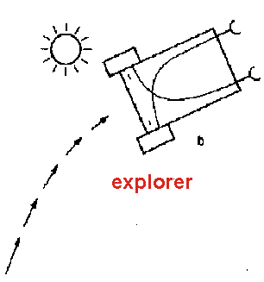
BV
Contralateral inhibition:
Slows down on seeing light, but then turns away and speeds up again.
Again, some constant positive signal to motors needed also.
Artificial Life Lecture 8
1 November 2010

Slide 8
Simulations of Agents
We generally reckon that simple 2-D simulations of agents should ideally be written by YOU in the language of your choice.
If you want 3-D with (fairly) realistic physics, then a Physics Engine like ODE is invaluable (http://www.ode.org/ )
“ODE is an open source, high performance library for simulating rigid body dynamics “ -- classes provided in January.
Or you could build robots for real – and a lot more interesting issues will crop up.
Artificial Life Lecture 8
1 November 2010

Slide 9
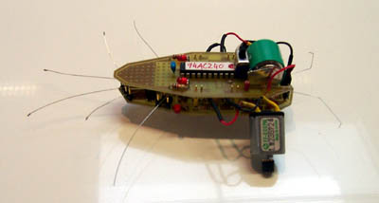
Theory and Practice
These sets of conceptual ‘wires’ could be implemented in real wires and capacitors and resistors and …
… or you can emulate all this with a computer
Artificial Life Lecture 8
1 November 2010

Slide 10
Basics
sensors
Body + nervous system
environment
motors
Many choices, but in this case body = Lego and
Nervous system = C program running on a mini-computer, hooked up to various sensors and motors
Artificial Life Lecture 8
1 November 2010

Slide 11
Program is a cheat
The computer program here is a bit of a cheat – it is emulating a nervous system of components passing real values around in real time.
Actually real values to/from motors/sensors are translated into digital signals, and real time is handled by going round a program loop indefinitely (… caution needed)
SEE important FAQ !! Relates also to GA+CTRNN exercise http://www.informatics.susx.ac.uk/users/inmanh/easy/alife10/TimeSteps.html
Artificial Life Lecture 8
1 November 2010

Slide 12
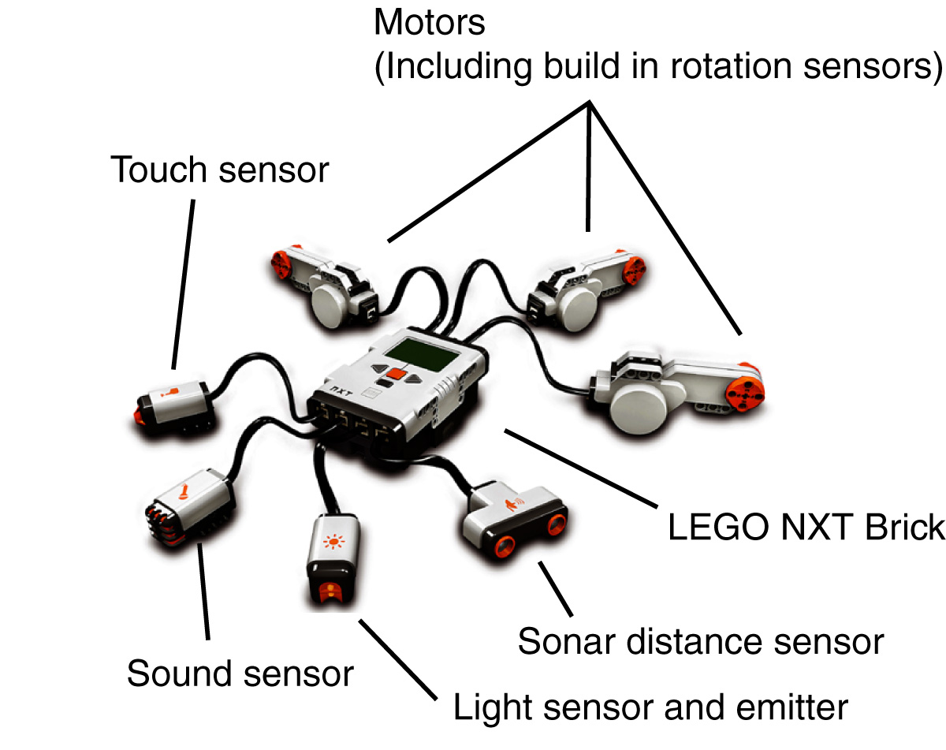
Lego NXT
We previously used our own EASyMind brick in a Lego structure ----- plug in sensors and motors appropriately ---and write a program to load onto it.
But now Lego has improved, we are using the Lego NXT system
Artificial Life Lecture 8
1 November 2010

Slide 13
NXT
Up to 3 motors (built-in rotary encoders, measure speed)
Up to 4 sensors:
Light (emitter+sensor)
Sonar (partly relates to distance)
Touch
Sound (microphone)
Artificial Life Lecture 8
1 November 2010

Slide 14
Warnings about sensors/motors
In simulations, magic sensors deliver reliable information about eg distances. Magic motors move the vehicle precise distances.
In the real world, it is nothing like that.
Real sensors are noisy, and react to far more than you might guess.
Calibration of sensors
Wheels slip on the floor, get jammed on bumps.
Artificial Life Lecture 8
1 November 2010

Slide 15
Programming NXT
USB port connects to a PC for downloading programs (also has Bluetooth)
Atmel 32-bit ARM processor, (AT91SAM7S256) 256 KB FLASH, 64 KB RAM and runs at 48 MHz.
There is a mode for (Labview-like) graphically programming it (simple, cannot do ANNs) – but we will be using RobotC (http://www.robotc.net/) which is a fairly basic C programming language with pre-written functions for controlling the NXT sensors motors and other peripherals.
Artificial Life Lecture 8
1 November 2010

Slide 16
Useful links
Browse these before the Robot Lab class
RobotC www.robotc.net
Our local programming instructions tinyurl.com/587zdx
For more adventurous (build your own hardware) people
Mindstorms.lego.com/Overview/nxtreme.aspx
Artificial Life Lecture 8
1 November 2010

Slide 17
What a simple program looks like
int LeftSensorValue;
int RightSensorValue;
task main()
{
while(1)
{
LeftSensorValue = SensorValue(LeftSensor);
RightSensorValue = SensorValue(RightSensor);
motor[LeftMotor] = RightSensorValue;
motor[RightMotor] = LeftSensorValue;
}
}
Artificial Life Lecture 8
1 November 2010

Slide 18
What does it do?
Every time round the loop, it reads in sensor values from where you told the program to look.
and sets the equivalent power levels (suitably scaled) to whatever you have plugged into the Motor Ports
All sorts of stuff is done in the background, hidden from you: A/D conversion, scaling factors, how fast round the loop?
This is an infinite loop while(1)
Get this going first, then modify and extend
Artificial Life Lecture 8
1 November 2010

Slide 19
Worries about cheating
Sometimes people forget they are using a program to emulate a ‘nervous system’, and sometimes this breaks down.
while ( 1) {
… … }
How long does this loop take? Does the time vary according to circumstances? If you want something to happen at a particular rate, how do you ensure that?
Artificial Life Lecture 8
1 November 2010

Slide 20
Robot lab classes
Start at normal seminar times (check exact numbers of people_
TUESDAY 2nd Nov 11:00 to 13:00 max
THURSDAY 4th Nov 11:00 to 13:00 max
PLACE: in Informatics Lab 4 – Chichester-2R226
2 people to a robot – the rule is that the worst programmer sits at the
Keyboard to write the program(s), and the clumsiest person does the
Robot assembly
See http://tinyurl.com/587zdx
Artificial Life Lecture 8
1 November 2010

Slide 21
GA+CTRNN exercise
This is an optional exercise – but strongly recommended if you may beusing CTRNNs at some stage, for modelling Dynamical Systems – and particularly ‘robot nervous systems’.
See via the course webpage
www.cogs.susx.ac.uk/users/inmanh/easy/alife10/ga_exercise2.html
Hand in your efforts, for feedback.
Artificial Life Lecture 8
1 November 2010

Slide 22

Evolve CTRNN to display "Interesting Dynamics"
In simulation, node activations are calculated forward through time by straightforward time-slicing using Euler integration;
I.e. choose a suitably small time-slice delta_t, use the above equations to calculate for each node how much their values change in time delta_t, and update them all simultaneously
Then repeat many times over, like a slightly jerky movie, though if your delta_t is small enough, hopefully it will be fairly smooth!
Artificial Life Lecture 8
1 November 2010

Slide 23
Simulating a Dynamical System using Update Steps
You will be doing this both for the GA+CTRNN exercise AND in the robot lab class.
So many people misunderstand what one is doing with Update Steps, that I have written a special FAQ
www.cogs.susx.ac.uk/users/inmanh/easy/alife10/TimeSteps.html
It is absolutely ESSENTIAL to make the update-steps small-enough,
So that your ‘jerky approximation’ is close enough to the smooth continuous dynamics of what you are simulating.
Artificial Life Lecture 8
1 November 2010

Slide 24
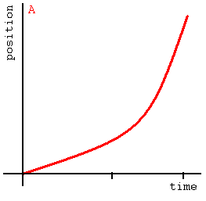
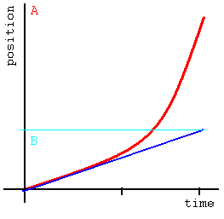
Tangents to a Smooth curve
The Blue Line is close-enough to the curve for only a short distance
Artificial Life Lecture 8
1 November 2010

Slide 25
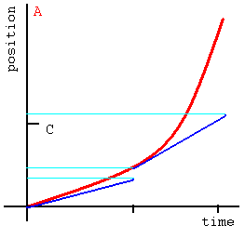
Successive approximations …
… will only work if they are close enough
How close is that ?
Artificial Life Lecture 8
1 November 2010

Slide 26
The ultimate test
The rigorous test is:
Pick a timestep that by Rule of Thumb (see below) you hope is small enough, run the code, see what result it gives.
Then run the whole program again with a different smaller timestep, 1/10 the size
If the end-result is (almost) the same, you were OK -- stick with it.
If the end-result is significantly different, your original guess was not small enough. Repeat steps 2-4 until you get there
Artificial Life Lecture 8
1 November 2010

Slide 27
Rule of Thumb for DSs including CTRNNs
Look at the smallest relevant timescale of the real dynamics of what you are simulating.
WIth CTRNNs, that might be the smallest time-parameter value that any node can have.
Then pick a simulation-update timestep at least one order of magnitude (1/10) smaller than that
Then you should also go through the rigorous test above, to double-check..
www.cogs.susx.ac.uk/users/inmanh/easy/alife10/TimeSteps.html
Artificial Life Lecture 8
1 November 2010

Slide 28
Some Public Service Announcements
Looking ahead to doing your Alife project
(Plagiarism)
Standards in Science
Bonfire Night
Artificial Life Lecture 8
1 November 2010

Slide 29
Alife projects
Next week I shall give a lecture on ‘how to plan an Alife project’….
… and the following week (deadline to be decided) you should be submitting your proposal for your own project, for feedback.
One strongly recommended approach is to take some existing piece of published work (paper, textbook, on web …) and replicate it – then adjust it, tweak it, play with it, extend it.
Artificial Life Lecture 8
1 November 2010

Slide 30
Plagiarism
This of course (…like most other work in science…) requires you to distinguish carefully in your report between ideas/code/text that you learnt from others – and new (or new tweaks to) ideas/code/text that you brought to this yourself.
Any piece of work contains both. The ‘Academic Development Course’ should have covered this issue, but you will also see among my FAQs a FAQ page of my own on this.
Go to
http://www.informatics.susx.ac.uk/users/inmanh/FAQ/FAQ.html
And follow link to “Local access only” FAQs
Artificial Life Lecture 8
1 November 2010

Slide 31
Science: Honesty, Integrity, Proof
You should be trying to demonstrate something that you believe to be true, that you can lay out clearly and with integrity, using proper standards of proof. If there are gaps in your argument, you will be scrupulous in searching them out, and bringing them to the attention of your readers.
Honesty and integrity should also include maintaining an open mind -- being able, indeed keen, to question one's own beliefs and revise them when evidence and argument point to new conclusions. Honesty includes being scrupulous to give credit to the origins of ideas, and of course no plagiarism; see my relevant FAQ via my homepage.
Artificial Life Lecture 8
1 November 2010

Slide 32
Standards of Proof
Imagine that you are giving the prosecution case against a defendant in a murder trial, with a potential life prison sentence.
The defence lawyer is convinced his client is innocent, and will do everything possible to point out the flaws in your arguments. For a scientific paper, we expect higher standards than the sort of prosecution case that will convince a jury.
Artificial Life Lecture 8
1 November 2010

Slide 33
Presenting Evidence
In a court case, every item that fits into the prosecution's argument will be cited, labelled, presented, and cross-examined by the other side. You must meet at least these standards in a scientific paper.
That is why assertions drawn from the literature must be sourced. That is why quotations from Wikipedia are not acceptable, however useful.
Wikipedia might be in tracking down the proper evidential support. In a court case it is not acceptable to say "I heard someone in the pub say he was the murderer" -- you have to bring that person to court and get them to give evidence under cross-examination..
Artificial Life Lecture 8
1 November 2010

Slide 34
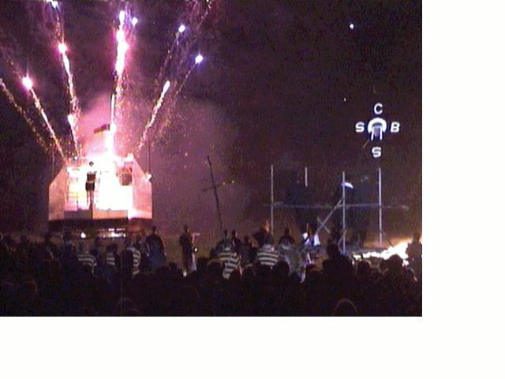
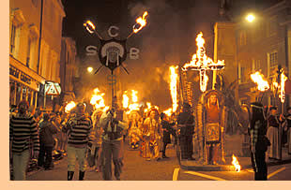
Reminder for Friday Nov 5th
Fri 5th is Bonfire Night
Lewes Bonfire (6am-2am)
Main processions ~7pm on
6 Bonfires from ~10pm
www.lewesbonfirecouncil.org.uk/
Semi-Compulsory
Artificial Life
Exercise !!!!
Artificial Life Lecture 8
1 November 2010

