Slide 1
A Needle In A Pineapple Field
Study of the Current State of Pineapple Leaves Valorisation in the Context of Circular Bioeconomy in Costa Rica
Ignacio Saldivia Gonzatti
May 17, 2023
Supervisor: Dr. Francisco Alpizar
MSc Climate Studies
Wageningen University & Research

Slide 2
Outline
Problem statement
Aim and Research Questions
Current state of Pineapple Leaves (PAL) valorisation in Costa Rica (CR)
Analysing barriers and opportunities of PAL valorisation
Facility Location Problem for PAL valorisation
Q&A

Slide 3
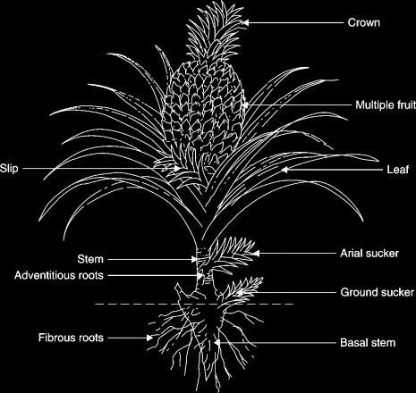
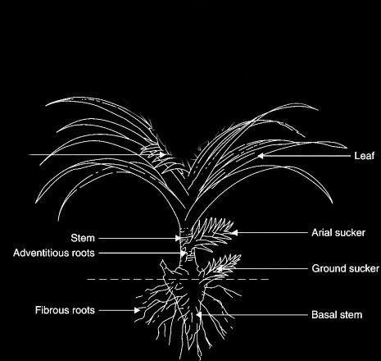

Problem statement

Slide 4
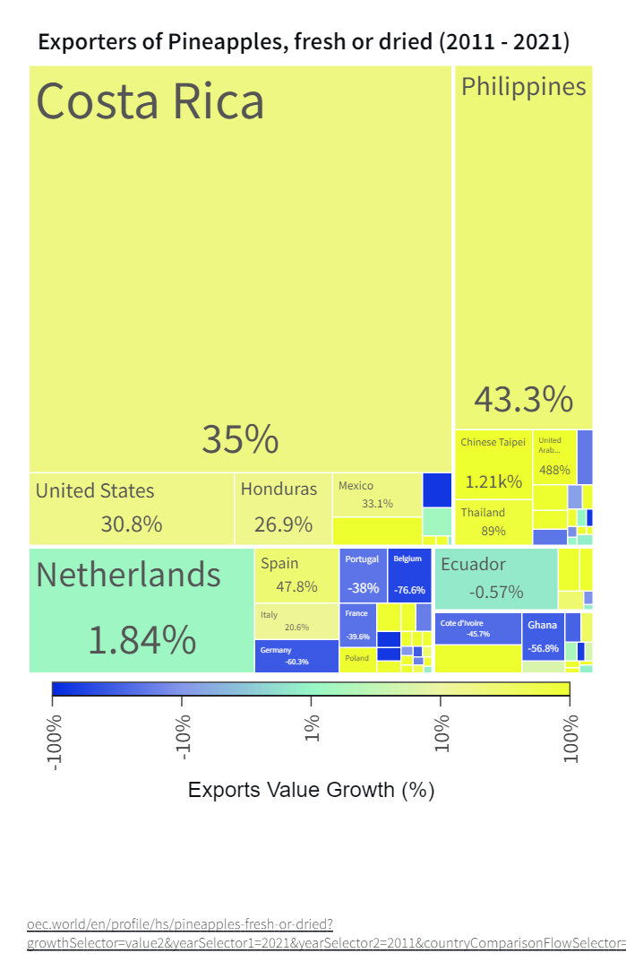
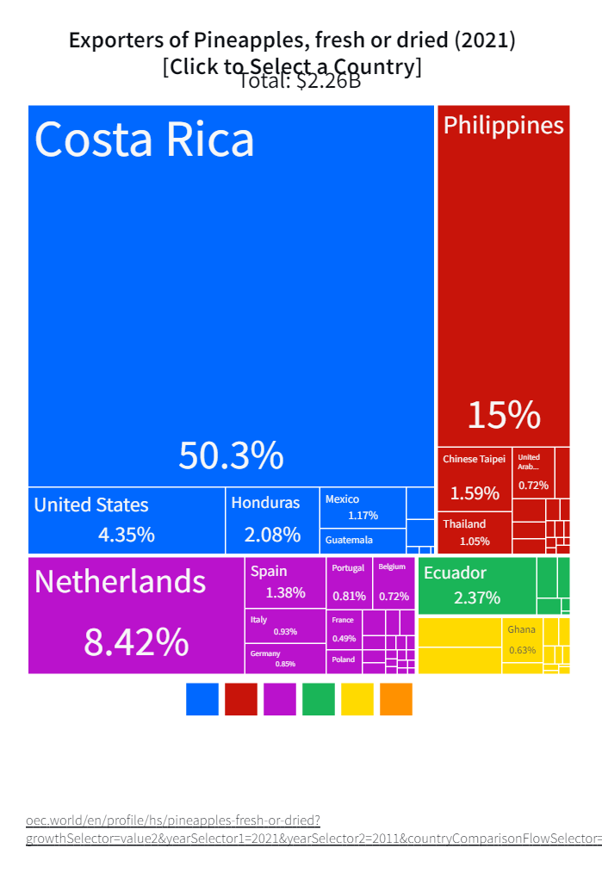
Problem statement
Exporters of pineapple, 2021
Exports Growth, 2011 - 2021

Slide 5
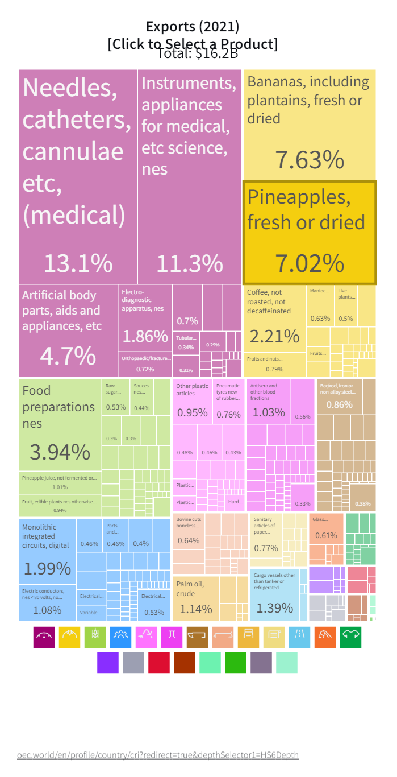
Problem statement
Costa Rica Exports, 2021

Slide 6
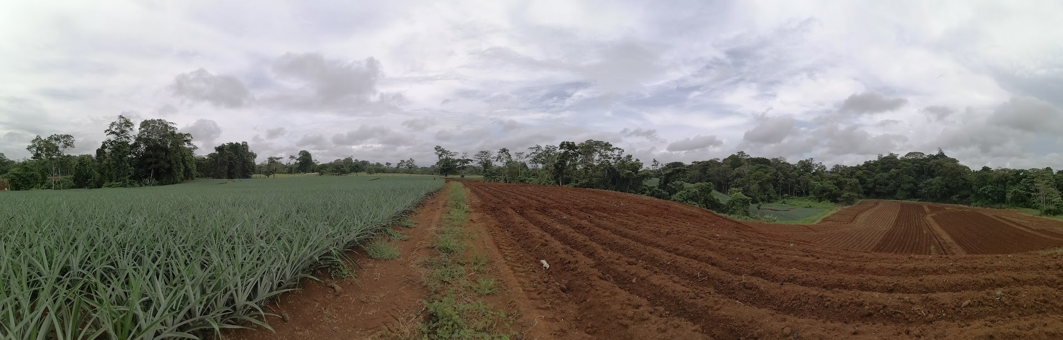
Problem statement
monoculture + waste/plant ratio + stable fly

Slide 7
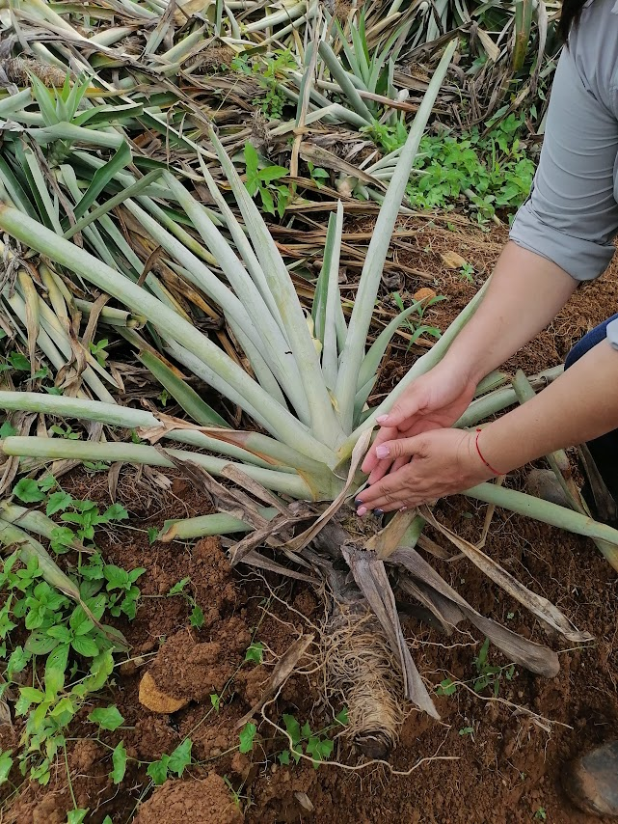
Problem statement
monoculture + waste/plant ratio + stable fly
40%
~165 tonnes/ha

Slide 8
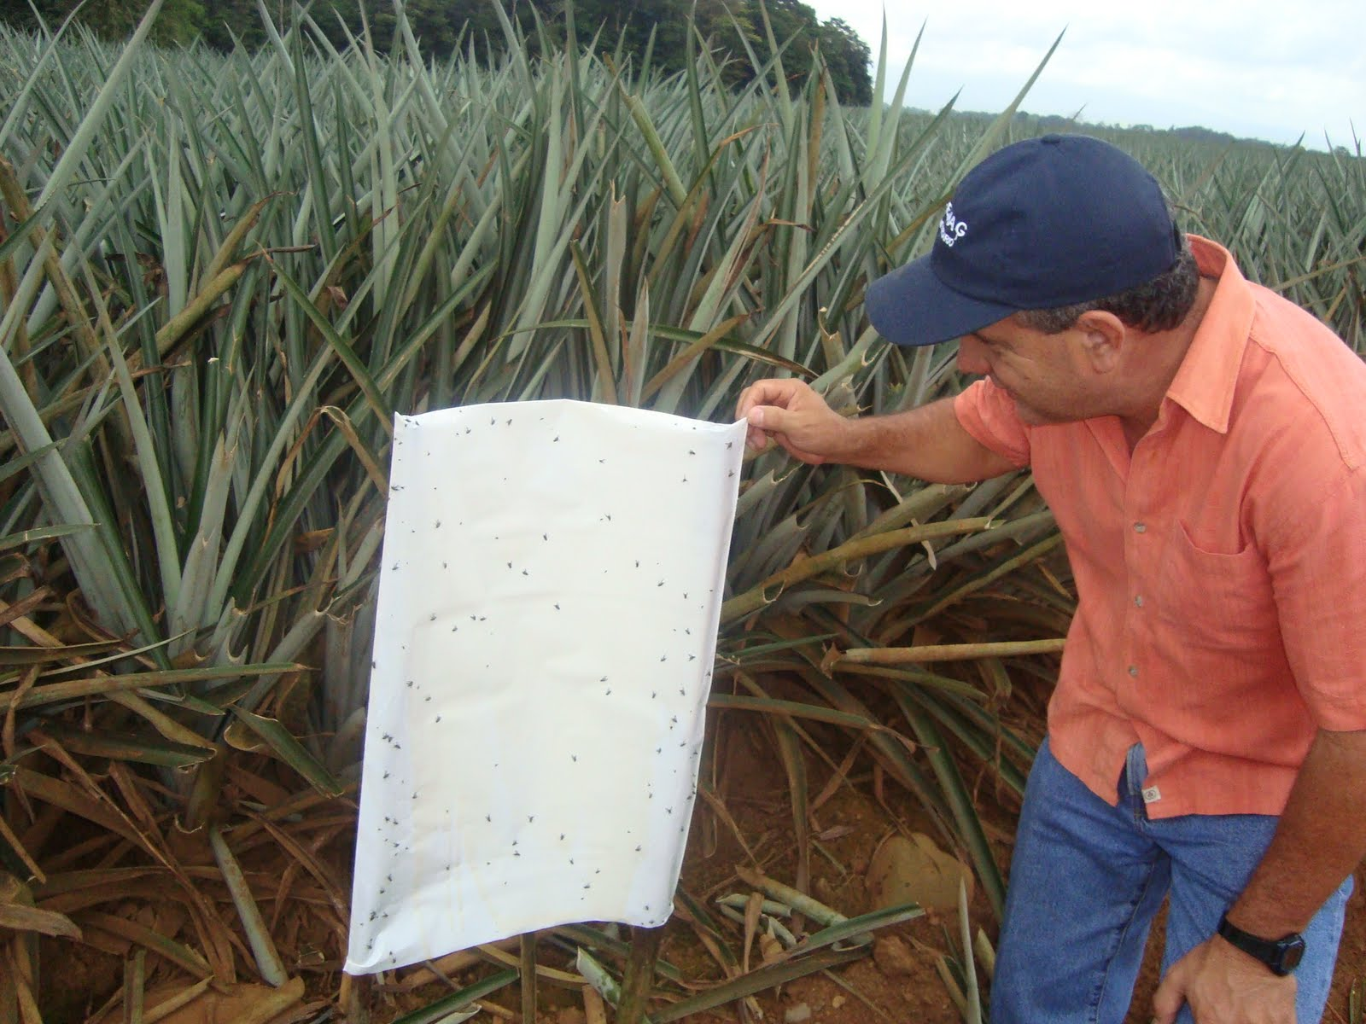
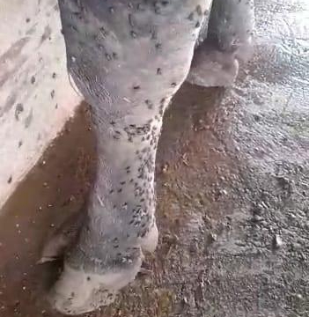
Problem statement
monoculture + waste/plant ratio + stable fly

Slide 9
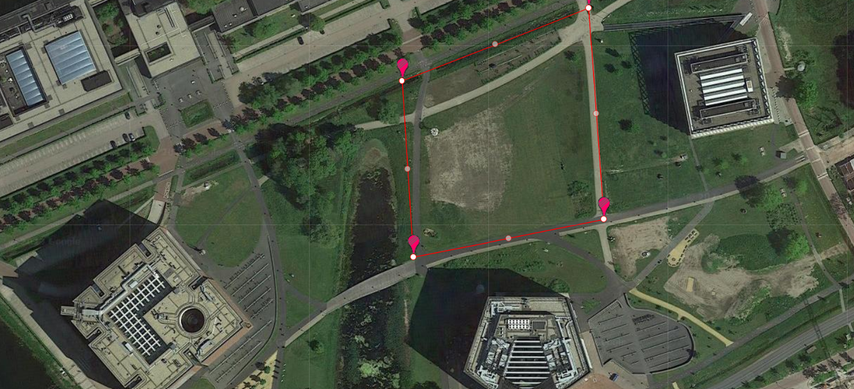
Problem statement
× 65.000

Slide 10
Problem statement
Current practices:
↑ GHG emissions
↑ Pollution of water → Communities
↓ Productivity and quality of pineapple

Slide 11
Problem statement

Slide 12
Aim and Research Questions
Problem statement
Aim and Research Questions
Current state of PAL valorisation in CR
Analysing barriers and opportunities of PAL valorisation
Facility Location Problem for PAL valorisation
Q&A

Slide 13
Aim and Research Questions
Aim: To help increase the sustainability of the pineapple industry in CR by introducing circular bioeconomy principles.
RQ1: What is the current state of PAL valorisation in the country?
RQ2: What are the barriers and benefits of PAL valorisation?
RQ3: How can a large-scale valorisation process be carried out?

Slide 14
Current state of PAL valorisation in CR
Problem statement
Aim and Research Questions
Current state of PAL valorisation in CR
Analysing barriers and opportunities of PAL valorisation
Facility Location Problem for PAL valorisation
Q&A

Slide 15
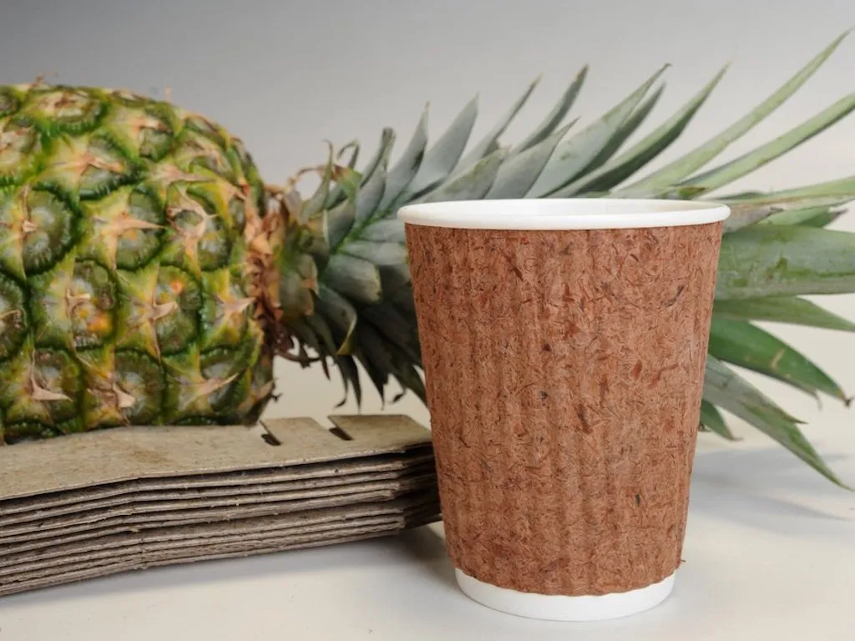
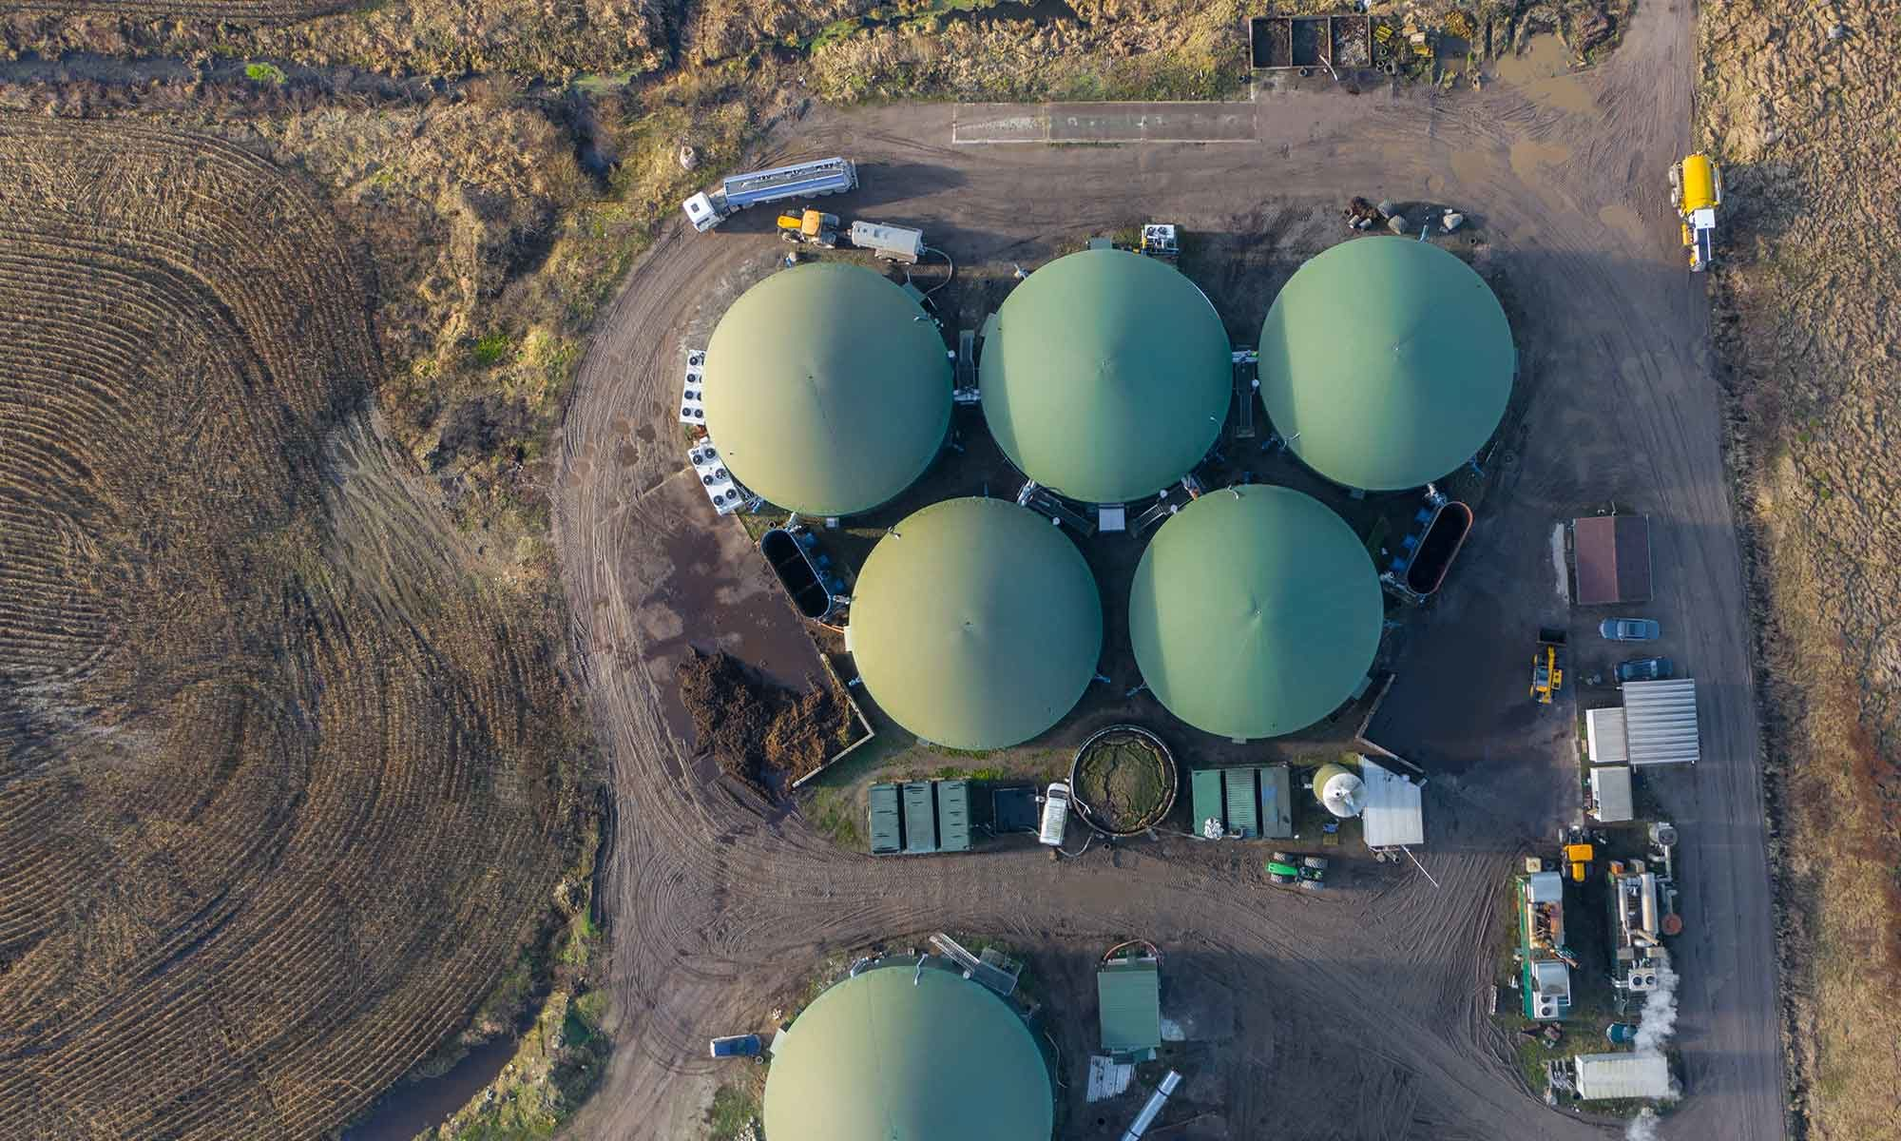

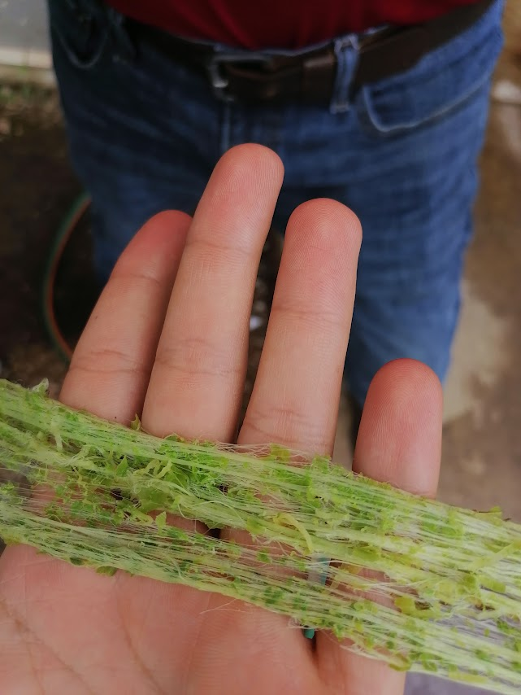
Current state of PAL valorisation in CR
A lot of ideas…
Fabrics
Bio-packaging
Energy

Slide 16
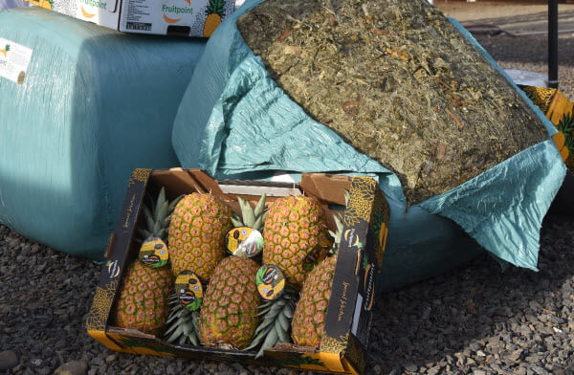
Current state of PAL valorisation in CR
But only 1 in place
Fabrics
Bio-packaging
Energy
Animal feed

Slide 17
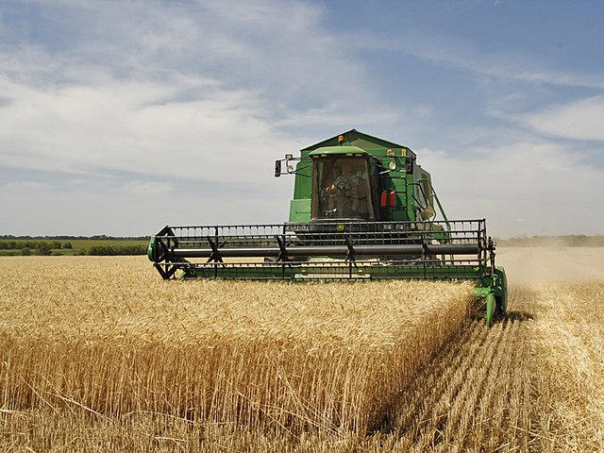
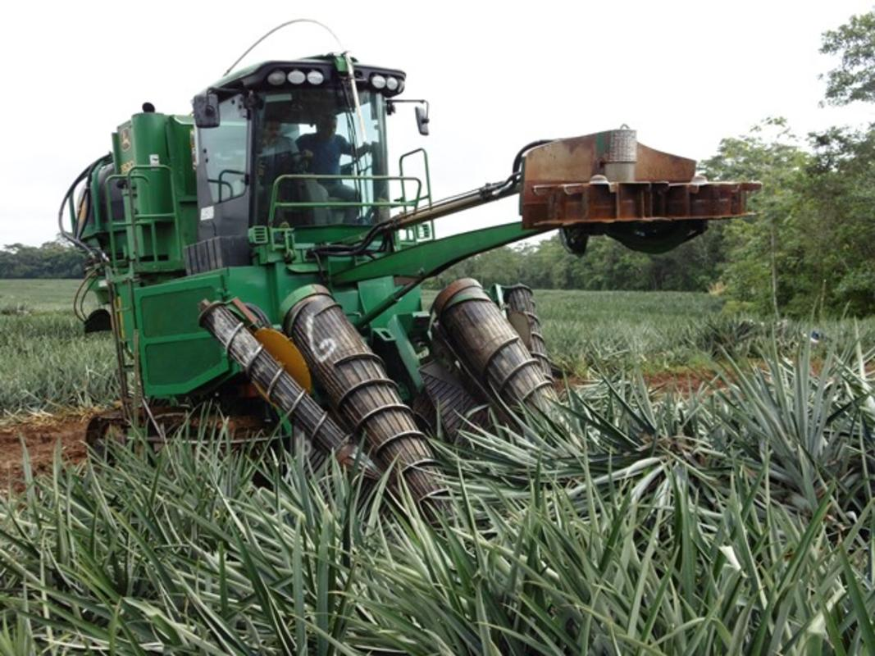
Current state of PAL valorisation in CR
Extraction is rough… literally
Hilly and muddy terrain
Dirt roads
High volume
Divide plant

Slide 18
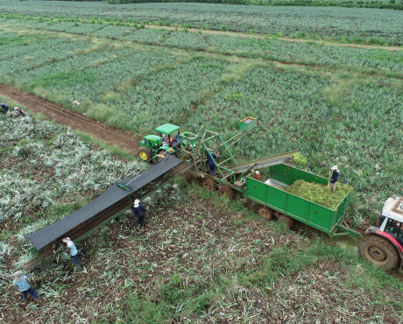
Current state of PAL valorisation in CR
Partial
Mechanical
Solution

Slide 19
Analysing barriers and opportunities of PAL valorisation
Problem statement
Aim and Research Questions
Current state of PAL valorisation in CR
Analysing barriers and opportunities of PAL valorisation
Facility Location Problem for PAL valorisation
Q&A

Slide 20
Analysing barriers and opportunities of PAL valorisation
Method
Fuzzy Cognitive Map (FCM)
Quasi-quantitative model
Elicit knowledge from stakeholders
Analyse interconnected variables in a system
Notes:
‘semi-quantitative’ (i.e. using and producing indicative rather than predictive numerical values)

Slide 21
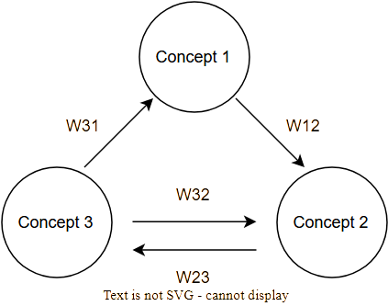
Analysing barriers and opportunities of PAL valorisation
PAL
valorisation
+0.7
W31
+0.5
W21
+0.2
W32
Extraction
From field
Innovation
+0.6
W23

Slide 22
Analysing barriers and opportunities of PAL valorisation
FCM Process
14 Interviews
Aggregate knowledge
Generate the FCM: 32 concepts and 52 connections
(Quasi)Dynamic Analysis: “What if” questions

Slide 23
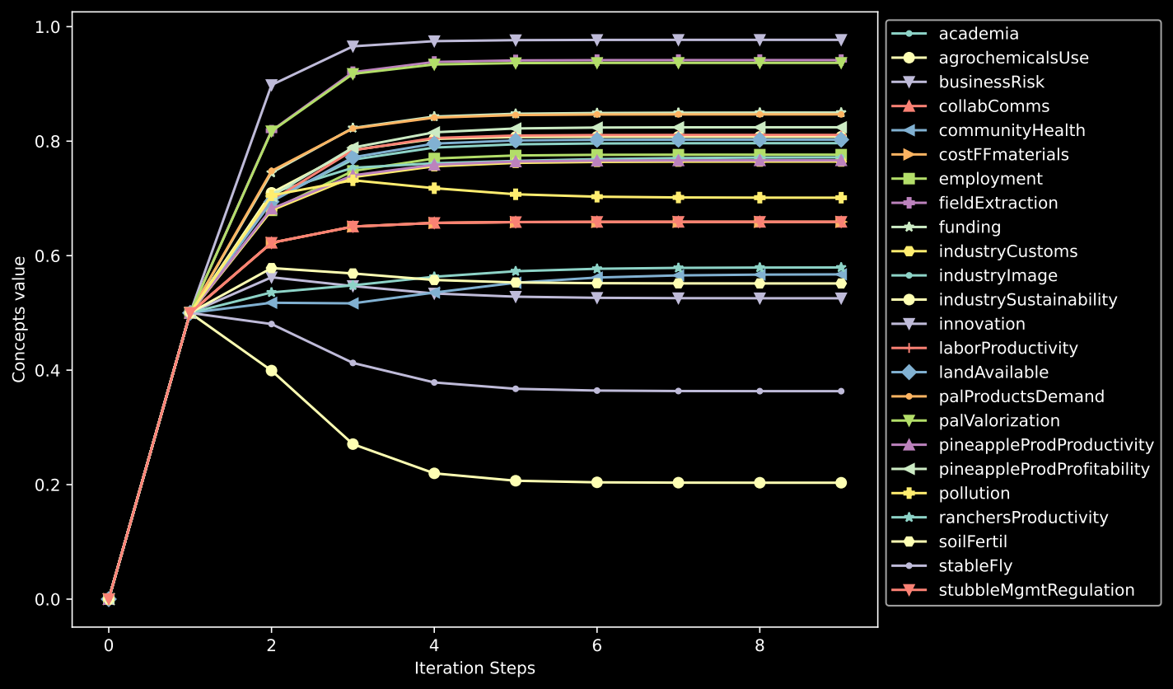
Analysing barriers and opportunities of PAL valorisation
Steady state of the system

Slide 24
Analysing barriers and opportunities of PAL valorisation
Senders (Policy Drivers)
Green consumers
Government presence
Import regulations
Industry transparency
Notes:
‘semi-quantitative’ (i.e. using and producing indicative rather than predictive numerical values)

Slide 25
Analysing barriers and opportunities of PAL valorisation
Receivers (Outcome Variables)
Ranchers’ productivity
Producers’ profitability
Community’s well-being
Industry sustainability
Notes:
‘semi-quantitative’ (i.e. using and producing indicative rather than predictive numerical values)

Slide 26
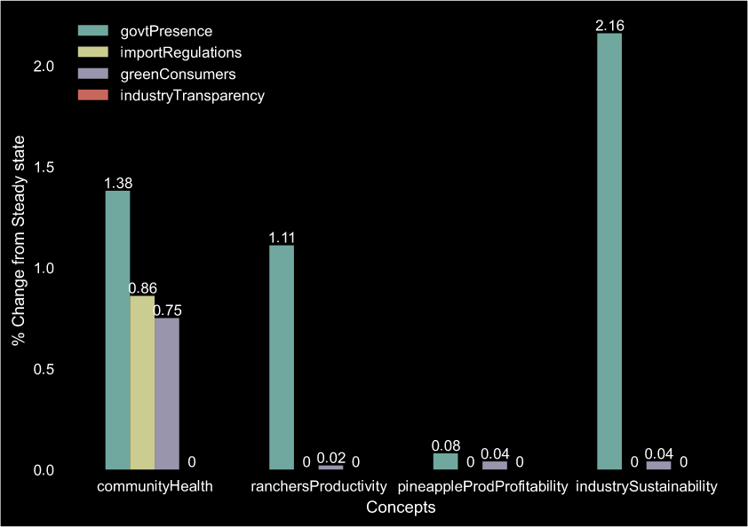
Analysing barriers and opportunities of PAL valorisation
Drivers &
outcome
variables
Notes:
‘semi-quantitative’ (i.e. using and producing indicative rather than predictive numerical values)

Slide 27
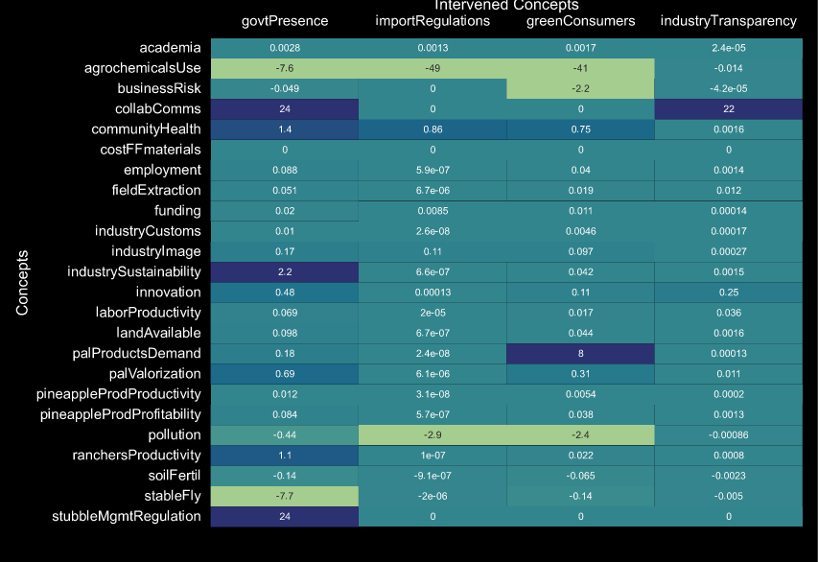
Analysing barriers and opportunities of PAL valorisation
Effect on
transmitters
Notes:
‘semi-quantitative’ (i.e. using and producing indicative rather than predictive numerical values)

Slide 28

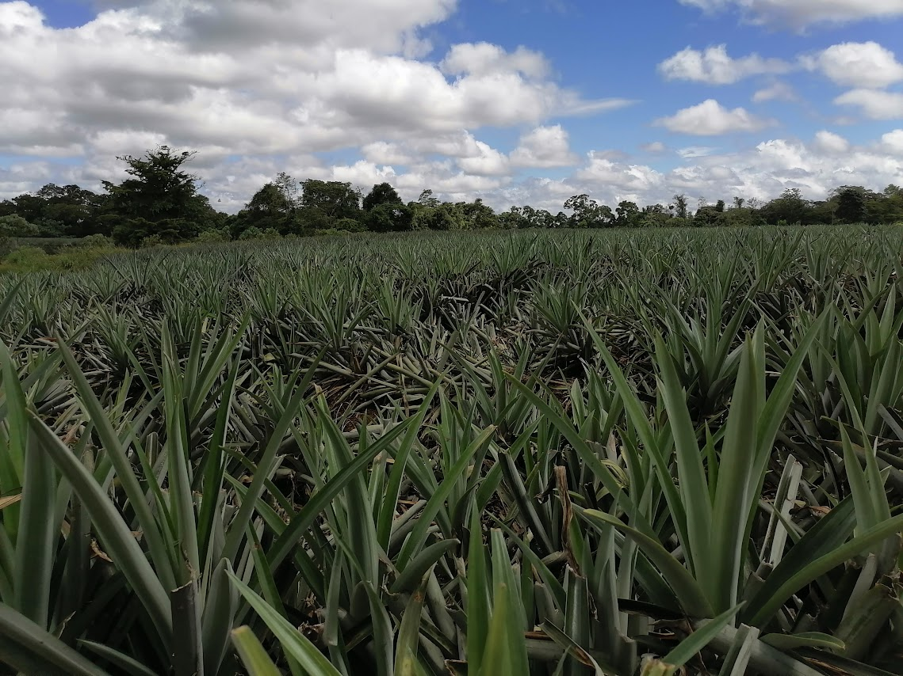

Analysing barriers and opportunities of PAL valorisation
Notes:
‘semi-quantitative’ (i.e. using and producing indicative rather than predictive numerical values)

Slide 29
Analysing barriers and opportunities of PAL valorisation
Results
Barriers:
Industry customs
Mobilisation of funding
Risk aversion
Little collaboration
Topography of the fields
Access to input material
Notes:
‘semi-quantitative’ (i.e. using and producing indicative rather than predictive numerical values)

Slide 30
Analysing barriers and opportunities of PAL valorisation
Results
Drivers of change:
Transparency & Openness → Collaboration & Communication
Government agencies as intermediaries
Applied research
Partnerships with organisations
Notes:
‘semi-quantitative’ (i.e. using and producing indicative rather than predictive numerical values)

Slide 31
Analysing barriers and opportunities of PAL valorisation
Results
Benefits:
↓ Agrochemicals
↓ Stable fly
↑ Profitability
BUT…
Not all stakeholders perceive agree
Notes:
‘semi-quantitative’ (i.e. using and producing indicative rather than predictive numerical values)

Slide 32
Analysing barriers and opportunities of PAL valorisation
Results
Challenges:
Research on market demand and scalability
Create a collaborative network
Increase the awareness about the benefits
Find an intermediary
Notes:
‘semi-quantitative’ (i.e. using and producing indicative rather than predictive numerical values)

Slide 33
Analysing barriers and opportunities of PAL valorisation
Conclusions & Recommendations
Barriers are common in circular bioeconomy transitions
Periodic analyses are recommended
Focus on challenges instead of barriers
Notes:
‘semi-quantitative’ (i.e. using and producing indicative rather than predictive numerical values)

Slide 34
Analysing barriers and opportunities of PAL valorisation
Research on market demand and scalability
Notes:
‘semi-quantitative’ (i.e. using and producing indicative rather than predictive numerical values)

Slide 35
Facility Location Problem for PAL valorisation
Problem statement
Aim and Research Questions
Current state of PAL valorisation in CR
Analysing barriers and opportunities of PAL valorisation
Facility Location Problem for PAL valorisation
Summary
Q&A

Slide 36
Facility Location Problem for PAL valorisation
Optimisation problem
Best location to place PAL processing facilities
Notes:
‘semi-quantitative’ (i.e. using and producing indicative rather than predictive numerical values)

Slide 37
Facility Location Problem for PAL valorisation
Choice variable: Location and number of facilities
Constraints: Facility capacity and operational state
Objective function: minimise costs
Notes:
‘semi-quantitative’ (i.e. using and producing indicative rather than predictive numerical values)

Slide 38
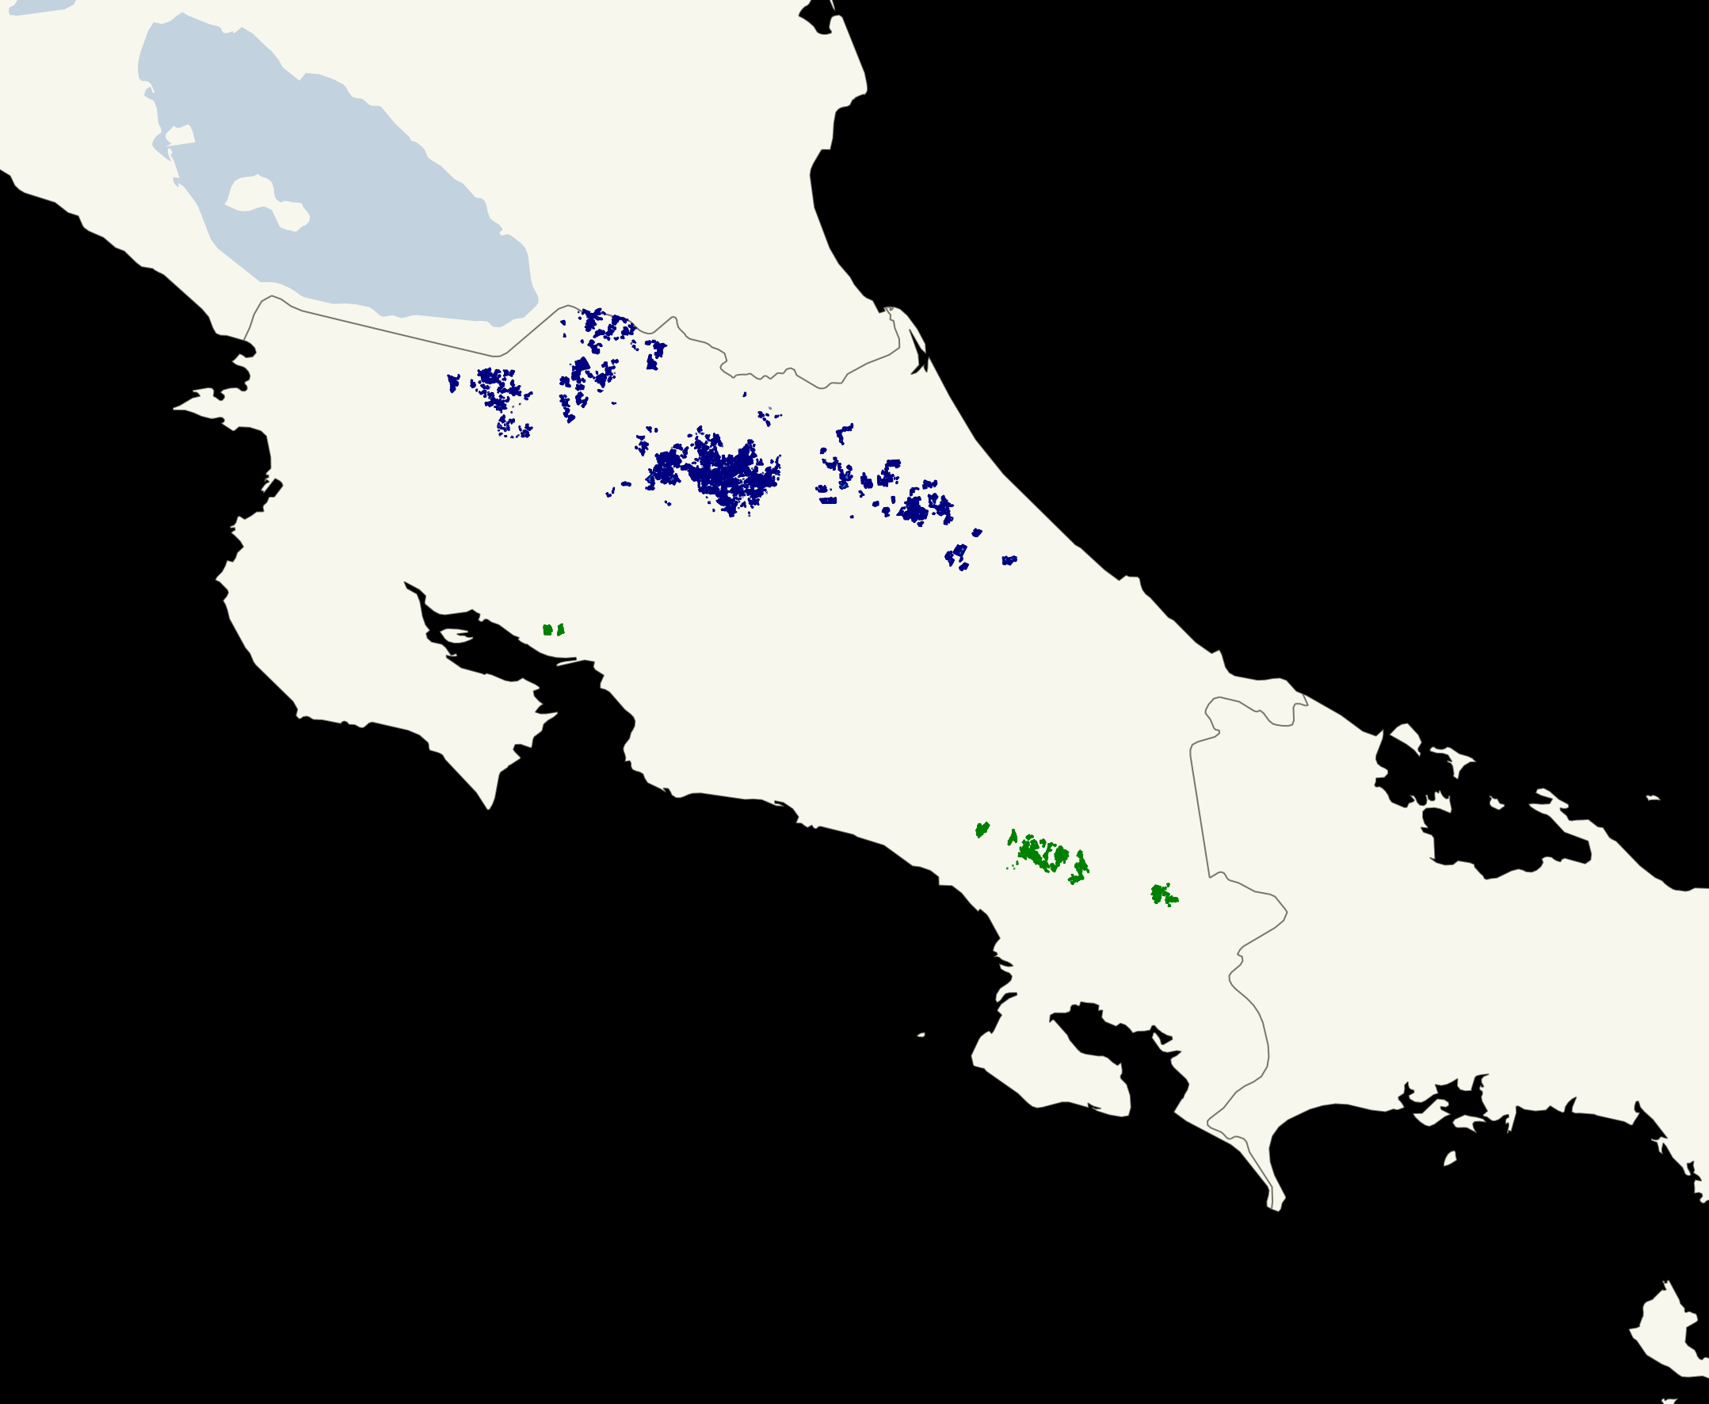
Facility Location Problem for PAL valorisation
86%
Notes:
‘semi-quantitative’ (i.e. using and producing indicative rather than predictive numerical values)

Slide 39
Facility Location Problem for PAL valorisation
PAL valorisation option: Biogas
Balance between most feasible and large scale option
Easy to complement with other options
Notes:
‘semi-quantitative’ (i.e. using and producing indicative rather than predictive numerical values)

Slide 40
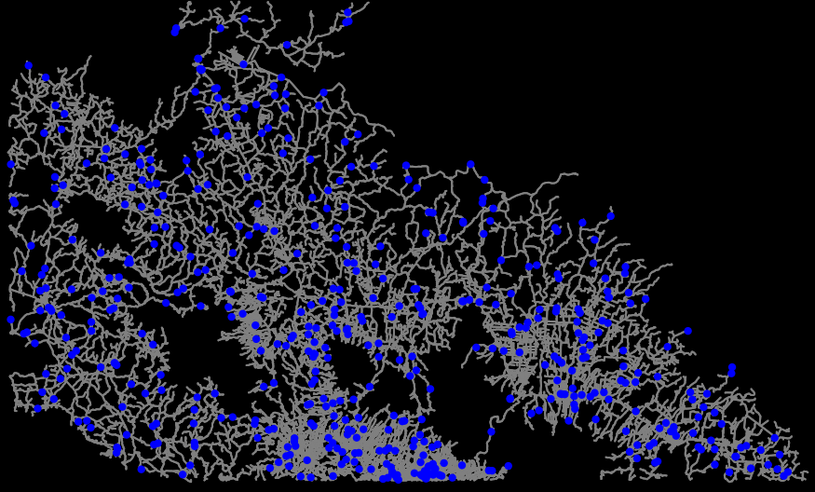
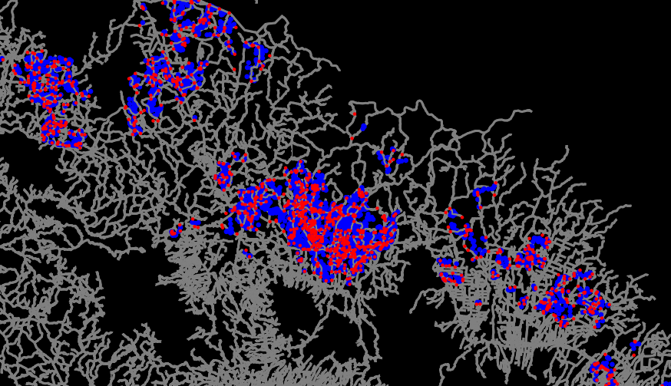
Facility Location Problem for PAL valorisation
1 MW biogas plant
Capital costs:
$2 to $4 MM
Operational costs:
$250 to $450 M/year
15 years lifespan
$0.20 and $0.35
tonne-kilometre
Truck with a load capacity of 8 tonnes
Planning rules (zoning) is ideal
But no data
Restrict candidates to
500 accessible locations
Materials
Source of PAL & Road Network
Candidate Locations
Costs of transport
Facility costs
Notes:
‘semi-quantitative’ (i.e. using and producing indicative rather than predictive numerical values)

Slide 41
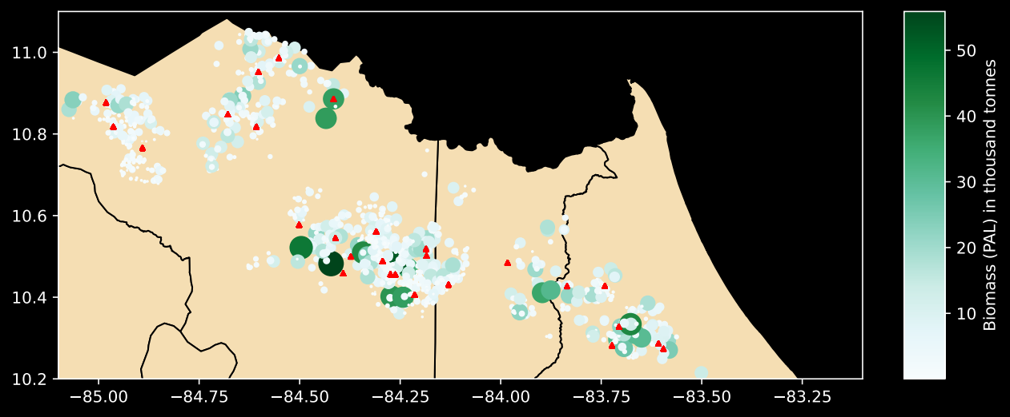
Facility Location Problem for PAL valorisation
Results
30 biogas plants
4.5 MM tonnes/year
Annual costs
Biogas facilities: $16.5 MM
Transportation: $13.6 MM
Scenarios to account for
costs uncertainty
Optimal locations
Notes:
‘semi-quantitative’ (i.e. using and producing indicative rather than predictive numerical values)

Slide 42
Facility Location Problem for PAL valorisation
Cost-Benefit
Annually:
Average biogas solution costs: 30 MM
Current stubble management costs: 28 MM min.
Revenues from generated electricity: 30 MM
(Costs of extraction and revenues from earlier planting not considered)
Notes:
‘semi-quantitative’ (i.e. using and producing indicative rather than predictive numerical values)

Slide 43
Facility Location Problem for PAL valorisation
Conclusions
Economically reasonable and attractive
Adaptable to several (cascading) solutions
Extension including environmental costs
Decentralised solution is preferable for biogas
Notes:
‘semi-quantitative’ (i.e. using and producing indicative rather than predictive numerical values)

Slide 44
Open Science
Support Open Science: All the data and code can be found at github.com/isaldiviagonzatti/MscThesis

Slide 45
Q&A
Q&A

Slide 46
Facility Location Problem for PAL valorisation
FLP type
Network-dependent
Capacitated
Desirable
Multi-facility problem
Single echelon
Notes:
‘semi-quantitative’ (i.e. using and producing indicative rather than predictive numerical values)

Slide 47
Analysing barriers and opportunities of PAL valorisation
Process
Scope and Objective
Stakeholder selection
Knowledge generation
Qualitative Aggregation
Weighting connections
Quantitative aggregation
Output
Questions
(14) interviewees
(32) Concepts and (52) Connections
Generalised labels and connections
(7) Individual FCMs
Aggregated FCM

Slide 48
Analysing barriers and opportunities of PAL valorisation
“[W]hat we are looking for with the recovery of stubble is ... converting something that today is waste into a value-added product. [A]n economic benefit, but also a social, environmental benefit. For example, if we avoid the fly problem, we already have an important environmental benefit.”
Value-added Product
Economic Benefit
Recovery of Stubble/Waste
Avoid Fly Problem
Environmental Benefit
Increase Profitability
[of the pineapple producers]
PAL valorisation
Reduce Stable Fly
Increase Community’s Health/Wellbeing
+
Profitability
PAL valorisation
Stable Fly
Community’s Health/Wellbeing
−
−

Slide 49
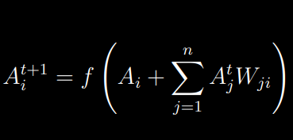
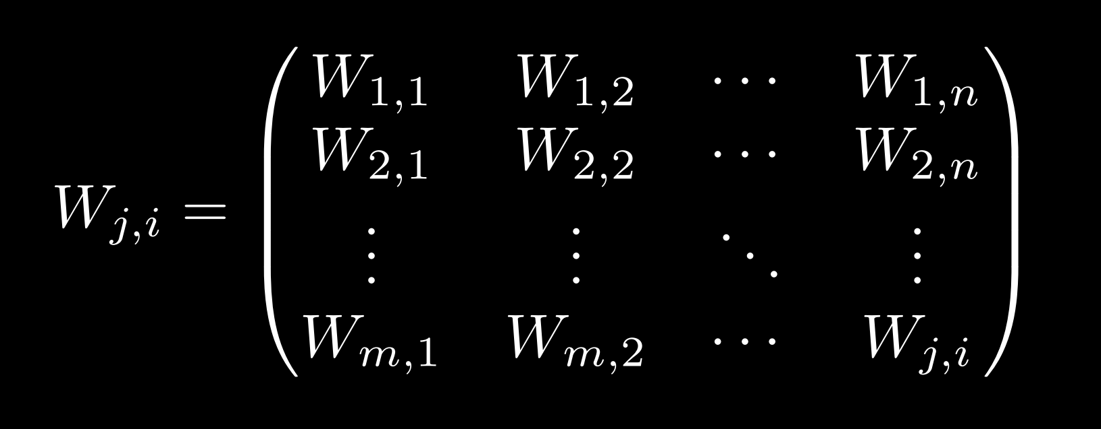
Analysing barriers and opportunities of PAL valorisation
Steady State and Dynamic Analysis

Slide 50
Analysing barriers and opportunities of PAL valorisation
Level of Agreement:
High:
Collaboration/Communication→Innovation (0.954)
Low:
Labour Productivity → Extraction from the field
Stubble Management Regulation → Agrochemicals Use (2.50)
Notes:
‘semi-quantitative’ (i.e. using and producing indicative rather than predictive numerical values)

Slide 51
Analysing barriers and opportunities of PAL valorisation
Limitations
Biases and errors in the modelling process
Collecting information in the field
Aggregation of contrary views
Simplification of a complex system
Notes:
‘semi-quantitative’ (i.e. using and producing indicative rather than predictive numerical values)

Slide 52

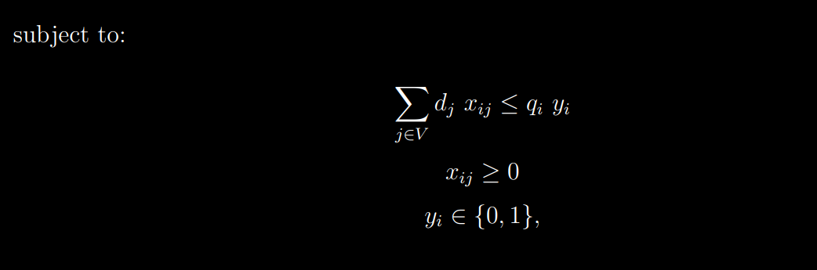
Facility Location Problem for PAL valorisation
Notes:
‘semi-quantitative’ (i.e. using and producing indicative rather than predictive numerical values)

Slide 53
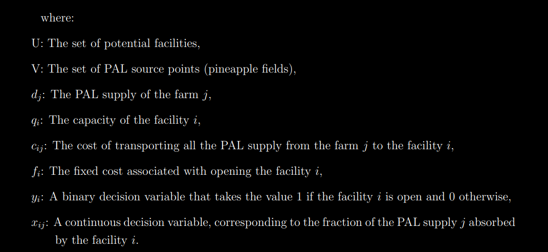
Facility Location Problem for PAL valorisation
Notes:
‘semi-quantitative’ (i.e. using and producing indicative rather than predictive numerical values)

Slide 54
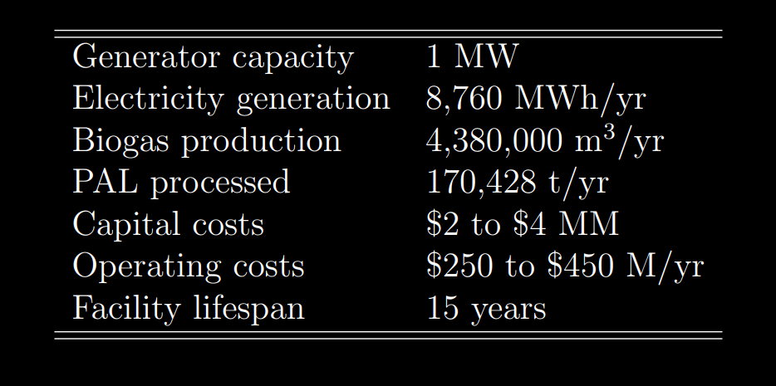
Facility Location Problem for PAL valorisation
Materials:
Estimates for the biogas plant
Notes:
‘semi-quantitative’ (i.e. using and producing indicative rather than predictive numerical values)

Slide 55
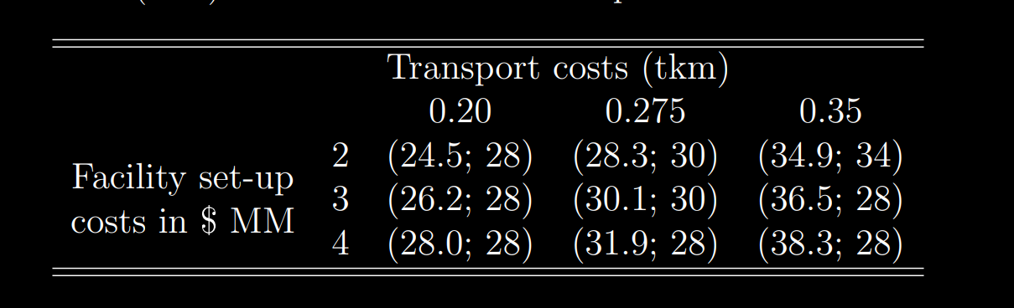
Facility Location Problem for PAL valorisation
Scenarios for the FLP problem.
Total annual costs (MM) & Number of Facilities in parentheses.
Notes:
‘semi-quantitative’ (i.e. using and producing indicative rather than predictive numerical values)

