Slide 1
FOUR IN A ROW
Irving Salmerón A01207256

Slide 2
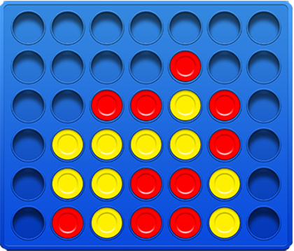
Rules
1 vs 1
Play in turns
The goal is to connect 4 tiles in any direction: horizontal, vertical or diagonal.
7 columns X 6 rows board
Draw
Four in a row:
introduction

Slide 3
How it works?
Structured thinking
Exponential possibilities as the depth grows: 417750499600 possible states [1]
Minimax algorithm

Slide 4
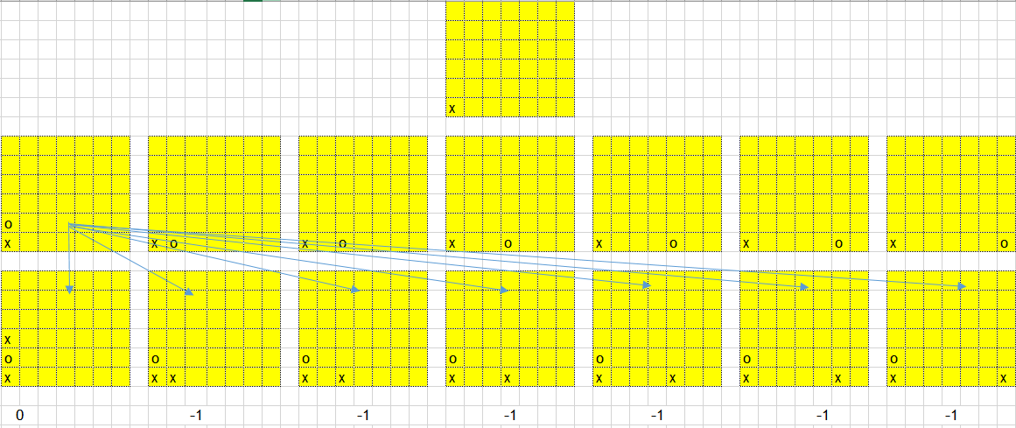
Minimax
Minimize the revenue of the opponent and maximize its own by thinking n steps ahead.
Structure: decision tree
Difficulty is determined by the depth of search in the tree
Alpha-beta pruning
Punctuations to board states

Slide 5
Alpha-beta and state evaluation
Alpha beta pruning works by calculating maximum and minimum values, the maximizer(computer) tries to get the highest board state while the minimizer is trying to get the lowest board state for the maximizer.
To complement punctuations to 4-in a row, 3-in a row and 2-in a row are given to determine how valuable a state is.

Slide 6
Demo
Human = X
Computer = O
Who will win ?

Slide 7
Problems and solutions
The algorithm
States evaluation
Optimizing the implemented algorithm

Slide 8
Thanks Everyone
References:
[1] Weisstein, Eric W. "Connect-Four." From MathWorld--A Wolfram
Web Resource. http://mathworld.wolfram.com/Connect-Four.html

