Slide 1

Flask Encrypted Vault API
A secure, Flask-based REST API for storing and managing encrypted user records — powered by SQLite and Fernet symmetric encryption.
OSSD SEMESTER 4 PROJECT
SAMAN NADEEM & FATIMA KARIM

Slide 2

What Is the Vault API?
The Flask Encrypted Vault API is a lightweight web application that acts as a secure repository for users and their private records. All sensitive data is encrypted at rest before being written to a local SQLite database, ensuring that even direct database access cannot expose plaintext content.
Flask Backend
SQLite Storage
Python web framework powering RESTful endpoints
Lightweight local database with relational integrity
Fernet Encryption
Symmetric encryption for all record data

Slide 3


Access & Authentication
Master Key Authentication
All API interactions require an authenticated session. Authentication is handled through a single master password sent to the login endpoint.
Master Password
Session State
Dual Purpose
1234 — sent as {"master_key": "1234"} to POST /api/login
Flask sessions (24-byte secret key) maintain the unlocked state between requests
The same password also derives the Fernet cipher key for encryption/decryption

Slide 4




Core Features
SQLite Database
Fernet Encryption
Auto-initializes vault.db with users and records tables on startup. No external database server required.
Uses cryptography.fernet to encrypt record titles and data before insertion. Data is decrypted on retrieval for authenticated sessions.
Session Management
Relational Integrity
Flask sessions secured by a randomly generated 24-byte secret key track the unlocked vault state across requests.
Cascade delete ensures that removing a user automatically purges all associated records — no orphaned data.

Slide 5
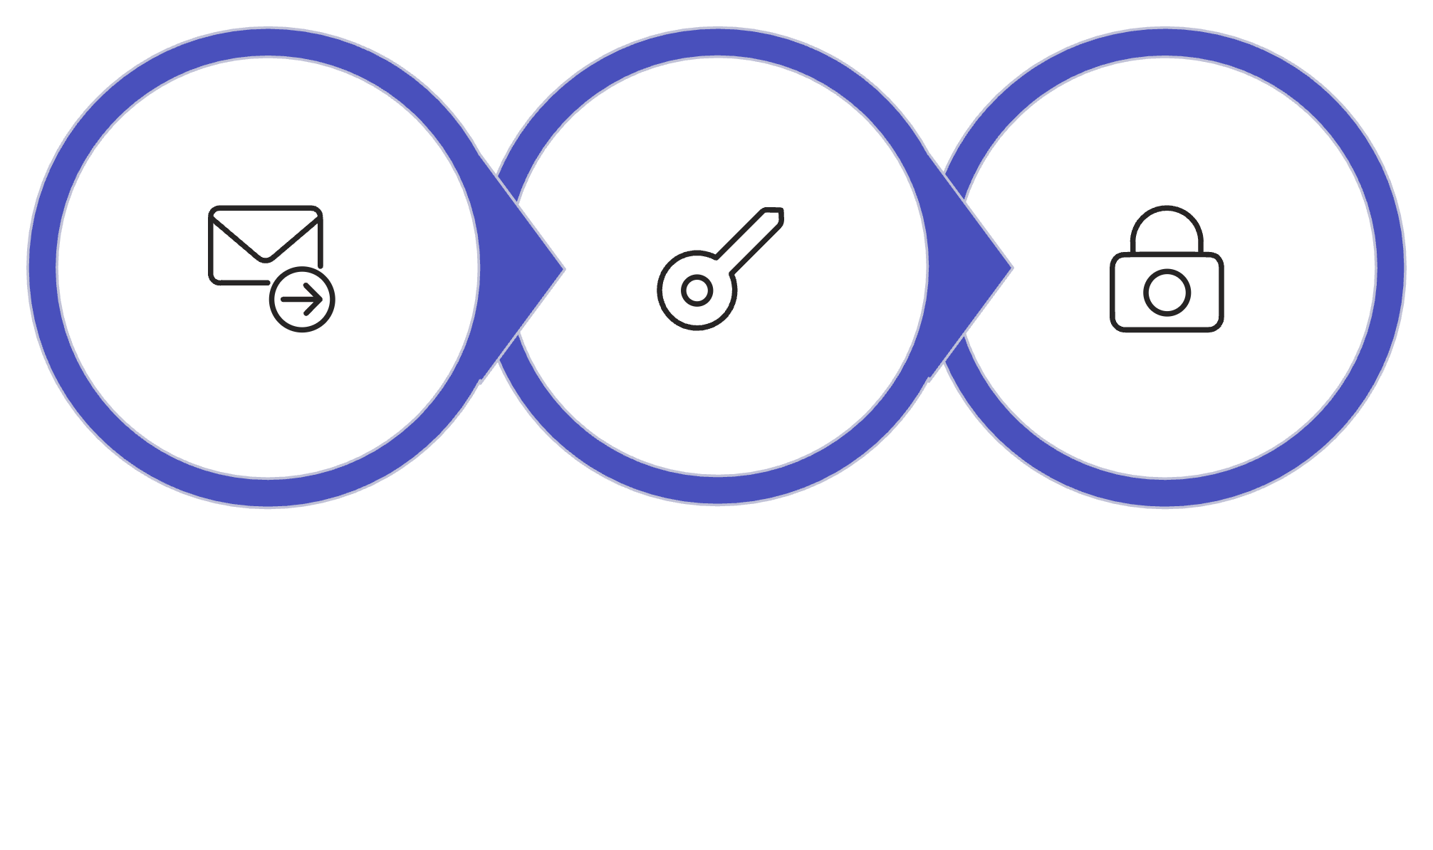
How Encryption Works
Send master_key
Derive cipher key
Encrypt / Decrypt data
The master password serves a dual role: it authenticates the session and derives the symmetric encryption key. This means data can only be decrypted while the vault is unlocked by the correct password — a simple but effective security boundary.

Slide 6
API Endpoints — Authentication & Users
Method
Endpoint
Description
POST
/api/login
Authenticates session. Payload: {"master_key": "1234"}
POST
/api/logout
Clears the current authentication session
GET
/api/status
Returns boolean: true if vault is unlocked
GET
/api/users
Lists all users, ordered alphabetically by username
POST
/api/users
Creates a new user. Payload: {"username": "..."}

Slide 7

API Endpoints — Records & Deletion
Method
Endpoint
Description
GET
/api/users/<user_id>/records
Retrieves and decrypts all records for a user
POST
/api/users/<user_id>/records
Encrypts and saves a new record. Payload: {"title": "...", "data": "..."}
DELETE
/api/records/<record_id>
Deletes a specific record by ID
DELETE
/api/users/<user_id>
Deletes a user and all associated records (cascade)
All record data is automatically encrypted on POST and decrypted on GET — the API consumer always works with plaintext.

Slide 8

Setup & Running the Server
Getting Started in 4 Steps
01
Install Dependencies
Ensure Flask and cryptography are installed in your Python environment
02
Run the Script
Execute the Python script to start the server
03
Database Auto-Init
The app initializes vault.db automatically on first run
04
Access the App
Server runs in debug mode on localhost:5000; web UI at /

Slide 9
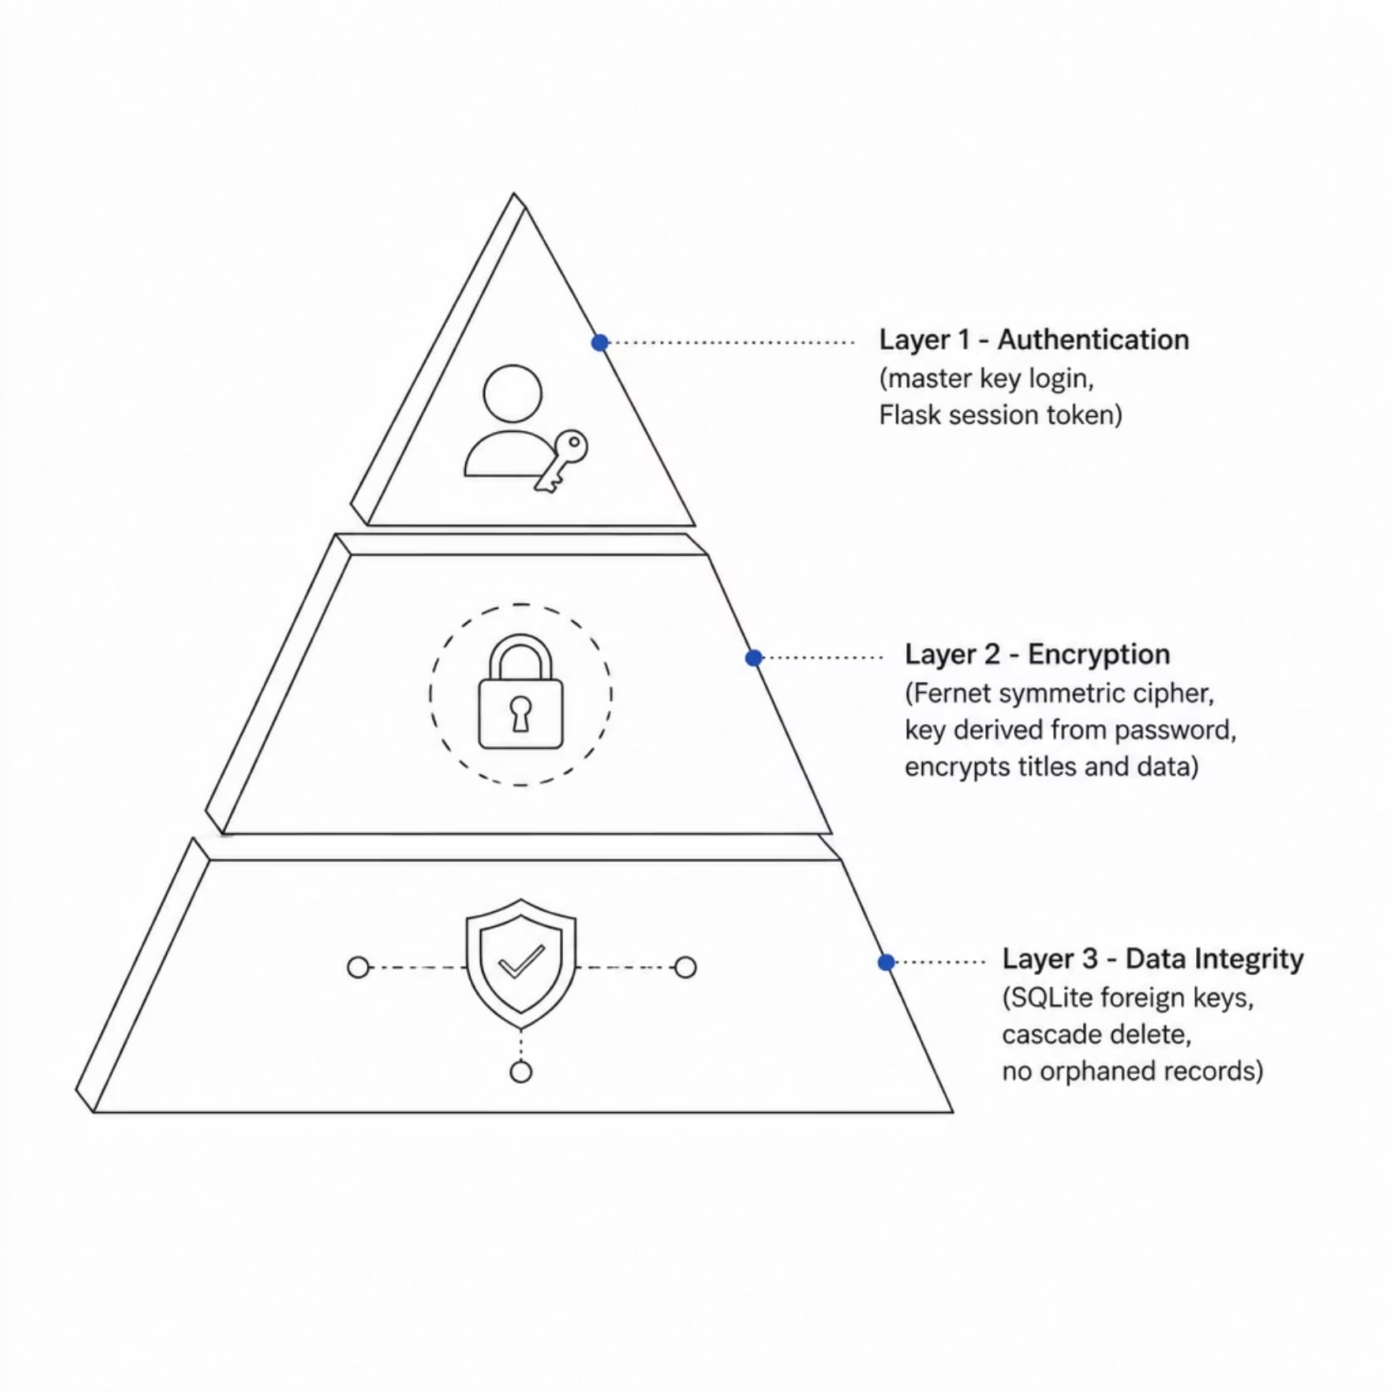
Security Architecture at a Glance
Defense in Depth
The vault applies security at three distinct layers, each reinforcing the others:
Authentication layer gates all access behind a master key session
Encryption layer ensures data at rest is never stored in plaintext
Integrity layer prevents dangling records through cascade deletes
Together, these layers ensure that even a compromised database file cannot be read without the master password.

Slide 10

Project Summary
The Flask Encrypted Vault API demonstrates a practical, end-to-end approach to securing sensitive data in a RESTful web application — combining authentication, symmetric encryption, and relational data integrity in a minimal footprint.
🔐 Encrypted at Rest
Fernet cipher on all record fields
🔑 Simple Auth
Single master key unlocks the session
🗄️ Zero Orphans
Cascade delete maintains clean data
⚡ Ready to Run
Flask + SQLite, no extra infrastructure
OSSD SEMESTER 4
SAMAN NADEEM & FATIMA KARIM

