Slide 1
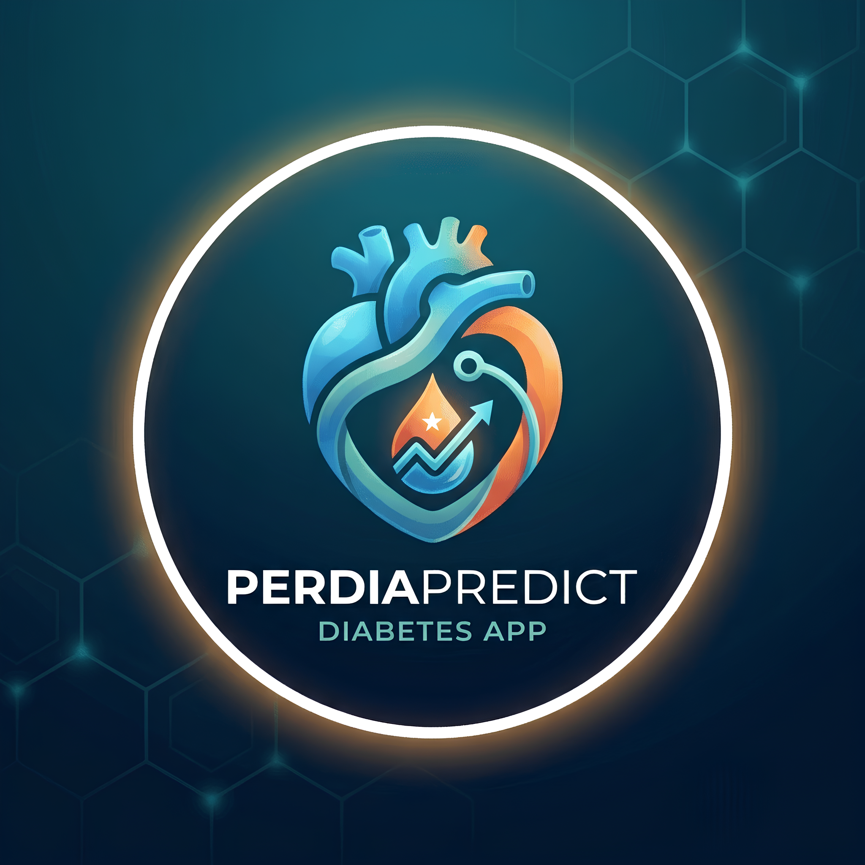
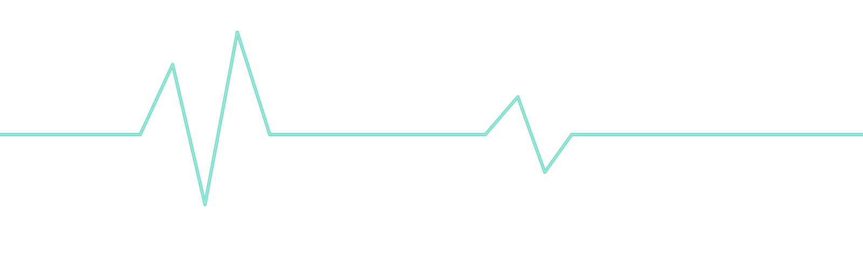
PERDIAPREDICT
AI-Powered Early-Stage Diabetes Risk Prediction
BCSAI&ML • Isbat University • Machine Learning Project

Slide 2


GROUP 5
ESAM MOHAMED OSMAN
GONDARYA DIXITA
SARA ZAKARIA AHMED
ASIIMWE TRACY TREZA
BOGERE MARTHA TRONELLA

Slide 3

INTRODUCTION
What is PerdiaPredict?
BUILT WITH
PerdiaPredict is a web application that uses artificial intelligence to estimate a person's probability of having early-stage diabetes from self-reported symptoms, instead of laboratory blood tests. It is built with Python and released as a Streamlit application, turning a trained model into an accessible tool that anyone can use in minutes.
Python + scikit-learn
Streamlit web interface
ReportLab PDF reports
Symptom based inputs give instant risk scores and downloadable reports.
Deployed on Streamlit Cloud
No lab tests required just simple yes/no questions plus age and gender.
One click PDF report the user can save or share with a doctor.
PerdiaPredict Diabetes Risk Prediction System
2

Slide 4
CONTEXT
Background
Diabetes continues to spread rapidly worldwide, and early-stage cases often go undetected because symptoms such as excessive thirst, fatigue, or slow healing wounds are easy to dismiss. Diagnosis traditionally relies on clinical blood-glucose testing a facility visit that costs time and money many people cannot spare.
537M+
1 in 2
16
Adults living with diabetes globally
Cases estimated to be undiagnosed
Symptom + demographic features used
Why symptom based screening matters A quick, accessible screening step lets people know when it's worth seeking a real medical test closing the gap before complications set in.
PerdiaPredict Diabetes Risk Prediction System
3

Slide 5




THE GAP
Problem Statement
Symptoms go unnoticed
Limited access to testing
Early stage diabetes symptoms are often mild and easy not to take seriously.
Lab-based screening needs a facility visit, plus cost, time, and distance many cannot spare.
No simple self-check tool
The gap PerdiaPredict fills
There is no easy way for someone to get an early indication of risk on their own.
Built to give people a quick, simple, and accessible diabetes risk-screening option.
PerdiaPredict Diabetes Risk Prediction System
4

Slide 6
GOALS
Goals and Objectives
MAIN GOAL Develop a simple machine-learning web application that estimates a person's risk of early-stage diabetes based on the symptoms they provide.
1
Train ML models on an early-stage diabetes symptom dataset.
2
Compare models using accuracy, precision, recall, F1-score, ROC-AUC.
3
Build an interactive Streamlit app for symptom entry and instant results.
4
Generate a downloadable PDF report of the assessment.
5
Provide basic nutrition and lifestyle guidance with each result.
6
Include an admin panel to view and manage assessment records.
PerdiaPredict Diabetes Risk Prediction System
5

Slide 7




IMPACT
Importance of the Project
An accessible first step
Gives users a simple way to understand their possible diabetes risk before going for proper medical testing.
No special equipment needed
The system works through a web browser, so anyone with a phone or computer can use it.
Builds health awareness
Basic nutrition and lifestyle information is provided alongside every assessment result.
Supports ongoing monitoring
Saved assessment records let the administrator review history and monitor how the system is used.
PerdiaPredict Diabetes Risk Prediction System
6

Slide 8
PROCESS
Project Workflow
1
2
3
4
5
6
Data Collection
Data Preparation
Model Training
App Integration
Result & Report
Deployment
Kaggle symptom dataset collected.
Symptoms cleaned and encoded.
Logistic Regression & Random Forest tested.
Model added to the Streamlit app.
Shows risk result, generates PDF.
Pushed to GitHub, live on Streamlit Cloud.
From raw Kaggle data to a live, publicly deployed risk-screening tool.
PerdiaPredict Diabetes Risk Prediction System
7

Slide 9
CONCLUSION
A convenient first step for diabetes risk screening
Shows how machine learning can give users an initial idea of their possible early-stage diabetes risk from simple symptom and demographic information.
Brings together a trained ML model, a simple Streamlit interface, instant risk results, PDF reports, and basic nutrition and lifestyle guidance.
Offers a convenient screening step that can encourage people with possible risk factors to seek proper medical testing and professional advice.
PerdiaPredict Diabetes Risk Prediction System

