Slide 2
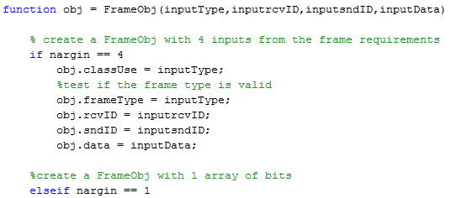
Section 4: Implementation Constructor
Constructor Method
Verification of number of inputs

Slide 3
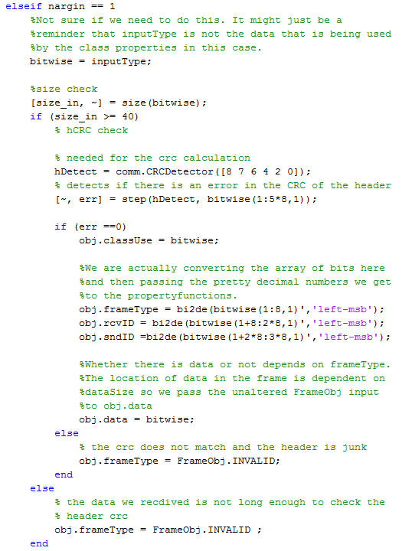
Implementation Constructor
Check if have minimum size
CRC check of header.

Slide 4
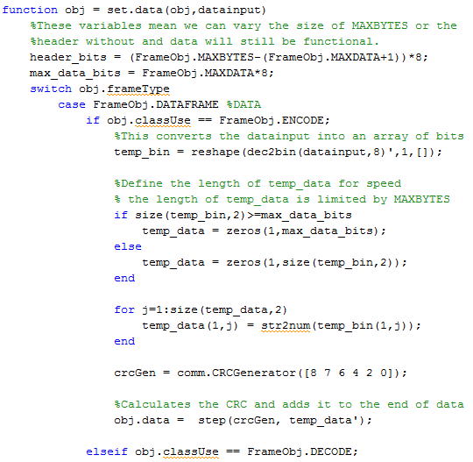
Implementation Data field
Maximum size of data field
Mapping chars to bits
Creation of CRC

Slide 5
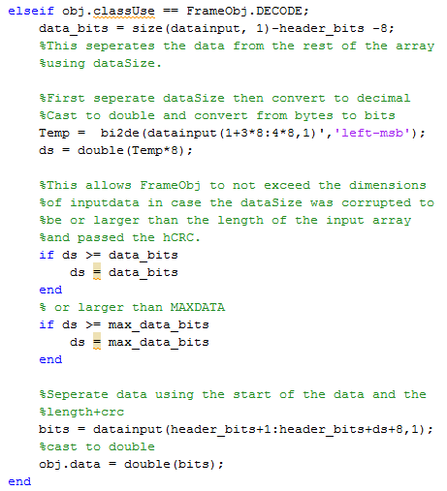
Implementation Data field
Extract the data size
Check of size

Slide 6
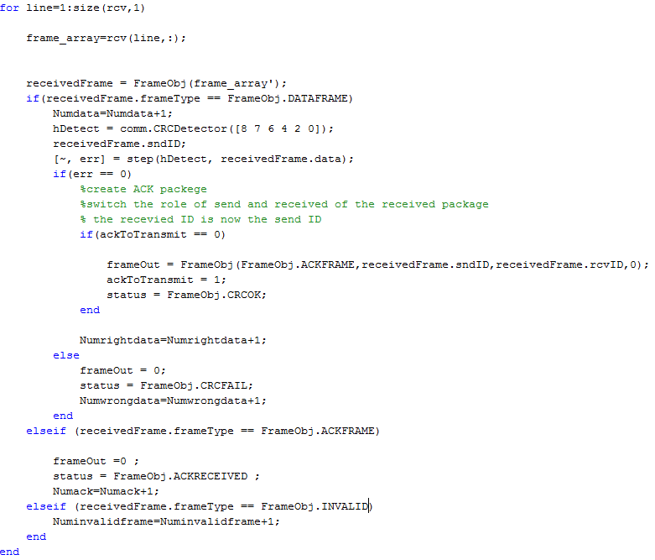
Implementation Receiving a Frame
Check The FrameType
Verify the data CRC
Create the ACK to send back
Drop Invalid Frame

