Slide 1
Hunting Bears (and Pandas, Spiders, Jackals, Tigers & more…)
Rob Barry
The Wall Street Journal
@rob_barry
https://bit.ly/nicar19-bears

Slide 2
Here’s how internet warfare works.

Slide 3
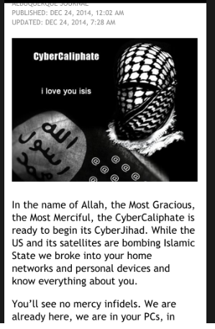
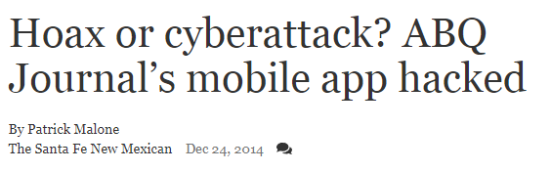
A group calling itself the CyberCaliphate hacks the Albuquerque Journal, defacing the newspaper’s website.
“You'll see no mercy infidels,” they write on Christmas Eve 2014. “With Allah's permission we begin with Albuquerque.”

Slide 4
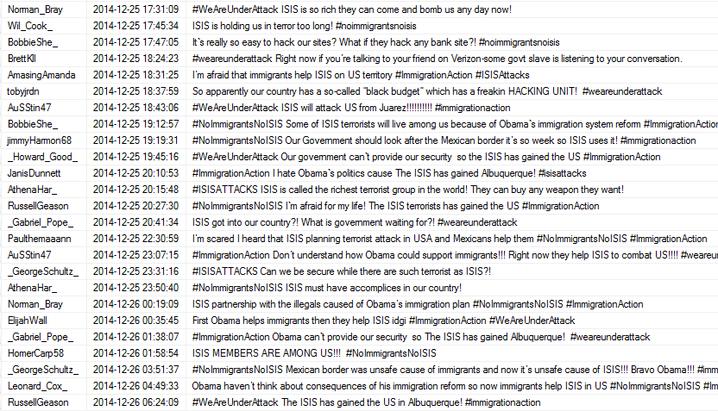
Hours later, dozens of Twitter accounts swing into action, amplifying news of the alleged terrorist cyberattack. Soon, they’re leaving out the word cyber, spreading an even more ominous message.
“I’m scared.”
“ISIS terrorists live among us!”
“Our government can’t provide our security.”
“Mexicans help them.”

Slide 5
The message: Brazen ISIS has penetrated the heartland, and America’s leaders are helpless.
“It’s all Obama’s fault!” wrote one account, using the hashtags #ImmigrationAction and #ISISattacks.

Slide 6

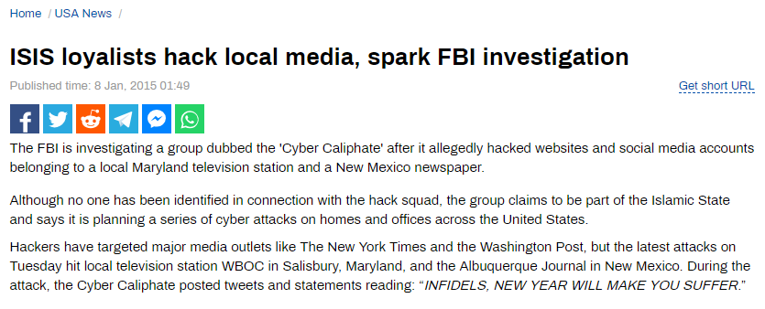
RT picks it up. Just the facts: American media outlets hacked by a group claiming to be ISIS. The FBI is investigating.

Slide 7
Some security pros mutter it doesn’t make sense. They’ve never heard of CyberCaliphate, and it isn’t ISIS’s MO.
But news of the hack has spread, and the CyberCaliphate goes on to hack other targets, including the U.S. military’s Central Command Twitter account.
The ISIS cyber army is here!

Slide 8
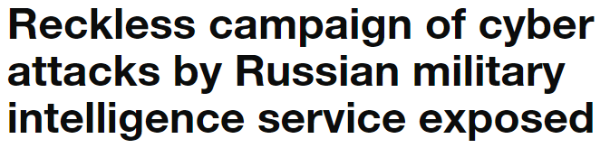
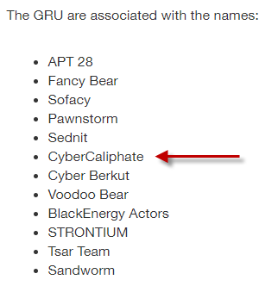

Except it’s not ISIS, according to British intelligence, who this October published a report saying CyberCaliphate is just another name for Russia’s military intelligence service.

Slide 9
Question: What makes a story about a cyberattack good?

Slide 10

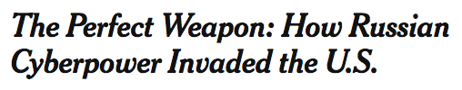
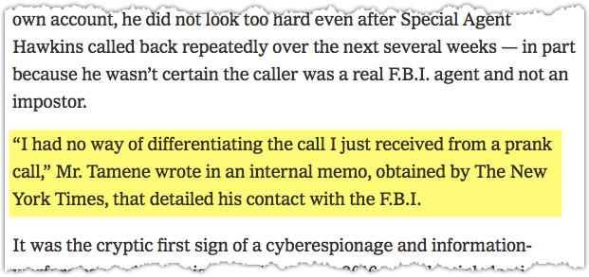
Specific details. Human drama.
What do people remember about this landmark NYT story about the DNC hack?
They remember Yared Tamene, the DNC tech-support contractor who didn’t believe the FBI was really on the phone.
They remember Charles Delavan, who, when asked by John Podesta about a Russian spearphishing effort, replied with these now infamous words: “This is a legitimate email.”
Notes:
What makes a good story? One that talks about human beings. Their fears, motivations, desires, interactions. Specifics.

Slide 11
This can be hard to do in the realm of nation-state hacking.

Slide 12
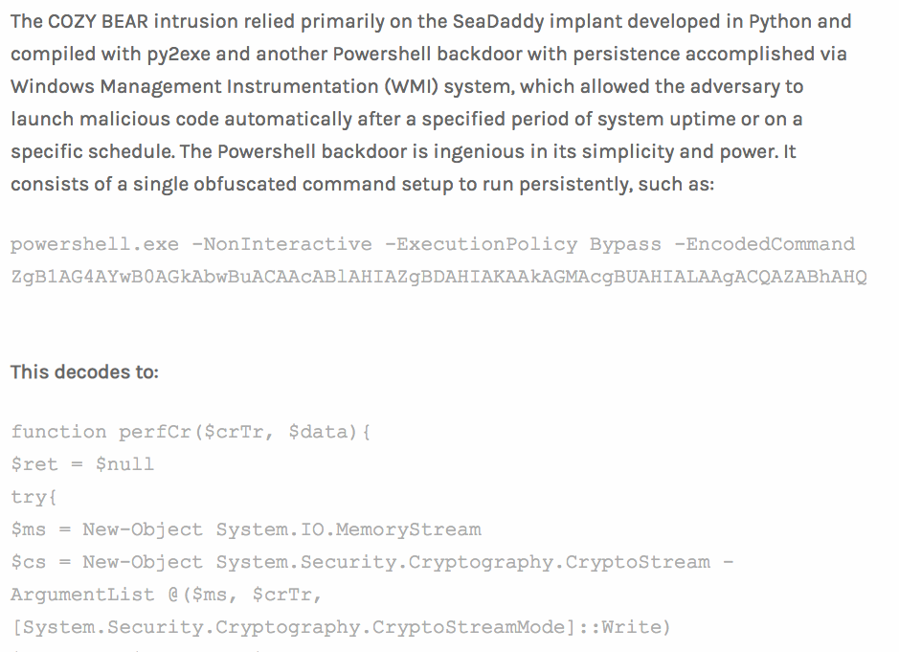
And much of what the security community says seems similarly inaccessible.
Much of what the U.S. government knows is unavailable to journalists.
Notes:
This is hard to do in the cyber realm, where vast troves of information are locked under “classified” headings. Meanwhile, much of the publicly available information is held by security researchers who are more interested in the technical aspects.

Slide 13
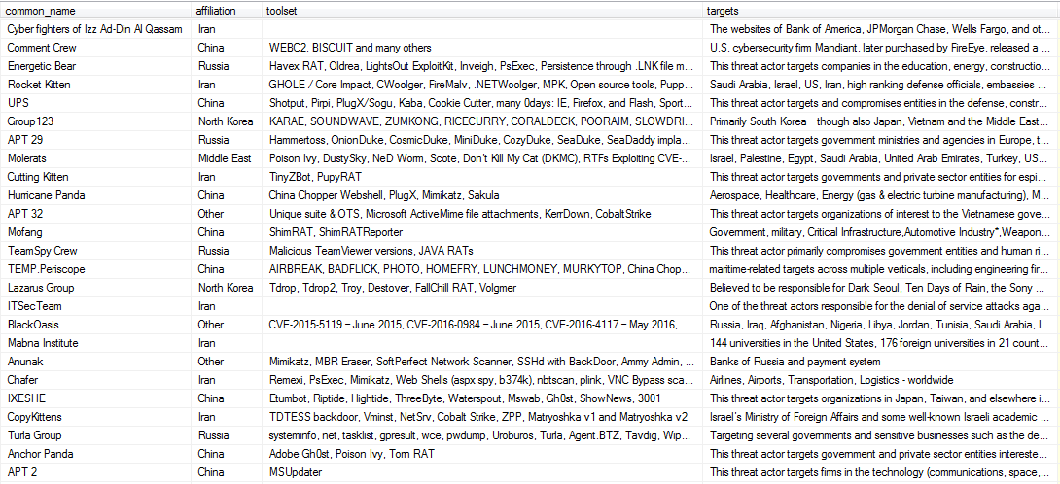
Terminology Overload

Slide 14
I’m going to walk through some of the tools and techniques I and others have used to try to piece things together. It’s by no means comprehensive, but it is what has worked for me.

Slide 15
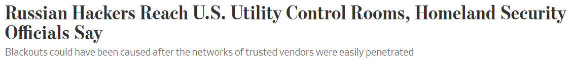
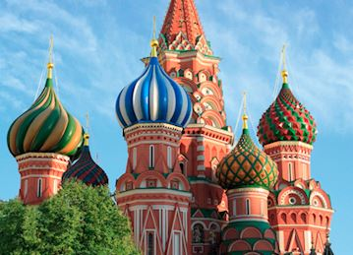
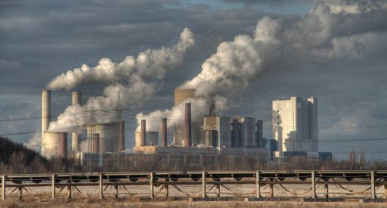
Reconstructing a Hack
?
Russian government
U.S. utilities

Slide 16


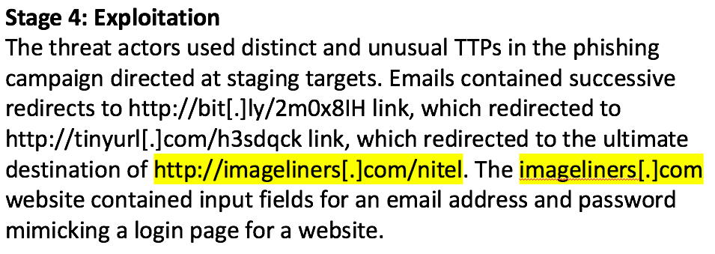
Security Reports

Slide 17
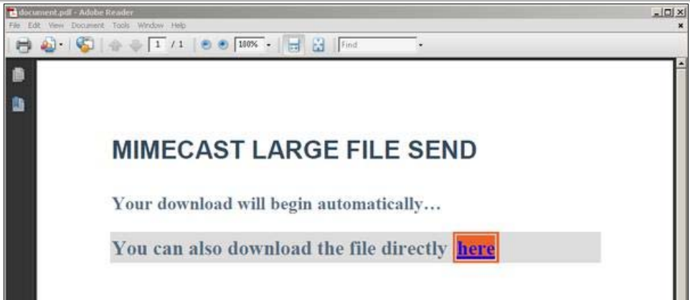
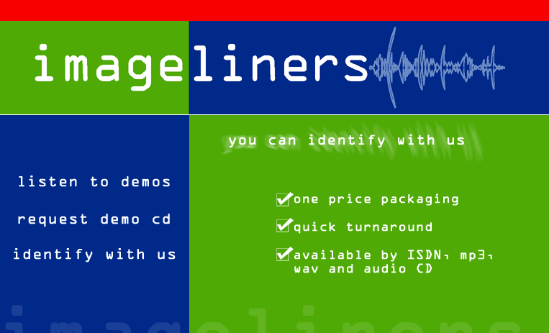
Security Reports

Slide 18
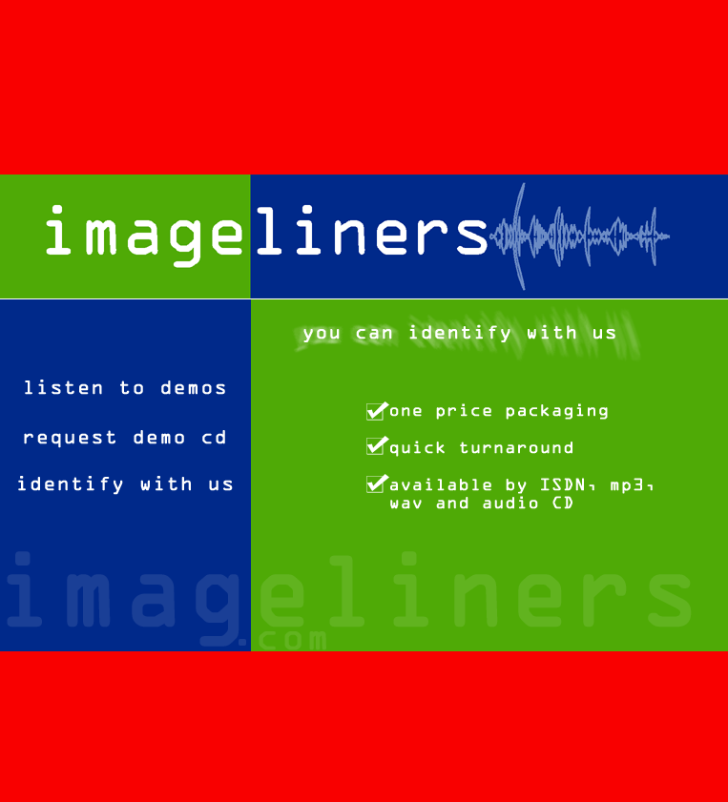
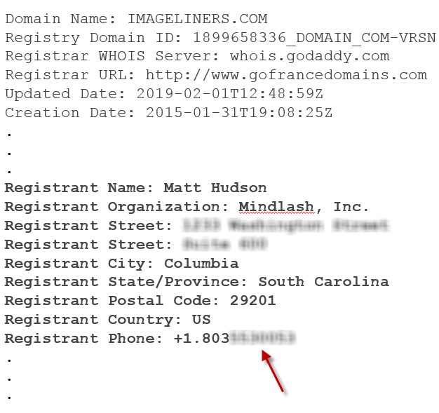
Domain WHOIS
imageliners[.]com

Slide 19
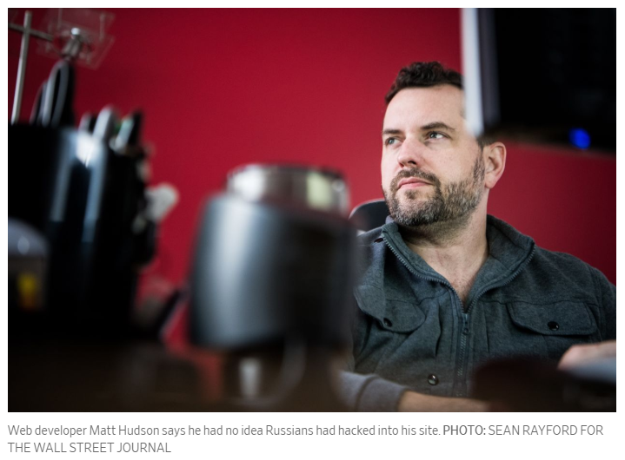
Talk to people!
imageliners[.]com

Slide 20
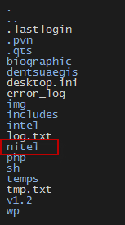
Talk to people!
http://imageliners[.]com/nitel

Slide 21
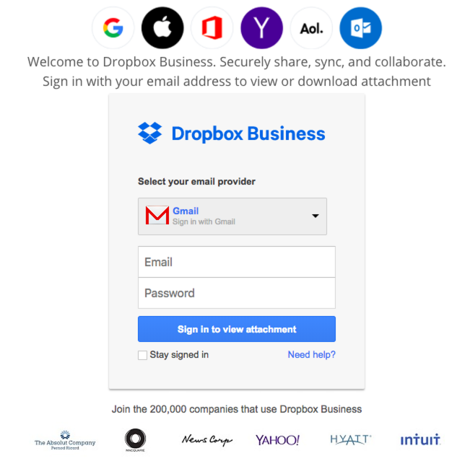
http://imageliners[.]com/nitel

Slide 22
So who were the victims?

Slide 23
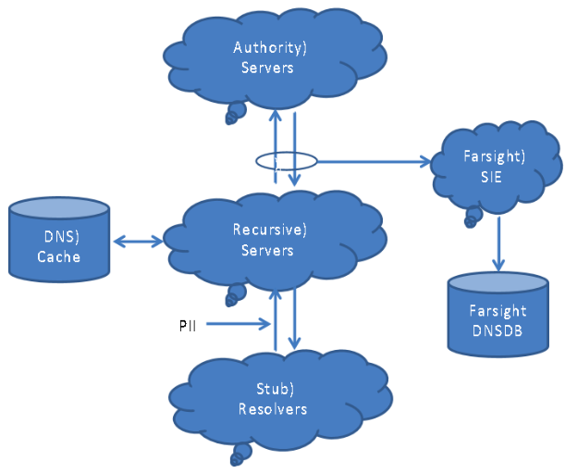



Passive DNS

Slide 24
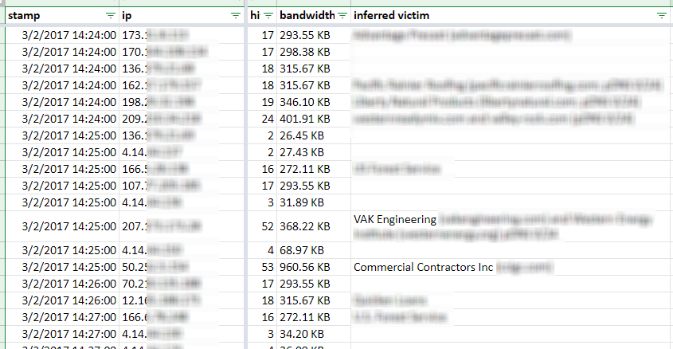
Passive DNS

Slide 25
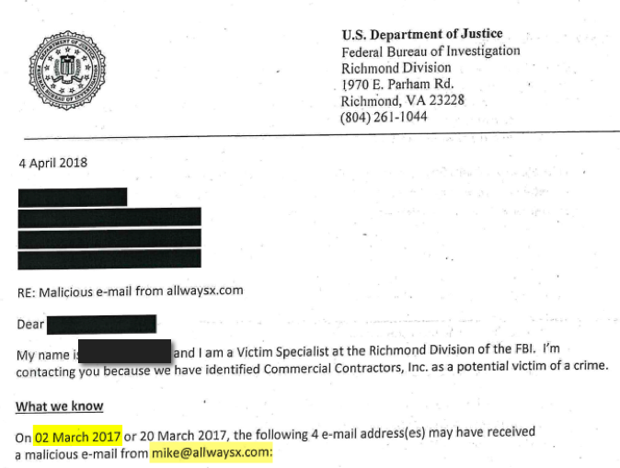

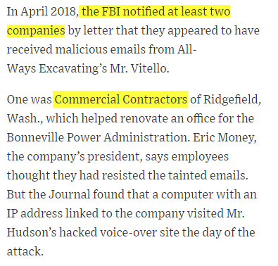

Slide 26
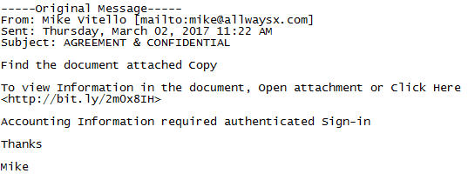

Slide 27
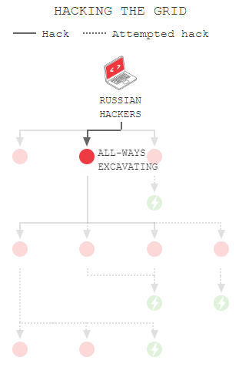
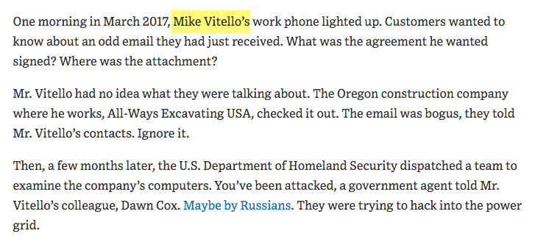

Slide 28
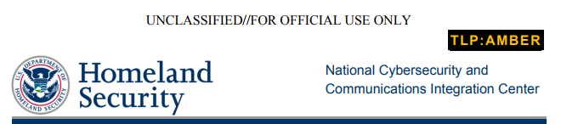

Slide 29
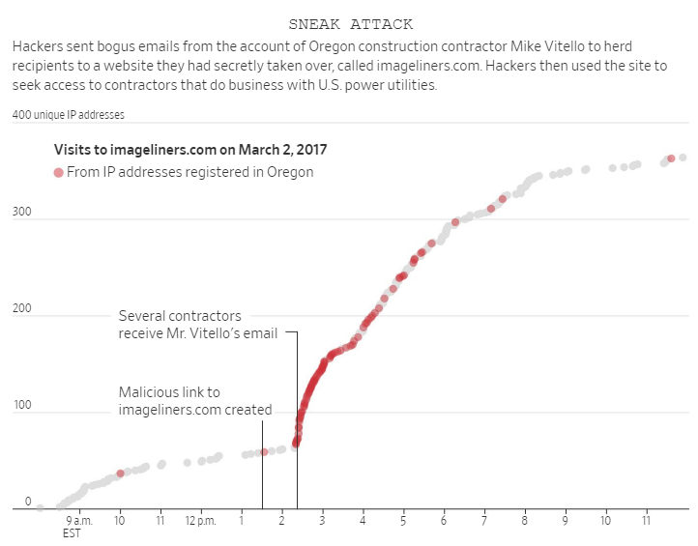
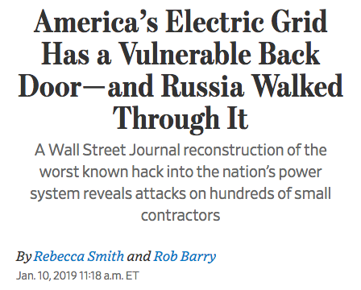
Notes:
South Carolina web developer named in US-CERT. Turned out nobody had spoken to him before, and he was more than happy to hand over lots of data.
Business owners. Many of them had been contacted by the FBI. Most of them were as curious as we were.

Slide 30
Resources and Tools
Passive DNS data
FarSight RiskIQ DomainTools SecurityTrails
Historical WHOIS data
DomainTools RiskIQ
Analyzing domains & IP addresses
Shodan Censys BGP Toolkit Robtex Masscan/NMAP
Website Technology
PublicWWW.com BuiltWith SimilarWeb
Archiving Content
WebRecorder.io
Researching Malware
VirusTotal Urlscan.io VMRay

Slide 31

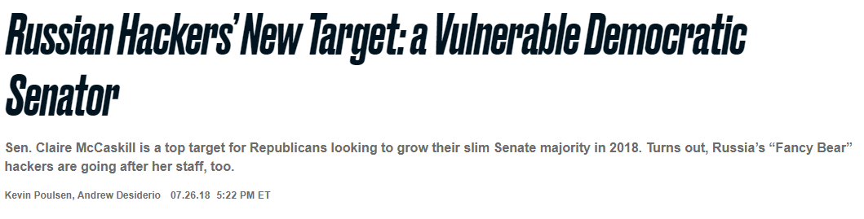
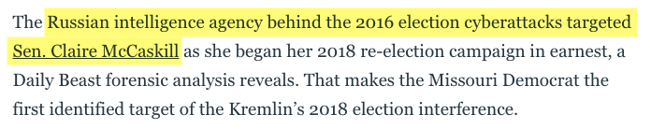
Passive DNS + Urlscan.io

Slide 32
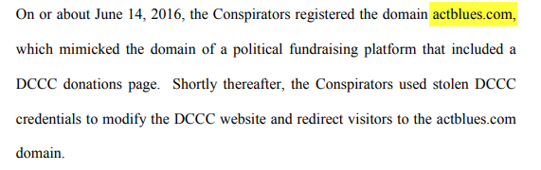

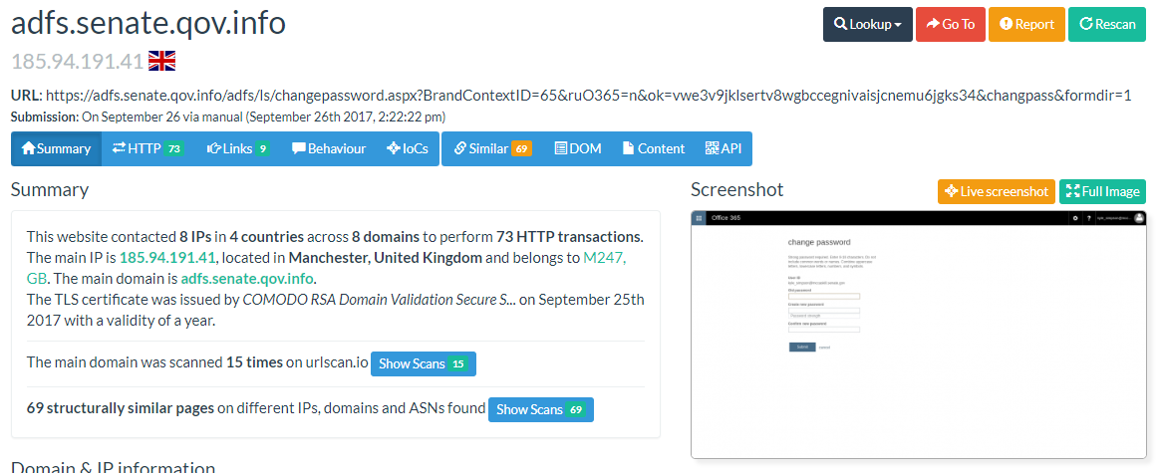
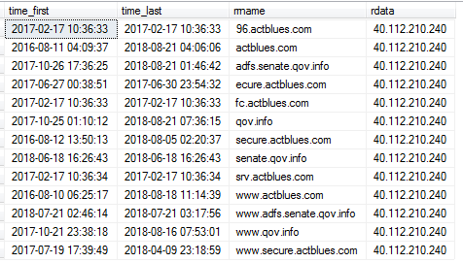
Mueller indictment
PDNS data for actblues[.]com
Urlscan.io for adfs[.]senate.qov.info
PDNS data for 40.112.210.240

Slide 33
Mueller indictment
PDNS data for actblues[.]com
Urlscan.io for adfs[.]senate.qov.info
PDNS data for 40.112.210.240

Slide 34
Mueller indictment
PDNS data for actblues[.]com
Urlscan.io for adfs[.]senate.qov.info
PDNS data for 40.112.210.240

Slide 35
Mueller indictment
PDNS data for actblues[.]com
Urlscan.io for adfs[.]senate.qov.info
PDNS data for 40.112.210.240

Slide 38
